Slide 1


Adonis: Neural-enhanced Fine-grained Leaf Wetness Sensing with Efficient mmWave Imaging
Yimeng Liu*, Maolin Gan*, Gen Li,
Younsuk Dong, Zhichao Cao
Notes:
Good afternoon everyone.
My name is Xikai Sun, and I’m here today to present this work on behalf of the authors of the paper titled ‘Adonis: Neural-enhanced Fine-grained Leaf Wetness Sensing with Efficient mmWave Imaging’.
The lead authors are Yimeng Liu and Maolin Gan from Michigan State University.
I’ll be walking you through their proposed framework, Adonis, which addresses the leaf wetness level detection.

Slide 2


Food Crises
Food crises are becoming increasingly severe worldwide, with nearly 282 million people in 59 countries facing acute food insecurity.
Notes:
Food crises are intensifying worldwide, with nearly 282 million people in 59 countries now facing acute food insecurity.
This represents a critical humanitarian emergency that demands immediate attention and action.

Slide 3
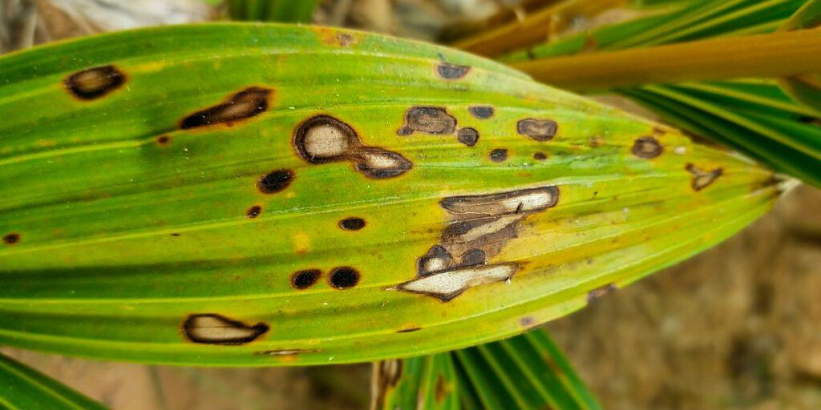
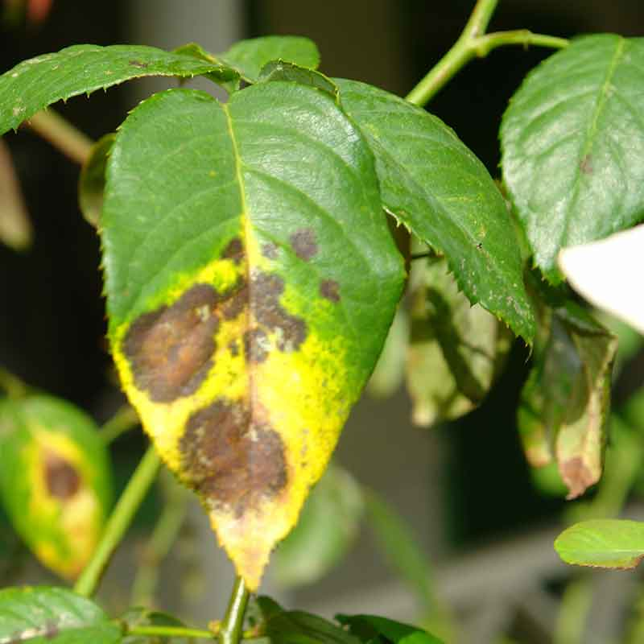


Plant Disease​
Notes:
Plant disease is a major driver of global food crises by reducing crop yields and destabilizing supply chains.
A critical factor in disease outbreaks is Leaf Wetness Duration [click] the length of time that water remains on leaf surfaces, which creates the ideal conditions for fungal and bacterial pathogens to germinate and spread.
By accurately measuring and predicting LWD, we can gain real‐time insight into plant moisture conditions and intervene early to protect staple crops and improve food security.

Slide 4
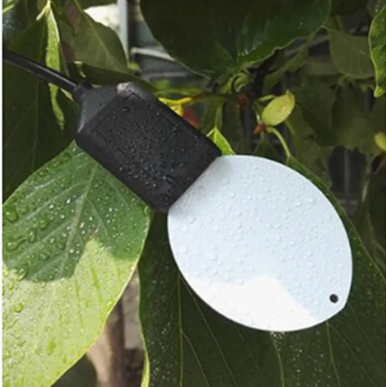
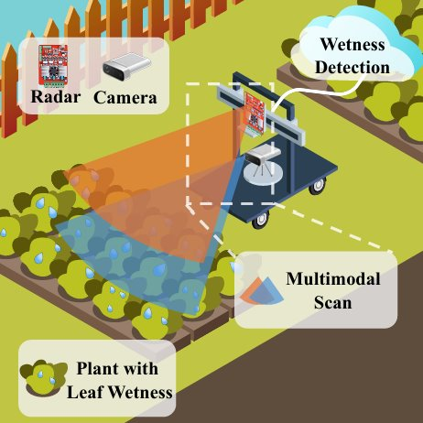
Existing Work
Leaf Wetness Sensor
Hydra: MobiCom 2024
Notes:
Existing solutions fall into two camps. leaf‐wetness sensors is most popular is today’s farm. They use probe-based electrodes with a leaf-like surface and monitor changes in electrical resistance to deliver real-time moisture readings.
On the other hand, Hydra published on MobiCom ’24 takes a multi-modality approach. It present with an novel fusion method combine with RGB camera image with mmWave SAR image and feeding both streams into a dual-path neural network, which fuses visual droplet detection with radar-based texture cues to achieve high accuracy in diverse lighting and occlusion scenarios.

Slide 5

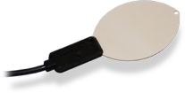



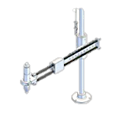


Existing Work
Low Accuracy
Leaf Wetness Sensor
Low Precision
High System Overhead
Hydra: MobiCom 2024
Notes:
However, each method has its own drawbacks.
First, Leaf-wetness sensors rely on artificial leaf probes that degrade accuracy over time.
Second, these systems only deliver a binary result which is wet/dry, lacking the precision to track the full drying curve or predict Leaf Wetness Duration which are essential information for proactive disease control rather than simple detection.
Finally, multimodal systems demand extra hardware and precise calibration, while leaf wetness sensors require multiple units per plant—both driving up cost and complexity.

Slide 6
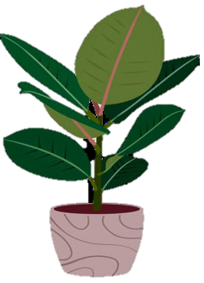





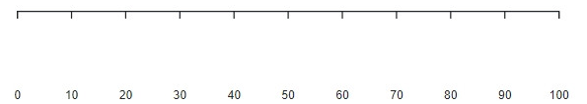


Leaf Wetness Level
LWL is expressed as a continuous variable that varies from 0% to 100%.
For the 0% represents completely dry.
The 100% represents saturated wetness.
The scale between these points is divided into equal increments.
Notes:
To enable precise disease management, we introduce Leaf Wetness Level which is a continuous metric ranging from 0 % fully dry to 100 % saturated wetness.
Leaf Wetness Level represents the exact proportion of the leaf surface covered by free water at any given time, capturing the dynamics of wetting and drying.
It enable us to track drying curves and predict disease risk with greater precision than binary sensors allow and target interventions based on real‐time risk.

Slide 7
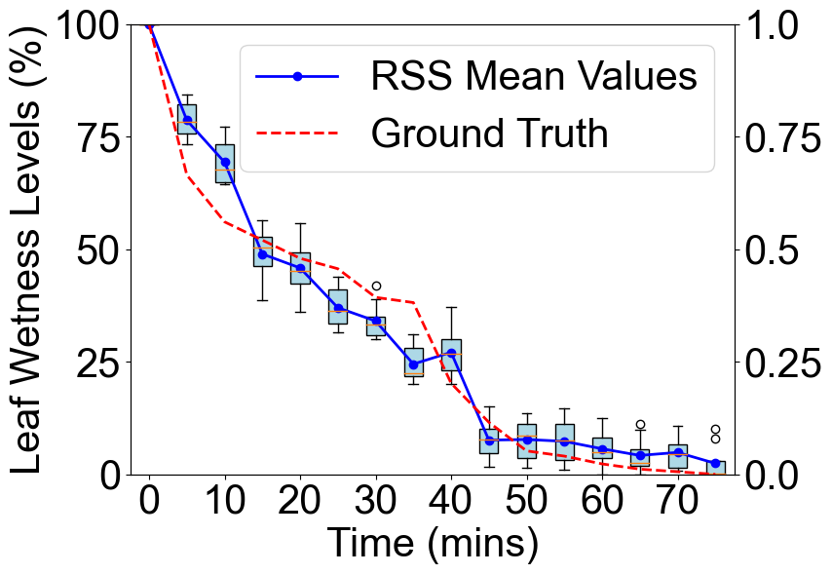
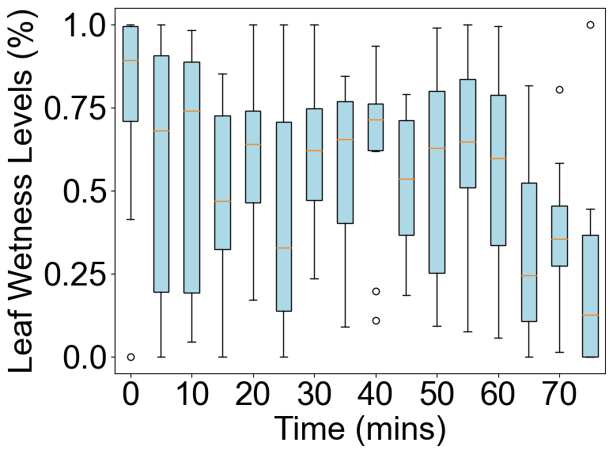
Challenge
The short wavelength of the radar would make it more sensitive to environmental changes
No Wind Stable Environment
Wind Environment
Notes:
There are several design challenges. First, dynamic environment introduce more uncertainty.
In our controlled setup we sampled the transition from fully saturated to dry every 5 minutes over 75 minutes repeating ten times and then extract the RSSI for the leaf. The boxplot shown with normalized RSS distribution and read line shown with ground truth value.
For the figure shown in the left, you can see RSS falls with leaf wetness levels, confirming a strong correlation between mmWave return strength and moisture content.
However, for the graph shown in the right, wind condition introduce RSS fluctuations that break this clean trend shown [click] The short wavelength of the radar would make it more sensitive to environmental changes

Slide 8
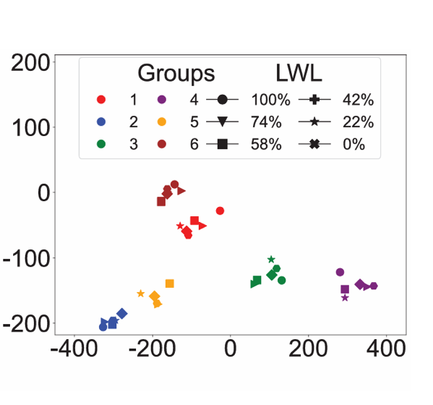
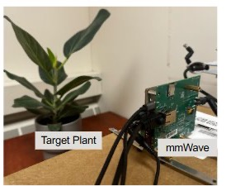
Challenge
Samples with the same LWLs have few similar features.
Notes:
Another challenge lies in feature similarity. We performed PCA on randomly sampled result across all Leaf Wetness Levels and plants.
For the result shows that samples from the same plant and location which represent with same color cluster tightly—indicating strong intra-group similarity—whereas samples with the same LWL which indicate with same marker scatter broadly, revealing weak inter-group similarity [click].
Traditional regression then struggles, because identical moisture levels look very different across leaves. This underscores the need for a novel feature-extraction approach that can align wetness cues across diverse plant instances.

Slide 9
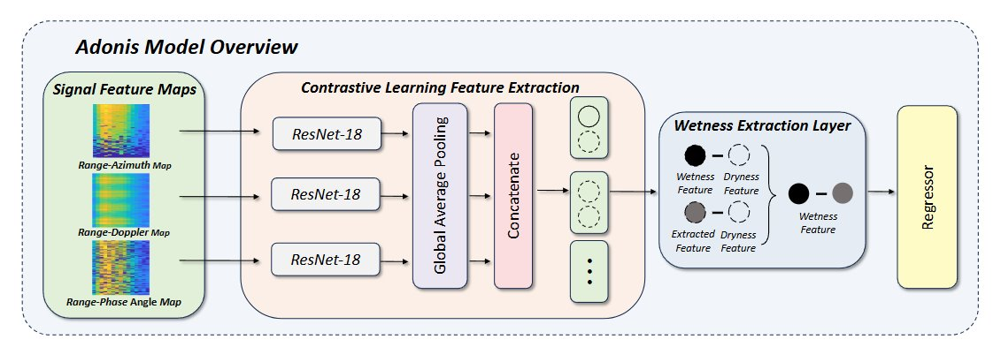
Adonis Design
Notes:
We present with Adonis.
[click] First, we process the raw mmWave IQ signal into three 2D feature maps—Range–Doppler, Range–Azimuth, and Range–Phase—each capturing different aspects of the leaf’s reflection.
[click] Next, we apply a contrastive learning stage: by sampling groups of measurements from the same leaf under different wetness levels, our CNN learns to pull intra-leaf features together and push inter-leaf features apart, building a discriminative feature space.
[click] Those consolidated features feed into a wetness extraction layer, a CNN block designed to isolate moisture-specific patterns across the fused feature maps.
[click] Finally, a lightweight regression head takes the distilled feature vector and predicts a continuous Leaf Wetness Level from 0 to 100 percent, giving us a precise, quantitative measure of surface moisture in real time.

Slide 10
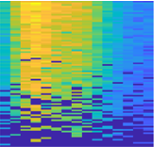
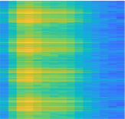
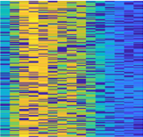
mmWave Signal Processing
Range-Azimuth Map
Range-Doppler Map
Range-
Phase Angle Map
Notes:
We start by transforming raw IQ samples into three complementary 2D feature maps.
We first compute the Range–Doppler map to get precise plant range and any tiny motion signatures.
Then we form the Range–Azimuth map to pinpoint the leaf’s angular position and filter out background echoes.
Finally, we extract the Range–Phase map so we can detect moisture-induced phase shifts, giving us direct sensitivity to leaf wetness.

Slide 11
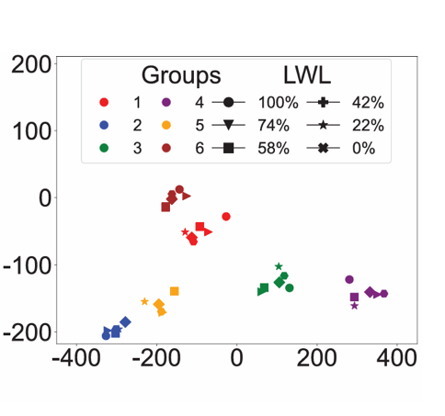
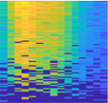
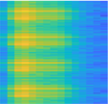
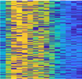
Contrastive Learning Feature Extraction​
ResNet-18
Global Average Pooling
ResNet-18
Concatenate
ResNet-18
• • •
Notes:
Next, we introduce contrastive learning for feature extraction.
Our preliminary analysis showed strong intra‐group but weak inter‐group similarity, making leaf wetness level regression difficult.
Contrastive learning addresses this by pulling together embeddings from the same plant with positive pairs and pushing apart those from different plants with negative pairs.
Applying a contrastive loss to embeddings from our feature maps with a feature space where wetness changes in one plant form tight clusters, while other plants remain distinct—dramatically improving regression robustness against variability and noise.

Slide 12
Calibration
Wetness Extraction Layer
Wetness Feature
Dryness Feature
Wetness Feature
Extracted Feature
Dryness Feature
Notes:
To adapt Adonis to new plants or setups, we begin with a quick calibration: we collect a handful of dry and fully saturated scans to standardize our feature scales.
We setup with Wetness Extraction Layer to highlights moisture‐sensitive channels across the fused feature maps and can accurately quantify intermediate Leaf Wetness Levels, ensuring reliable performance

Slide 13
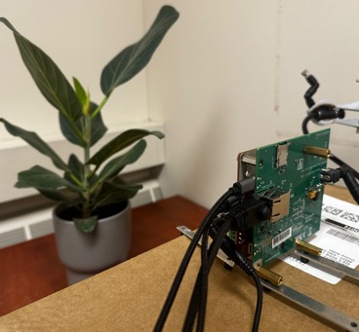
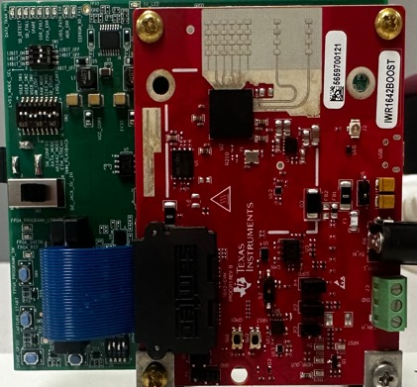
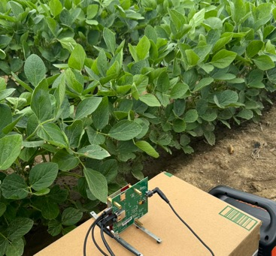
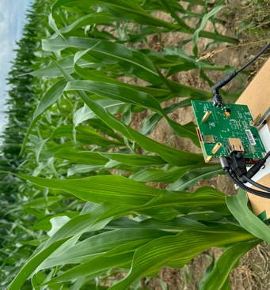
Implementation
Indoor Data Collection
mmWave Radar: TI IWR 1642
Real Field Data Collection
Notes:
Our prototype is built on a Texas Instruments IWR1642 mmWave radar. We use 2 transmitters and 4 receivers to collect IQ signals.
We validated the system both in a controlled indoor setup and in real soybean and corn fields shown in the right.

Slide 14
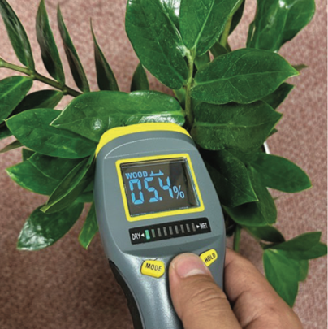
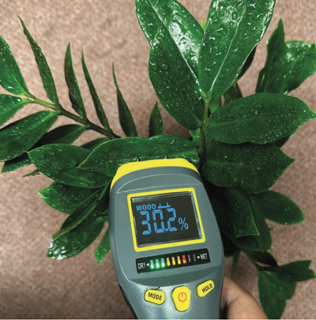
Implementation
Dry Leaf
Wet Leaf
Moisture Meter Utilized for Ground Truth
Notes:
We employ a commercial moisture meter by gently pressing the moisture meter pins onto the leaf surface to detect the leaf’s moisture content.
We utilized the change in readings to measure the leaf wetness levels.
Initially, we calibrated the moisture meter by setting the baseline readings for complete dryness at 0%.
The readings are then normalized based on these baselines to determine the leaf wetness levels.

Slide 15
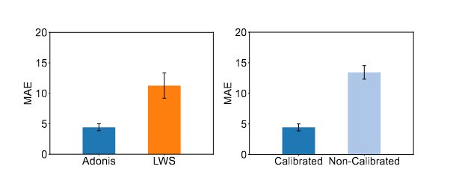
Evaluation
Adonis achieve mean average error for 4.43 outperforming traditional method.
Notes:
We compare the detection results with the commercial Leaf Wetness Sensors. Mean absolute error is the average absolute difference between the predicted and actual values. It offers a straightforward interpretation of prediction accuracy.
In our overall tests, Adonis achieves a mean absolute error of 4.43 dramatically lower than commercial leaf-wetness sensors, which exhibit 11.27 MAE under the same conditions .
We also evaluated the impact of our lightweight calibration step: without calibration, Adonis’s MAE balloons to 13.43, but after a quick two-point dry/wet calibration, error plummets back to 4.43 ± 0.57.

Slide 16
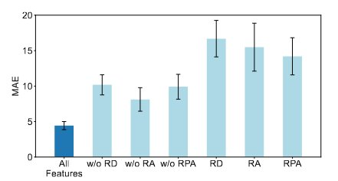
Evaluation
The ablation study demonstrates that effectiveness of signal processing and feature extraction.
Notes:
We also performed an ablation on our signal‐processing front end to isolate each map’s contribution.
Removing any single map pushes MAE above 7, and stripping out two maps sends error soaring past 14, underscoring that all three—range, angle, and phase—are essential for precise wetness estimation.

Slide 17
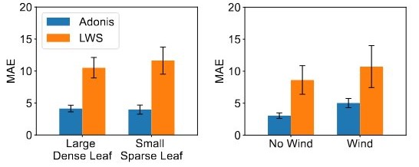
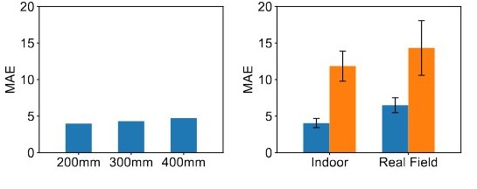
Evaluation
Results demonstrate robust performance across diverse leaf types, environmental conditions, distances, and real-field deployments.
Notes:
We evaluated Adonis on both large, dense leaves and small, sparse ones—common crop varieties worldwide—and consistently achieved MAE under 5. We also challenged the system with wind, varied distances, and real‐field conditions, yet it maintained robust performance with errors remaining below 5 MAE.

Slide 18
Key Insights
Leaf Wetness Level: an agricultural metric derived from RF signal reflections to quantify plant water content and health.
mmWave Signal Analysis: applying signal processing and contrastive learning for robust feature extraction.
Robust Performance: Adonis achieve MAE for 4.43 indoors and 6.49 for real field outperforming traditional methods.
Notes:
Here are our three key insights:
Leaf Wetness Level introduces a continuous RF‐derived metric that quantifies surface moisture on a 0–100 scale, directly tying mmWave reflections to plant hydration.
mmWave Signal Analysis leverages tailored Range–Doppler, Range–Azimuth, and Range–Phase maps combined with group‐wise contrastive learning to extract robust, discriminative moisture features.
Robust Performance is demonstrated by Adonis’s low MAE—4.43 indoors and 6.49 in real fields—significantly outperforming conventional leaf‐wetness sensors.

Slide 19


Adonis: Neural-enhanced Fine-grained Leaf Wetness Sensing
with Efficient mmWave Imaging
Maolin Gan
ganmaoli@msu.edu
Michigan State University
Yimeng Liu
liuyime2@msu.edu
Michigan State University
Notes:
Thank you for your attention. For further details or questions, please feel free to contact the authors.

