Slide 1
DSAI 6226 · Data Engineering and Analytics
Labs 6–9
Data Quality, Analytics, ML Readiness & Optimisation
A healthcare admissions pipeline, built on evidence: 5 quality checks that fire and quarantine, a served mart with provable freshness, an ML feature table with a documented leakage audit, and a pipeline we profiled before touching a single line.
Group 3 — Allen L. Lyimo · Asina Mchomvu · Frank Mtimbili · Claverfred Mhidze · Kelvin Mwanga
MSc. Data Science & AI · NM-AIST

Slide 2
What We'll Walk Through
SOURCE
TREAT
STORE
SERVE
ML PREP
OPTIMISE
raw CSV
55,500 rows
→
5 quality checks
quarantine
→
star schema
DuckDB
→
mart +
dashboard
→
features +
split + audit
→
profile, fix,
prove
Lab 6
Data Quality & Governance
5 checks fire, quarantine proof, lineage, PDPA
Lab 7
Analytics From the Pipeline
mart, metrics, live freshness demo
Lab 8
Preparing Data for ML
features, leakage audit, split, datasheet
Lab 9
Optimisation & Performance
profile → real bottleneck → fix → proof

Slide 3
Five Executable Checks, Not a One-Time Look
LAB 6 · DATA QUALITY & GOVERNANCE
Lab 3 had one validity check. We extended ingest.py to five checks across validity, completeness and uniqueness — and changed failure behavior from silently dropping rows to quarantining them with a reason.
# | Check | Dimension | Result on Real Data
1 | Billing Amount ≥ 0 | Validity | 108 rows quarantined (negative_billing_amount)
2 | Age between 0–120 | Validity | 0 rows — clean
3 | Discharge Date ≥ Admission Date | Validity | 0 rows — clean
4 | Name, Condition, Billing not null | Completeness | 0 rows — clean
5 | No exact duplicate rows (row-hash) | Uniqueness | 532 rows quarantined (duplicate_row)
Proof the checks actually fire, not just look correct on paper
Checks 2–4 catch nothing on our clean 55,500-row dataset. test_quarantine.py injects 3 deliberately bad rows (implausible age, discharge before admission, missing Name) through the same validate() used in production — all 3 correctly quarantined, kept in the repo as presentation evidence.

Slide 4
Nothing Silently Lost — Every Row Traceable
LAB 6 · DATA QUALITY & GOVERNANCE
Raw CSV
55,500 rows
validate()
5 checks
quarantine
(reason code)
admissions
54,860 clean
Star schema
+ analytics
→
→
→
→
Across two pipeline runs the quarantine table holds 1,283 rows (216 negative-billing, 1,064 duplicates, 3 injected test rows) — safe to accumulate because ingestion is idempotent (row-hash key, INSERT OR REPLACE). Any published number can be traced hop by hop back to its raw source row.
PDPA (Tanzania Data Protection Act) — Governance Note
Personal & indirectly identifying fields: Name (direct); Age, Gender, Medical Condition, Hospital, Doctor (indirect).
Lawful basis: synthetic, publicly published Kaggle data — not real patient records; use limited to DSAI 6226 coursework under academic/legitimate interest.
Minimization: no personal fields added beyond the raw file; quarantine stores full rows only for pipeline debugging, not secondary use.
If this were real data: access to Name/medical fields restricted to authorized members, data kept in-country, and a specific retention period stated.

Slide 5
One Mart, Metrics Defined Once
LAB 7 · ANALYTICS FROM THE PIPELINE
build_marts.py aggregates the clean admissions table into marts_admissions_daily (1,827 daily rows), stamped with refreshed_at on every build. metrics.md documents both published numbers — formula, grain, filters, owner — so the dashboard never redefines them independently.
One consumer view
dashboard.py (Streamlit) reads only from marts_admissions_daily — never raw data.
Two KPI cards + two daily trend charts, all sourced from the one mart.
A live freshness label computed from MAX(refreshed_at) vs now — never hardcoded.
Sidebar demo: backdate 30h → label flips green to red STALE; rerun pipeline → restores. Proves the mechanism reacts, not just looks fine.
TOTAL ADMISSIONS (ALL DAYS)
AVG BILLING AMOUNT
54,860
$25,596.95
GRAIN
FRESHNESS PROMISE
per admission date
≤ 24 hours

Slide 6
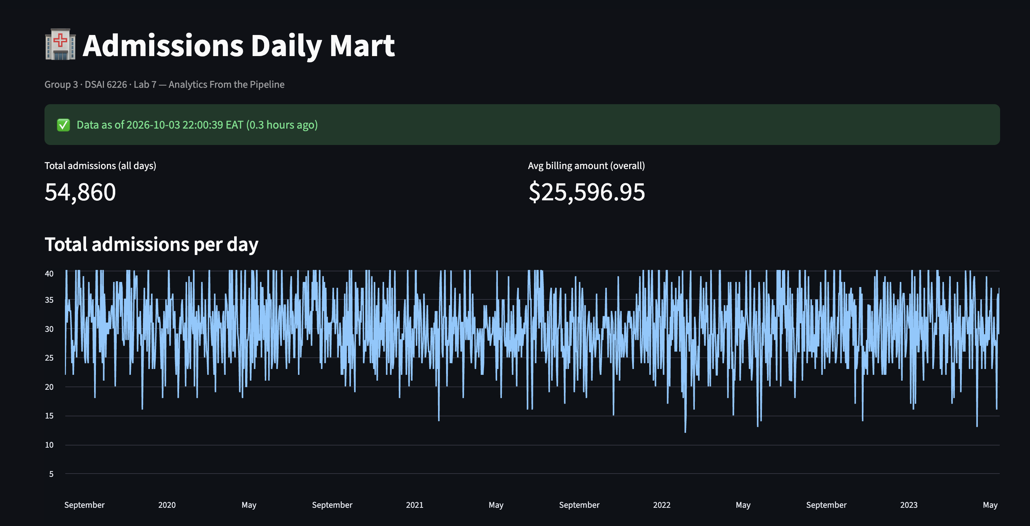
Live Demo: Freshness Is Provable, Not Decorative
LAB 7 · ANALYTICS FROM THE PIPELINE
What to watch for live
Click “Simulate missed refresh” → banner flips to red STALE DATA
Click “Run pipeline now” → rebuilds mart live, banner returns to green
KPI numbers never change — only the freshness label reacts, because it reads refreshed_at, not the data itself

Slide 7
ML-Readiness Decided Before Modeling
LAB 8 · PREPARING DATA FOR ML
build_features.py builds ml_features (54,860 rows) from the clean admissions table: raw columns plus six engineered features, each checked against one question — would this value be knowable at prediction time?
length_of_stay_days
Discharge − Admission date
Deliberately excluded
admission_month / dayofweek
Calendar position of admission
Name, Doctor, Hospital
near-unique identifiers, no predictive signal
Room Number
operational, not clinical
Test Results
borderline — excluded as a leakage risk
is_weekend_admission
Admission fell on Sat/Sun
age_group
Child / Adult / Senior bucket
is_chronic_condition
Condition in {Diabetes, Hypertension, Asthma}
The leakage question, applied to every column
“Would this value be knowable at prediction time, before the outcome is known?” — covering all three leakage types: future leakage, split leakage, and target leakage. Full column-by-column verdicts are documented in features.md.

Slide 8
A Split Decided Up Front, and an Honest Datasheet
LAB 8 · PREPARING DATA FOR ML
Time-based split, not group-based
DATASHEET.md — Gebru et al. framework
Split | Rows | Ends
Train (70%) | 38,402 | 2022-11-04
Validate (15%) | 8,230 | 2023-08-05
Test (15%) | 8,228 | —
Origin: Kaggle prasad22/healthcare-dataset, synthetic.
Known gap: billing amount near-uniform across conditions/insurers — evidence of synthetic generation (Lab 2).
Privacy: no real patients; same PDPA minimization lens as Lab 6.
Intended use: DSAI 6226 coursework ML exercise — explicitly not for real clinical or insurance decisions.
Why not group by Doctor/Hospital? Lab 2's cardinality evidence: Doctor 40,341/55,500, Hospital 39,876/55,500, Name 49,992/55,500 distinct — all near-unique, making group-based splitting impractical. Stated residual limitation: possible Doctor/Hospital overlap across the time boundary.

Slide 9
We Guessed Wrong — And Measured Instead of Acting On It
LAB 9 · OPTIMISATION & PERFORMANCE
The assumption
What we actually measured
Matching the unit's own worked example, we expected reading the raw CSV (fetch_source) would dominate the pipeline's runtime.
Timing every real step, 3 times, before touching any code (per the unit's warning against “benchmarking once”).
0.144s
1.287s
fetch_source — consistently fast across all 3 runs. Not the bottleneck.
build_features.py — nearly double the next-slowest step, in every single run. The real bottleneck.

Slide 10
The Fix: Vectorize, Don't Loop Row by Row
LAB 9 · OPTIMISATION & PERFORMANCE
df["age_group"] = df["Age"].apply(age_group)
pd.cut(df["Age"], bins=[-1,17,64,200],
labels=["Child","Adult","Senior"])
BEFORE — 54,860 individual Python calls, one row at a time
AFTER — one vectorized pass over the whole column
Step | Before (avg) | After (avg) | Change
fetch_source | 0.144s | 0.148s | ~flat (untouched)
validate | 0.058s | 0.059s | ~flat (untouched)
load_to_duckdb | 0.726s | 0.760s | ~flat (untouched)
build_marts | 0.211s | 0.150s | ~flat / noise (untouched)
build_features | 1.287s | 1.134s | −0.153s (≈12% faster)
Reproducible in all 3 runs — modest, not dramatic, because most of this step's time is process/library startup, not the loop. Reported honestly rather than inflated.

Slide 11
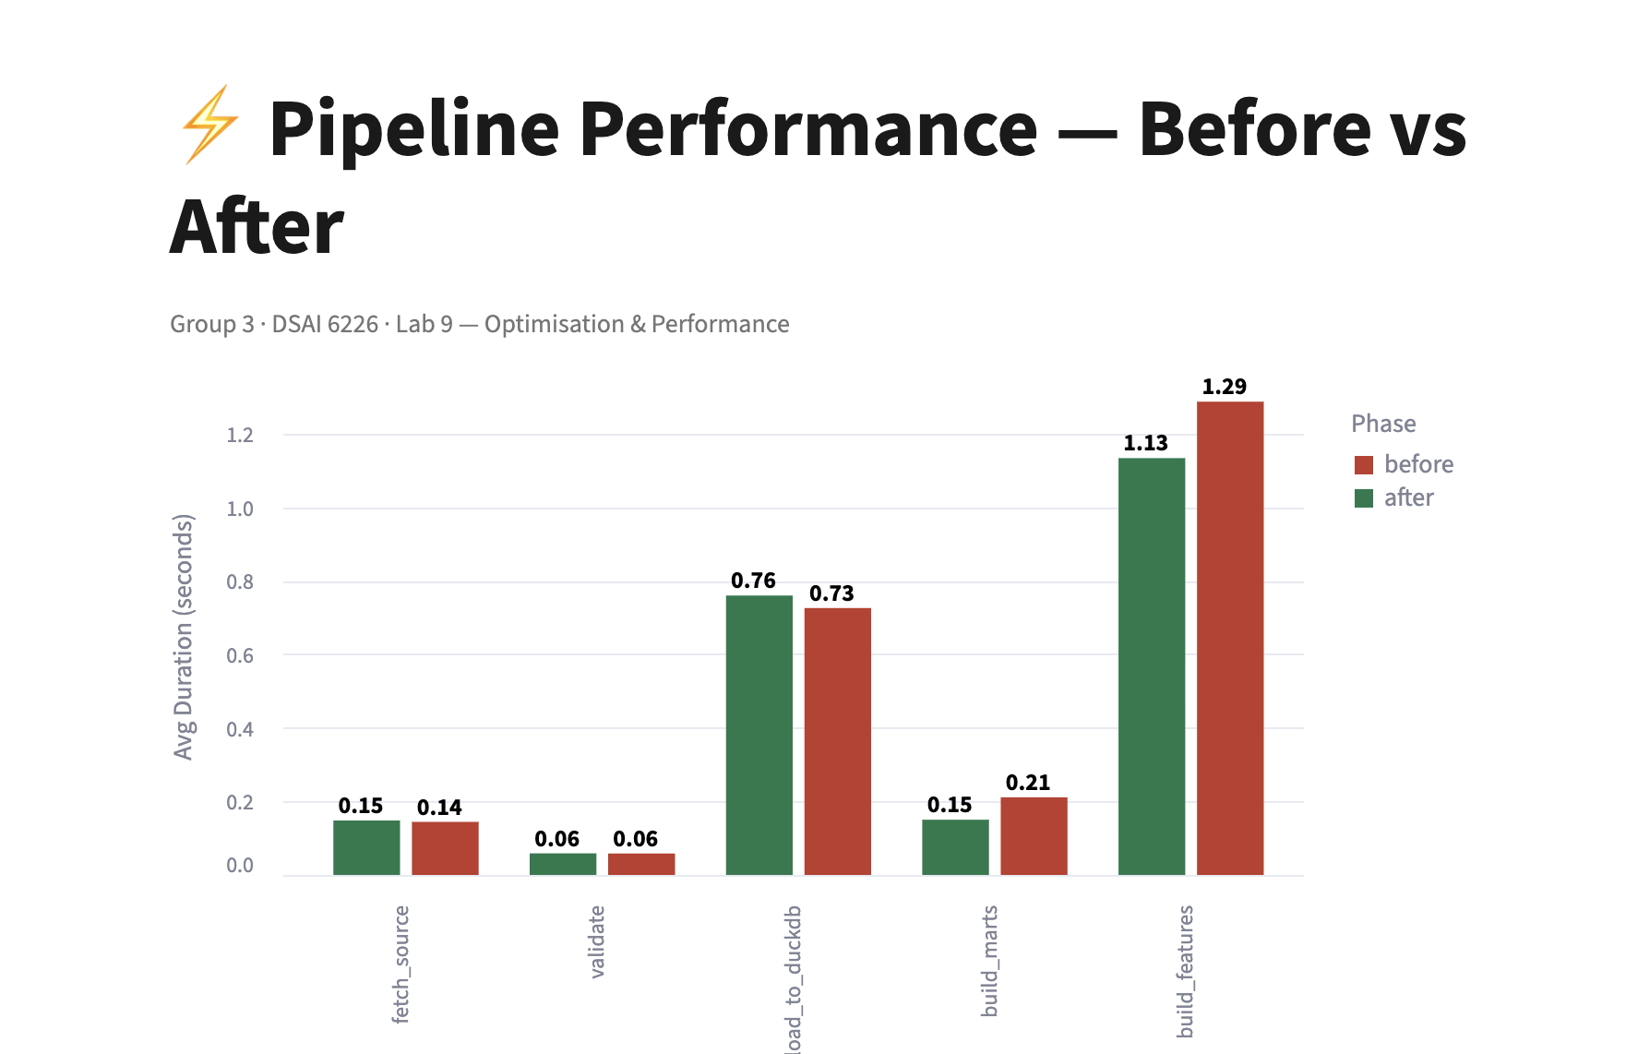
Before/After, Visualized
LAB 9 · OPTIMISATION & PERFORMANCE

Slide 12
Four Labs, One Discipline: Evidence Over Assumption
Lab 6
Quality checks must be proven to fire, not just written — quarantine, don't silently drop.
Lab 7
A metric defined once and a freshness label that reacts to real failures beats a dashboard that just looks fine.
Lab 8
ML-readiness — leakage, splits — is decided before modeling, with a documented audit trail.
Lab 9
Measure first. Our own intuition about the bottleneck was wrong; the data corrected us.
Across all four labs, every claim in this deck is backed by a script you can re-run and a number you can reproduce.

Slide 13
Thank You
Questions welcome.
Group 3
Allen L. Lyimo · Asina Mchomvu · Frank Mtimbili · Claverfred Mhidze · Kelvin Mwanga
github.com/lyimoa/Data-Engineering-Group-3-New-Dataset-

