Slide 1
Hit Song Science:
Modeling Weekly Billboard 100 Chart with Twitter Data
Team 6
John Lee | Hsin-Yuan Wu | Melody Chang
SI 699 WN 21

Slide 2
Introduction
We aim to seek how textual components and popularity patterns of tweets may help predict rankings of the Hot 100 songs on Billboard.
Notes:
Melody
In this project, we aim to explore whether textual components and popularity patterns from Twitter data can help predict rankings of the top 100 songs on Billboard.

Slide 3
Approach
Feature Extraction
Model Building
Model Optimization
Billboard Dataset
Weekly chart rankings.
+
Spotify Dataset
Songs from weekly top 100 chart but not in Billboard chart.
+
Twitter Dataset
Extract 16 features related to popularity, network patterns, and textual components.
Multi-class Classification
Support Vector Machine
Naive Bayes
Random Forest
Logistic Regression
K-Nearest Neighbor
Gradient Boosting
AdaBoost
Multi-layer Perceptron
CART
LDA/QDA Classification
Bagging
Methods
Normalization
Feature Selection
Feature Expansion
Hyperparameters Tuning
Evaluation
MAE
Confusion Matrix
Skewness
Compared to Baselines
Notes:
Melody
A brief review of the approach:
We ended up combining information from three dataset.
Focus on features we extracted from twitter dataset

Slide 4
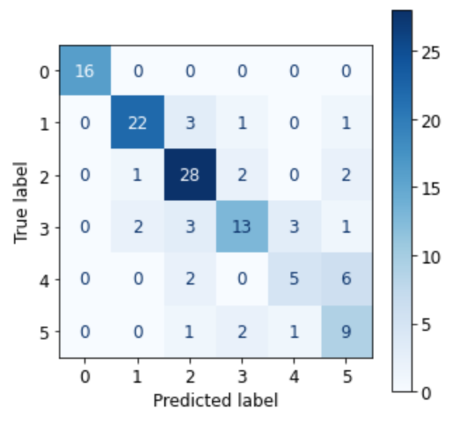
Results
Baselines
Multinomial Naive Bayes (MNB) classifier
default parameters and MinmaxScaler
SVC classifier
Parameters from cross validation and MinmaxScaler
Best Model
Random Forest Classifier
Use ExtraTrees as selector to select features and Random Forest classifier to predict
Evaluation | MAE | Macro Precision | Macro Recall | Macro F1 Score | Skewness
Naive Bayes | 1.18 | 0.33 | 0.34 | 0.30 | 0.38
SVC | 0.74 | 0.51 | 0.50 | 0.50 | 0.47
RF | 0.39 | 0.73 | 0.72 | 0.71 | 0.38
Best Model: RF
Notes:
Sean
Select features according to a percentile of the highest scores
Chi score can be used to select the n_features features with the highest values for the test chi-squared statistic from X
skewness = 0 : normally distributed.
skewness > 0 : more weight in the left tail of the distribution.
skewness < 0 : more weight in the right tail of the distribution.

Slide 5
Findings & Conclusions
Random Forest de-correlates the features via bootstrap sampling
Averaging uncorrelated features leads to a higher reduction in variance than averaging correlated ones
Main takeaway: Discussion on social media could predict the popularity of a song on music chart
Limitation and future work: Retrieving approach for tweets relevant to the songs
Notes:
Sean

Slide 6
Challenge 1
The Twitter Decahose Data
Deeply nested data structure
Missing some popularity features - retweet, reply, favorite, quote counts all 0 due to the nature of Decahose
Notes:
John
Deeply nested data structure→ difficult to narrow down features for our analysis, especially similar ones- example: for one tweet, handling urls under different root (entities, user_mentions)
(We can mention that tweets count - which is a popularity measure - is considered an important feature??)
Because Decahose delivers a 10% random sample of the realtime Twitter Firehose through a streaming connection. So,a tweet that we capture at one moment will be updated in the next. And at the moment that we capture popularity features, they are not populated yet. Maybe in a later time, they will.
However, still left out some unobserved features→ We did include text and emoji sentiment features→ hopefully capture some of the latency of tweet features

Slide 7
Challenge 2
Limited resources on Cavium
Only a limited number of users can use Cavium at the same time
Disruptions on Cavium slowing the running time
Not able to collaborate (e.g., PySpark)
Notes:
John

Slide 8
Thank You!

