Slide 1
Capstone Presentation
Ron Hankey

Slide 2

Introduction Diabetes Prediction
11.6% of the total population, or 38.4 million people, have diabetes diagnosed or undiagnosed
About 22.8% of adults with diabetes, or 8.7 million people, are undiagnosed.
97.6 million American adults aged 18 and older have prediabetes, representing 34.5% of the adult population.

Slide 3
Introduction Diabetes Prediction
The risk of developing diabetes within 5 years after a prediabetes diagnosis is around 50%
The total estimated cost of diagnosed diabetes in the US in 2022 was a staggering $412.9 billion
Diabetes significantly increases the risk of early death, resulting in lost economic productivity and potential earnings.

Slide 4
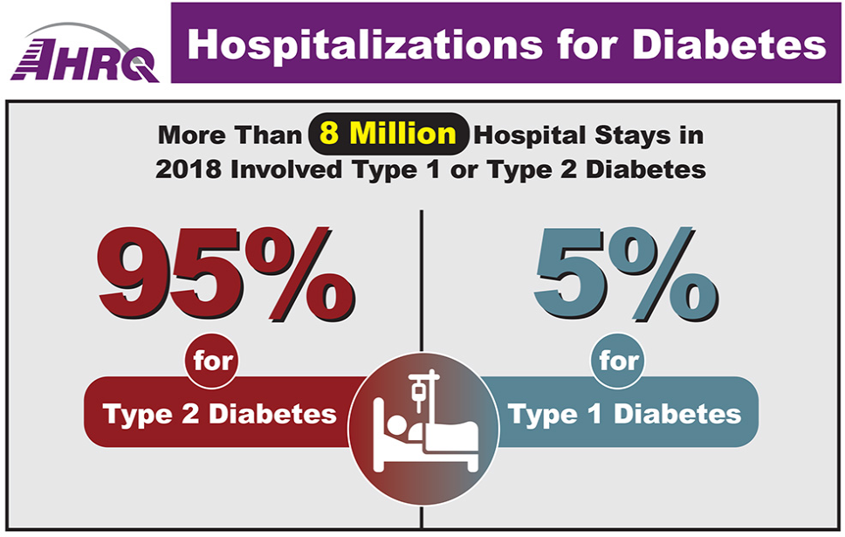
Capstone Presentation Diabetes Prediction Cost Breakdown
Direct Medical Costs ($306.6 billion):
Hospitalizations: $101.1 billion (33% of direct costs) - Diabetes complications like heart disease, stroke, and kidney failure often require hospitalization, driving up costs.

Slide 5
Capstone Presentation Diabetes Prediction Cost Breakdown
Medications: $52.3 billion (17%) - Insulin, diabetes medications, and other related drugs are essential for managing blood sugar levels but can be expensive.
Doctor visits: $49.3 billion (16%) - People with diabetes require regular doctor visits for monitoring and managing their condition.
Blood sugar monitoring supplies: $18.5 billion (6%) - Blood glucose meters, test strips, and other monitoring tools are crucial for managing diabetes but add to the overall cost.
Other diabetes-related treatments and procedures: $85.4 billion (28%) - This includes costs associated with diabetes education, foot care, vision care, and other essential services.

Slide 6
Capstone Presentation Diabetes Presentation Indirect Costs
Indirect Costs ($106.3 billion)
Reduced productivity at work: $53.2 billion (50% of indirect costs) - Diabetes can impact work performance due to fatigue, illness, and doctor appointments, leading to lost productivity.
Absenteeism from work: $27.5 billion (26%) - Diabetes-related illness and complications can lead to missed workdays, further impacting productivity and income.
Unemployment due to diabetes-related complications: $13.3 billion (13%) - In severe cases, diabetes can lead to disabilities and job loss, adding to the financial burden.
Premature mortality: $12.3 billion (11%) - Diabetes significantly increases the risk of early death, resulting in lost economic productivity and potential earnings.

Slide 7
Capstone Presentation Goal
Build a machine learning model to predict whether patient may be at risk for having diabetes.

Slide 8
Capstone Presentation Data Source
UC Irvine Machine Learning Repository
Compiled by the Centers for Disease Control (CDC)
Contains healthcare statistics and lifestyle survey information
253,680 patients
21 features consist of some demographics, lab test results, and answers to survey questions
Target variable for classification is whether a patient has diabetes, is pre-diabetic, or healthy.

Slide 9
Capstone Presentation Data Wrangling
# Check for NULL values
merged_df.isnull().sum()
Diabetes_binary 0
HighBP 0
HighChol 0
CholCheck 0
BMI 0
Smoker 0
Stroke 0
HeartDiseaseorAttack 0
PhysActivity 0
Fruits 0
Veggies 0
HvyAlcoholConsump 0
AnyHealthcare 0
NoDocbcCost 0
GenHlth 0
MentHlth 0
PhysHlth 0
DiffWalk 0
Sex 0
Age 0
Education 0
Income 0

Slide 10
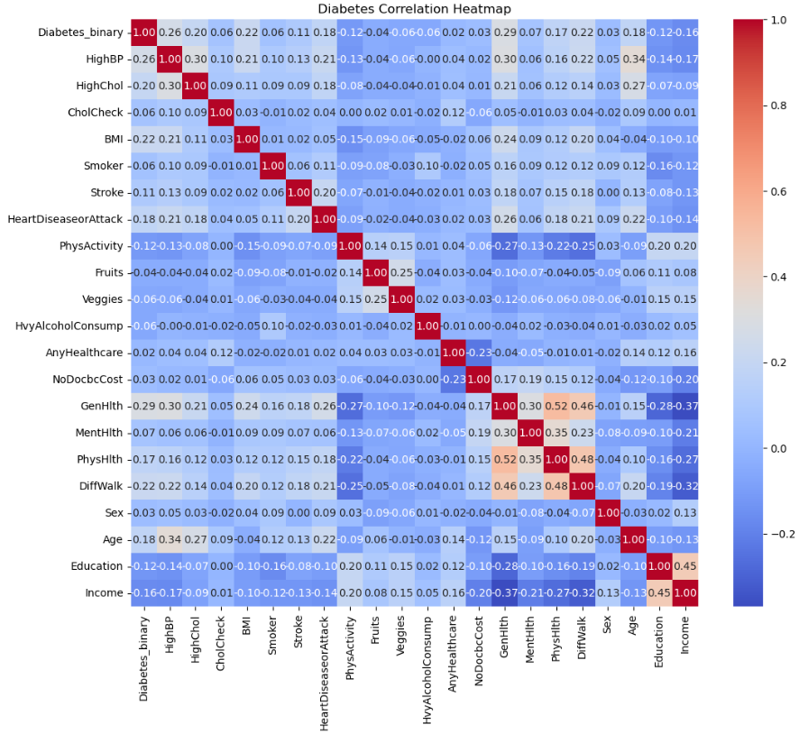
Capstone Presentation Exploratory Data Analysis
Graphed all of the features

Slide 11
Capstone Presentation Pre-processing & Training Data Development
Created 2 new features
merged_df['mrna_booster'] = np.random.choice([1, 0], size=len(merged_df), p=[0.17, 0.83])
merged_df['prior_covid'] = np.random.choice([1, 0], size=len(merged_df), p=[0.71, 0.29])
from sklearn.model_selection import train_test_split
# Define the target variable and features
X = merged_df.drop("Diabetes_binary", axis=1) # Features - all columns except Diabetes_binary
y = merged_df["Diabetes_binary"] # Diabetes_binary is the target variable
# Split the data into training and testing sets
X_train, X_test, y_train, y_test = train_test_split(X, y, test_size=0.2, random_state=47)

Slide 12
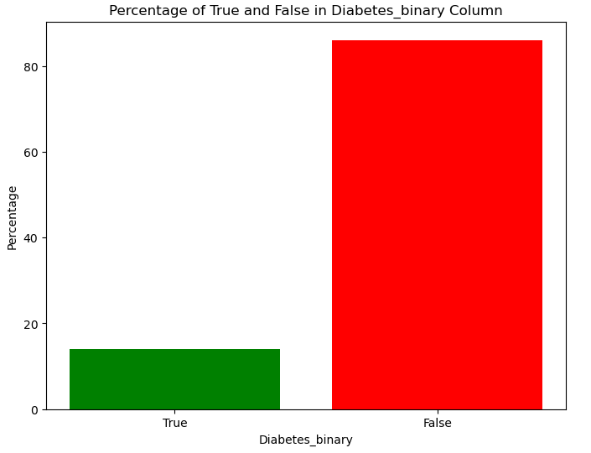
Capstone Presentation Modeling

Slide 13
Capstone Presentation Modeling
Logistic Regression: A linear model for classification rather than regression. It's simple, fast, and provides a probability score for observations.
The XGBoost classifier is a decision-tree-based ensemble machine learning algorithm that uses a gradient boosting framework.
Random Forest: An ensemble of decision trees, typically trained with the "bagging" method. It's more robust and accurate than a single decision tree.
Support Vector Machines (SVM): A powerful model that finds the optimal boundary between the possible outputs. It's effective in high-dimensional spaces.
Naive Bayes: A simple probabilistic classifier based on applying Bayes' theorem with strong (naive) independence assumptions between the features.
K-Nearest Neighbors (K-NN): A non-parametric method used for classification and regression. It classifies data based on the majority vote of its neighbors.
Multi-Layer Perceptron Classifier (MLPClassifier), which is a type of neural network used for classification tasks.

Slide 14
Capstone Presentation Modeling
# Define the list of models to process for comparison
models = [
('Logistic Regression', LogisticRegression(max_iter=1000, random_state=47)),
('Random Forest', RandomForestClassifier(random_state=47)),
('XGBoost', xgb.XGBClassifier(random_state=47)),
('MLP', MLPClassifier(hidden_layer_sizes=(100, 50), max_iter=1000, random_state=47))
]
# Create the list of pipelines for each model to be used the next step
pipelines = []
for model_name, model in models:
pipelines.append((
model_name,
Pipeline([
('Model', model)
])
))

Slide 15
Capstone Presentation Modeling
Accuracy: The proportion of true results (both true positives and true negatives) among the total number of cases examined.
Precision: The ratio of true positives to the sum of true and false positives, indicating the quality of the positive class predictions.
Recall (Sensitivity): The ratio of true positives to the sum of true positives and false negatives, indicating how well the model can identify the positive class.
F1 Score: The harmonic mean of precision and recall, providing a balance between the two in cases where one may be more important than the other.
ROC-AUC Score: The area under the Receiver Operating Characteristic (ROC) curve, which plots the true positive rate against the false positive rate at various threshold settings.
Confusion Matrix: A table that describes the performance of a classification model on a set of test data for which the true values are known.
The Matthews correlation coefficient (MCC) takes into account true and false positives and negatives, providing a balanced measure that can be used even if the classes are of very different sizes.

Slide 16
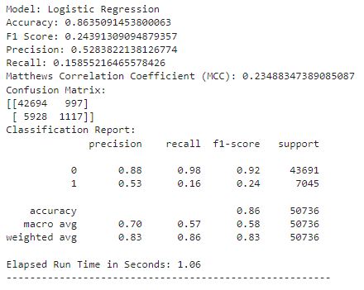
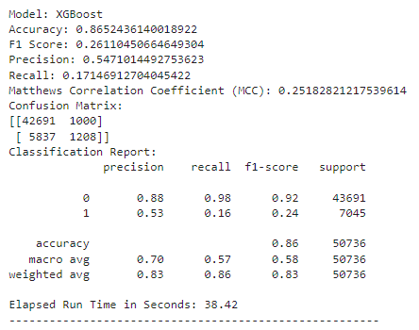
Capstone Presentation Modeling
Choose a medical that minimizes false positives.

Slide 17
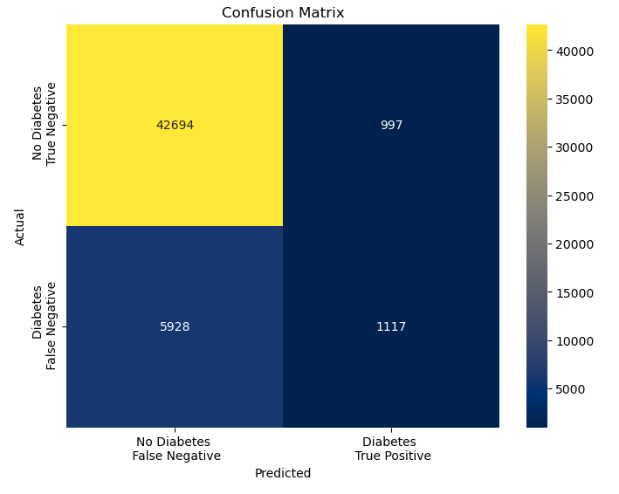
Capstone Presentation Modeling

Slide 18
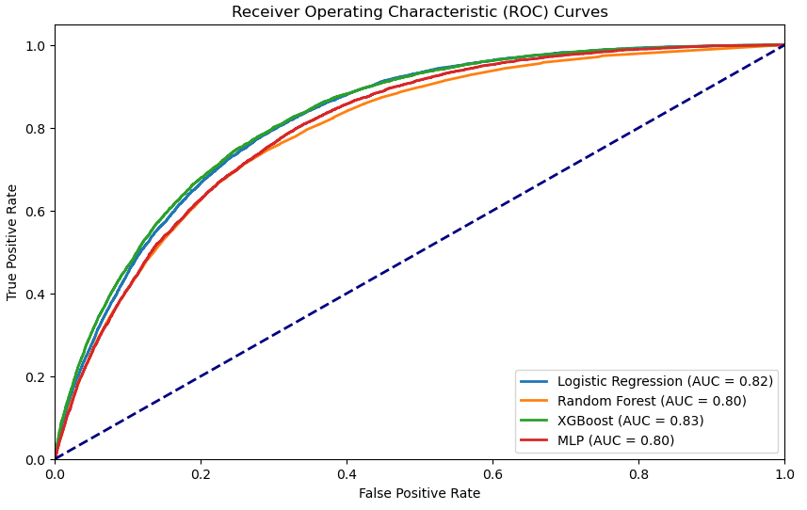
Capstone Presentation Modeling

Slide 19
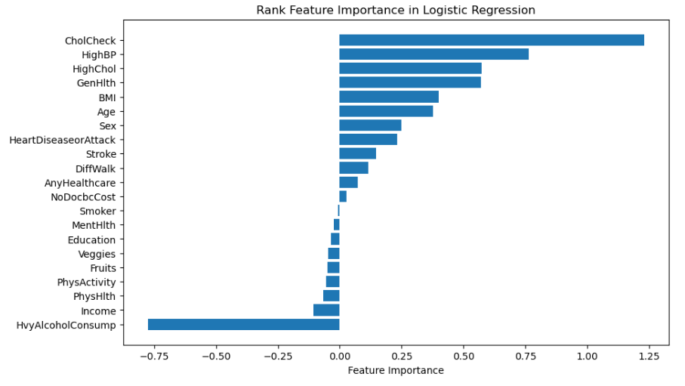
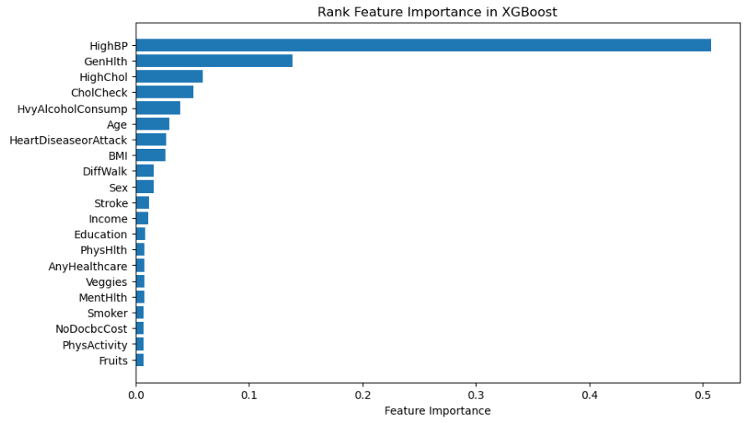
Capstone Presentation Modeling

Slide 20
Capstone Presentation Hyperparmeter Tuning
from sklearn.model_selection import GridSearchCV
# Define the hyperparameter grid and regularization penalty ('l1' or 'l2')
param_grid = {
'penalty': ['l1', 'l2'],
'C': [0.001, 0.01, 0.1, 1.0, 10.0]
}
L1 regularization (also known as Lasso regularization) adds a penalty equal to the absolute value of the magnitude of coefficients. This can lead to sparse models where some coefficients can become zero and thus eliminated, providing a form of feature selection.
L2 regularization (also known as Ridge regularization) adds a penalty equal to the square of the magnitude of coefficients. This discourages large coefficients but does not set them to zero, leading to models where all features are included but their impact is balanced.

Slide 21
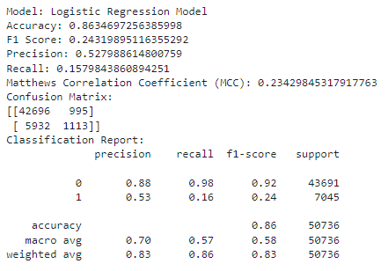
Capstone Presentation Hyperparmeter Tuning
Run model again with the tuned parameters
Best Hyperparameters: {'C': 10.0, 'penalty': 'l2’}

Slide 22
Capstone Presentation Summary
Want to choose a model that minimized false positives
Want to reduce medical testing a patient needs to endure
Want to reduce the cost of unnecessary testing
Logistical regression produced the fewest false positives
Logistical regression was the model chosen

Slide 23
Thank you
Ron Hankey
Hankey.Ronald@mayo.edu

