Slide 1
Capstone Presentation
Ron Hankey

Slide 2

Introduction Diabetes Prediction
11.6% of the total population, or 38.4 million people, have diabetes diagnosed or undiagnosed
About 22.8% of adults with diabetes, or 8.7 million people, are undiagnosed.
97.6 million American adults aged 18 and older have prediabetes, representing 34.5% of the adult population.

Slide 3
Introduction Diabetes Prediction
The risk of developing diabetes within 5 years after a prediabetes diagnosis is around 50%
The total estimated cost of diagnosed diabetes in the US in 2022 was a staggering $412.9 billion
Diabetes significantly increases the risk of early death, resulting in lost economic productivity and potential earnings.

Slide 4
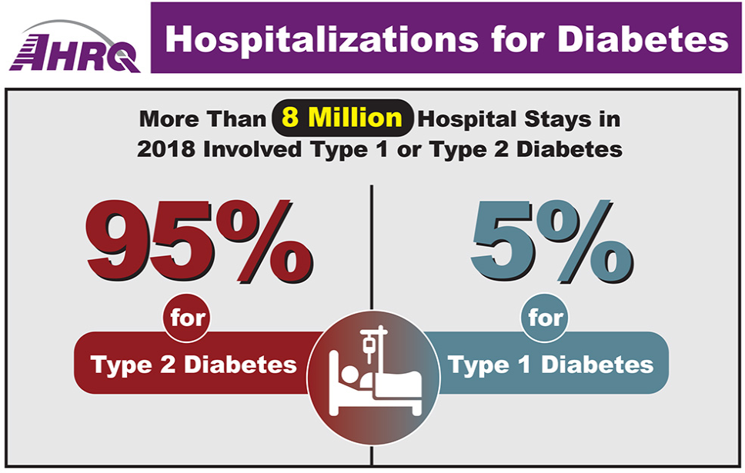
Capstone Presentation Diabetes Prediction Cost Breakdown
Direct Medical Costs ($306.6 billion):
Hospitalizations: $101.1 billion (33% of direct costs) - Diabetes complications like heart disease, stroke, and kidney failure often require hospitalization, driving up costs.

Slide 5
Capstone Presentation Diabetes Prediction Cost Breakdown
Medications: $52.3 billion (17%) - Insulin, diabetes medications, and other related drugs are essential for managing blood sugar levels but can be expensive.
Doctor visits: $49.3 billion (16%) - People with diabetes require regular doctor visits for monitoring and managing their condition.
Blood sugar monitoring supplies: $18.5 billion (6%) - Blood glucose meters, test strips, and other monitoring tools are crucial for managing diabetes but add to the overall cost.
Other diabetes-related treatments and procedures: $85.4 billion (28%) - This includes costs associated with diabetes education, foot care, vision care, and other essential services.

Slide 6
Capstone Presentation Diabetes Presentation Indirect Costs
Indirect Costs ($106.3 billion)
Reduced productivity at work: $53.2 billion (50% of indirect costs) - Diabetes can impact work performance due to fatigue, illness, and doctor appointments, leading to lost productivity.
Absenteeism from work: $27.5 billion (26%) - Diabetes-related illness and complications can lead to missed workdays, further impacting productivity and income.
Unemployment due to diabetes-related complications: $13.3 billion (13%) - In severe cases, diabetes can lead to disabilities and job loss, adding to the financial burden.
Premature mortality: $12.3 billion (11%) - Diabetes significantly increases the risk of early death, resulting in lost economic productivity and potential earnings.

Slide 8
Thank you
Ron Hankey
Hankey.Ronald@mayo.edu

