Slide 1

Capstone Presentation Medical Chatbot for Enhanced Patient Data Insights
Ron Hankey

Slide 2

Agenda
Problem, Context, & Success
Data Science Formulation
Data Foundations
Data Wrangling
Modeling Approach
Analysis Results
Recommendations

Slide 3
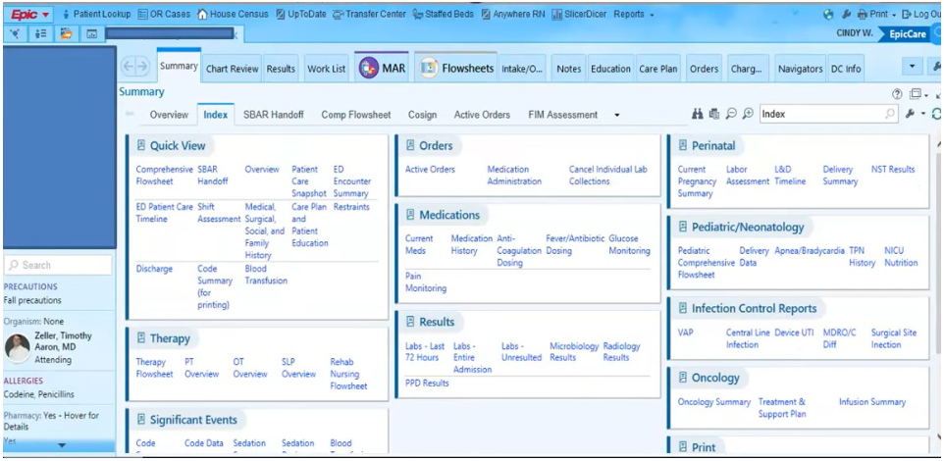

Problem, Context, & Success
Physicians spent an average of 16 minutes and 14 seconds per encounter using EHRs
Source: Ann Intern Med. 2020 Feb 4;172(3):169-174. doi: 10.7326/M18-3684

Slide 4

Problem, Context, & Success
Problem: Busy healthcare professionals often need quick answers to specific patient-related questions but extracting insights from Electronic Health Records (EHR) can be complex and time-consuming.
Context: The vast amount of data stored in medical databases holds valuable information that could improve patient care.
Success Metric: A tool that enables healthcare professionals to get answers directly from their patient database using natural language queries.
Stakeholders: Doctors, Nurses, Caregivers, Healthcare Administrators
Constraints: Data privacy, potential technical hurdles in integrating systems

Slide 5
Data Foundations
Project Formulation: Combination of natural language processing (NLP) & database querying & Large Language Model (LLM) Integration
Dataset Source: Kaggle datasets + cleaning process
Medical Records Dataset - This dataset contains simulated medical records for a fictional group of patients. The dataset was generated using the Python Faker library to create realistic but fake data.
https://www.kaggle.com/datasets/cankatsrc/medical-records-dataset
Medical Transcriptions - Medical data is extremely hard to find due to HIPAA privacy regulations. This dataset offers a solution by providing medical transcription samples.
https://www.kaggle.com/datasets/tboyle10/medicaltranscriptions
Dataset Characteristics: Two Tables: Patient and Patient_Notes
Patient Columns: Patient_ID (K), Name, Date_Of_Birth, Gender, Next_Appt, PDF_Available, PDF_Directory
Patient_Note Columns: Patient_ID (K), Description, Transcription, Keywords, Medications, Allergies

Slide 6
Data Wrangling
Data Cleaning
Medical Records Dataset - The dataset was generated using the Python Faker library to create realistic but fake data
Medical Transcriptions - Medical transcription data scraped from mtsamples.com
Data Transformation
Fix issues with Medical Records Dataset – Name and Gender did not align, names were random
Merging both datasets – Had to align transcriptions with gender
Aligning data to SQL Server data model
Key Takeaways
Difficult to find a dataset because of HIPAA (Health Insurance Portability and Accountability Act )
Merging datasets to make it more realistic more work than estimated
Once created dataset provided robust realistic examples for use in model
Writing to SQL Server challenges because of Python data structure

Slide 7
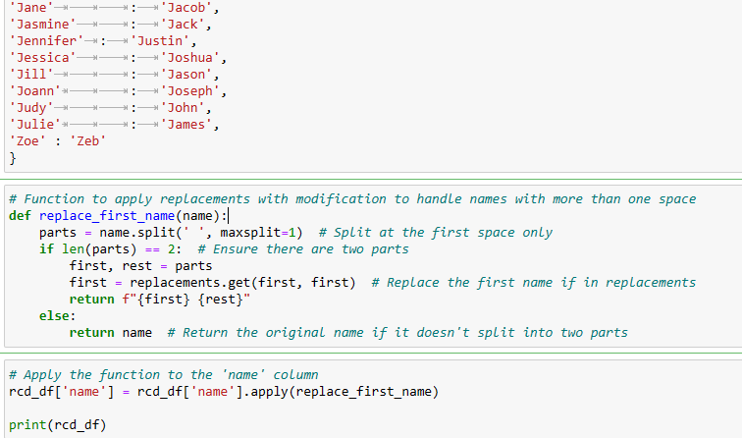
Data Wrangling

Slide 8
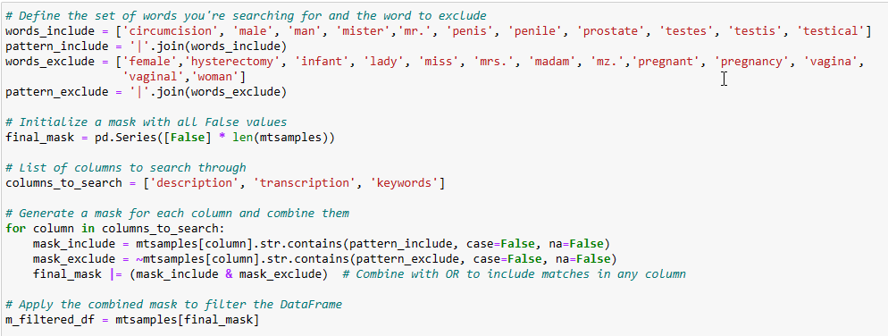
Data Wrangling

Slide 9
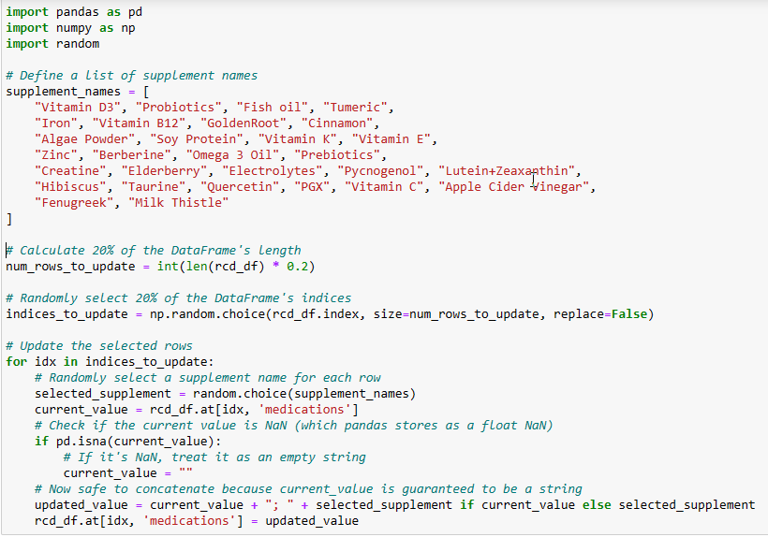
Data Wrangling

Slide 10
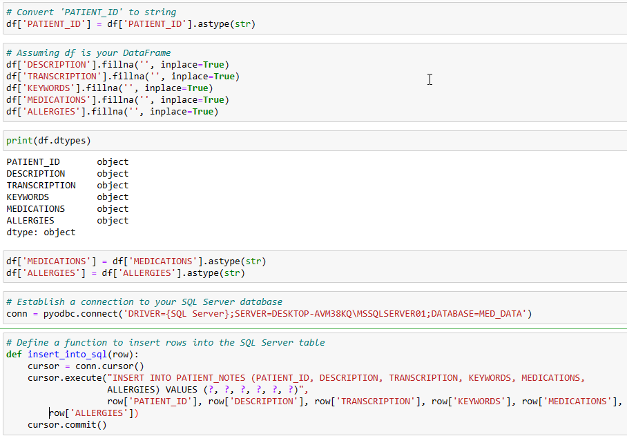
Data Wrangling

Slide 11
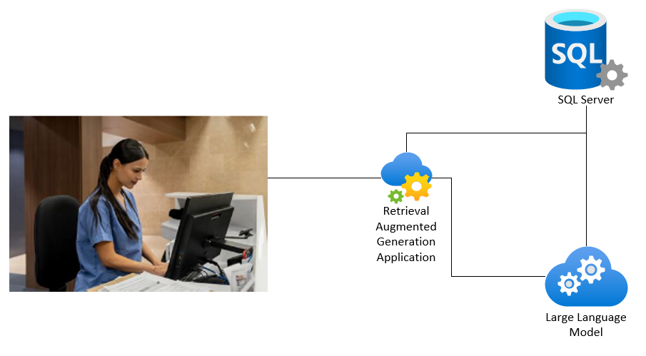
Modeling Approach

Slide 12
Modeling Approach
Generative AI (GenAI)
A type of AI that can create new content and ideas, including conversations, stories, images, videos, and music
Large Language Model (LLM)
Type of artificial intelligence (AI) program that can recognize and generate text, among other tasks.
Retrieval Augmented Generation (RAG)
The process of optimizing the output of a large language model, so it references an authoritative knowledge base outside of its training data sources before generating a response.
Langchain
LLM orchestration framework that helps developers build generative AI applications or retrieval-augmented generation (RAG) workflows.
Streamlit
Open-source Python framework for data scientists and AI/ML engineers to deliver dynamic data apps with only a few lines of code
Database
Microsoft SQL Server but any relational database would work

Slide 13
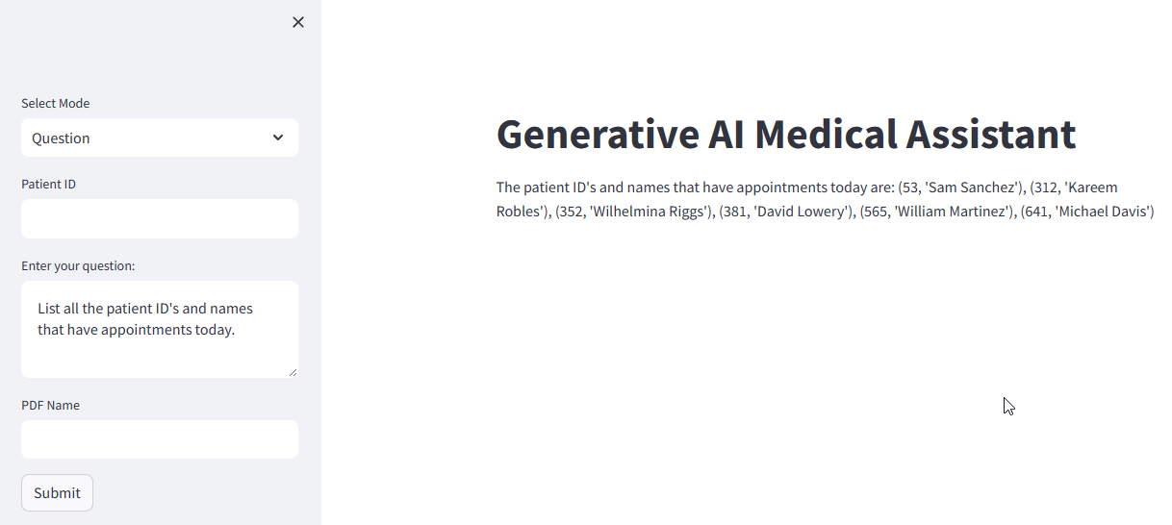
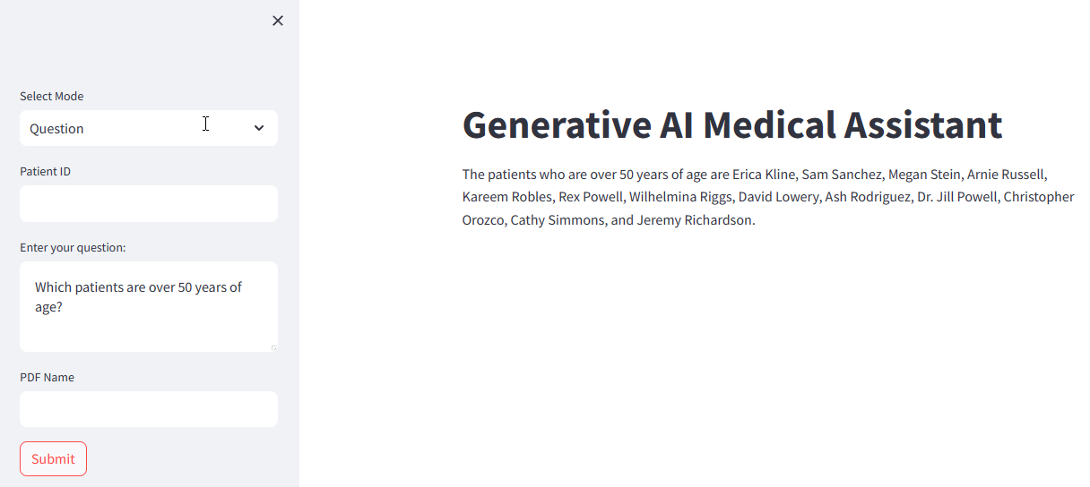
Analysis Results
Ability to ask questions about patients
List all the patient ID's and names that have appointments today.
List all the patient ID's and names that have appointments tomorrow.
Which patients have had a colonoscopy? Include patient ID and name.
Which patients are over 50 years of age?

Slide 14
Recommendations
Let Caregivers Drive Requirements
This was a proof of concept, need to gather detailed requirements from users
Integrate With Other Data Sources
EMR’s use many data sources, images, unstructured text, various document types
Open Source models can be trained on organization data for better integration
Requires GPU’s with sufficient memory
Training GPT-4 reportedly surpassed $100 million
Five to six months using 10,000 V100, running for 150 days on full power
3 trillion tokens, which is roughly 10 trillion words
Large Language Model
Using Langchain makes it easy to integrate with any LLM (Claude, Gemini, Llama, Mistral, etc.)
Open Source LLM
HIPAA requirements require confidentiality so use an open source LLM on site or cloud based
Database
Can interface with any relational database with the correct driver

Slide 15

Thank you Questions?
Ron Hankey
https://www.linkedin.com/in/ron-hankey-m-s-mba-00561553

