Slide 1

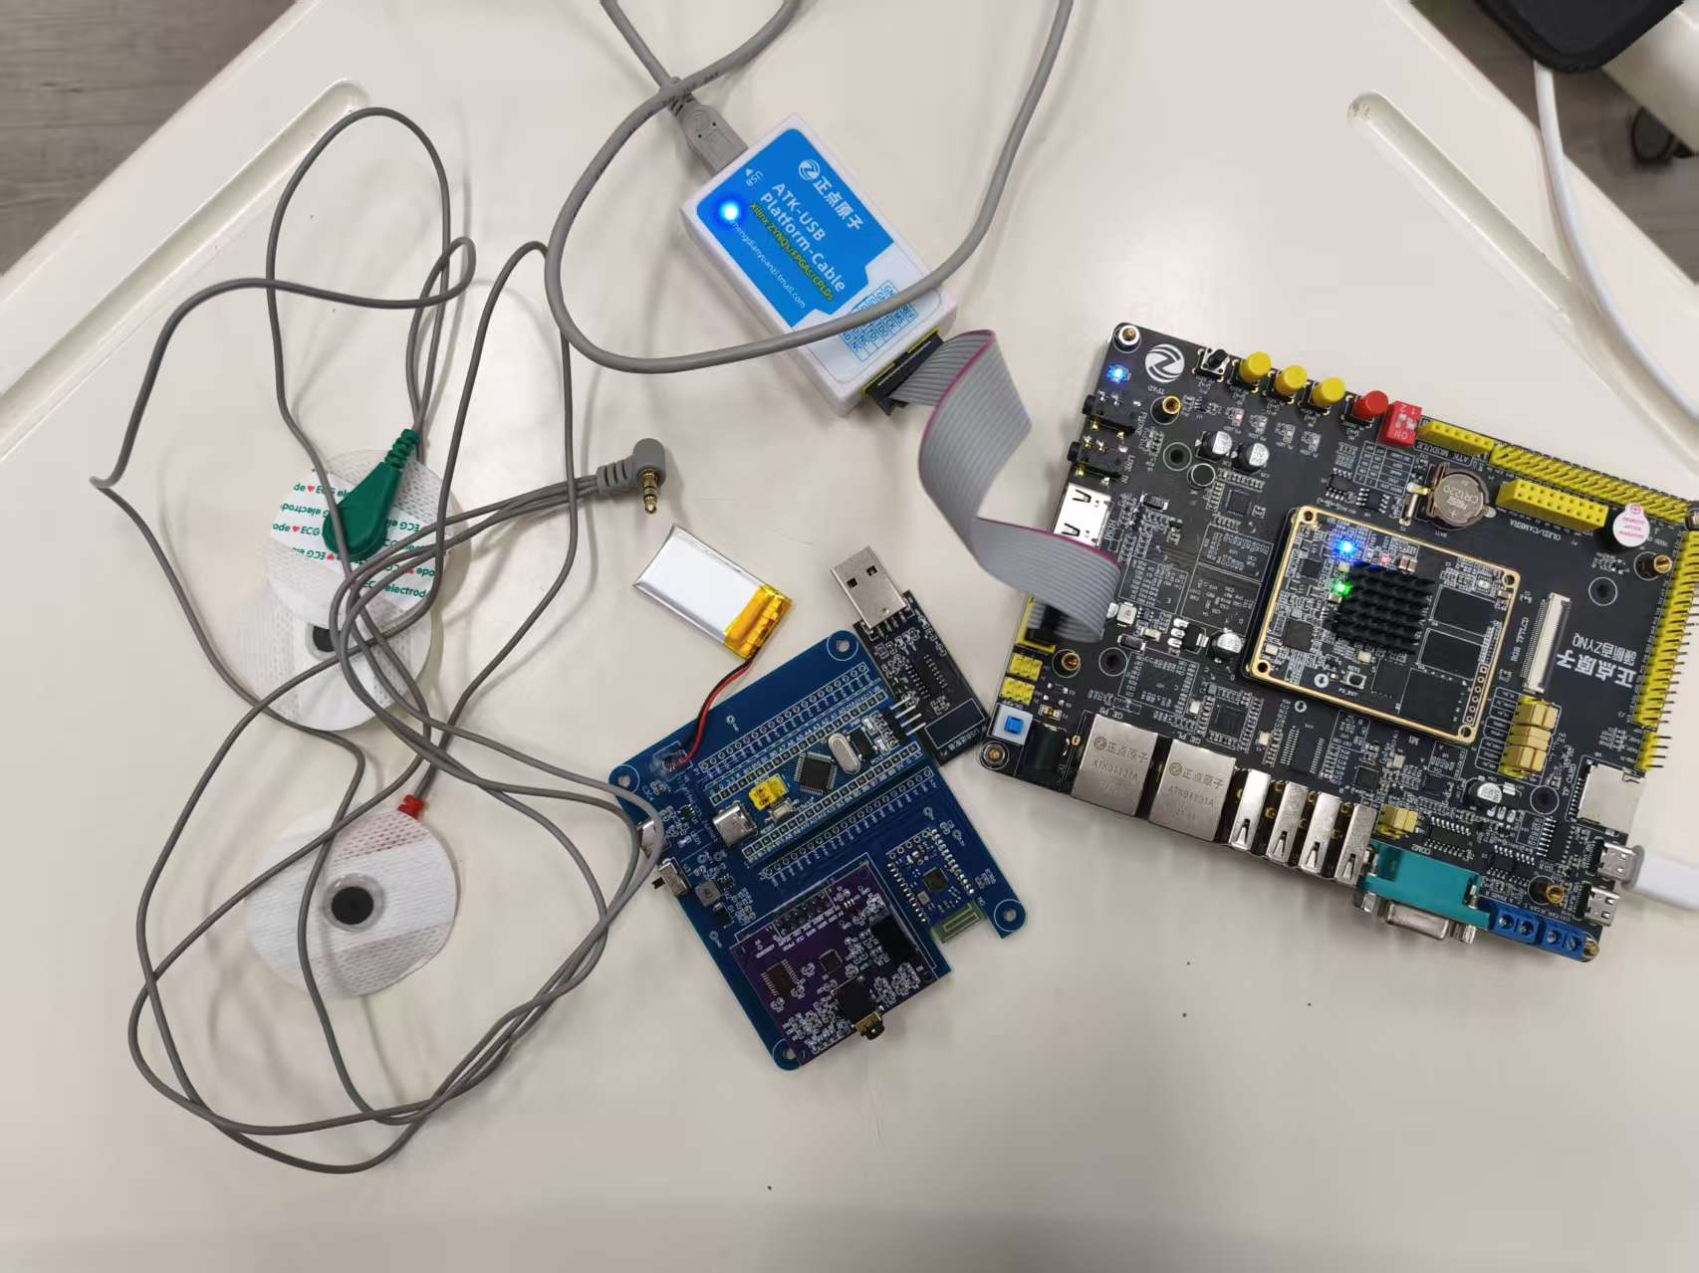

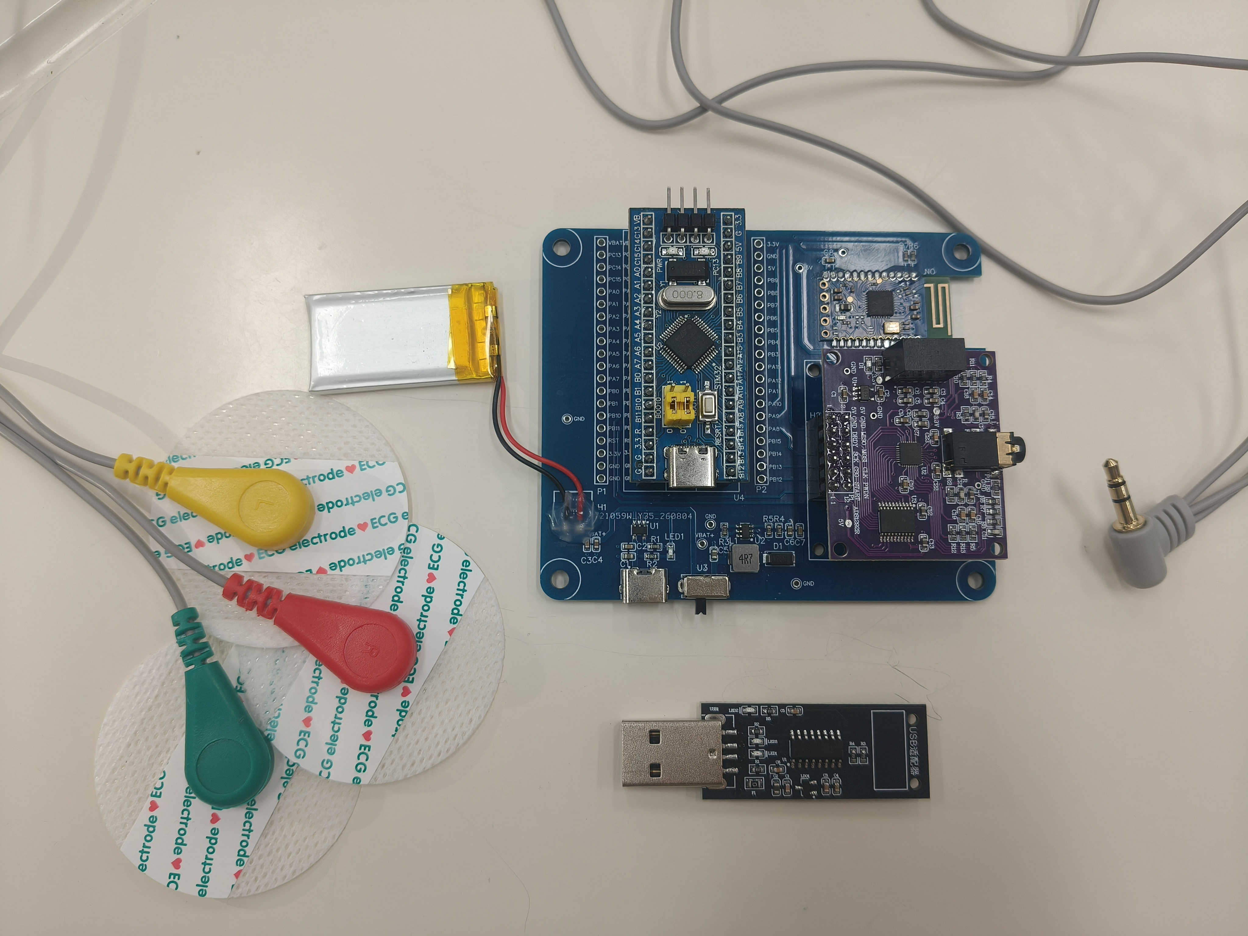


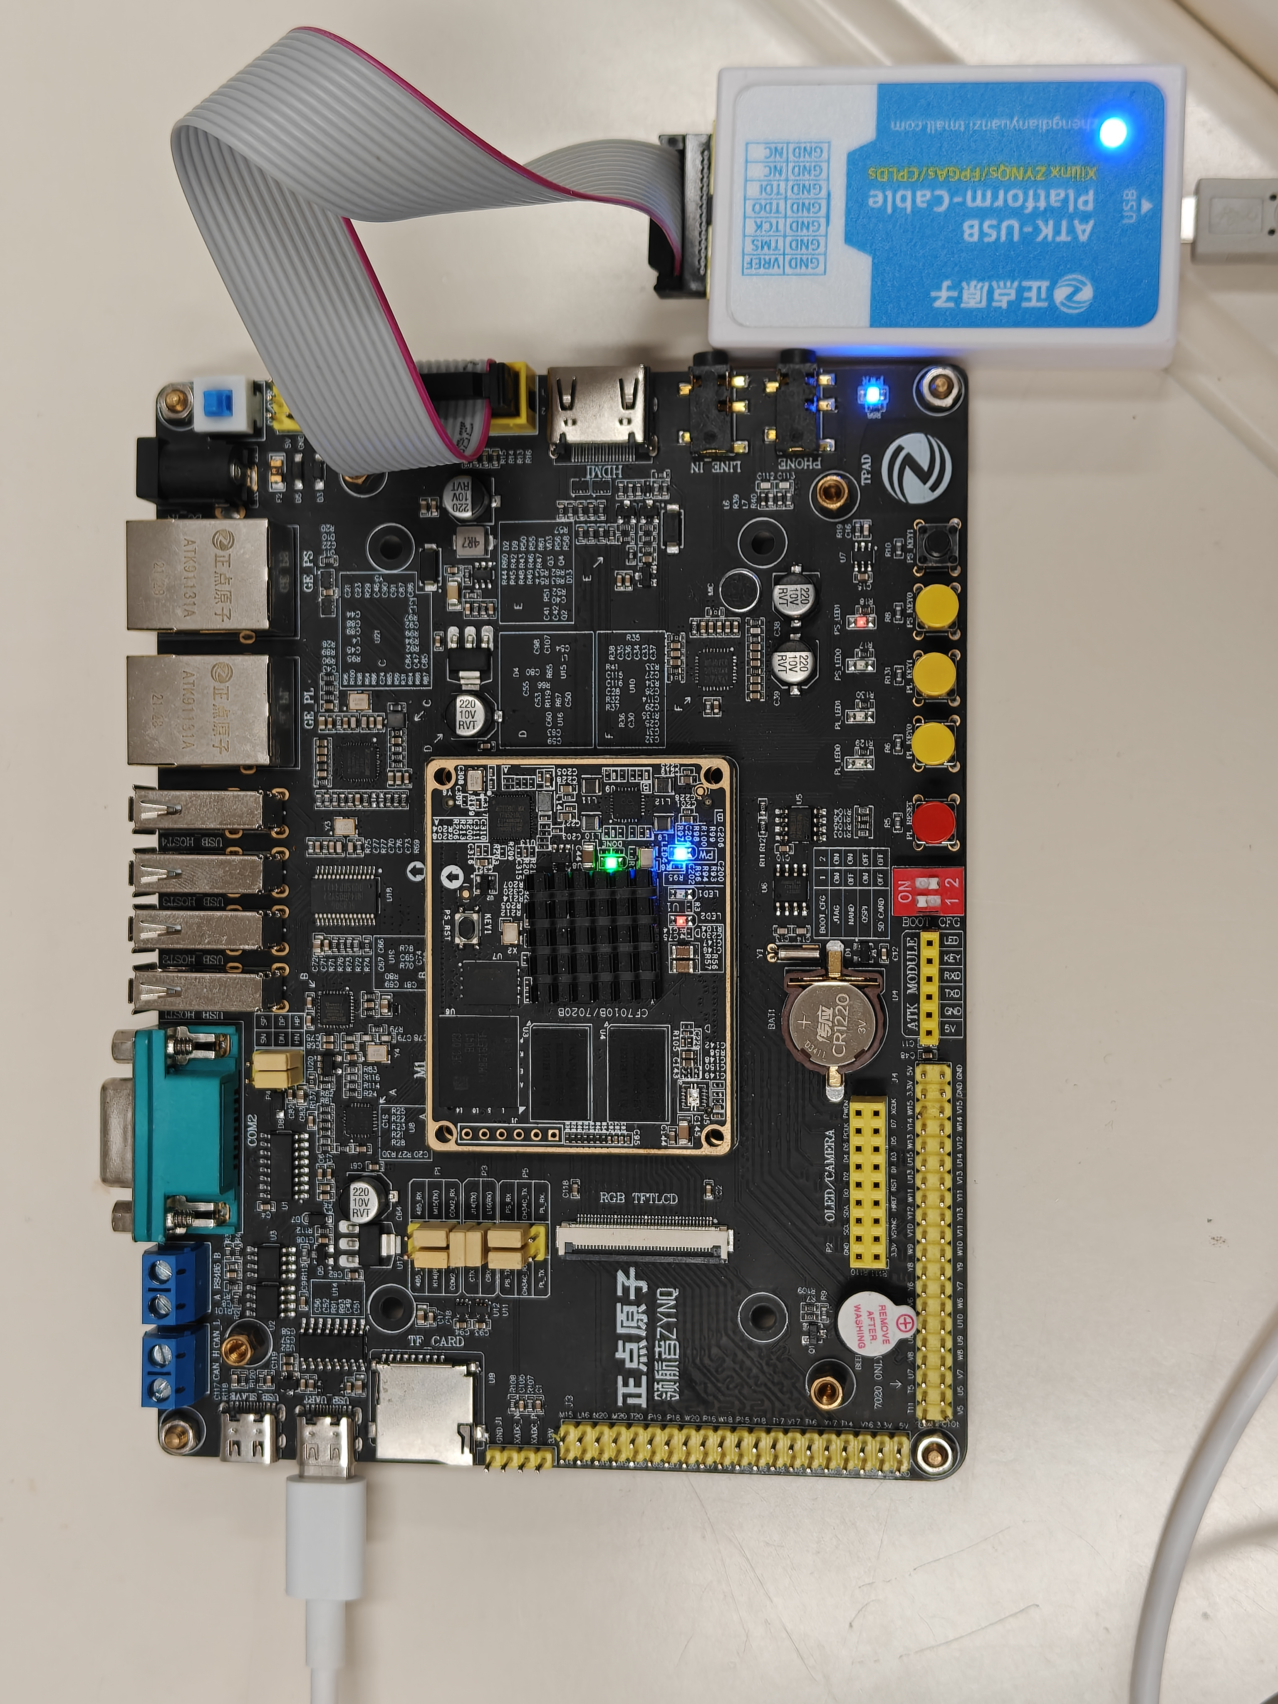
项目介绍
刘源 王兴维 曾博文
基于FPGA的心电边缘分析系统
北京邮电大学
北京
ADS1292R / STM32 / JDY-18
电脑：接收、换算、网页显示
系统实物全景
无线采集心电，Zynq完成检测与分类。
网页实时显示波形、心率及分析结果。
创新设计
实测结果
2.994×
Zynq-7020
ARM
检测、切拍、RR
FPGA
CNN / HGB 推理
CNN · FPGA调用加速
1.914×
系统架构
HGB · FPGA调用加速
ARM与FPGA协同
ARM：心拍检测、切拍及RR计算
CNN：并行乘加与流水线计算
HGB：多树并行与定点运算
结果关联源采样位置返回网页
模型 | ARM / µs | FPGA / µs
CNN | 8272.33 | 2763.25
HGB | 94.83 | 49.54
完整心电采集端
100 MHz 资源占用
500 Hz 无线心电采集
无线采集链路
ADS1292R：500 Hz双通道采样
STM32整理，JDY-18无线发送
电脑换算电压后转发Zynq
LUT 16.86% FF 8.33%
BRAM 71.79% DSP 17.27%
ADS1292R采样，STM32整理数据
JDY-18蓝牙4.2，3.7V锂电池供电
心拍检测、RR计算、板端模型推理
同板、同模型、同输入。调用含读写，不含检测、通信和显示；资源为静态实现占用。

Slide 2
INTRODUCTION
Y. Liu, X. Wang, B. Zeng
FPGA ECG Edge Analysis System
Beijing University of
Posts and Telecommunications
ADS1292R / STM32 / JDY-18
PC: receive, convert and display
Complete System Prototype
Wireless ECG. On-board analysis.
Live waveform, heart rate and beat class.
CREATIVE DESIGN
RESULTS
2.994×
Zynq-7020
ARM
QRS, windows, RR
FPGA
CNN + HGB
CNN FPGA Call Speedup
1.914×
System Architecture
HGB FPGA Call Speedup
ARM / FPGA Co-design
ARM: beat detection, windows and RR
CNN: parallel MACs and pipelining
HGB: parallel trees, fixed-point math
Results retain source sample positions
Model | ARM / µs | FPGA / µs
CNN | 8272.33 | 2763.25
HGB | 94.83 | 49.54
ECG Acquisition Hardware
100 MHz Resource Use
500 Hz Wireless ECG
Wireless Acquisition
ADS1292R: 500 Hz, two channels
STM32 frames, JDY-18 transmits
PC converts voltage and forwards data
LUT 16.86% FF 8.33%
BRAM 71.79% DSP 17.27%
ADS1292R sampling, STM32 data framing
JDY-18 Bluetooth 4.2, 3.7 V Li-ion supply
Beat detection, RR and on-board inference
Same board, models and inputs. Calls include I/O, exclude detection, serial and display. Resources are static.

