Slide 1
2.14组会
李俊彦

Slide 2

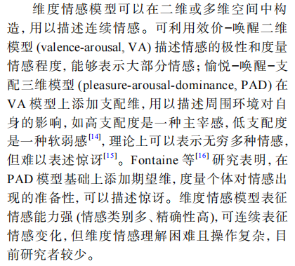
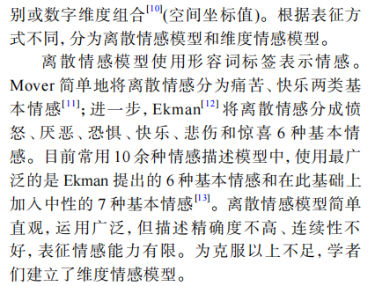

Slide 3
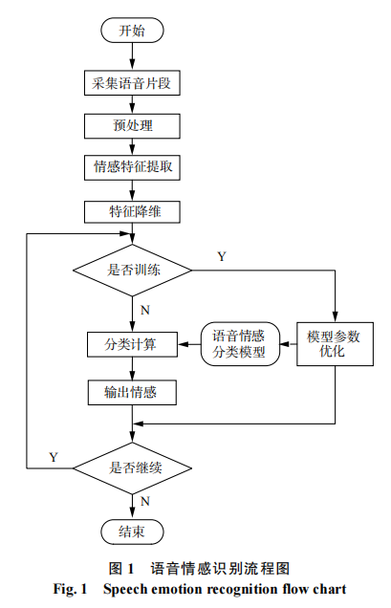
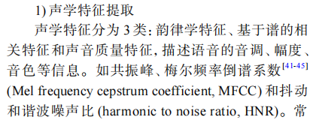
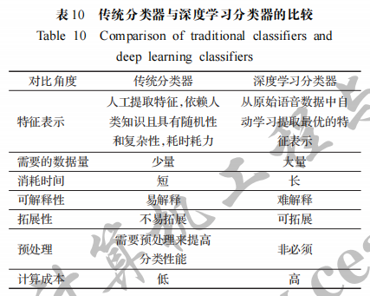
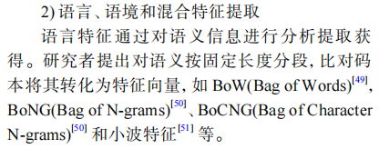
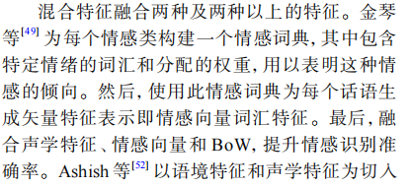
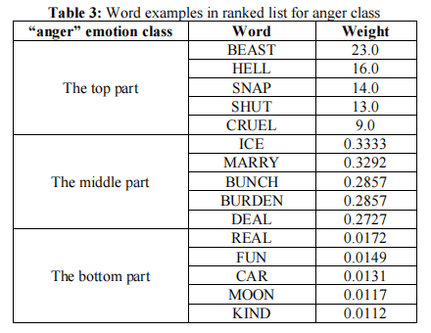

Slide 4
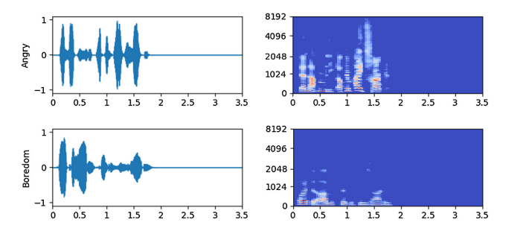
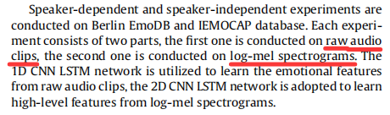
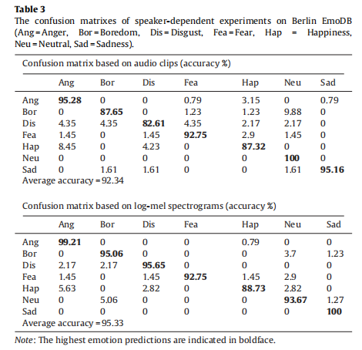
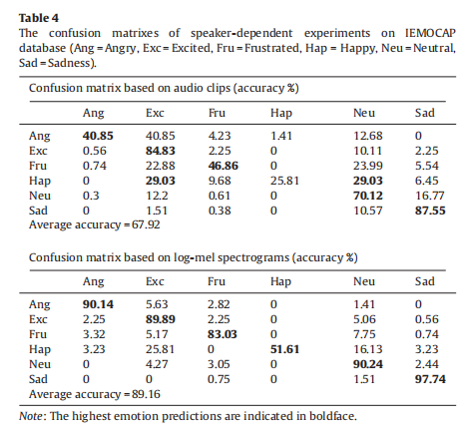
Speech emotion recognition using deep 1D & 2D CNN LSTM networks
LSTM（Long Short-Term Memory，长短期记忆网络） 是一种特殊的循环神经网络（RNN），专门设计用来解决传统 RNN 在处理长序列数据时遇到的 “梯度消失”和“梯度爆炸” 问题。
简单说：LSTM 就是一个拥有“选择性记忆”能力的智能单元，让它在处理像语音这样充满时间动态的信息时，表现远超普通神经网络。

Slide 5
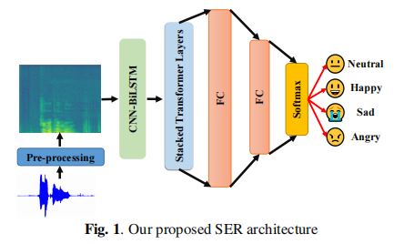
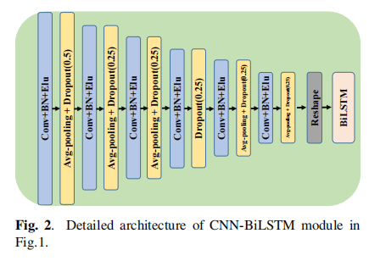
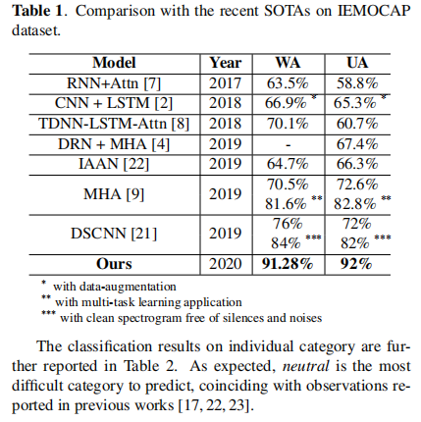
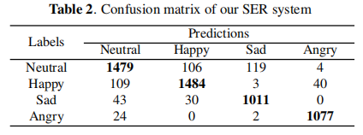
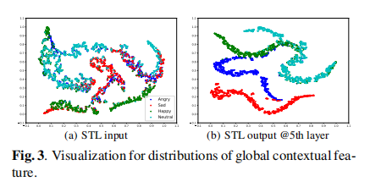
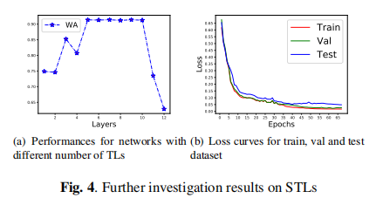
A NOVEL END-TO-END SPEECH EMOTION RECOGNITION NETWORK WITH STACKED TRANSFORMER LAYERS

Slide 6
yue_emo_speech|粤语语音数据集|情感识别数据集
该数据集从YouTube和RTHK收集，包含1,000小时的粤语语音，每段语音都被标记为以下情绪之一：愤怒、厌恶、恐惧、快乐、中性、其他、悲伤或惊讶。数据集中还包括了情绪标签的置信度。音频文件通过resemble-enhance进行了降噪处理。转录文本由SenseVoiceSmall生成，并使用MinHash去重。
JSON
[{
“audio_file”:
{
“bytes”:
{
“0”:255,
“1”:255,
...
}
},
“path”:”xxx.mp3”,
“duration”:xxx,
“label”:neutral,
“confidence”:1.0,
“text”:”素素仲留低咗一个地址记得，系曼谷嘅吞母李府。”
},
...]

Slide 7
Reference
[1]GAO Qingji, ZHAO Zhihua, XU Da, et al. Review on speech emotion recognition research[J]. CAAI transactions on
intelligent systems, 2020, 15(1): 1–13.
[2]罗德虎, 冉启武, 杨超, 等. 语音情感识别研究综述[J]. Journal of Computer Engineering & Applications, 2022, 58(21).
[3]刘振焘, 徐建平, 吴敏, 等. 语音情感特征提取及其降维方法综述[J]. 计算机学报, 2018, 41(12): 2833-2851.
[4]Jin Q, Li C, Chen S, et al. Speech emotion recognition with acoustic and lexical features[C]//2015 IEEE international conference on acoustics, speech and signal processing (ICASSP). IEEE, 2015: 4749-4753.
[5]Zhao J, Mao X, Chen L. Speech emotion recognition using deep 1D & 2D CNN LSTM networks[J]. Biomedical signal processing and control, 2019, 47: 312-323.
[6]Wang X, Wang M, Qi W, et al. A novel end-to-end speech emotion recognition network with stacked transformer layers[C]//ICASSP 2021-2021 IEEE International Conference on Acoustics, Speech and Signal Processing (ICASSP). IEEE, 2021: 6289-6293.

