Slide 1
3月24日

Slide 2
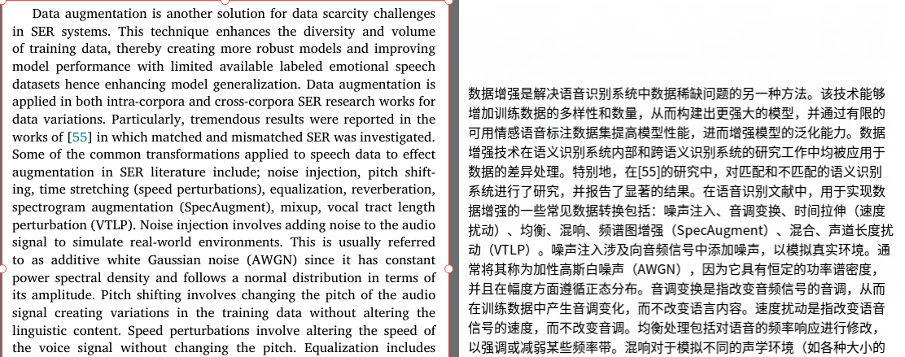
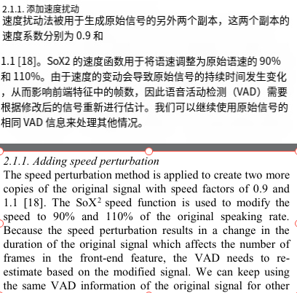
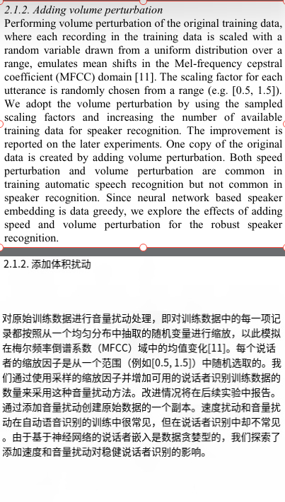
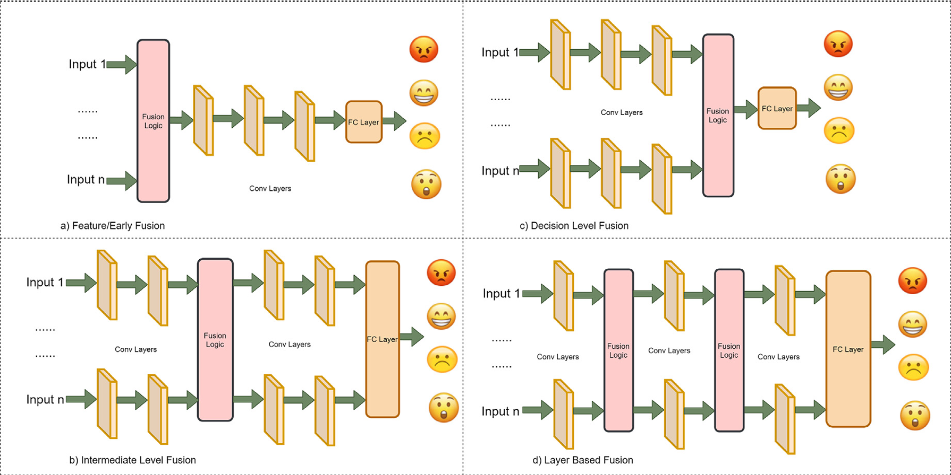
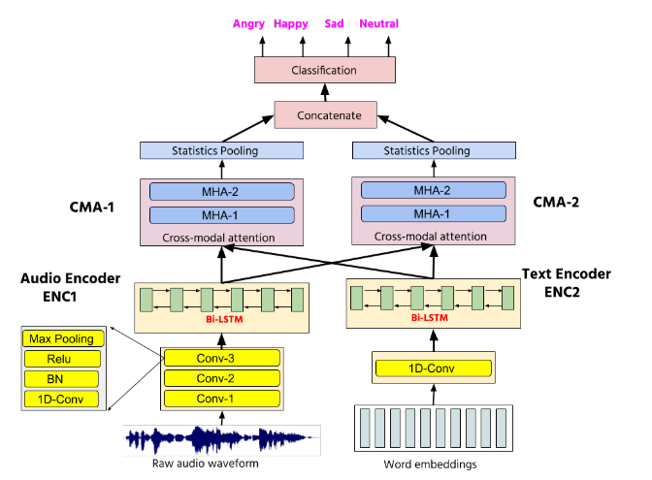
Addressing datascarcity in speech emotionrecognition:Acomprehensive review
EXPLORING EFFECTIVE DATA AUGMENTATION WITH TDNN-LSTM NEURAL NETWORK EMBEDDING FOR SPEAKER RECOGNITION
a) Early Fusion
dimensional difference -> data sparsity
b) Decision Level Fusion
heterogeneous features are not learned

Slide 3
