Slide 1
3月2日组会
李俊彦

Slide 2
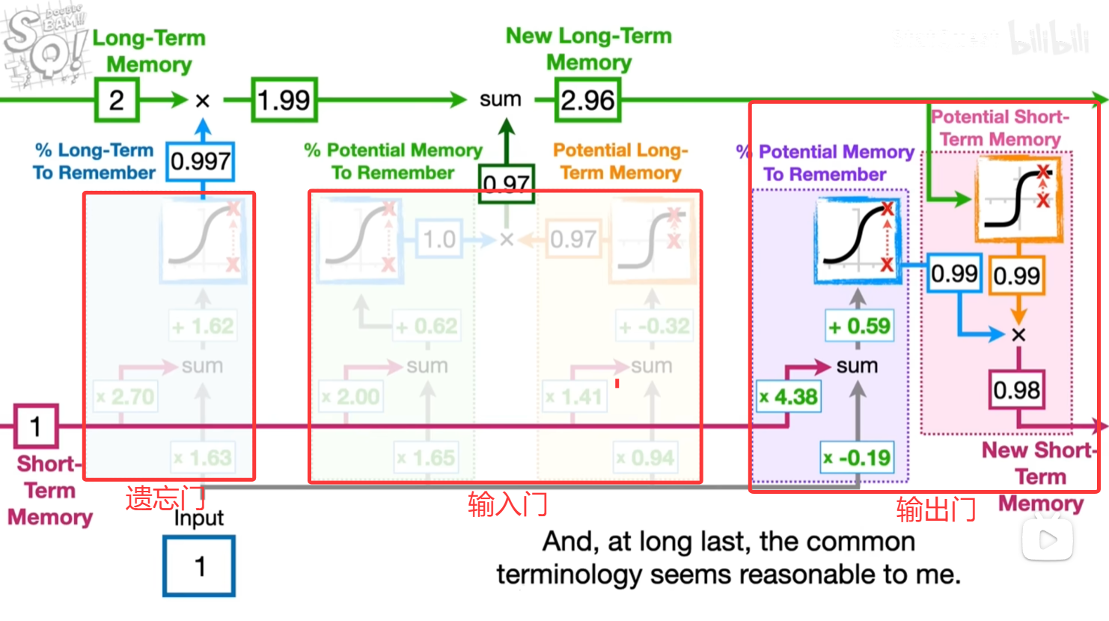
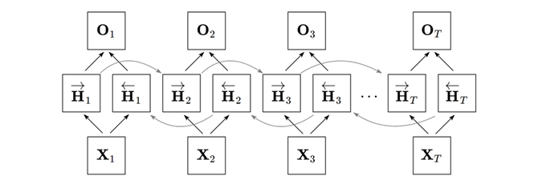



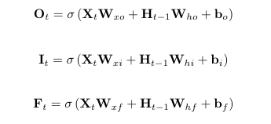

Recurrent Neural Networks (RNNs): Agentle Introduction and Overview
Long Short-Term Memory
Bidirectional RNN
适应性强，变长序列，
能记长远，解决梯度消失/爆炸
双向上下文
不能用于预测，适合提取特征

Slide 3
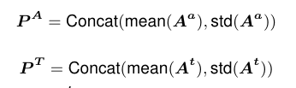
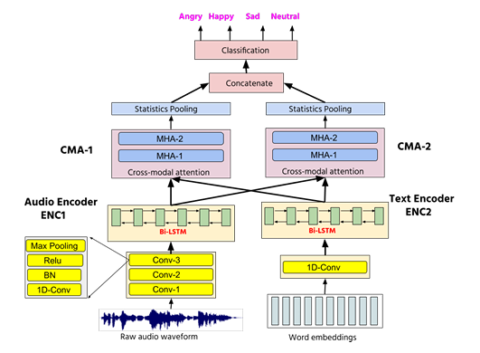
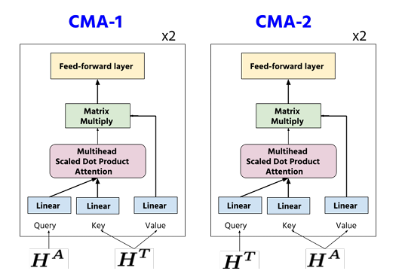
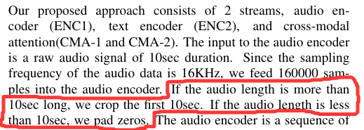
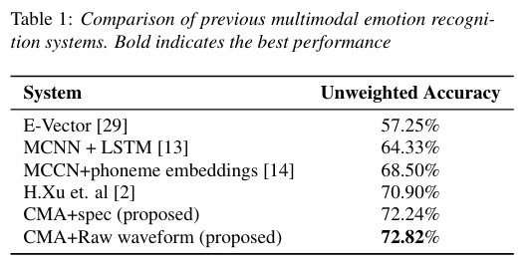
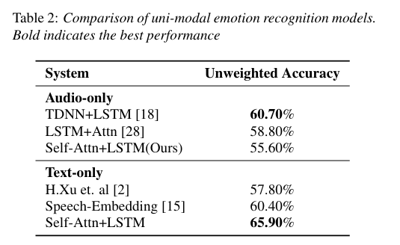
Multimodal Emotion Recognition using Cross-Modal Attention and 1D Convolutional Neural Networks

