Slide 1

A Multimodal Approach to Cantonese SER
Bridging Acoustic and Linguistic Cues with Cross-Modal Attention
Li Junyan
2026.3.24

Slide 2

目录
01.
Introduction
02.
Literature Review
03.
Methodology

Slide 3
Introduction
This project addresses the critical gap in Speech Emotion Recognition (SER) for Cantonese, a tonal language where emotion is deeply intertwined with linguistic and cultural nuances.

Slide 4
Research Background
The Need for Culturally-Aware SER
01
Human-Computer Interaction
Emotionally aware voice interaction is central to natural and efficient human-computer interfaces, enhancing user experience in intelligent devices.
02
Affective Computing Core
SER is a core technology in affective computing, aiming to automatically infer a speaker's emotional state from acoustic and prosodic features.
03
The unique challenges of Cantonese
Cantonese emotion expression is deeply intertwined with tone perturbation, sentence-final particles, and context-driven prosody, rendering generic models less effective.

Slide 5
Project Aim
Two Primary Objectives
Develop a Multimodal Framework
Create a multimodal acoustic-text fusion framework that leverages ground-truth transcripts and pretrained Cantonese language models to complement deep acoustic modeling.
01
Conduct First Systematic Evaluation
Perform the first systematic evaluation of hybrid architectures (CNN-BiLSTM + Cross-Modal Attention) on a real-world Cantonese emotional speech dataset.
02

Slide 6
Literature Review
We situate our work at the intersection of deep learning for SER and the unique challenges of tonal languages, identifying a significant gap in existing research.

Slide 7
Evolution of SER
From Handcrafted Features to Deep Learning
01
Early Work
02
Deep Learning Advances
03
Limitations in Tonal Contexts
Since the 1970s, SER has evolved from handcrafted feature engineering, with Williams et al. first identifying the correlation between pitch contours and emotional states.
Recent advances, particularly CNNs, RNNs, and Transformers, have significantly improved SER performance in major languages like English and Mandarin.
However, these models often overlook emotion cues embedded in linguistic content, which is critical in tonal languages like Cantonese.

Slide 8
Gap in Cantonese SER
A Linguistically Unique Setting
1
2
3
Lack of Research
Insufficient Data
No Systematic Evaluation
Compared to Mandarin and English, research on Cantonese SER remains largely underexplored, despite it being a major dialect spoken by over 80 million people.
Publicly available, well-annotated Cantonese emotional speech corpora are scarce, hindering the development of data-driven models.
There is a lack of systematic evaluation of state-of-the-art models in this domain, creating a barrier for culturally adaptive affective technologies.

Slide 9
Our Key Innovation
Introducing Cross-Modal Attention for Cantonese
01
02
03
Multimodal Fusion
Cross-Modal Attention (CMA)
Linguistic Grounding
We address the limitations of single-modality models by fusing acoustic and textual information, capturing both "what is said" and "how it is said".
Our approach, inspired by Krishna and Patil (2020), uses CMA to dynamically align acoustic and textual representations, which is crucial for capturing tone-based emotions.
By using ground-truth transcripts and Cantonese-BERT, we ensure the text modality is linguistically grounded, providing rich semantic cues.

Slide 10
Methodology
Our methodology comprises three core components: data preprocessing, model development with a dual-track approach, and systematic evaluation.

Slide 11
Data Preprocessing
Enhancing Robustness and Balance
Speed Perturbation
01
Volume Perturbation
02
Class Balancing
03
Generate additional samples at 0.9× and 1.1× original speed using `sox` to simulate different speaking rates while preserving pitch.
Randomly scale audio amplitude within [0.5, 1.5] to simulate real-world recording variations and improve model robustness.
Perform oversampling on minority emotion categories (e.g., angry, sad) to create a balanced training set, mitigating bias towards dominant classes like "neutral".

Slide 12
Model Development: Dual-Track
Two Complementary Architectures
1
2
Track 1: Acoustic-Text Fusion
Track 2: Cross-Modal Attention
This track processes audio into log-mel spectrograms and extracts acoustic embeddings using a 2D CNN-BiLSTM. The ground-truth text is encoded by Cantonese-BERT. These embeddings are fused via late fusion with a learnable gating mechanism.
This track implements the CMA framework. An audio encoder (ENC1) and a text encoder (ENC2) process their respective inputs. Two parallel CMA blocks (CMA-1 & CMA-2) enable bidirectional information flow between modalities.

Slide 13
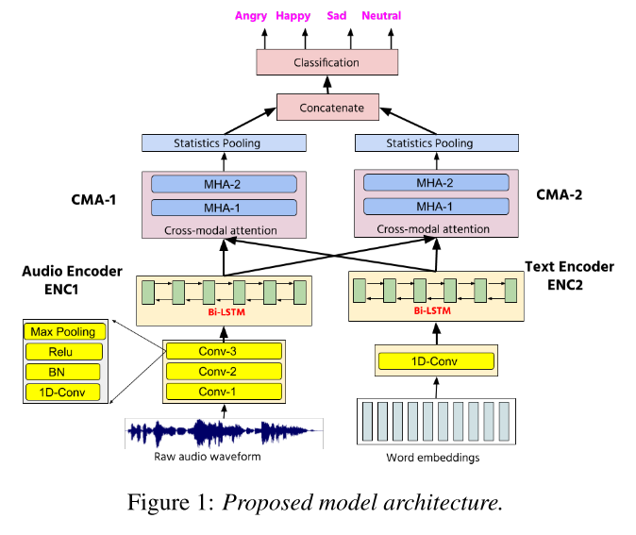
Model Architecture (Track 2)

Slide 14
Evaluation Protocol
Ensuring Rigorous and Fair Comparison
1
Evaluation Metric
3
Baseline Models
Use Unweighted Average Recall (UAR) as the primary metric to fairly evaluate model performance on the imbalanced dataset.
Compare against strong baselines, including fine-tuned Wav2Vec 2.0 and a monolingual CNN-LSTM model.
2
Cross-Validation
4
Statistical Significance
Employ speaker-independent 5-fold cross-validation to ensure the generalizability and reliability of the model evaluation.
Assess the statistical significance of performance differences using paired t-tests (p < 0.05).

Slide 15
Thank you!
Li Junyan
2026.3.24

