Slide 1
Kotlin
For Happy Development

Slide 2
Sazzad Islam
Sr Software Engineer @ DSi
@szlynas
#github.com/lynas/Kotlin-Presentation
#youtube.com/user/szLynAs/videos

Slide 3
What is Kotlin?
Statically typed language
Started 2010
Jetbrains tooling
Open source
Apache 2
Android friendly
Complete interoperable with JAVA
Easy ramp up
Small runtime
Who using it ?
Google, Expedia, NBC News, Netflix, Amex

Slide 4


Slide 5
How Can I use It
Ant
Maven
Gradle
Kobalt
Intellij IDEA
Android Studio
Eclipse
Netbeans
Command line
Vim
Emacs

Slide 6
public class Main {
public static void main(String[] args) {
System.out.println("Hello world");
}
}
fun main(args: Array<String>) {
println("Hello world”)
}

Slide 7
public class PersonInJava {
private int id;
private String name;
public PersonInJava(int id, String name) {
this.id = id;
this.name = name;
}
public int getId() {
return id;
}
public void setId(int id) {
this.id = id;
}
public String getName() {
return name;
}
public void setName(String name) {
this.name = name;
}
}
JAVA
Kotlin
class PersonInKotlin (var id: Int, var name:String)

Slide 8
public class PersonInJava {
private int id;
private String name;
public PersonInJava(int id, String name) {
this.id = id;
this.name = name;
}
public int getId() {
return id;
}
public void setId(int id) {
this.id = id;
}
public String getName() {
return name;
}
public void setName(String name) {
this.name = name;
}
@Override
public boolean equals(Object o) {
if (this == o) return true;
if (o == null || getClass() != o.getClass()) return false;
PersonInJava that = (PersonInJava) o;
if (id != that.id) return false;
return name.equals(that.name);
}
@Override
public int hashCode() {
int result = id;
result = 31 * result + name.hashCode();
return result;
}
}
JAVA
Kotlin
data class PersonInKotlin (var id: Int, var name:String)

Slide 9
Val / Var
data class PersonIn (val id: Int, val name:String)
data class PersonIn (var id: Int, var name:String)
val name = “GOT”
name = “IGI” <- compile error

Slide 10
val person2 = Person(name = "Sazzad", id = 2)
Creating Object
data class Person(var id: Int, var name:String)
val person = Person(1, “Sazzad")

Slide 11
data class Person(var id: Int=0, var name:String=“”)
val person = Person()
person.id = 10
Default Parameter
val person2 = person.copy()
val person3 = person.copy(id=20)

Slide 12
fun printPersonName(name: String) {
println(name)
}
Null Safety
fun personJava(person: Person?) {
if (person?.name != null) {
printPersonName(person.name)
}
}

Slide 13
Function / Method
fun printMe(name: String) {
println(name)
}
fun addNumbers(num1:Int, num2:Int) : Int {
return num1 + num2
}
fun addNumbers(num1:Int, num2:Int) = num1 + num2
fun unlimited(vararg numbers: Int) {
for (number in numbers) {
}
}
unlimited(1,2,3,4)

Slide 14
fun testPair() : Pair<Int, Int>{
return Pair(1,2)
}
Function / Method
fun testTriple() : Triple<String, String, Int>{
return Triple(“name"," address”, 44)
}
val list = listOf(Pair("dhaka", "Bangladesh"), "delli" to "india")
for (item in list) {
println(item.first)
println(item.second)
}
for ((city, country) in list) {
}

Slide 15
fun String.hello() {
println("Hey String")
}
val name : String = “SAZZAD”
println(name.hello())
println(“”.hello())
Extension Function
fun String.shouldEqual(value: String) = value == this
“this".shouldEqual("this")
infix fun String.shouldEqual(value: String) = value == this
“this" shouldEqual “this”

Slide 16
Higher Order Function
fun higherOrder(func: (Int, Int) -> Int) {
println(func(2, 3))
}
fun using(obj: Closeable,
action: () -> Unit) {
try {
action()
} finally {
obj.close()
}
}
using(closableObject) {
}
fun mySum(x: Int, y: Int): Int {
return x + y
}
higherOrder(::mySum)
higherOrder {
x, y ->
x + y
}

Slide 17
fun conditionTest1(input: Int) {
if (input > 100) {
println("GT")
} else {
println("LT")
}
}
CONDITION
fun conditionTest1(input: Int) {
val result = if (input > 100) {
"GT"
} else {
"LT"
}
println(result)
}

Slide 18
fun validVacation(person: Person) {
if (person is Employee) {
if (person.vacationDays < 20) {
println("You need some more time off!!")
}
}
}
CLASS / INHERITANCE
open class Person
class Employee(val vacationDays : Int) : Person()
class Contractor : Person()

Slide 19
And many more …

Slide 20
ANKO
relativeLayout{
editText{
id = 1
hint = "name"
textSize = 24f
}.lparams{
alignParentTop()
alignParentLeft()
alignParentRight()
}
editText{
id = 2
hint = "age"
}.lparams {
below(1)
alignParentLeft()
leftOf(3)
}
}

Slide 21
ANDROID EXTENSION
TextView textView = ( TextView ) findViewById(R.id.textView)
textView.setText(“Hello World”)
Instead
textView.setText(“Hello World”)

Slide 22
All open plugin
set certain annotation based class to open

Slide 23
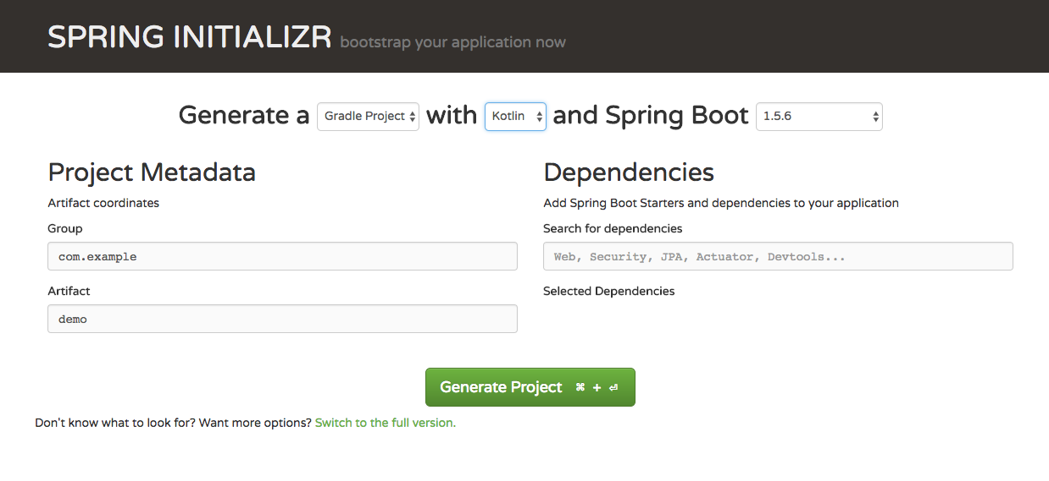
Spring Boot

Slide 24
Coming next
Coroutines
Java 9 support
Kotlin native

Slide 25
Next Step
kotlinlang.org
try.kotlinlang.org
kotlin koans

Slide 26
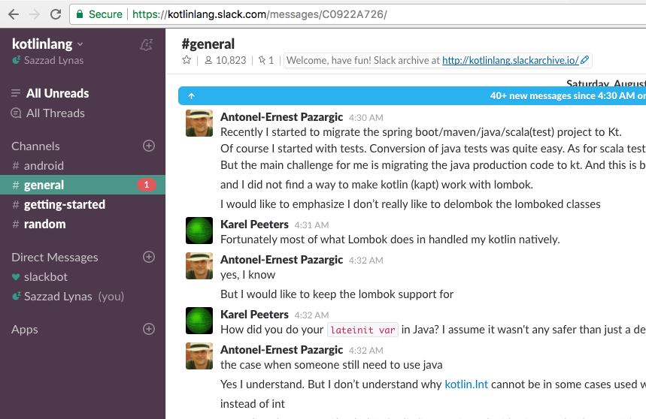
Community

Slide 27
Thank you

