Slide 1
Algebra Game (Graspable Math)
Laxmi Bhavani Malkareddy
Liping Sun
Prasandeep Singh
Rohith Nedunuri
Sameedha Bairagi
Shree Harsha Sridharamurthy
CSCI-P632 Object Oriented Software Management

Slide 2
Agenda
Meeting with Client
Create Git Issues to Ask for GM API Clarifications
Redesign the Game According to Customer’s Feedback
Clarify Details of Our Game
Implement on the Dino Game
Next steps

Slide 3
Meeting with Client
What we done:
Show five game ideas with our client and a short demo
Ask for more GM API codes to implement features we want
Client Opinion
Prefer Dino Egg and Tic Tac Toe Game
Try to make sure Math is the heart, not annoying part
Make it easy and appealing to children
Sketch details on the Game
Make prototype with easy level and advanced level

Slide 4
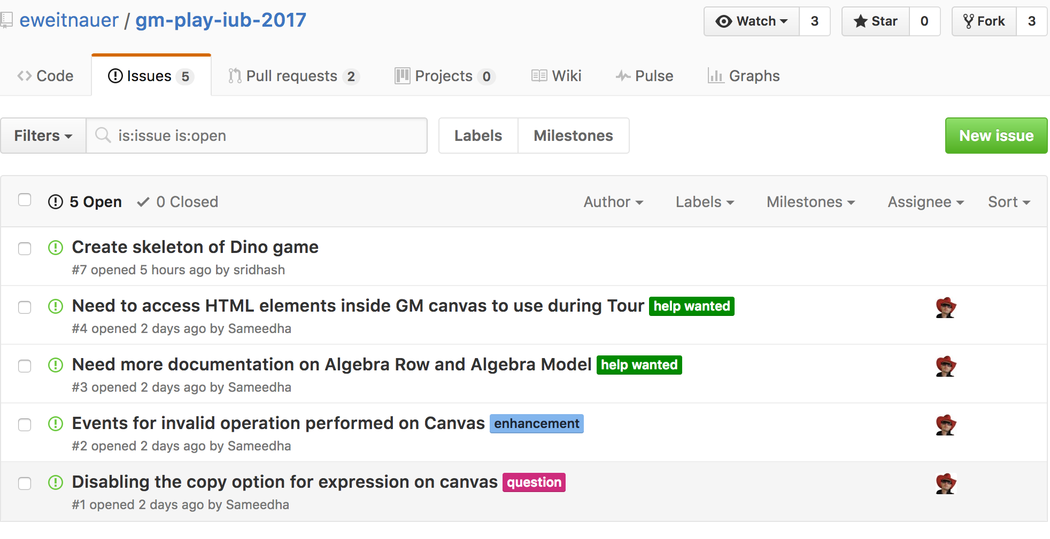
Git Issues

Slide 5
Clarify Details and Redesign Our Game
Sketch here easy level

Slide 6
Clarify Details and Redesign Our Game
Sketch Advanced Level

Slide 7
Implement Dino Egg Game
demo

Slide 8
Next Steps
Meet clients with proposed ideas
Finalize the idea to be implemented
Start work on the finalized idea

Slide 9
Communication Tools
Git
Whats App, Skype
Picture of Sameedha screenshot

Slide 10
Thank you! ☺

