Slide 1
Big Mountain Ski Resort
Business Analysis & Advising

Slide 2
Feasibility, Analysis & Factors of Resort Pricing Increase
The business (Big Mountain Ski Resort) needs to better understand and utilize data to identify the optimal price range for their facilities while taking into account the amount of ski lifts they have and all other components the resort offers that customers value most.
Increasing their ticket pricing but understanding the whole ski resort market and what each facility offers and what customers are willing to pay. Also potentially cutting costs while not undermining the increased ticket price.
Goals:
Provide insight to what sets “Big Mountain Ski Resort” apart from other competitors.
What are the most valuable components to “Big Mountain Ski Resort”.
How “Big Mountain Ski Resort” assets or liabilities affect revenue.
Main Goal:
What is the optimal price that “Big Mountain Ski Resort” can and should be charging given the value they offer & what can they increase their ticket price to from the current $81 level.

Slide 3
Feasibility, Analysis & Factors of Resort Pricing Increase
Challenges:
Proven criteria & data supporting higher ticket pricing
Correlating resort pricing within the industry based on each facilities value offers and overall price.
Measuring the incremental value of each ski resorts asset such as; ski lifts and overall mountain optimization.
Identifying & providing data backed insight into why or why not “Big Mountain Ski Resort” should increase or decrease their ticket price and to what exact number or within what range.
Data and accuracy of other ski resort prices based on features and assets.

Slide 4
Recommendations and Key Findings
Features that came up as important in the modeling (not just our final, random forest model) included:
vertical_drop
Snow Making_ac
total_chairs
fastQuads
Runs
LongestRun_mi
trams
SkiableTerrain_ac
Big Mountain Resort modelled price is $93.14, actual current price is $81.00.
Even with the expected mean absolute error of $10.21, this suggests there is room for an increase.

Slide 5
Modeling Results and Analysis (Data)
Data Outcomes & Modeling Mission:
Big Mountain suspects it may not be maximizing its returns, relative to its position in the market. It also does not have a strong sense of what facilities matter most to visitors, particularly which ones they're most likely to pay more for.
This project aims to build a predictive model for ticket price based on a number of facilities, or properties, boasted by resorts (at the resorts).
This model will be used to provide guidance for Big Mountain's pricing and future facility investment plans.
Big Mountain Resort modelled price is $93.14, actual current price is $81.00.
Even with the expected mean absolute error of $10.21, this suggests there is room for an increase.

Slide 6
Modeling Results
Scenario 1 results; the model says closing one run makes no difference. Closing 2 and 3 successively reduces support for ticket price and so revenue. If Big Mountain closes down 3 runs, it seems they may as well close down 4 or 5 as there's no further loss in ticket price. Increasing the closures down to 6 or more runs leads to a large drop.
The Model suggests that the current price of Big Mountain Ski resort tickets is low in comparison to the market and features of the mountain. Big Mountains current price of $81.00, could be increased to $93.14 derived from the model predicting the price based on historical data and features of other resorts.
Scenario 2, 3, 4, results; Big Mountain is adding a run, increasing the vertical drop by 150 feet, and installing an additional chair lift.
The above scenario model suggests: increased support for ticket price raise by $2.55
Over the season, this could be expected to amount to $4,454,545.

Slide 7
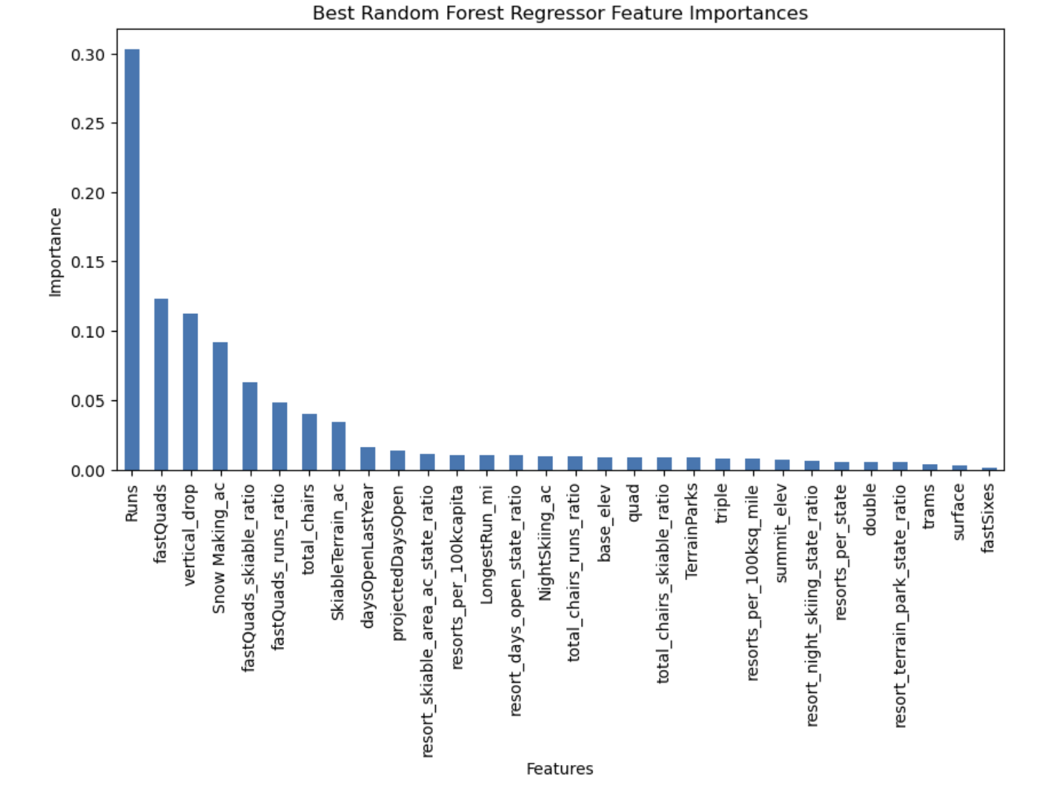
Modeling Visualization - Resort Features/Assets
Top Resort Features:
Runs
Fast Quads
Vertical Drop
Snow Making

Slide 8
Modeling Interpretation
Scenario 2, 3, 4 Feature Testing:
Big Mountain is adding a run, increasing the vertical drop by 150 feet, and installing an additional chair lift.
The above scenario model suggests: increased support for ticket price raise by $2.55
Over the season, this could be expected to amount to $4,454,545.
Model Analysis & Results
The modelled price of $93.14 is based on historical data and features of other resorts.
The actual price of $81.00 is the current price charged by Big Mountain Resort.
The mean absolute error (MAE) of $10.21 indicates the average deviation of the model's predictions from the actual prices in the training data.
Scenario 1 Feature testing,
Gauging the value of Big Mountain chair lifts and stress testing the closure of chair lifts. The model suggests the closure of 6 chair lifts will dramatically affect ticket price and what customers are willing to pay dropping the price significantly and will have a negative impact on revenue.

Slide 9
Big Mountain Model Analysis Assets & Pricing Conclusion
Scenario’ Analysis Recommendations:
Adding a run, increasing the vertical drop by 150 feet, and installing an additional chair lift = This scenario increases support for ticket price by $2.55. Over the season, this could be expected to amount to $4,454,545.
The other scenarios(Additional Snow making of 2 acres & increase longest run by .2 miles) suggested no measurable impact on price increase or decrease.
Model Results & Impact of Recommendations:
The current price of $81.00 should be increased to $93.14; derived from the model predicting the price based on historical data and features of other resorts.
The mean absolute error (MAE) of $10.21 indicates the average deviation of the model's predictions from the actual prices in the training data suggesting that there may be room for increase or decrease in the modelled price, even still suggesting that Big Mountain Ski resort is currently underpriced @ $81.00 and my recommendation is with the addition of adding a run, increasing the vertical drop by 150 feet, and installing an additional chair lift that Big Mountain Ski Resort increase their ticket price to a fair and profitable $93.14

