Slide 1

Opioid Sales Increased 400% in a Decade
In 2011, the Average US Pharmacy filled 73,000 Oxycodone Prescriptions¹
In 2012, 259 Million Opioid Prescriptions were Filled representing sales of more than $10B²
Enough for Every Adult American to have a Bottle
Every Year Over 9 Billion Hydrocodone Pills Prescribed in the US. 99% of these pills are consumed in the US.
Every 16 Months enough pills go Unused to Encircle the Earth
Vast Pools of Unused Prescribed Opioids are a Liability

Slide 2
Meanwhile, Opioid Abuse Grew 300%
329,000 New Patients are Diagnosed with Opioid Addiction Each Year³
2.1 Million Americans are Addicted to Opioids⁴
Every Month, 7 Million Americans Take Prescription Pain Medication for Non-Medical Use⁵
70% of Opioid Abusers Obtained the Drugs from Friends or Family⁶
Unused Prescription Opioids Fuel Recreational Use

Slide 3
Significant Societal Cost of Opioid Abuse
Since 2011, Drug Overdose is the Leading Cause of Death⁷
greater than car accidents and homicide
Every 15 Minutes, one American Dies of an Overdose⁸
Overdose Rates in the US have More Than Tripled Since 1990⁹
In 2007, Opioid Abuse Cost the US Economy $55.7 Billion¹⁰
No Good Solution Exists to Prevent Opioid Diversion

Slide 4
Take Back Programs are Unproven
The True Costs and Effectiveness are Unknown
According to a Recent Study by Carnevale Associates¹¹:
Assessing Takebacks: Little is Known
Despite their proliferation, little data is available on the impact and effectiveness of takeback programs. In fact, no research has been conducted to investigate takebacks’ effect on prescription drug abuse.
… In addition, we found no evidence that takeback programs affect prescription drug abuse. We conclude that additional research is needed before incorporating takebacks into any substance abuse prevention plan.
What if Patients had a Convenient Disposal System at Home?

Slide 5
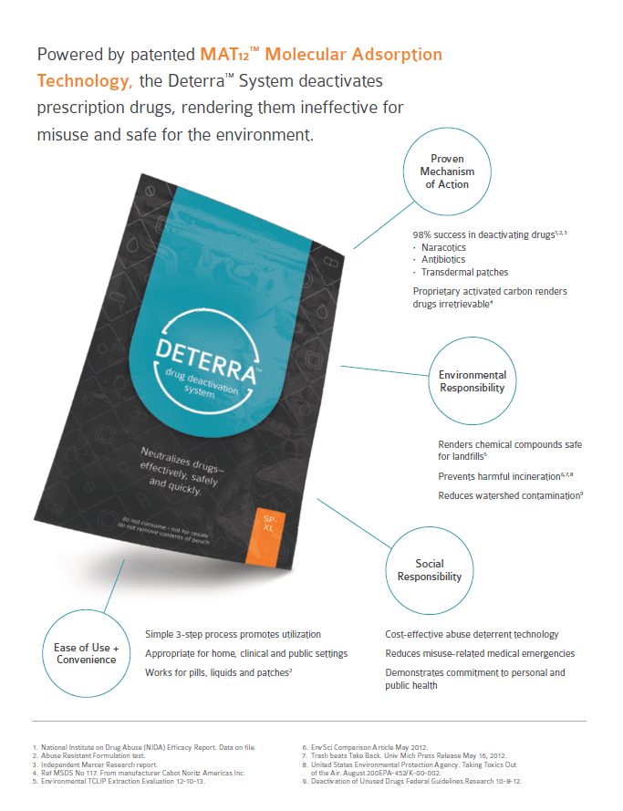
Introducing Deterra

Slide 6
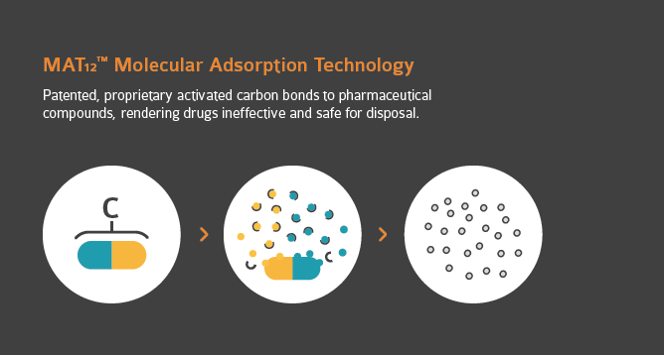
Patented Mat₁₂ Technology

Slide 7
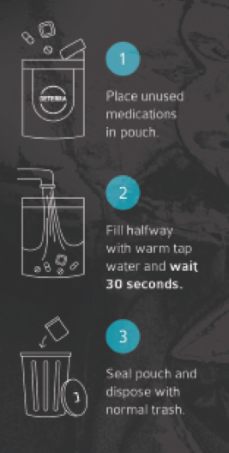
Easy to Use, Cost Effective, Safe
Convenient, Easy to Use Solution Fosters Consumer Compliance
Cost Effective Package Ensures Economic Feasibility
Patented Deactivation Technology Enables Environmentally Safe Disposal

Slide 8
Sources
1. 2013 pain medicine news http://www.painmedicinenews.com/ViewArticle.aspx?d=Policy%2B%26%2BManagement&d_id=83&i=March+2013&i_id=935&a_id=22628
2. http://www.cdc.gov/injury/wisqars/fatal.html (2014)
3. 2002-2012 Treatment Episode Data Set (TEDS)
4. In 2012, the National Institute on Drug Abuse estimated that 2.1 million Americans live with opioid pain reliever addiction and 467,000 are addicted to heroin.
5. (SAMHSA) 2010 National Survey on Drug Use and Health (NSDUH)
6. SAMHSA, Center for Behavioral Health Statistics and Quality: Results from the 2012 National Survey on Drug Use and Health
8. Cardinal Health, GenerationRx , http://cardinalhealth.mediaroom.com/download/GenerationRx+infographic+-+printable.pdf
7. According to statistics from the Centers for Disease Control and Prevention’s Wide-ranging OnLine Data for Epidemiologic Research (CDC Wonder), drug overdose was the leading cause of injury death in 2011, killing more than car accidents and homicide.
9. National Vital Statistics System. Drug Overdose death rates by state 2008
10. Birnbaum HG, White AG, Schiller M, Waldman T, Cleveland JM, and Roland CL. Societal costs of prescription opioid abuse, dependence, and misuse in the United States. Pain Medicine 2011; 12: 657-667
11. http://www.carnevaleassociates.com/takebacks

