Slide 1


Slide 2
Agenda
Current State of the Business
Go-Forward Plan
Mobile Product Demonstration
Wrap Up

Slide 3
State of the Business
Volerro has two Product Offerings:
Volerro Agile Marketing Tool
$8 per seat/month
Drives All Current Revenue
Loved by Agile Marketing Teams
Not Enough Agile Marketing Teams to Drive Growth
Revu.me Sales Presentation Tool (new)
$19.99 per seat/month
Designed for Sales Teams who Present on:
In Person on Mobile Devices
Remotely Over the Web
Eliminates Screen Sharing Headaches

Slide 4
Commercial Status
US Bank Renewed for 775 Seats
Brings in $48k lump sum in late May/June
All other customers bring in about $5k
US Bank Deal Funds Operations until April 2016
Network Operating Costs for All Customers = $30k
Estimated Developer Support Expense = $20k
Reinstate Delaware Good Standing Status
Estimated Cost = $2500-$4000

Slide 5
Steps Taken to Rebuild
Returned to the Business in September
Existing Customers Intact
Development and Sales Teams Had Moved On
Still willing to do work on the side to help (until end of 2014)
We Had Significant Barriers to Strategic Sale
Can’t Sell a Tech Asset with No Development Team
Mobile Apps are now Table Stakes – Ours Was Not Done
No Capital & No Team
Solution:
I would become the development team
I’d build the mobile app with a focus on Sales Engagement

Slide 6
Go-Forward Plan
Maintain US Bank Account
Need Former Developers to Help Me Transition
Goal: Kevin is able to maintain the Volerro App
This should happen by the end of July
Launch the Revu.me Mobile App
Web App and IOS Mobile App in May
Redo Revu.me Website to Reflect Mobile Focus
Android App in Beta, Plan to Launch in July
Focus our Sales Efforts on Revu.me
US Bank has this technology in it’s 2015 budget
Potential of between 100 and 400 seats @$19.99

Slide 7
Volerro’s Integrated Product
Marketing Project Management
Project Calendar
Task Management
Resource Management
Preview & Annotation
Supports Agile Marketing
Sales Engagement
Slide & Content Library
Build Custom “Pitches”
Present without Downloads
Engagement Analytics
Interaction Alerts
Deal Rooms

Slide 8
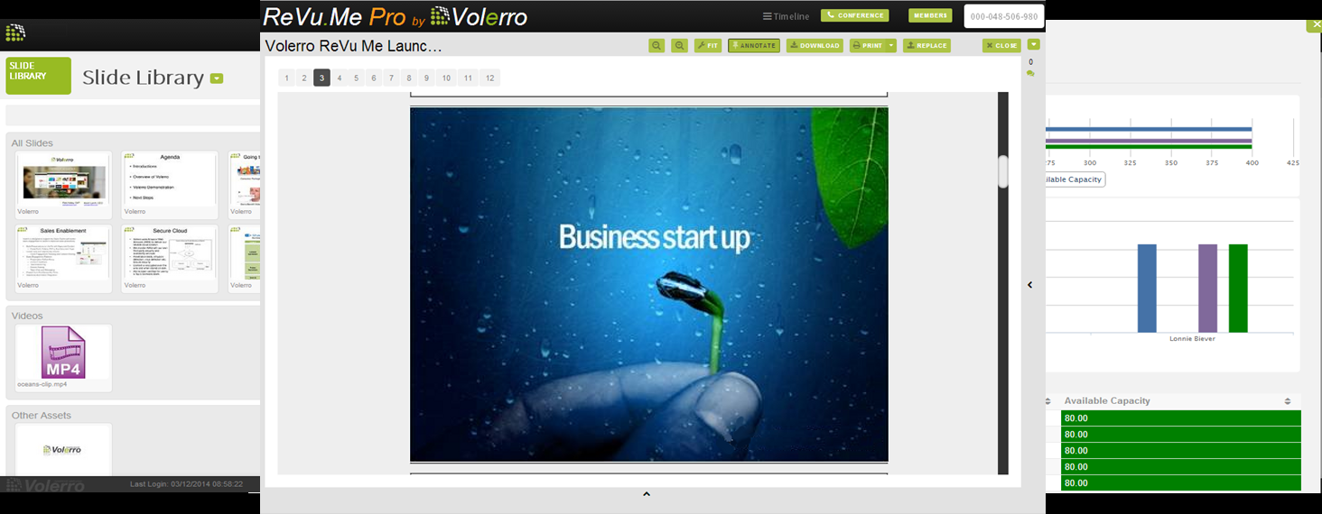
Sales Engagement Platform
Deliver Better Pitches, Close More Deals
Share Winning Content and Gauge Prospect Interest

Slide 9
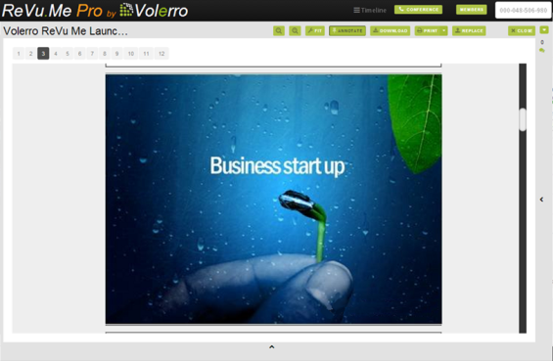
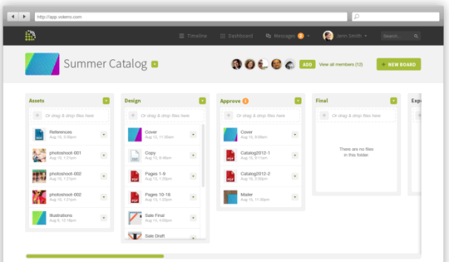
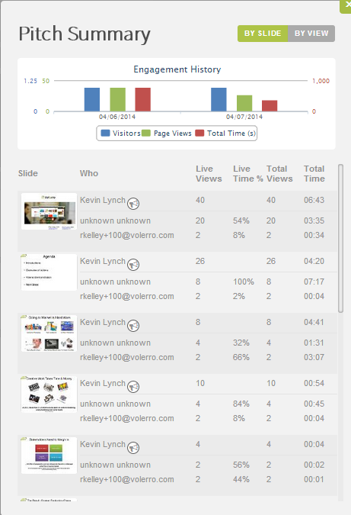
Sales Engagement
Revu.me is designed to support the Sales Teams with better sales engagement to assist in improved sales productivity.
Build Presentations on the Fly with Approved Content
Sales Engagement Platform:
Presentation Follow Along
Content Feedback
Teleconferencing
Screen Sharing
Create Deal and Opportunity Rooms
Present from Any Device Any Time

Slide 10
Planned Integration Points
Join.me for Screen Sharing
Objective: Reengage LogMeIn as a Strategic
Threaten the need for Screen Sharing
Salesforce.com
Manage Sales Presentations Inside SFDC
Push Engagement Analytics Into SFDC
Leverage SFDC Customer Base
Dropbox & Box
Extend FileSharing into Sales Engagement
Leverage Large Install Base

Slide 11
Launch Product and Sell
Get Revu.me Listed:
IOS App Store
Android App Store
SFDC Partner App Directory
Dropbox and Box Partner App Directory
Focus Sales Efforts on Revu.me
Very Focused Value Proposition
Land US Bank and 3-5 other Key Accounts
Spend Time but not a lot of Money

Slide 12
Capital Plan
Treat All Atlas Payments to Lynch as Investment
Price and Terms = 2014 MN Angel Investment
Build a Case for $50k Additional Investment
Use of Proceeds:
First Half ($25k)
Outside Help for IOS Store Listing and Amazon Server Setup
Pay Existing Team to Help Transition Me on Existing Production Environment
Second Half ($25k)
Outside Sales and Marketing Help
Hire an inside sales firm to drive leads to Kevin
Promote our App in the Partner App Directories

Slide 13
Mobile Demonstration

Slide 14
We Even Handle Video

Slide 15
Revu.me

