Slide 1
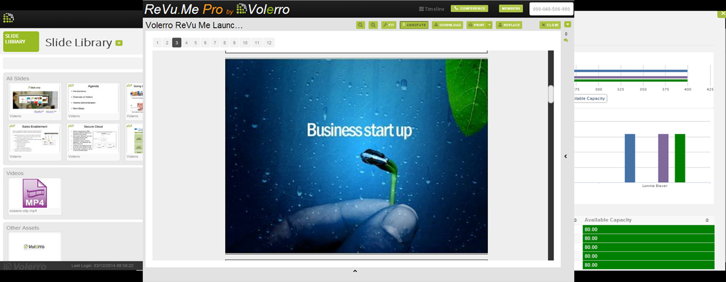

Welcome to Volerro
Improving
Sales Engagement
Kevin Lynch, CEO
klynch@volerro.com
612-834-1818

Slide 2











Marketing Project Management
Plan and Schedule
Manage Resources and Tasks
Upload, Preview, Comment & Annotate
Teleconference & Chat
Complete Cloud Service Designed to End Content Chaos
Notes:
45 seconds – elapsed 2 min
We built Volerro to solve this “Content Chaos”
An integrated calendar allows everyone to coordinate timelines and schedules
Flexible workflows allows team members to establish efficient stages for different types of projects
Preview and Annotation features ensure that everything is in one place
We even have a PowerPoint slide library that allows Marketing to Distribute Approved Slides to Sales
Built in Chat and Teleconferencing keep team members in touch to speed communication
Full project management features ensure everything stays on track

Slide 3
Linking Marketing and Sales Teams
Product
Management
Product
Marketing
Marketing
& Marcom
Legal
& Compliance
Sales Enablement
& Sales
Operations
Efficient Content Pipeline
Customers
Features
Specifications
Roadmap
Release Dates
Pricing
Positioning
Competitive Data
Success Stories
Brand /Messaging
Creative/Production
Inbound Marketing
Outbound Marketing
Regulatory Issues
Product Claims
IP Rights
Safe Harbor
Sales Training
Lead Nurturing
Pitch Materials
Market Feedback
Simplifying the way teams create, refine and distribute content

Slide 4
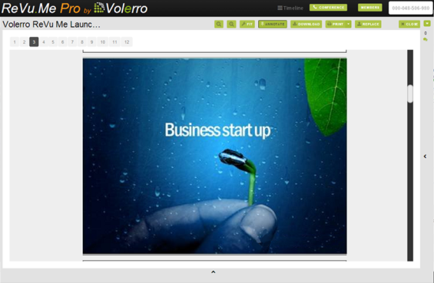
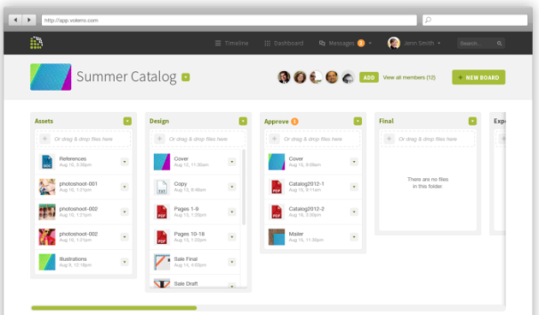
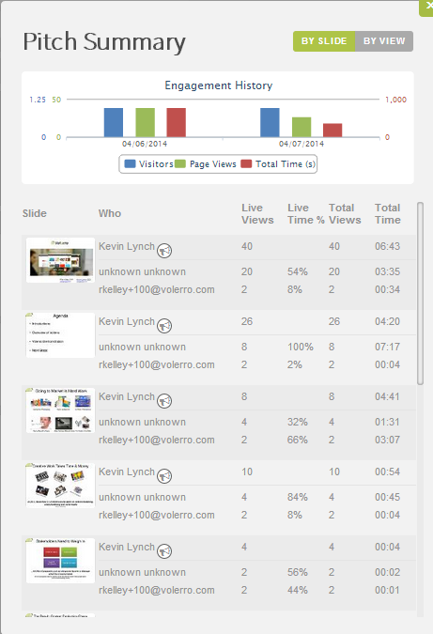
Sales Engagement
ReVu.Me is designed to support the Sales Teams with better sales engagement to assist in improved sales productivity.
Build Presentations on the Fly with Approved Content
Sales Engagement Platform:
Presentation Follow Along
Content Feedback
Teleconferencing
Screen Sharing
Team Chat and Messaging
Create Deal and Opportunity Rooms
Present from Any Device Any Time

