Slide 1
Cassandra and AZURE Resource Manager
Carlos Rolo - Pythian

Slide 2

Who am I?
Cassandra Consultant for Pythian
I’m all about Distributed Systems
Certified Datastax Architect
Cassandra MVP
Programming since 1997
Cassandra DBA since 2001
Twitter: @cjrolo
LinkedIn: linkedin.com/carlosjuzarterolo
Blog: blog.pythian.com/carlosrolo

Slide 3





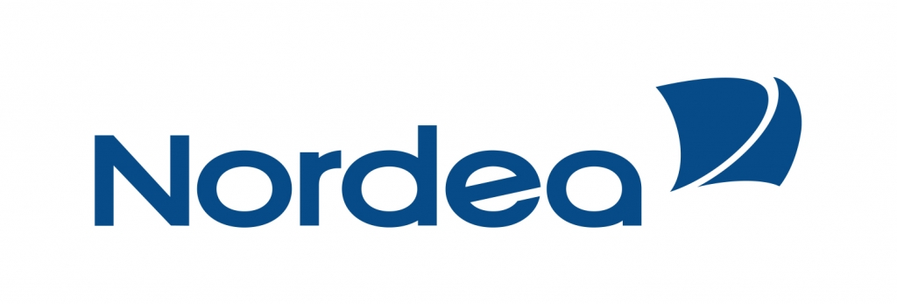



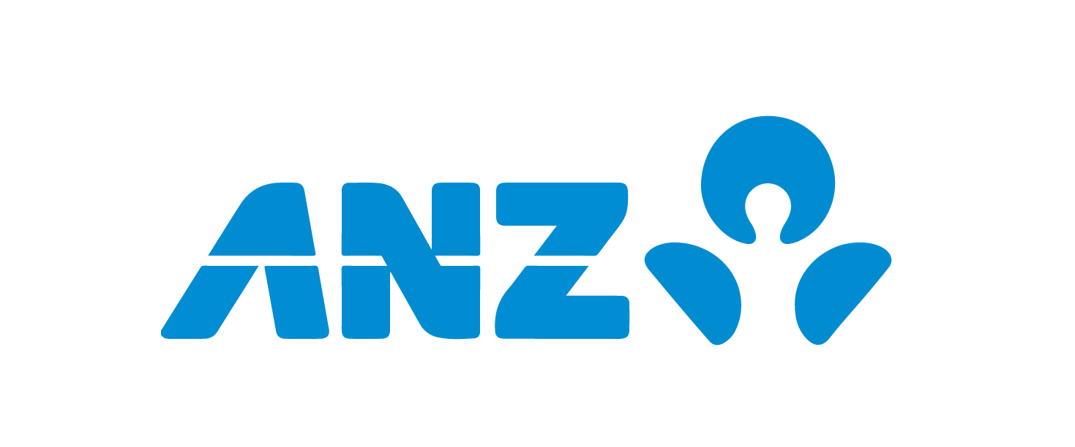





About Pythian
18 Years of Data infrastructure management consulting
200+ Top brands
6000+ databases under management
Over 400 DBA’s, in 29 countries
Top 5% of DBA work force,
9 Oracle ACE’s,
2 Microsoft MVP’s,
1 Cassandra MVP
Oracle, Microsoft, MySQL, Datastax partners, Netezza, Hadoop and MongoDB plus UNIX Sysadmin and Oracle apps

Slide 4
Azure
Microsoft Cloud Service
53 different services
27 Locations (22 Active)
CLI offerings for Linux, Mac, Windows

Slide 5
Azure Integrations
Powershell, Azure-Cli, Visual Studio
Linux, Mac: Azure-Cli
Web Interface
Rest API

Slide 6
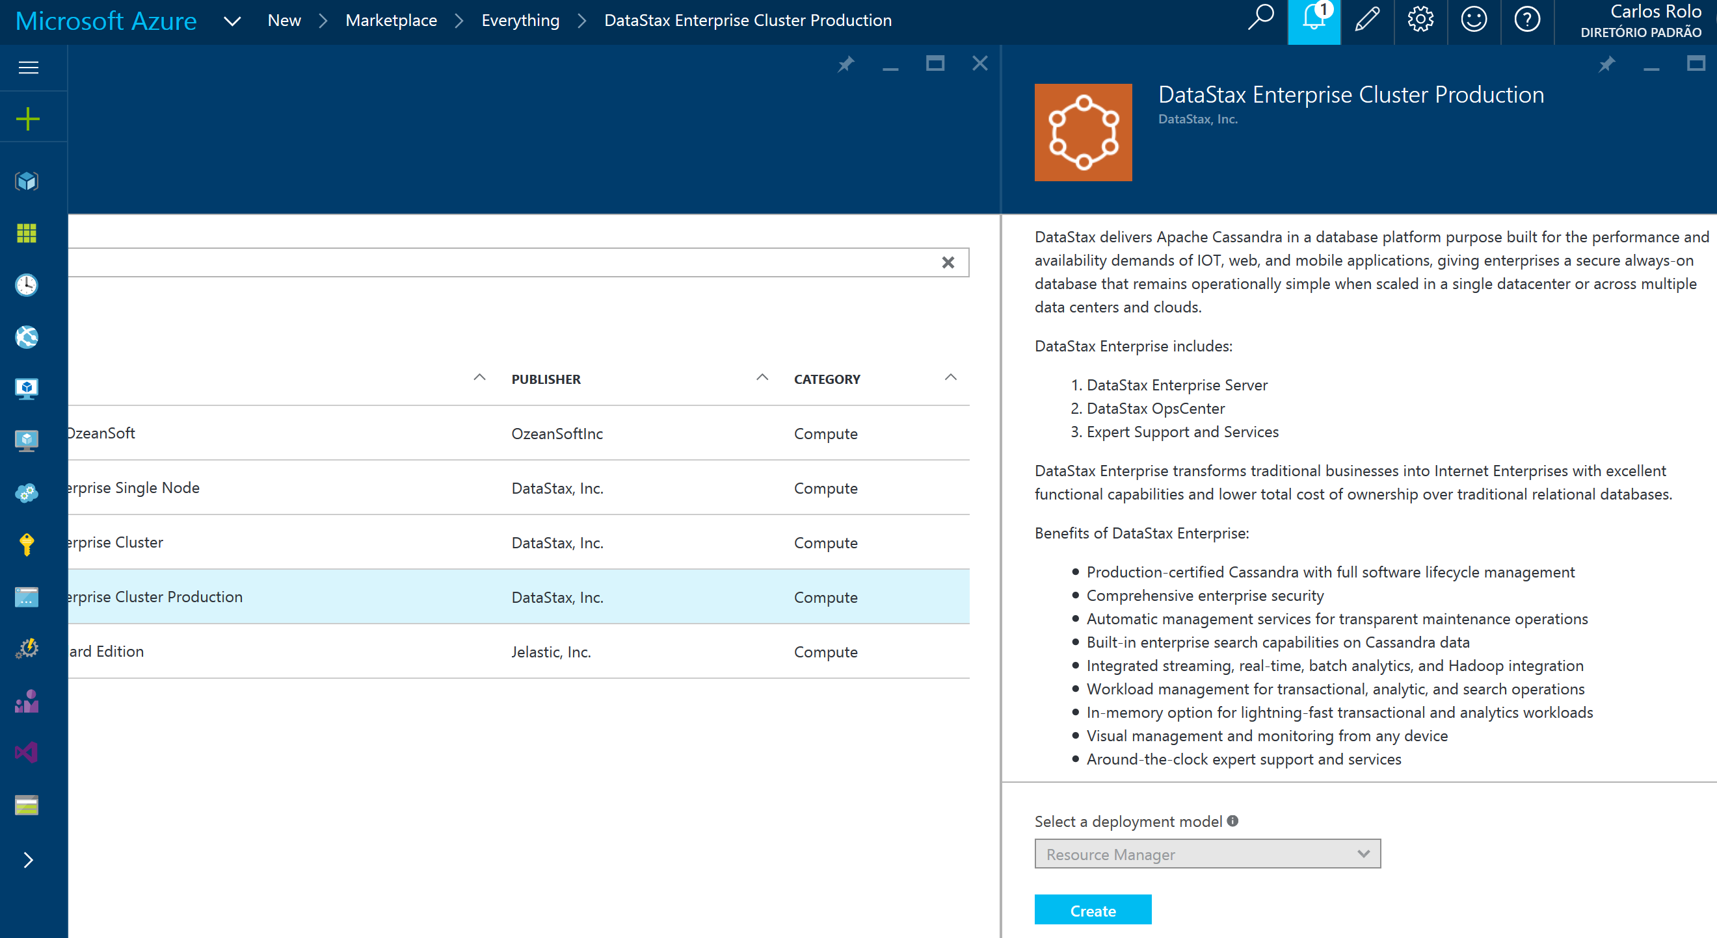
Azure and Cassandra

Slide 7
Azure Instance Sizing
A instances – Ephemeral is Spinning
D (v2) instances – Ephemeral is SSD
D5 is a full box! 16Cores, 58GB RAM, 800GB SSD
D4 is half of a D5
D15 is a full box too, but bigger: 20Cores, 140GB, 1TB SSD
D14 is half D15, and D13 is ¼ of D15.
I normally pick D2 or D3 for testing.
You need more RAM or SSD? G-Series are for you
G5, full box, 32 Cores, 448GB, 6TB SSD

Slide 8
Azure Storage
Premium and Standard
Premium is Network attached SSD
Standard is the same with Spinning
It might get confusing…
Table
Blob
Queue
Several levels of redundancy
LRS
ZRS
GRS
RA-GRS
Several levels of Premium
P10, P20, P30

Slide 9
Azure Storage and Cassandra
Use Standard for OS disks
Use Ephemeral for Data disks
And now a little Math:
Standard storage has a max of 20k IOPS
And a max of 500 IOPS per Disk
20,000 IOPS / 500 IOPS = 40
If you attach more than 40 disks, you need to create an extra storage account.

Slide 10
Networking
Azure has the most regions of all cloud providers
Structure is the following
Private IP > NIC > VNET > Region
Private IPs won’t route through regions
Use Public IPs
Don’t forget to configure network security groups!
Other options are available
VPN Gateway - Limited
Express Route

Slide 11
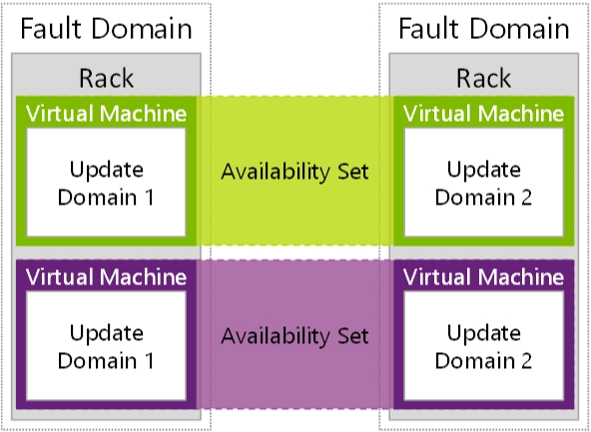
Availability Sets
Making sure your VMs don’t suffer reboots all at the same time!

Slide 12
Azure Templates
This is where automation gets in!
Painfull to learn, but…
… lots of examples available (github)
Visual Studio makes wonders here!
This is called the ARM (Azure Resource Manager) Mode
You still have “Classic” for older deployments
Azure Resource Manager (ARM) is a “package”
You assign resources to your Resource Group
You can track all the resources from a single point, including:
Billing
Monitoring
Access Control
Template based provisioning

Slide 13
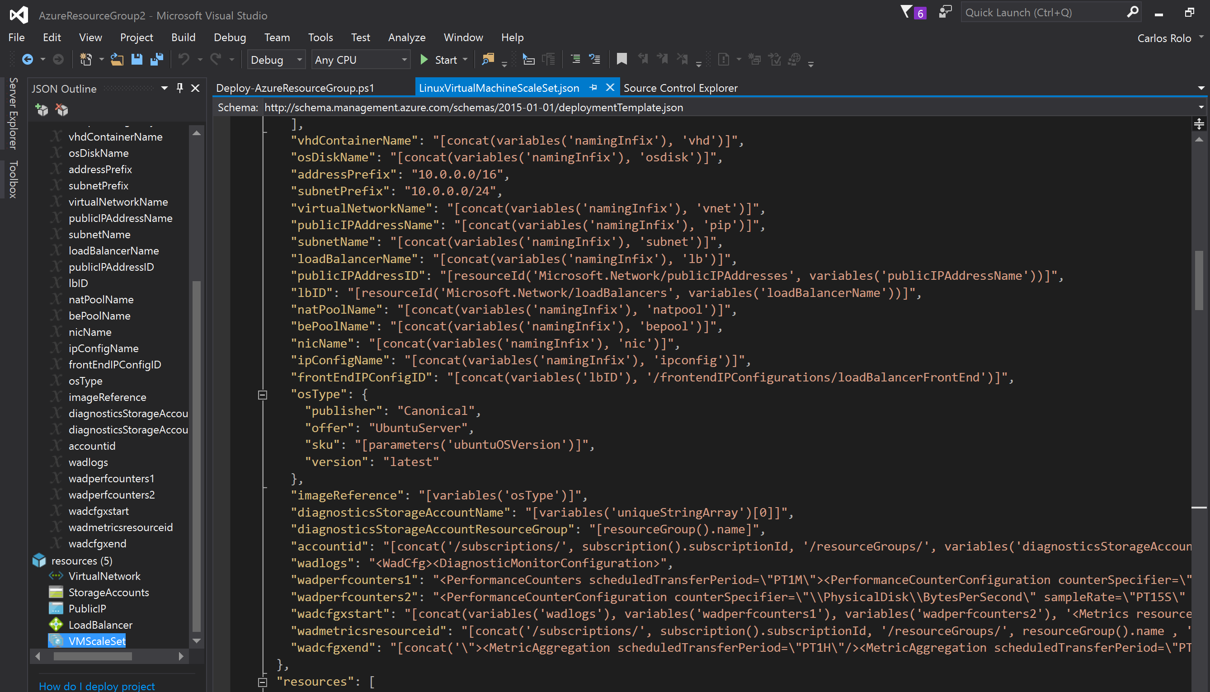
Azure Templates (2)
.json, but not really json. JSON-ish…

Slide 14
Azure Templates (3)
Highly powerful and Highly complex
Supports things like:
Link templates to each other
Define dependencies
Share states
Etc…
Not easy to author from scratch!
Save yourself with:
https://github.com/Azure/azure-quickstart-templates
Visual Studio

Slide 15
Azure Templates (4)
You can deploy Templates with:
Powershell
Azure-cli
Visual Studio (?)
Testing templates…
You can’t!
You can only test by deploying…

Slide 16
Takeaways
You’ll need patience if you’re coming from AWS
You will go through a lot of trial and error.
Documentation and examples are disperse
Github is your friend for ARM templates
Azure is moving really fast
Can’t remember the last day I didn’t have an update!
Beware of storage!
You can deploy not knowing anything about Cassandra!

Slide 17
Q&A
Thanks for Listening!

