Slide 1
Running Cassandra on Apache Mesos across multiple datacenters at Uber
Abhishek Verma (verma@uber.com)

Slide 2
About me
MS (2010) and PhD (2012) in Computer Science from University of Illinois at Urbana-Champaign
2 years at Google, worked on Borg and Omega and first author of the Borg paper
~ 1 year at TCS Research, Mumbai
Currently at Uber working on running Cassandra on Mesos

Slide 3
“Transportation as reliable as running water, everywhere, for everyone”

Slide 4
“Transportation as reliable as running water, everywhere, for everyone”
99.99%

Slide 5
“Transportation as reliable as running water, everywhere, for everyone”
efficient

Slide 6


Cluster Management @ Uber
Statically partitioned machines across different services
Move from custom deployment system to everything running on Mesos
Gain efficiency by increasing machine utilization
Co-locate services on the same machine
Can lead to 30% fewer machines¹
Build stateful service frameworks to run on Mesos
“Large-scale cluster management at Google with Borg”, EuroSys 2015

Slide 7

Apache Mesos
Mesos abstracts CPU, memory, storage away from machines
program like it’s a single pool of resources
Linear scalability
High availability
Native support for launching containers
Pluggable resource isolation
Two level scheduling

Slide 8

Apache Cassandra
Horizontal scalability
Scales reads and writes linearly as new nodes are added
High availability
Fault tolerant with tunable consistency levels
Low latency, solid performance
Operational simplicity
Homogeneous cluster, no SPOF
Rich data model
Columns, composite keys, counters, secondary indexes
Integration with OSS: Hadoop, Spark, Hive

Slide 9
DC/OS Cassandra Service
https://github.com/mesosphere/dcos-cassandra-service
Mesosphere
Chris Lambert
Gabriel Hartmann
Keith Chambers
Kenneth Owens
Mohit Soni
Uber
Abhishek Verma
Karthik Gandhi
Matthias Eichstaedt
Varun Gupta
Zhitao Li
Zhiyan Shao

Slide 10
Cassandra service architecture
Web interface Control plane API
Deployment system
Aurora (DC1)
Aurora (DC2)
ZK
ZK
Framework dcos-cassandra-service
ZooKeeper quorum
DC2
ZK
C*Cluster 1
C*Cluster 2
Mesos master
(Leader)
Mesos master
(Standby)
Client App uses CQL interface
Mesos agent
Mesos agent
Mesos agent
CQL
CQL
CQL
CQL
CQL
. . .
C*Node 1a
C*Node 2a
C*Node 1b
C*Node 2b
C*Node 1c

Slide 11
Cassandra Mesos primitives
Mesos containerizer
Override 5 ports in configuration (storage_port, ssl_storage_port, native_transport_port, rpc_port, jmx_port)
Use persistent volumes
Data stored outside of the sandbox directory
Offered to the same task if it crashes and restarts
Use dynamic reservation

Slide 12
Custom seed provider
Number of Nodes = 3
Number of Seeds = 2
http://scheduler/seeds
{
isSeed: false
seeds: [ 10.0.0.1,
10.0.0.2]
}
{
isSeed: true
seeds: [ ]
}
{
isSeed: true
seeds: [ 10.0.0.1]
}
Node 1
10.0.0.1
Node 1
10.0.0.1
Node 2
10.0.0.2
Node 3
10.0.0.3
Node 2
10.0.0.2
Node 3
10.0.0.3

Slide 13
Cassandra Service: Features
Custom seed provider
Increasing cluster size
Changing Cassandra configuration
Replacing a dead node
Backup/Restore
Cleanup
Repair
Multi-datacenter support

Slide 14
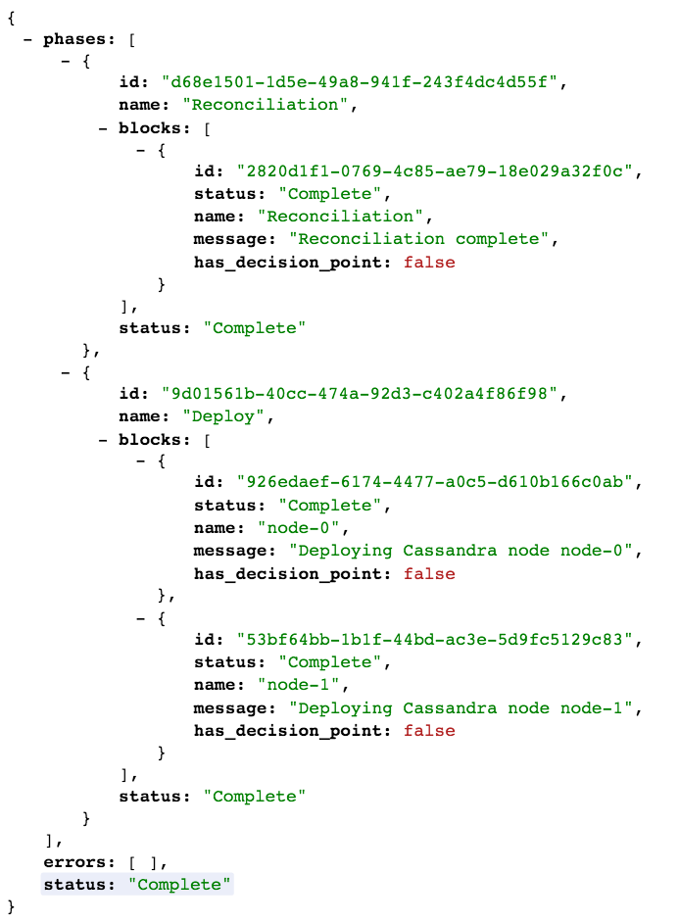
Plan, Phases and Blocks
Plan
Phases
Reconciliation
Deployment
Backup
Restore
Cleanup
Repair

Slide 15
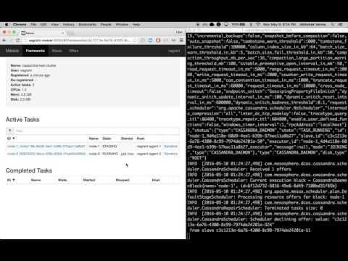
Spinning up a new Cassandra cluster
https://www.youtube.com/watch?v=gbYmjtDKSzs

Slide 16
Automate Cassandra operations
Repair
Synchronize all data across replicas
Last write wins
Anti-entropy mechanism
Repair primary key range node-by-node
Cleanup
Remove data whose ownership has changed
Because of addition or removal of nodes
Cleanup node-by-node

Slide 17
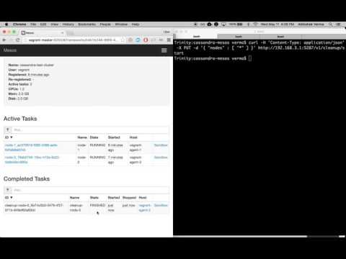
Cleanup operation
https://www.youtube.com/watch?v=VxRLSl8MpYI

Slide 18
Failure scenarios
Executor failure
Restarted automatically
Cassandra daemon failure
Restarted automatically
Node failure
Manual REST endpoint to replace node
Scheduling framework failure
Existing nodes keep running, new nodes cannot be added
Mesos master failure: new leader election

Slide 19
Experiments

Slide 20
Cluster startup
For each node in the cluster:
Receive and accept offer
Launch task
Fetch executor, JRE, Cassandra binaries from S3/HDFS
Launch executor
Launch Cassandra daemon
Wait for it’s mode to transition STARTING -> JOINING -> NORMAL

Slide 21
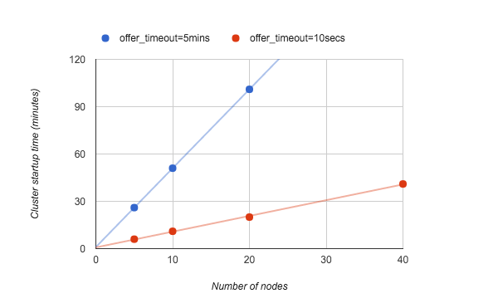
Cluster startup time
Framework can start ~ one new node per minute

Slide 22
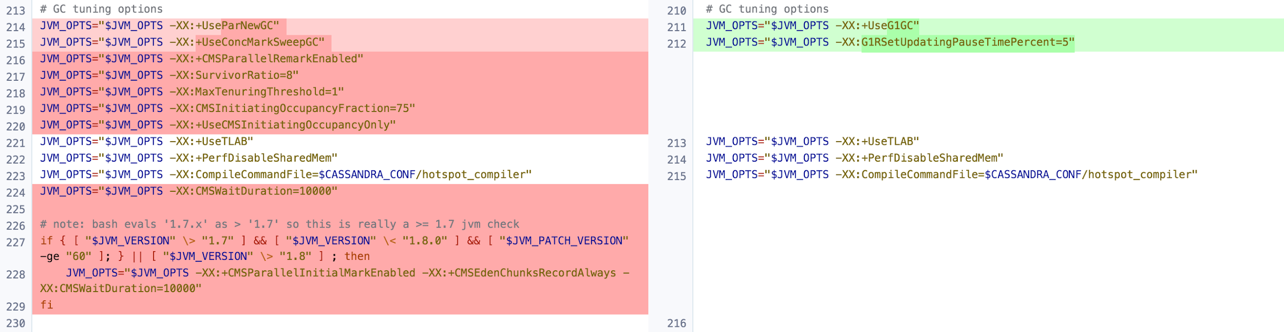
Tuning JVM Garbage collection
Changed from CMS to G1 garbage collector
Left: https://github.com/apache/cassandra/blob/cassandra-2.2/conf/cassandra-env.sh#L213
Right: https://docs.datastax.com/en/cassandra/2.1/cassandra/operations/ops_tune_jvm_c.html?scroll=concept_ds_sv5_k4w_dk__tuning-java-garbage-collection

Slide 23
Tuning JVM Garbage collection
Using cassandra-stress, 32 threads client
Metric | CMS | G1 | G1 : CMS Factor
op rate | 1951 | 13765 | 7.06
latency mean (ms) | 3.6 | 0.4 | 9.00
latency median (ms) | 0.3 | 0.3 | 1.00
latency 95th percentile (ms) | 0.6 | 0.4 | 1.50
latency 99th percentile (ms) | 1 | 0.5 | 2.00
latency 99.9th percentile (ms) | 11.6 | 0.7 | 16.57
latency max (ms) | 13496.9 | 4626.9 | 2.92
G1 garbage collector is much better without any tuning

Slide 24
Cluster Setup
3 nodes
Local DC
24 cores, 128 GB RAM, 2TB SAS drives
Cassandra running on bare metal
Cassandra running in a Mesos container

Slide 25
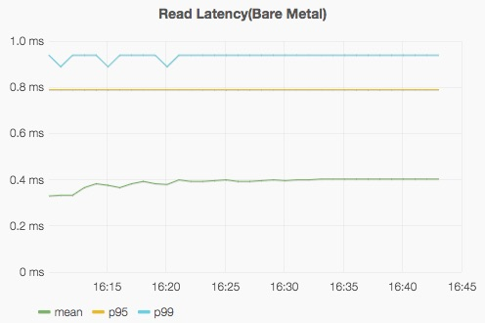
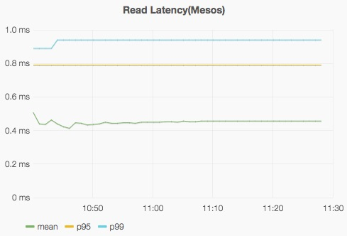
Read Latency
Bare metal
Mesos
Mean: 0.38 ms
P95: 0.74 ms
P99: 0.91 ms
Mean: 0.44 ms
P95: 0.76 ms
P99: 0.98 ms

Slide 26
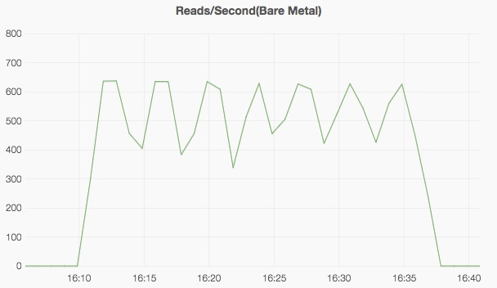
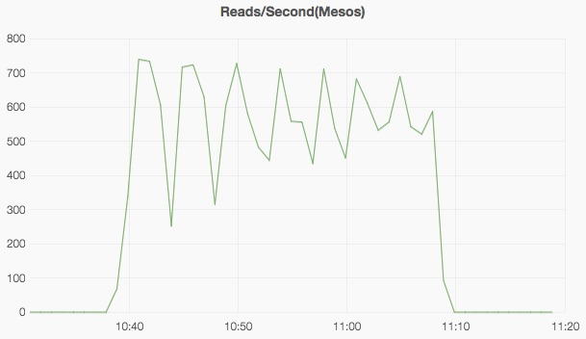
Read Throughput
Bare metal
Mesos

Slide 27
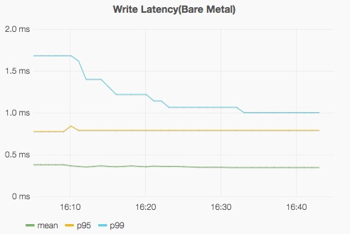
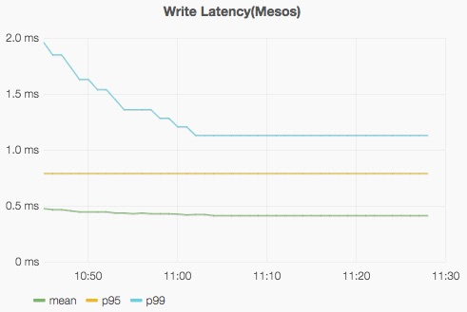
Write Latency
Bare metal
Mesos
Mean: 0.43 ms
P95: 0.94 ms
P99: 1.05 ms
Mean: 0.48 ms
P95: 0.93 ms
P99: 1.26 ms

Slide 28
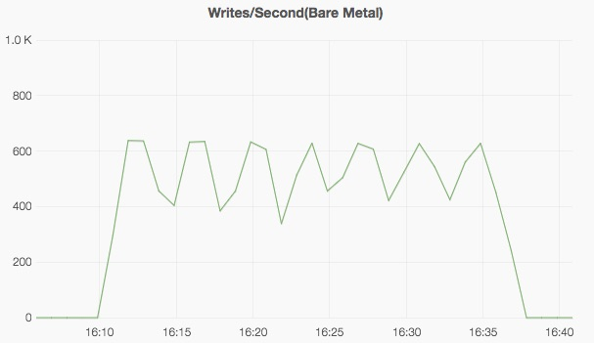
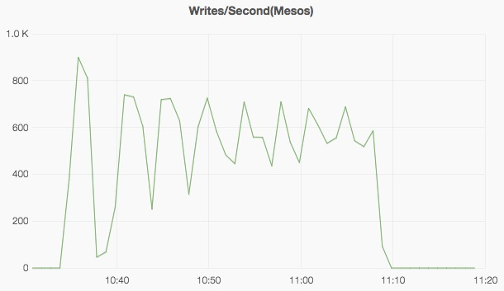
Write Throughput
Bare metal
Mesos

Slide 29
Running across datacenters
Four datacenters
Each running dcos-cassandra-service instance
Sync datacenter phase
Periodically exchange seeds with external dcs
Cassandra nodes gossip topology
Discover nodes in other datacenters

Slide 30
Asynchronous cross-dc replication latency
Write a row to dc1 using consistency level LOCAL_ONE
Write timestamp to a file when operation completed
Spin in a loop to read the same row using consistency LOCAL_ONE in dc2
Write timestamp to a file when operation completed
Difference between the two gives asynchronous replication latency
p50 : 44.69ms, p95 : 46.38ms, p99:47.44ms
Round trip ping latency
77.8ms

Slide 31
Cassandra on Mesos in Production
~20 clusters replicating across two datacenters (west and east coast)
~300 machines across two datacenters
Largest 2 clusters: more than a million writes/sec and ~100k reads/sec
Mean read latency: 13ms and write latency: 25ms
Mostly use LOCAL_QUORUM consistency level

Slide 32
Questions?
verma@uber.com

Slide 33
Cluster startup
For each node in the cluster:
Receive and accept offer
Launch task
Fetch executor, JRE, Cassandra binaries from S3/HDFS
Launch executor
Launch Cassandra daemon
Wait for it’s mode to transition STARTING -> JOINING -> NORMAL
Aurora hogging offers

Slide 34
Aurora hogs offers
Aurora designed to be the only framework running on Mesos and controlling all the machines
Holds on to all received offers
Does not accept or reject them
Mesos waits for --offer_timeout time duration and rescinds offer
--offer_timeout config
Duration of time before an offer is rescinded from a framework. This helps fairness when running frameworks that hold on to offers, or frameworks that accidentally drop offers. If not set, offers do not timeout.
Set to 5mins in our setup, reduced to 10secs

Slide 35
Long term solution: dynamic reservations
Dynamically reserve all the machines resources to the “cassandra” role
Resources are offered only to cassandra frameworks
Improves node startup time: 30s/node
Node failure replacement or updates are much faster

Slide 36
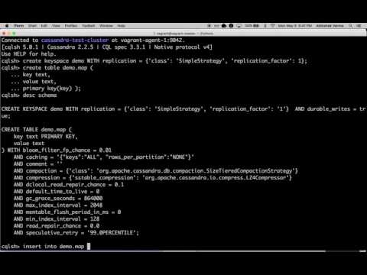
Using the Cassandra cluster
https://www.youtube.com/watch?v=qgqO39DteHo

