Slide 1
Nick Panahi – Sr. Product Manager, Search
DSE Search 5 & Beyond

Slide 2
1 | Recap
2 | Trail Map
3 | Implementation Discussion
4 | Q & A

Slide 3

Last Year…
DSE Search
“We’ve built a coherent search platform that integrates Cassandra’s distributed persistence, Lucene’s core search and indexing functionality, and the advanced features of Solr in the same JVM…and then we’ve made a number of our own enhancements”
Notes:
Intro. To DSE Search + deep dive into architecture + demo
DSE Search == coherent search platform that integrates C*’s distributed persistence and Lucene’s search and indexing functionality along with the advanced features of Solr along with a number of our own enhancements.

Slide 4
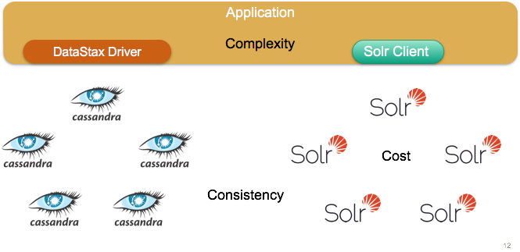
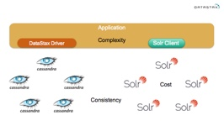
Last Year…
Why?
“…With DSE search, we can eliminate the cost associated with running a separate search cluster. We can eliminate much of the complexity at the application layer, since we don’t have to deal with two clients, and we only have to manage one write path…and with all of our data stored in Cassandra alone and collocated with the relevant shards of our search index, we’ve eliminated many of the potential issues of consistency between the two.”
Notes:
Why? To eliminate the cost and complexity of running a separate cluster, application logic. Problems: split-brain.

Slide 5
Current State of DSE Search
4.6 | 4.7 | 4.8 | 5.0
dsetool core support | Live indexing | Tuple & UDT support | Encrypted indexes
Automatic resource generation | Health based shard routing | Live indexing enhancements | Off-heap live indexing
CQL solr_query | Global, configurable filter cache | Advanced spatial queries | timeuuid range support
PK routing | Implement fault-tolerant distributed queries | Support SELECT count() | Graph support
VNode support | … | Deprecated DataImportHandler | …
… | … | … | …
Notes:
DSE features, 5.0 completes security story with encrypted indexes. RT indexing can make use of off-heap configuration. Support for range search queries on timeuuid fields

Slide 6
1 | Recap
2 | Trail Map
3 | Implementation Discussion
4 | Q & A
Notes:
Not quite a Road map.

Slide 7
Trail Map
5.0 | 5.1 | 5.2
… | Performance improvements phase 1 | Performance improvements phase 2
… | Solr 6 Integration | Deprecate HTTP API
… | Facet/Stats API support | Deprecate solr_query API
Profile single-node performance | Improvement A | JBOD support?
… | Improvement B | Tiered storage support?
… | Richer CQL search API | ?
Notes:
Highlighted a few key points to go over
Profile performance + 2 phases of improvements
Richer search syntax API

Slide 8
Richer Syntax – Core Operations
REBUILD SEARCH INDEX ON TABLE <ks.tb> WITH OPTIONS {deleteAll:true};
CREATE SEARCH INDEX ON keyspace.table WITH CONFIG { realtime : true } AND OPTIONS { reindex : true };
ALTER SEARCH INDEX <ks.tb> WITH SCHEMA = '...' AND CONFIG = '...' AND OPTIONS = '...’ ;
DROP SEARCH INDEX <ks.tb>;
Notes:
CQL extension
Built on native protocol
5.1

Slide 9
Richer Syntax - Search
SEARCH <ks.tb> [AS JSON]
FOR AGGREGATE [
...
| <selectionClause>
| COUNT(*|1)
[WITHIN <pk | token restriction>]
WITH [QUERY <query>] [FILTER <filter1> ...[AND filterN]]
[PARAMS <name1>=<value1>, ..., <nameN>=<valueN>]
[ORDER BY <sort>]
[OFFSET <offset>]
[LIMIT <limit>]
...;
Notes:
CQL extension
Built on native protocol
May see some of it in 5.1.
Why? Expressing all the rich functionality in Solr 6 is not trivial with just CQL or JSON. Goal is to provide a more intuitive and abstracted query syntax to easily express non-trivial search queries.

Slide 10
1 | Recap
2 | Trail Map
3 | Implementation Discussion
4 | Q & A

Slide 11
Ariel Weisberg
Things you never knew about Lucene
(And didn’t know you wanted to)

Slide 12
Lucene & Solr are not a database
Primary key & unique constraints not quite 1st class
Insert without delete adds a duplicate
Primary keys implemented as overwrites
“atomically” insert a doc and delete a key (Term)

Slide 13
Deletes, Cassandra vs. Lucene
Cassandra is a distributed database
Requires tombstones w/ timestamps for consistency
Lucene is single node Information Retrieval system
A bit-set per segment works

Slide 14
Lucene Deletes

Slide 15
Lucene LSM
S1
S2
S3
S_{N}

Slide 16
Lucene Segment
Bloom filter
Live document bitset
Other stuff

Slide 17
Unnecessary
Apply deleted terms
Thread A
DocWriter A
Shared Delete Queue
Deleted Term
Deleted Term
Deleted Terms
Sent to
Global Queue
Thread B
DocWriter B
Deleted Term
Deleted Term
Apply deleted terms

Slide 18
Global
Delete
Queue
Global
Frozen Delete
Queue
Segment 1
Segment 2
Freezing
Soft commit
Global Lock,
Foreground thread
Global Lock,
Single threaded
Segment N

Slide 19
Applying delete to segment
Bloom filter
#1 Check term presence
Live document bitset
#3 Mark doc ids
Other stuff
#2 Docs matching Term

Slide 20
Lucene & Global Locks
There are many of them and they are used everywhere
Attempt at a shared nothing write path
Only shared nothing until a thread stalls holding a lock
Eventually other threads need the lock
Significant shared state per write, not lock free
Shared state isn’t leveraged for additional performance

Slide 21
Cassandra Deletes

Slide 22
Cassandra Tombstones
A tombstone is a data item like a row
Appended to a Memtable without checking existence
Can overwrite data row in memtable
Must be retained until GC grace has passed
Timestamp
Key

Slide 23
Compacting tombstones
SSTable
Tombstone
Timestamp
Key
SSTable
SSTable
Tombstone
Row
Timestamp
Key
Timestamp
Key

Slide 24
Cassandra Deletes
Tombstones never require reads for writes
Updates perform similar to inserts
Reclaiming a row via compaction less predictable
Tombstones cause filter positives on read

Slide 25
Future work

Slide 26
Locks and stalls
Lucene regularly stops indexing, and blocks threads
Deletes cause stalls
Soft commit causes stalls
Flushing causes stalls
Locking small critical sections unschedules threads
There is room to improve scale up

Slide 27
FIN

Slide 28
1 | Recap
2 | Trail Map
3 | Implementation Discussion
4 | Q & A
Notes:
Not quite a Road map.

