Slide 1
Eddie Satterly CTO & Co-Founder DataNexus @eddie_satterly
Real World Cassandra

Slide 2
1 | Who is IAG
2 | Single Customer View
3 | Telematics
4 | Why Cassandra

Slide 3





Insurance Leader
IAG is a group of top insurance brands across Asia and ANZ region
Whether you are a customer, partner, employee, shareholder or part of the communities IAG serves across Australia, New Zealand or Asia, IAG exists to ‘make your world a safer place’.
The Group’s Vision is: To be Asia Pacific's most loved, most inventive and most successful insurer.

Slide 4
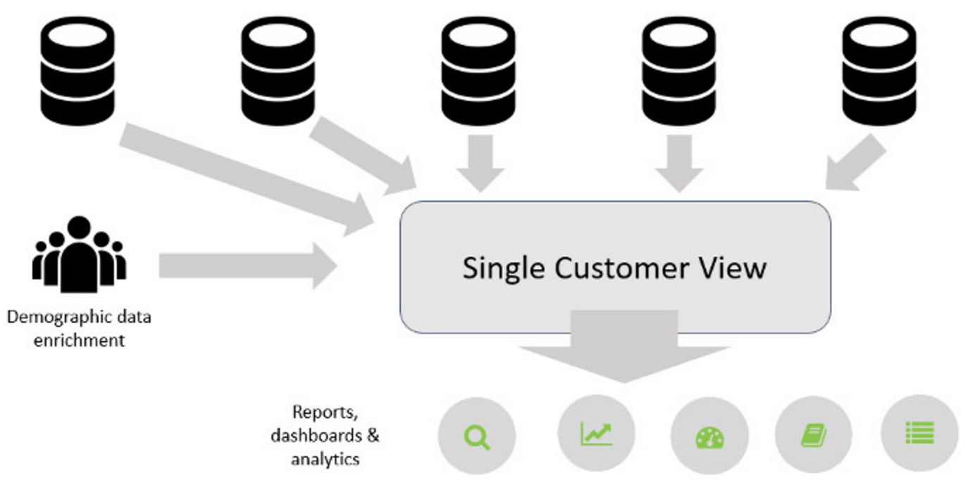
Data Challenge #1
Problem Statement #1 – Customer View
As a group with a large number of brands and all with separate products most with separate source systems it is very difficult to represent a single customer in a useful way. There are over 130 internal source systems with data and several external sources as well that make up what IAG knows about customers, but no way to bring that data together. The view to the right is a high level overview. This is a much harder problem to solve than you might think and there has been more than 2 years of effort put into trying various approaches using traditional data tools. All have failed

Slide 5
How to Solve for Customer View

Slide 6
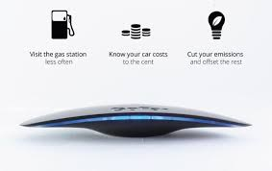
Data Challenge #2
Problem Statement #2 – Telematics
Collection of massive amount of telemetry from devices in cars and homes provides a very rich source of information to make critical Insurance decisions and get our customers a better price and a better experience when they opt in to share. The initial use case was simply to pull in data from a few vehicles and determine if customers were interested in sharing that data to improve their insurance price in ANZ like they are in the US. Since then there has also been a project undertaken to help save on fuel and make drivers safer, in staying with IAG vision statement. On top of all this there is also a current effort to work with customers on connected home platform to price more accurately on home policies as well.

Slide 7
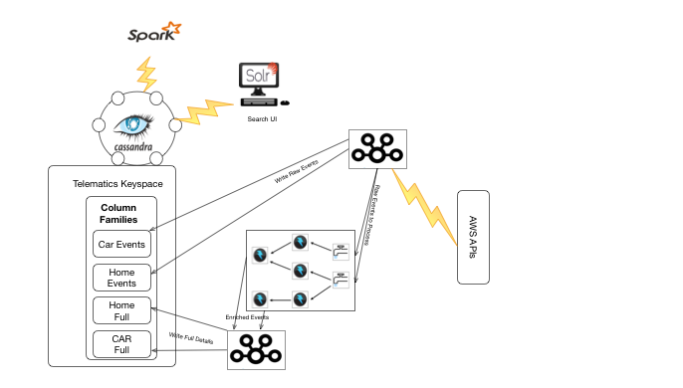
How to Solve for Telematics

Slide 8
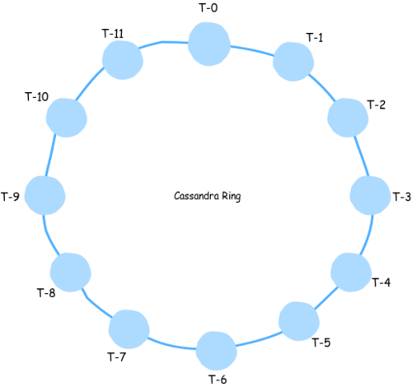
Why Cassandra
Cassandra Solution Approach
All on Openstack Appliance
9 Nodes Cassandra with 3x800GB SSD
3 Nodes Solr with 3x800 SSD
All R3
2 node Kafka Broker for all data feeds
6 nodes Storm for processing and enrichment

Slide 10
Table Design Style
Content | Content | Content | Content | Content | Content
Content | Content | Content | Content | Content | Content
Content | Content | Content | Content | Content | Content
Content | Content | Content | Content | Content | Content
Content | Content | Content | Content | Content | Content
Content | Content | Content | Content | Content | Content
Content | Content | Content | Content | Content | Content
Content | Content | Content | Content | Content | Content

