Slide 1
Yabin Meng
An Effective Approach to Migrate Thrift to CQL

Slide 2
About Pythian
Founded in 1997, a global leader in Enterprise IT transformation and operational excellence
  www.pythian.com
  https://www.linkedin.com/company/pythian
Love your Data
  6000+ database under management
  Over 400 DBA’s, in 35 countries
  Top 5% of DBA workforce – 9 Oracle ACE’s, 2 Microsoft MVP’s, 1 Cassandra MVP
  Partners with Amazon, Cloudera, Oracle, Microsoft, DataStax, and a lot more
Specialities: Databases, Cloud, DevOps, Big Data Infrastructure, Advanced Analytics, Infrastructure Management
Industry Recognition
  DBTA¹ 100 2016 - The Companies That Matter Most in Data
  IAOP² - GLOBAL OUTSOURCING 100® RISING STAR FOR 2016
  Top 25 Canadian ICT³ Professional Services Companies
  … …
DBTA¹: Database Trend and Applications (http://www.dbta.com/)
IAOP²: International Association of Outsourcing Professionals (https://www.iaop.org/)
ICT³: Information & Communication Technology
© Pythian, All Rights Reserved.

Slide 3
About Myself
15+ years IT experience - relational database/data warehousing, business intelligence and analytics (BIA), NoSQL database/Big Data
Started my career as a RDBMS client application developer (PowerBuilder, Java)
5 years as IBM DB2 Kernel Developer, New Development (DB2 v9.5, 9.7, 9.8, 10)
Multi-years data warehousing and BIA experience in insurance and capital market sectors as technical lead/architect (IBM/Cognos, SAS/SAS 9.x, Information Builders/WebFocus)
DataStax Certified Developer, Administrator, and Partner Architect
https://www.linkedin.com/in/yabinmeng
@yabinmeng
© Pythian, All Rights Reserved.

Slide 4
1 | Problem Overview
2 | Background Discussion
3 | Thrift to CQL Transition
4 | C* Storage Engine (pre 3.0)
5 | Data Migration
6 | Conclusion
© Pythian, All Rights Reserved.

Slide 5
Problem Overview
C* cluster upgrade from version 1.2 to 2.1
Thrift based application (Hector)
  Plan to convert to CQL, but not done yet
Data copied from one C* cluster to another
  C* COPY command
Application failed in DEV/TEST
  Cannot retrieve some required data
  cqlsh output shows NO difference
    Schema
    Data query result
© Pythian, All Rights Reserved.

Slide 6
Background Disccsion, COPY commands
COPY commands
  Syntax: COPY <table_name> (column1, column2, …) TO/FROM <file_name> WITH options
  Since 1.1.3 (PostgresSQL COPY commands)
  Simple yet with limitation. Continuous improvement
    Small datasets (max. a few million rows)
    CSV format
    No primary key check
    New options and better performance in cqlsh copy
      2.1.13, 2.2.5, 3.0.3, 3.2
      ex (common): NUMPROCESSES, CONFIGFILE
      ex (TO): BEGINTOKEN / ENDTOKEN
      ex (FROM): INGESTRATE (rows/second)
  Predefined schema
© Pythian, All Rights Reserved.

Slide 7
Background Discussion, Schema-less?
Schema-less or Schema
  Many NoSQL DBs is marked as “schema-less”
    A lot of debate
  C* is schema optional (Thrift)
  C* is schema required (CQL)
© Pythian, All Rights Reserved.

Slide 8
Background Discussion, C* Utilities
cassandra-cli utility
  Command line interface since very early years of C*
  Thrift-based counterpart of “cqlsh”
  C* data engine format (pre 3.0)
  Deprecated since C* 2.1 and will be removed in 3.0
  Comparator and Validator
    Validator: row key, column value
    Comparator: column name + column sorting order
sstable2json utility
  Deprecated and will be removed in 3.0
SET users['key_val']['column1_name']='some value';
SET users['key_val']['column2_name']='some value';
...
LIST users;
GET users['key_val']['column1_name']

Slide 9
Thrift to CQL Transition
What is Thrift and CQL?
  Thrift is a general framework (interface definition language and binary communication protocol)
    "scalable cross-language services development"
  APIs to interact with C*
  CQL is also a query language
Access Abstraction Layer
N/A *
CQL query language
CQL query language
Protocol Layer
Thrift
Thrift
CQL Binary
Storage Layer
C* Data Engine
C* evolvement
© Pythian, All Rights Reserved.

Slide 10
Thrift to CQL Transition, continued
Thrift in C*
  Since the beginning as a communication protocol
  Low level API
  Deprecated
CQL in C*
  0.8, CQL as a language
  1.2, CQL as a language, version 3 (CQL3)
  1.2, CQL as a communication protocol (CQL3 only)
  Continuously evolving
Thrift vs. CQL as protocol
  Thrift: RPC based; Synchronous
  CQL: Server notification (event registration); Asynchronous
CQL as a language
  Feature rich: UDF, lightweight transaction, JSON support, materialized view, …
Thrift vs. CQL as client driver
  Thrift driver is deprecated and not supported
© Pythian, All Rights Reserved.

Slide 11
Thrift to CQL Transition, continued
What is needed for the transition?
  Application
  Data Model
  Data itself
  Understanding C* storage engine *
* Pre-3.0 C*
© Pythian, All Rights Reserved.

Slide 12
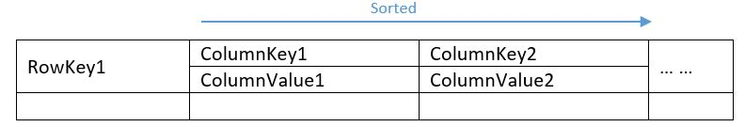
C* Storage Engine (pre 3.0)
C* ColumnFamily (Thrift) / Table (CQL) data structure
  Map of sorted map:
  Map<RowKey, SortedMap<ColumnKey, ColumnValue>>
  CREATE TABLE song_tags (
  id uuid,
  tag_name text,
  PRIMARY KEY (id, tag_name)
  ) WITH COMPACT STORAGE
© Pythian, All Rights Reserved.

Slide 13
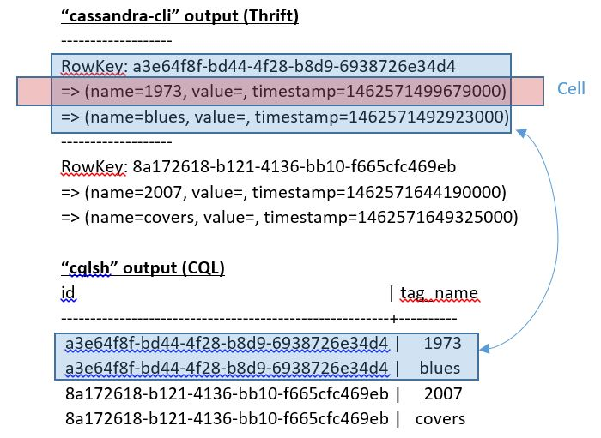
C* Storage Engine – Thrift vs. CQL Terminology
Table
  Thrift: Column Family
  CQL: Table
Row
  Thrift: Storage Row / Partition
  CQL: Logic Representation / Part of a partition
Column
  Thrift: Cell (column key + column value)
  CQL: Metadata / column key or column value
© Pythian, All Rights Reserved.

Slide 14
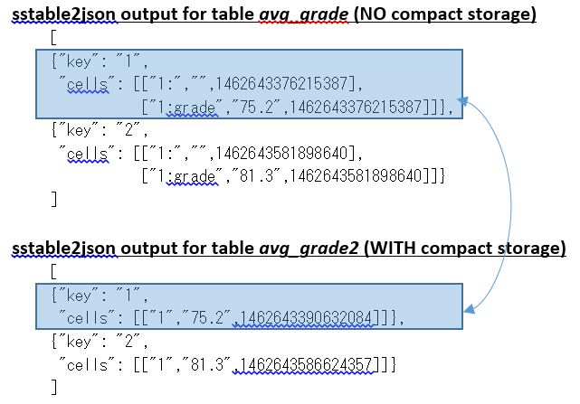
C* Storage Engine – Compact Storage
CREATE TABLE avg_grade2 (
student_id int,
class_id int,
grade double,
PRIMARY KEY (student_id, class_id)
) WITH COMPACT STORAGE
Storage space vs. table metadata
  Backward compatibility
  Thrift: always compact
  CQL: optional
Caveats:
  No adding / dropping column
  Single non-key column if compound primary key
  Non-frozen collection type
© Pythian, All Rights Reserved.

Slide 15
C* Storage Engine – Static Table Definition
Thrift / cassandra_cli
create table avg_grade (
key int primary key,
class_id int,
grade float
) with compact storage
Equivalent definition
Thrift: no name for key -- default name used in CQL: “key”
create column family avg_grade
with key_validation_class = Int32Type
and comparator = UTF8Type
and column_metadata = [
{column_name: class_id, validation_class: Int32Type},
{column_name: grade, validation_class: FloatType}
]
© Pythian, All Rights Reserved.

Slide 16
C* Storage Engine – Dynamic Table Definition
Thrift / cassandra_cli
Thrift only
No “column_metadata” section
create column family sensor_data
with key_validation_class = Int32Type
and comparator = TimeUUIDType
and default_validation_class = DecimalType;
-------------------
RowKey: 1
=> (name=1171d7e0-14d2-11e6-858b-5f3b22f4f11c, value=21.5, timestamp=1462680314974000)
=> (name=23371940-14d2-11e6-858b-5f3b22f4f11c, value=32.1, timestamp=1462680344792000)
-------------------
RowKey: 2
=> (name=7537fcf0-14d2-11e6-858b-5f3b22f4f11c, value=11.0, timestamp=1462680482367000)
CREATE TABLE sensor_data (
key int,
column1 timeuuid,
value decimal,
PRIMARY KEY (key, column1)
) WITH COMPACT STORAGE
Default “key” for key name
Default “column1” for column name/key
Default “value” for column value
Alter Table
© Pythian, All Rights Reserved.

Slide 17
C* Storage Engine – Mixed Table Definition
Thrift / cassandra_cli
create column family blogs
with key_validation_class = Int32Type
and comparator = UTF8Type
and column_metadata = [
{column_name: author, validation_class: UTF8Type}
]
CREATE TABLE blogs (
key int PRIMARY KEY,
author text
) WITH COMPACT STORAGE
key | author
-----+--------
1 | Donald
2 | John
-------------------
RowKey: 1
=> (name=author, value=Donald, timestamp=1462720696717000)
=> (name=tags:category, value=music, timestamp=1462720526053000)
=> (name=tags:rating, value=A, timestamp=1462720564590000)
=> (name=tags:recommend, value=Yes, timestamp=1462720640817000)
-------------------
RowKey: 2
=> (name=author, value=John, timestamp=1462720690911000)
© Pythian, All Rights Reserved.

Slide 18
Migrate Thrift Data – Overview
Do not fully trust C* schema
  “show schema” / “describe keyspace”
Sample your data
  “cassandra-cli”, yes
  “cqlsh”, no
Review application design and code
  Schema-less / schema -optional
Determine CQL schema
Data Migration Method
© Pythian, All Rights Reserved.

Slide 19
Migrate Thrift Data – Determine CQL Schema
Thrift / cassandra-cli
CQL / cqlsh schema
create column family some_tbl_name
with key_validation_class = BytesType
and comparator = UTF8Type
and column_metadata = [
{column_name: StaticColName1, validation_class: xxx1},
{column_name: StaticColName2, validation_class: xxx2}
{column_name: StaticColName3, validation_class: xxx3}
… …
]
StaticColNameSet = {StaticColName1, StaticColName2, StaticColName3, …}
DynamicColNameSet = {DynamicColName1, DynmaicColName2, DyanmicColName3, …}
Application specific
Could it be a little bit more generic?
CREATE TABLE some_tbl_name (
key blob,
StaticColName1 yyy1,
StaticColName2 yyy2,
StaticColName3 yyy3,
… …,
DynamicColMapName map<text, blob>;
PRIMARY KEY (key)
)
© Pythian, All Rights Reserved.

Slide 20
Migrate Thrift Data - ETL Method
ETL
  COPY command
  Commercial product (jasper soft, pentaho, …)
  Self developed
Natural Approach
  Read every record from the source table and write it into the target table
  Slow
C* load utility
  sstableloader
© Pythian, All Rights Reserved.

Slide 21
Migrate Thrift Data – Methods, continued
writer = CQLSSTableWriter.build()
thrift_rows = thirft_conn.fetchRows()
for each row in thrift_rows() {
keyValue = row.getKey()
dynColMap = new Map()
thirft_columns = row.getColumns()
for each column in thirft_columns {
colName = column.getName()
if colName is in DynamicColNameSet {
dynColMap.addKeyValuePair(column.name, column.value)
}
else {
staticColVal1 = column.getValue(StaticColName1)
staticColVal2 = column.getValue(StaticColName2)
… … … } } }
writer.addRow(keyValue, staticColVal1, staticColVal2, …, dynColMap)
}
writer.close()
Read source data
  Thrift API
Writing SSTables Directly
  SSTableSimpleUnsortedWriter
  CQLSSTableWriter

Slide 22
Migrate Thrift Data - Result
Fetching result from source table and generate SSTable ...
-------------------------
> batch_run: 1; batch_size: 20001; batch_runtime: PT5.594S
> batch_run: 2; batch_size: 20000; batch_runtime: PT4.368S
> batch_run: 3; batch_size: 20000; batch_runtime: PT3.937S
> batch_run: 4; batch_size: 20000; batch_runtime: PT3.838S
> batch_run: 5; batch_size: 20000; batch_runtime: PT2.015S
… … …
> batch_run: 59; batch_size: 20000; batch_runtime: PT1.941S
> batch_run: 60; batch_size: 12581; batch_runtime: PT2.82S
#### Total Records Processed: 1192582; Total Run Time: PT2M35.178S
$ sstableloader -d <node_ip> <sstable_root>/<keyspace_name>/<target_cql_table_name>/
… … …
Summary statistics:
Connections per host: : 1
Total files transferred: : 15
Total bytes transferred: : 511566477
Total duration (ms): : 47451
Average transfer rate (MB/s): : 10
Peak transfer rate (MB/s): : 20
© Pythian, All Rights Reserved.

Slide 23
Conclusion
C* is moving from Thrift to CQL
  Do it !
C* schema may not tell you all
Effective C* data migration is not easy
  C* does have “load” utility (framework)
C* storage engine changes a lot in 3.0
Pythian Blog Space:
  https://www.pythian.com/blog/
  An Effective Approach to Migrate Dynamic Thrift Data to CQL (Part 1, Part 2, Part 3)
© DataStax, All Rights Reserved.

Slide 24

© DataStax, All Rights Reserved.

