Slide 1
Building a Multi-Region Cluster at Target
Presenters: Andrew From and Aaron Ploetz

Slide 2
1 | Introduction
2 | Target’s DCD Cluster
3 | Problems
4 | Solutions
5 | Current State
6 | Lessons Learned

Slide 3

TTS - CPE Cassandra
Data model consulting
Deployment
Operations

Slide 4
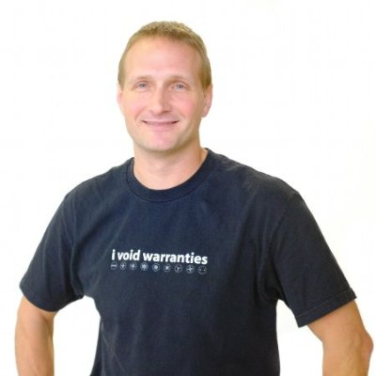
$ whoami_
Aaron Ploetz
B.S.-MCS University of Wisconsin-Whitewater.
M.S.-SED Regis University.
10+ years experience with distributed storage tech.
Supporting Cassandra in production since v0.8.
Contributor to the Apache Cassandra project (cqlsh).
Contributor to the Cassandra tag on Stack Overflow.
3x DataStax MVP for Apache Cassandra (2014-17).

Slide 5
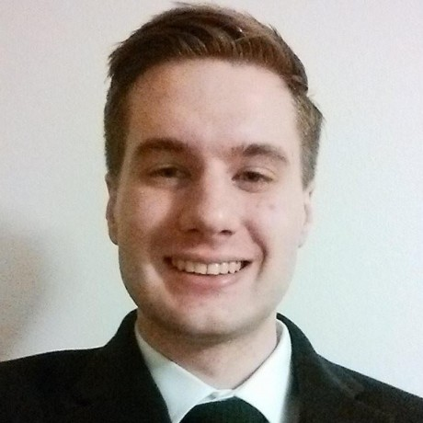
$ whoami_
Andrew From
B.S. Computer Engineering University of Minnesota
Using Cassandra in production since v2.0
Contributor to the Ratpack Framework Project.
Contributor to the Cassandra tag on Stack Overflow.
Maintainer for statsd-kafka-backend plugin on the Target public Github org
I am very passionate and interested in metrics, monitoring, and alerting (not just on Cassandra)

Slide 6
Introduction
Cassandra at Target

Slide 7

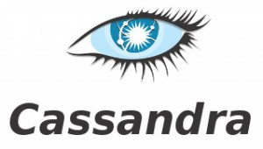
Cassandra clusters at Target
Cartwheel
GAM
DCD
Subscriptions
Enterprise
Services
Personalization
Adaptive-SEO
Checkout
Item Locations
GDM

Slide 8
Versions used at Target
Depends on experience of the application team.
Most clusters run DSE 4.0.3.
Some clusters have been built with Apache Cassandra 2.1.12-15.
Most new clusters built on 2.2.7.

Slide 9
Target’s DCD Cluster
Data footprint = 350Gb
Multi-tenant cluster, supporting several teams:
Rating and Reviews
Pricing
Item
Promotions
Content
A/B Testing
Back To School, Shopping Lists
…and others

Slide 10
2015 Peak (Black Friday -> Cyber Monday)
DataStax Enterprise 4.0.3 (Cassandra 2.0.7.31)
Java 1.7
CMS GC
18 nodes (256GB RAM, 6-core, 24 HT CPUs, 1TB disk):
6 nodes at two Target data centers (3 on-the-metal nodes each).
12 nodes at two tel-co data centers (6 on-the-metal nodes each).
500 Mbit connection with Tel-co datacenters.
Sustained between 5000 and 5500 TPS during Peak.
Zero downtime!

Slide 11
2016 Q1: Expand DCD to the cloud
Plan to expand DCD Cassandra cluster to cloud East and West regions:
Add six cloud instances in each region.
VPN connection to Target network.
Data locality: Support teams spinning-up scalable application servers in the cloud.
Went “live” early March 2016:
Cloud-West 6 nodes
Cloud-East 6 nodes
TTC – 3 nodes
TTCE – 3 nodes
Tel-co 1 – 6 nodes
Tel-co 2 – 6 nodes

Slide 12
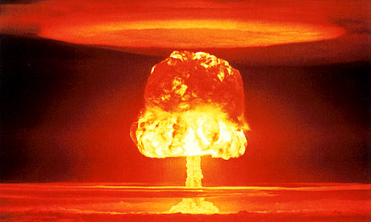
Problems
Cassandra at Target

Slide 13
Problems
VPN not stable between Cloud and Target.
GC Pauses causing application latency.
Orphaned repair streams building up over time.
Data inconsistency between Tel-co and Cloud.
Issues with large batches.
Issues with poor data models.

Slide 14

Solutions
Cassandra at Target

Slide 15
VPN not stable between Cloud and Target
Gossip between Tel-co and Cloud was sketchy.
Nodes reporting as “DN” that were actually ”UN.”
Worked with Cloud Provider admins, reviewed architecture.
Set-up increased monitoring to determine DCD Cassandra downtimes, cross-referenced that with VPN connection logs with both our (Target) Cloud Platform Engineering (CPE) Network team and Cloud Provider admins.
Our CPE Network team worked with Cloud Provider to:
Ensure proper network configuration.
“Bi-directional” dead peer detection (DPD).
“DPD Responder” handles dead peer requests from Cloud endpoint.
Upgrade our VPN connections to 1Gbit.

Slide 16
GC Pauses causing application latency
STW GC pauses of 10-20 seconds (or more) rendering nodes unresponsive, during nightly batch jobs (9pm – 6am). Most often around 2am.
Was a small issue just prior to 2015 Peak Season; became more of a problem once we expanded to the cloud.
Worked with our teams to refine their data models and write patterns.
Upgraded to Java 1.8.
Enabled G1GC…biggest “win.”

Slide 17
Orphaned repair streams building up over time
Due to VPN inconsistency, repair streams between Cloud and Tel-co could not complete consistently.
Orphaned Streams (pending repairs) built-up over time, system load average in Tel-co and Target nodes rose, nodes eventually became unresponsive.
Examined our use cases, scheduled ”focused” repair jobs, and only for certain applications.
nodetool –h <node_ip> repair –pr -hosts <source_ip1,source_ip2,etc…>
Only run repairs between Cloud and Target or Tel-co and Target.

Slide 18
Data inconsistency between Tel-co and Cloud
Data inconsistency issues causing problems for certain teams.
Upgraded our Tel-co connection to 1Gbit, expandable to 10Gbit on request.
But this was ultimately the wall we could not get around.
Problems with repairs, but also issues with boot-strapping and decommissioning nodes
Met with ALL application teams:
Discussed a future plan to split-off the Cloud nodes (with six new Target nodes) into a new “DCD Cloud” cluster.
Talked through application requirements, determined who would need to move/split to “DCD Cloud.”
Also challenged the application teams on who really needed to be in both Cloud and Tel-co. Turns out that only the Pricing team needed both, and the rest could successfully serve their requirements from one or the other.

Slide 19
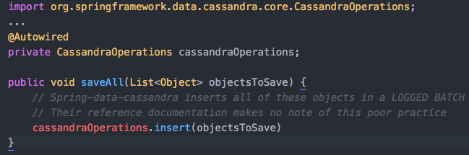
Issues with large batches
Teams unknowingly using batches:

Slide 20
Poor Data Models
Using Cassandra in a batch way:
Reading large tables entirely with SELECT * FROM table;
Re-inserting data to a table on a schedule, even when data has not changed
Lack of de-normalized tables to support specific queries
Queries using ALLOW FILTERING
“XREF” tables
Queue-like usage of tables
Extremely large row sizes
Abuse of Collection data types
Read before writing (or writing then immediately reading)

Slide 21
Current State
Cassandra at Target

Slide 22
August 2016
DataStax Enterprise 4.0.3 (Cassandra 2.0.7.31)… Upgrade to 2.1 planned.
Java 1.8
G1GC 32GB Heap, MaxGCPauseMillis=500
DCD Classic - 18 nodes (256GB RAM, 24 HT CPUs, 1TB disk):
6 nodes at two Target data centers (3 on-the-metal nodes each).
12 nodes at two Tel-co data centers (6 on-the-metal nodes each).
DCD Cloud - 18 nodes (256GB RAM, 24 HT CPUs):
6 nodes at two Target data centers (3 on-the-metal nodes each).
12 nodes at two Cloud data centers (6 i2.2xlarge nodes each).
Upgraded connection (up to 10 Gbit) with Tel-co.

Slide 23
Lessons Learned
Spend time on your data model!
Most overlooked aspect of Cassandra architecting.
Build relationships with your application teams.
Build tables to suit the query patterns.
Talk about consistency requirements with your app teams.
Ask the questions:
Do you really need to replicate everywhere?
Do you really need to read/write at LOCAL_QUORUM?
What is your anticipated read/write ratio?
Watch for tombstones! TTL-ing data helps, but TTLs are not free!

Slide 24
Lessons Learned (part 2)
Involve your network team.
Use a metrics solution (Graphite/Grafana, OpsCenter, etc)
Give them exact data to work with.
When building a new cluster with data centers in the cloud, thoroughly test-out the operational aspects of your cluster:
Bootstrapping/decommissioning a node.
Running repairs.
Trigger a GC (cassandra-stress can help with that).
G1GC helps for larger heap sizes, but it’s not a silver bullet.

Slide 25

Questions?
Cassandra at Target

