Slide 1

Gurpreet Singh
Deploying ,backing up and restore with Datastax and Azure .

Slide 2
1 | Introduction
2 | What is ARM ?
3 | Data Backup Strategy
4 | Restore Data
5 | Questions ?

Slide 3
About me :
Currently working as a Cloud Architect At Albertsons/Safeway
Passionate about cloud and Big data technologies, self-motivated
I love to socialize and I believe in never giving up.

Slide 4

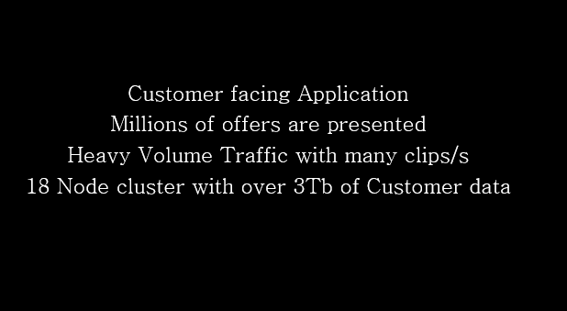

Slide 5
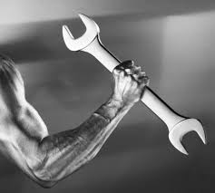
ARM (Deployment)
RESOURCE
RESOURCE GROUP
RESOURCE PROVIDER
RESOURCE MANAGER TEMPLATE
DECLARATVE SYNTAX

Slide 6
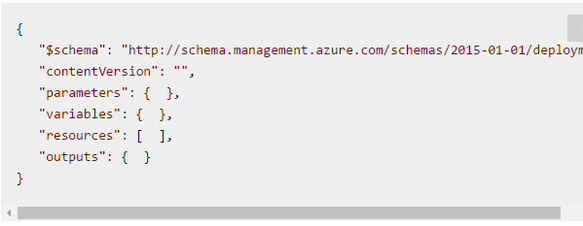
ARM (Deployment CONTD ..)
ARM : Azure Resource Manager , a template which is written in JSON a key–value pair .
Template Format :

Slide 7

Backup
OpsCenter backups the data ,how ?

Slide 8
ChallenGES/Limitations
OpsCenter 5.X didn't have option to backup the data in Centralized location in Azure cloud , the way it has Amazon S3 .
Network latency if we try to use one or two blob storage for multiple VMs (Causes failure) .

Slide 9
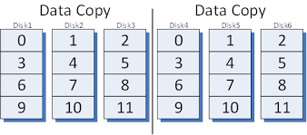
rsync – a mirror !
All the nodes MUST have custom script at location
“/usr/share/datastax-agent/bin/backup-scripts”
Or
./bin/backup-scripts for tarball
Using Opscenter ->Backups , you can schedule backups.

Slide 10
Restore
How and where to start Restore ?

Slide 11
Steps to Restore Cassandra on Azure
Standup new infrastructure with DSE software and with exact same no. of nodes as in Production .
Copy the mirror disks to the location where a restore should be performed
Update cassandra.YAML with cluster name ,seeds ,broadcast_address,rpc_address ,num_tokens and data, commit logs and saved caches directory .
Update cassandra-rackdc.properties with the dc and rack (Fault domains in Azure , Availability zones in amazon) .
Clean-up the SYSTEM tables Peers, Local .
Update Cluster name, data-center & Rack for LOCAL column family .
NODETOOL FLUSH .
START Your DSE .

Slide 12


