Slide 1
Brian Hess, Rob Murphy, Rocco Varela
Data Science with DataStax Enterprise

Slide 2
Who Are We?
Brian Hess
Senior Product Manager, Analytics
15+ years in data and analytics
Rob Murphy
Solution Architect, Vanguard Team
Rocco Varela
Software Engineer in Test
Gov’t, NoSQL, Data Warehousing, Big Data
Math and CS background
PhD in Bioinformatics
Background in predictive modeling, scientific computing
DSE Analytics Team
Background in computational science and science-focused informatics
Thinks data, stats and modeling are fun

Slide 3
1 | Data Science in an Operational Context
2 | Exploratory Data Analysis
3 | Model Building and Evaluation
4 | Deploying Analytics in Production
5 | Wrap Up

Slide 4


Slide 5
Willie Sutton
Bank Robber in the 1930s-1950s
FBI Most Wanted List 1950
Captured in 1952

Slide 6
Willie Sutton
When asked “Why do you rob banks?”

Slide 7
Willie Sutton
When asked “Why do you rob banks?”
“Because that’s where the money is.”

Slide 8
Why is DSE Good for Data Science?

Slide 9
Why is DSE Good for Data Science?
That’s where the data ARE

Slide 10
Why is DSE Good for Data Science
Analytics on Operational Data is very valuable
Data has a half-life
Insights do, as well
Cassandra is great for operational data
Multi-DC, Continuous Availability, Scale-Out, etc, etc
Workload isolation allows access
No more stale “snapshots”
Cassandra lets you “operationalize” your analysis
Make insights available to users, applications, etc
E.g., recommendations

Slide 11
Exploratory Data Analysis in DSE
What is EDA?
Wikipedia is pretty solid here:
Exploratory data analysis (EDA) is an approach to analyzing data sets to summarize their main characteristics, often with visual methods (https://en.wikipedia.org/wiki/Exploratory_data_analysis)
Why EDA?
John Tukey – Exploratory Data Analysis (1977) emphasized methods for exploring and understanding data as a precursor to Confirmatory Data Analysis (CDA).
You can’t escape statics even if you just want to dive head first into machine learning!

Slide 12
Exploratory Data Analysis in DSE
sqlContext
General Statistics
DataFrame
// packages for Summary Statistics
import numpy as np
from pyspark.mllib.stat import Statistics
from pyspark.sql import Row, SQLContext from pyspark import SparkContext, SparkConf
data= sqlContext.read.format("org.apache.spark.sql.cassandra").options(table="input_table",keyspace="summit_ds").load() rdd = data.map(lambda line: Vectors.dense(line[0:]))
summary = Statistics.colStats(rdd)
print(summary.mean())
print(summary.variance())
print(summary.numNonzeros())
# OR !!!!!!
data.describe().toPandas().transpose()
RDD
Spark ML
Start

Slide 13
Exploratory Data Analysis in DSE
sqlContext
Correlation
DataFrame
// packages for Summary Statistics
(imports)
data= sqlContext.read.format("org.apache.spark.sql.cassandra").options(table="input_table",keyspace="summit_ds").load() rdd = data.map(lambda line: Vectors.dense(line[0:]))
print(Statistics.corr(data, method="pearson"))
Or
print(Statistics.corr(rdd, method="spearman"))
RDD
Spark ML
Start

Slide 14
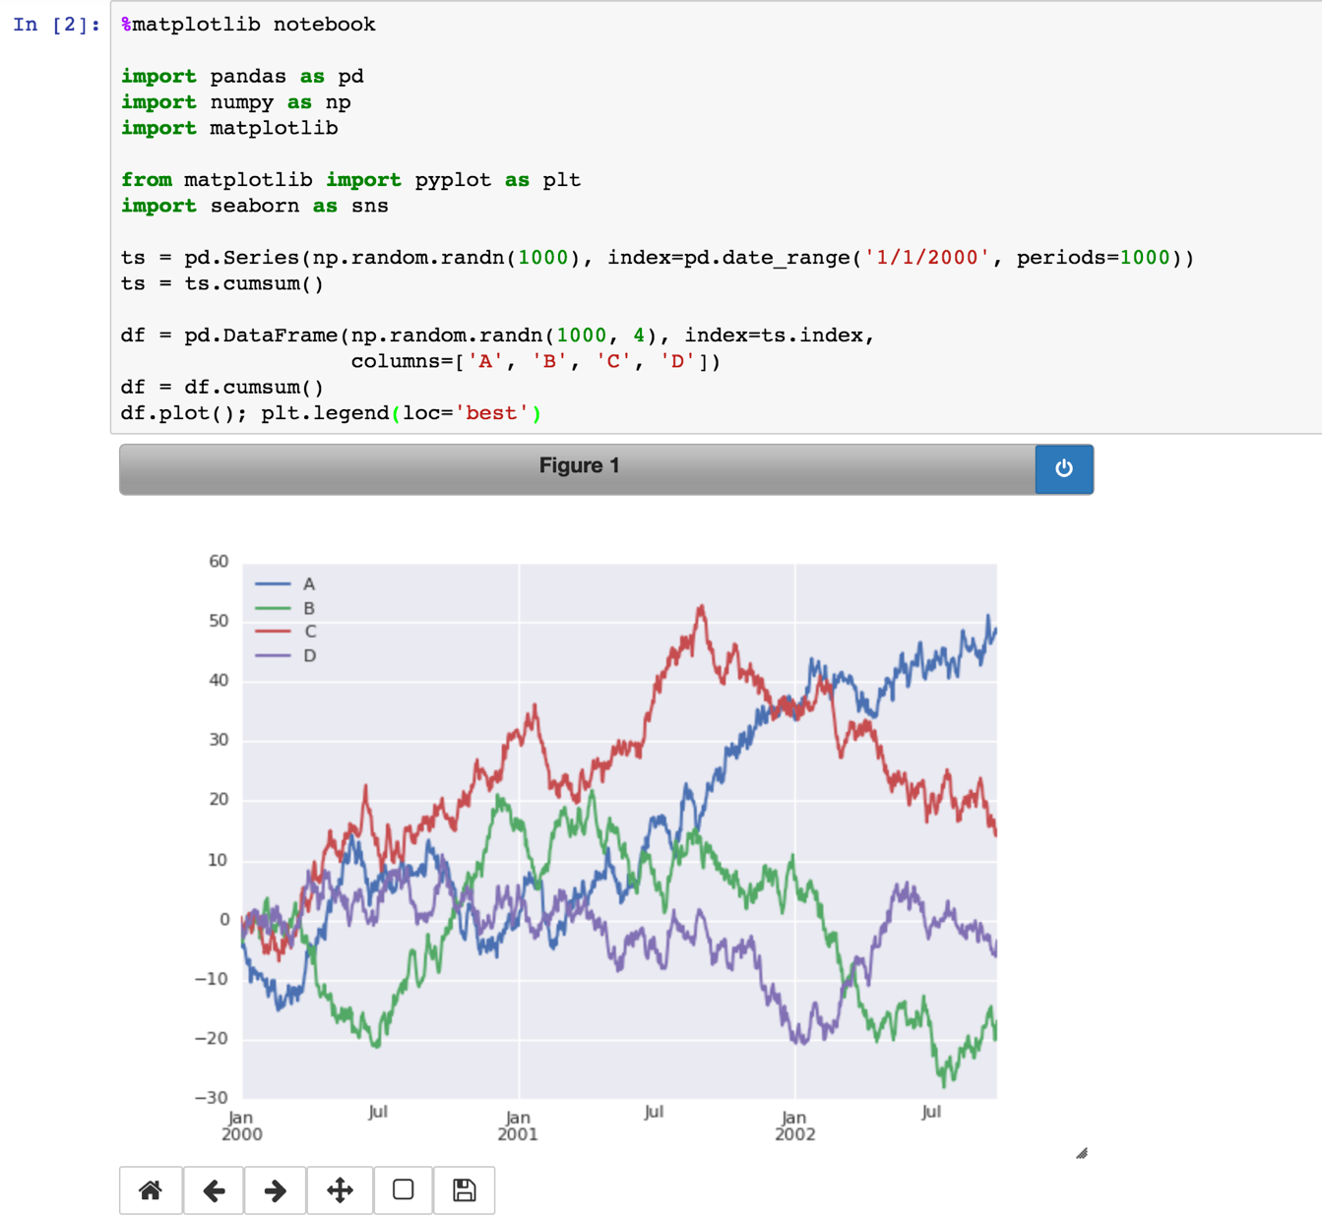
Exploratory Data Analysis in DSE
Visualization

Slide 15

Building Models
There are a few dragons:
Spark ML – DataFrames and “The Way” of the future
Spark MLLib, more complete but largely RDD based.
Lots of good features are experimental and subject to change (this is Spark right?)

Slide 16
Building Models
sqlContext
from pyspark.mllib.regression import LabeledPoint from pyspark.mllib.tree import RandomForest, RandomForestModel #- Pull data from DSE/Cassandra data = sqlContext.read.format("org.apache.spark.sql.cassandra").options(table="class_table",keyspace="summit_ds").load() #- Create an RDD of labeled points dataForPredict = data.map(lambda line: LabeledPoint(line[1], [line[2:]])) #- Basic split of train/test train, test = (dataForPredict.randomSplit([0.8, 0.2])) catFeatures = {2: 2, 3: 2} #- Create instance of classifier with appropriate config classifier = RandomForest.trainClassifier(train, numClasses=2, categoricalFeaturesInfo=catFeatures, numTrees=5, featureSubsetStrategy="auto", impurity="gini", maxDepth=5, maxBins=100, seed=42) predictions = classifier.predict(test.map(lambda x: x.features)) labelsAndPredictions = test.map(lambda lp: lp.label).zip(predictions)
DataFrame
RDD
Spark ML
Start

Slide 17
Evaluating Models
Spark ML has continuously expanded model evaluation packages.
Classification
Spark does still not provide useful, ubiquitous coverage.
You can create your own confusion matrix
Precision is NOT the magic bullet.
You MUST understand how much of the accuracy is attributed to the model and how much is not.
Regression
Spark does still not provide useful, ubiquitous coverage.

Slide 18
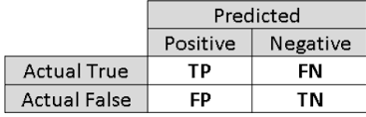
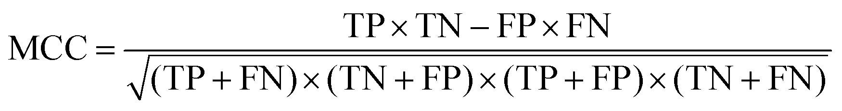
Evaluating Models
Use simple data driven ‘fit’ measures
Apply these standard measures across high level ML classes
Easy to implement, wholly based on expected vs. predicted label
Confusion Matrix
Matthews Correlation Coefficient

Slide 19
Evaluating Models
sqlContext
<imports>
< data pulled from Cassandra and split >
rf = RandomForestClassifier(numTrees=2, maxDepth=2, labelCol="indexed", seed=4) model = rf.fit(td) test = model.transform(testingData) predictionAndLabels = test.map(lambda lp: (float(lp.prediction), lp.label)) # Instantiate metrics object metrics = BinaryClassificationMetrics(predictionAndLabels) # Area under precision-recall curve print("Area under PR = %s" % metrics.areaUnderPR) # Area under ROC curve print("Area under ROC = %s" % metrics.areaUnderROC)
DataFrame
RDD
Spark ML
Start

Slide 20
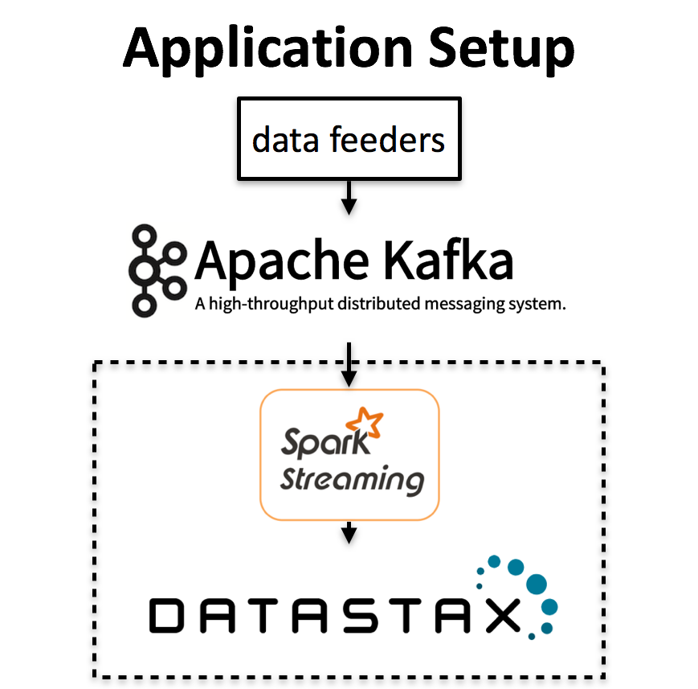
We can easily analyze data with existing workflows
Say for example we have multiple streams incoming from a Kafka source.
Suppose we want to cluster data into known categories.
Using Spark StreamingKmeans, we can easily update a model in real time from one stream, while making predictions on a separate stream.
Let’s see how we can do this.

Slide 21
We can easily update a clustering model in real time
Streaming Model Setup
// define the streaming context
val ssc = new StreamingContext(conf, Seconds(batchDuration))
// define training and testing dstream by the Kafka topic
val trainingData = KafkaUtils.createDirectStream[String, String, StringDecoder, StringDecoder](ssc, kafkaParams, trainTopic)
val testData = KafkaUtils.createDirectStream[String, String, StringDecoder, StringDecoder](ssc, kafkaParams, testTopic)
val model = new StreamingKMeans() .setK(numClusters) .setDecayFactor(1.0) .setRandomCenters(nDimensions, seed) model.trainOn(trainingData) model.predictOnValues(testData.map(lp=>(lp.label,lp.features))).print()
ssc.start()
StreamingContext
Training Stream
Testing Stream
StreamingKmeans Model
Start

Slide 22
We can easily update a clustering model in real time
// define the streaming context
val ssc = new StreamingContext(conf, Seconds(batchDuration))
// define training and testing dstream by the Kafka topic
val trainingData = KafkaUtils.createDirectStream[String, String, StringDecoder, StringDecoder](ssc, kafkaParams, trainTopic)
val testData = KafkaUtils.createDirectStream[String, String, StringDecoder, StringDecoder](ssc, kafkaParams, testTopic)
val model = new StreamingKMeans() .setK(numClusters) .setDecayFactor(1.0) .setRandomCenters(nDimensions, seed) model.trainOn(trainingData) model.predictOnValues(testData.map(lp=>(lp.label,lp.features))).print()
ssc.start()
Decay factor is used to ignore old data.
Decay = 1 will use all observed data from the beginning for cluster updates.
Decay = 0 will use only the most recent data

Slide 23
We can easily update a clustering model in real time
Real time Training
DStream[Vector]
// define the streaming context
val ssc = new StreamingContext(conf, Seconds(batchDuration))
// define training and testing dstream by the Kafka topic
val trainingData = KafkaUtils.createDirectStream[String, String, StringDecoder, StringDecoder](ssc, kafkaParams, trainTopic)
val testData = KafkaUtils.createDirectStream[String, String, StringDecoder, StringDecoder](ssc, kafkaParams, testTopic)
val model = new StreamingKMeans() .setK(numClusters) .setDecayFactor(1.0) .setRandomCenters(nDimensions, seed) model.trainOn(trainingData) model.predictOnValues(testData.map(lp=>(lp.label,lp.features))).print()
ssc.start()
For each RDD
Perform a k-means update on a batch of data.
Predictions
DStream[(K, Vector)]
mapOnValues
Find closest cluster center for given data point
DStream[(K, PredictionVector)]

Slide 24
The same setup can be used for a real time logistic regression model
// define the streaming context
val ssc = new StreamingContext(conf, Seconds(batchDuration))
// define training and testing dstream by the Kafka topic
val trainingData = KafkaUtils.createDirectStream[String, String, StringDecoder, StringDecoder](ssc, kafkaParams, trainTopic)
val testData = KafkaUtils.createDirectStream[String, String, StringDecoder, StringDecoder](ssc, kafkaParams, testTopic)
val model = new StreamingLogisticRegressionWithSGD() .setInitialWeights(Vectors.zeros(numFeatures))
model.trainOn(trainingData) model.predictOnValues(testData.map(lp=>(lp.label,lp.features))).print()
ssc.start()
StreamingContext
Training Stream
Testing Stream
StreamingModel
Start

Slide 25
Layering this with fault-tolerance in DataStax Enterprise is straight forward
Modeling with Fault-tolerance
// define the streaming context
val ssc = new StreamingContext(conf, Seconds(batchDuration))
// define training and testing dstream by the Kafka topic
val trainingData = KafkaUtils.createDirectStream[String, String, StringDecoder, StringDecoder](ssc, kafkaParams, trainTopic)
val testData = KafkaUtils.createDirectStream[String, String, StringDecoder, StringDecoder](ssc, kafkaParams, testTopic)
val model = new StreamingLogisticRegressionWithSGD() .setInitialWeights(Vectors.zeros(numFeatures))
model.trainOn(trainingData) model.predictOnValues(testData.map(lp=>(lp.label,lp.features))).print()
ssc.start()
def main(args: Array[String]) {
def createStreamingContext():
Create StreamingContext
Define checkpoint path
Define Streams
Define Model
Make predictions
Process data
val ssc = StreamingContext.getActiveOrCreate(
checkpointPath,
createStreamingContext)
ssc.start()
ssc.awaitTermination()
}

Slide 26
Things you should take away
Cassandra is "where the data are”
Data Science Data Center - access to live data at low operational impact
Good (and *growing*) set of Data Science tools in Spark-
Part of Spark, so leverage the rest of Spark for gaps-
Easy to operationalize your Data Science –
deploy models in streaming context –
deploy models in batch context –
save results to Cassandra for low-latency/high-concurrency retrieval in operational apps

Slide 27
Thank You

