Slide 1
Oracle, let my people go!
Ilya Sokolov, Technical Director / Architect
Shu Zhang, Director, Database Engineering
Lei Gu, Technical Director / Architect
Navdeep Kainth, Principal Database Engineer

Slide 2





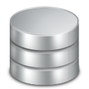
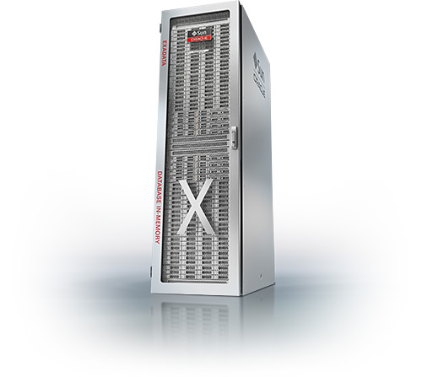


Oracle @
50+ products
500
Oracle Databases
750
1000+
250
Notes:
Symantec is the largest security company who protects enterprise and people in their digital life. We are part of Norton business unit.
Email security, device, user, BH, Email in the cloud,
Consumer Security Products Backend DBs: Licensing, Accounts, Estore…
Enterprise Security Products Backend DBs:
Oracle databases: Oracle Grid Control for monitoring; Oracle GoldenGate replication for multi-DC; Oracle Data Guard for DR.
Oracle applications: Financials, Inventory, I-procurement, supply chains and etc to run Symantec business internally.
We use Coherrence (in-memory caching) for consumer products;
We use Super cluster for estore and etc
DEV, QA, INT, UAT, Prod in 20+ DCs

Slide 3

Oracle can do anything, but …
Scale
Oracle Supercluster couldn’t keep up with our event generation rates
Cloud
Higher licensing cost, no RAC, support issues
Cost
Symantec Oracle Licensing Cost: $$$M+ Annually
Notes:
Event generation rate: 50M customers, 100M+ endpoints; 10K+ events per second, Oracle cannot keep up because of its fundamental architecture limit, e.g. update: CBO, index, data block, maxtrans, pctused, pctfree, LRUs, migrated or chained rows, locks, enqueue; redo buffer flush to disk, DB writer writes SCNs to file headers
limited by OGG integrated replicat can only replicate 1,000 events per second due to FK and other dependencies; Therefore most of the time it runs serially instead of parallel
DB size: entire Oracle Super cluster 96TB;
NSP:10 million, with 50 PB meta data alone
Public or Hybrid Cloud:
no (or very expensive) physical servers ($0.13 vs. $5), limited VM size; more licensing cost
support issues: Oracle Linux
HA: VM less reliable
no RAC (cannot run multi-cast),
OS patching: spin off new VMs with new versions, re-deploy
Cost
How it cuts into our profit
POC, $20K revenue resume while oracle licensing cost $1M
- Oracle $47K per core, $23K, $80K per core; DSE$800 per core including support, search and Spark. 100 times diff
Oracle RDBMS: $10M licensing cost + $2.5M for Oracle support.
Oracle Superclusters: $5M for HW alone (SW licenses additional), $1M annual support
Additional: Oracle 12c PDB, OGG with non-Oracle DB targets, Oracle Coherence, and etc
Oracle Applications
----------
Oracle performance bottleneck: Redo log; undo, locks, enqueues (internal structure); limited memory; Update/delete does a read first, then write back to the same place; insert/update/delete involves index changes;
All index are b-tree indexes, levels.
Inserts: indexes; LOBs, writing index meaning retrieving it first; unlimited shared memory
Updates: in-place update: when updating one column, you update all; LCRs (old and new images); read and updating all index
Delete: physical
DDL changes: remove columns, add columns,
Queries: ; query by PK is at least two I/Os;
, redo, commit, not all in memory Cassandra

Slide 4

And Pharaoh said…
“…Cassandra’s underlying tech actually came from an acquisition Facebook did which we looked at very closely, compared to Oracle and passed because there was lot of tech overlap…”
Notes:
[A picture of boss from Dilbert and a quote “…Casandra’s underlying tech actually came from an acquisition Facebook did which we looked at very closely, compared to Oracle and passed because there was lot of tech overlap…”]
We don’t actually want to say that our managers in Symantec are not experts. They’re actually very experienced and talented people working on a lot of innovation and having many patents.
[A picture of Lei covers the boss]
Problem is Oracle is indeed viewed as a time proven technology that can do anything and therefore de facto should be selected for any solution.
If you start something new, psychologically you want to rely on something verified over time to eliminate the risk. Something you know your DBAs are proficient in.
The only way to fight the perception is to start small, show benefits, provide concrete examples how projects based on Cassandra can succeed
We were somewhat lucky because we had several chief architects having background in No-SQL and coming from companies big on No-SQL (Google, Netflix, Intuit) and this process wasn’t terribly hard.
This is not to say this is always the case.

Slide 5
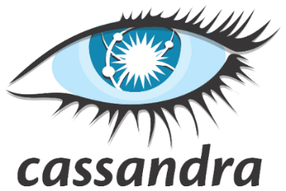



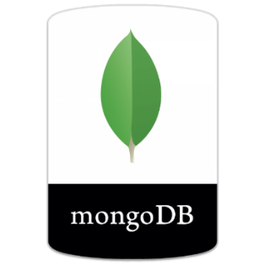
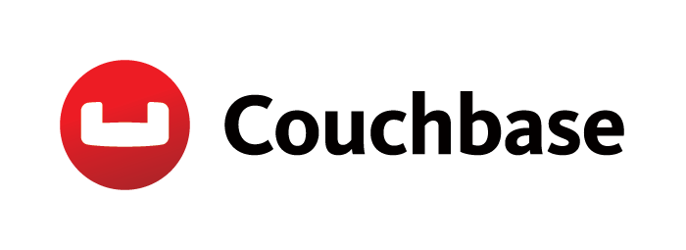

Why Cassandra
Active-Active
Licensing
Secondary indexes
Performance
Multi-DC
Notes:
Elastic: cannot do full recovery

Slide 6
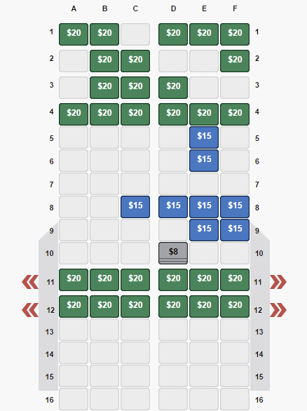
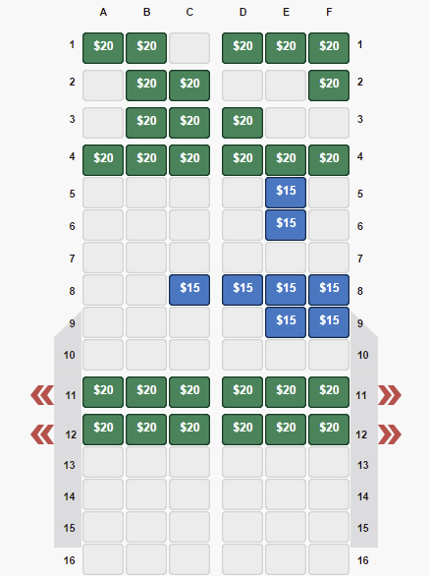
Pitfalls #1: Eventual Consistency
?
Notes:
[Two images of airplane seat selection system side by side, one showing seat is available and another that it is not]
[Add arrows pointing to the difference for visibility]
At first it may be confusing (and even scary) that some parts of your system may get different results when querying for the same data at the same time.
This may be viewed as a strong reason to continue using Oracle. However, truth to be said, the moment you go truly go global, place geo located DC all over the world, Oracle stops being consistent as well.
For example, we still try to merge 30K colliding Norton user accounts stored in Oracle that got created individually in separate datacenters, bought different sets of products but look to us as completely different accounts.
Instead of treating eventual consistency and collisions as “big evil” that needs to be fought at all costs, do not waste time trying to create over engineered solutions that would slip probability of a collision under the carpet.
We need to accept and include them into architecture, embrace them in such a way that architecture expects that system being inconsistent for a short period of time.
For example, Facebook keeps sending you to the same DC where the change was made for 5 min after the change was made. Or instead of using sequences, “natural keys” may be used always resolving to the same value in any component of the system (e.g. a hash of user email can be used as PK)
Oracle does not guarantee logical consistency:
Wrong combination: Address in three columns, street, city, state; One person updated the City column; another person updated the state
when running multi-DC: Why does oracle have Veridata? Because OGG replication has problems. records not replicated. 30K users we cannot consolidate due to conflicts cannot be resolved; email ; normalized data;

Slide 7
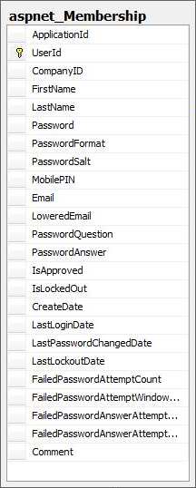
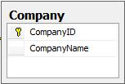
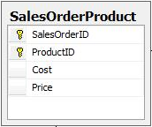
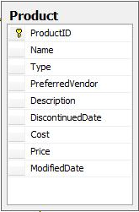
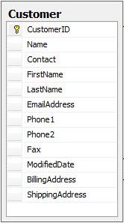
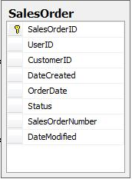
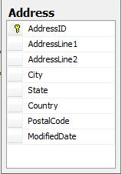
Pitfalls #2: Normalize a lot
Notes:
[Tables start popping up with connections/relations between them]
Back in the days when I was designing schema for a new Oracle based product I’d start normalizing data, establishing foreign keys between them, making sure that all proper secondary indexes are set.
Often it was an exercise of staring at a query execution plan to understand why it suddenly taking 30 min to complete.
And naturally, since there’re tables in Cassandra the first knee jerk reaction is to do the same. Only this doesn’t work: you can’t join the data
Luckily there’re new nice datatypes (such as lists, maps, sets) that often allow store collections of child associated data in a single row.
As result often or schema becomes very simplistic
[Many tables fade, one table appears]
Alright, may be not as simplistic
[Another table appears]

Slide 8
Pitfalls #2: Normalize a lot
CREATE TABLE USER (
NORTON_ID VARCHAR PRIMARY KEY,
EMAIL VARCHAR,
PASSWORD_HASH VARCHAR,
FIRST_NAME VARCHAR,
LAST_NAME VARCHAR,
BIRTHDAY TIMESTAMP,
ID_PROOF_HISTORY LIST<TEXT>,
TFA_DEVICE LIST<TEXT>
);
ID | FIRST NAME | LAST NAME | TFA DEVICE
1 | Ilya | Sokolov | {“(555)123-4567”, “(555)987-6543”}
2 | Shu | Zhang | {“(555)567-1234”}
USER | SKU | QUANTITY
1 | 8653f7d1-5114-4a9c-b158-7ae1d71ff9fe | 1
2 | a1018ab3-1674-4ab6-b19b-91e0a24ac75f | 1

Slide 9


Pitfalls #3: Code like for Oracle
try {
statement.executeUpdate(“INSERT INTO USER “+
“(ID, FIRST_NAME, LAST_NAME) “+
“VALUES (1, “Shu”, “Zhang”)”);
}
catch (ConstraintViolationException cve) {
…
}
Notes:
[Update statement WHERE PK=X and then a check if rows affected > 0]
If you show this statement to a developer who worked with Oracle for a while, he’d never believe you that it’ll actually insert a row in Cassandra if it was not there before.
In short, you likely can’t really take the code you have, point to Cassandra and expect it to work.
You need to rethink this tiny things you used to do to check if row exists or doesn’t exist (For example, you could use INSERT IF NOT EXISTS) or to make sure that if you decrease balance in one account, the same amount is actually credited to another account.
May be some of the tricks are already not needed because of how the schema is designed (e.g. you don’t need to create transactions to update parent and child table consistently – you’d atomically change one row in one table)
If transactions are not avoidable (for whatever reason), batching updates will help

Slide 10




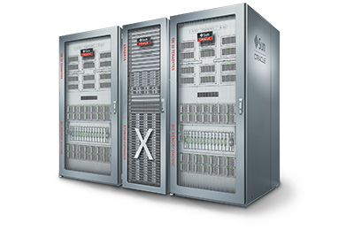
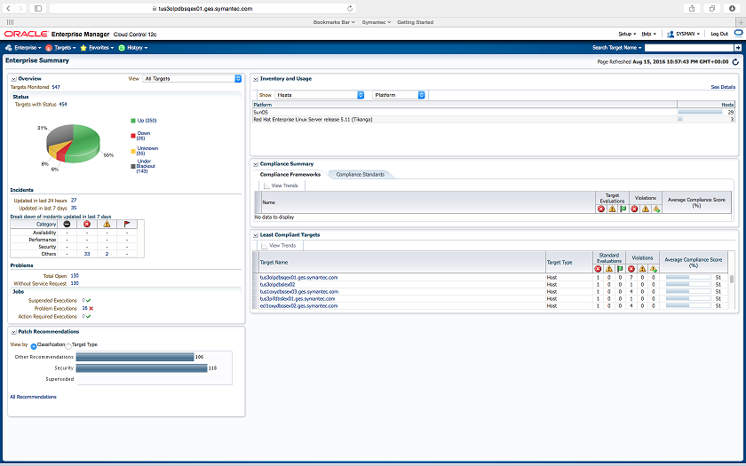
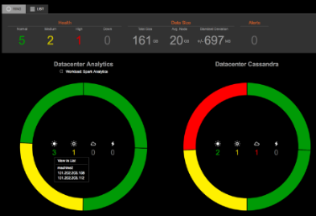

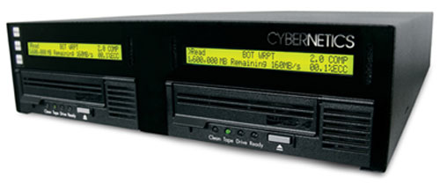
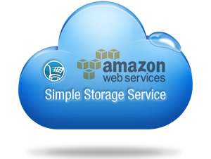
Pitfalls #4: Deploy like on Oracle
CloudFormation
Deploy
Deploy
Analyze
VS.
Analyze
Backup
Backup
Notes:
Sas, DBAs, SW Eng work together manually
SAN: 16K+ events/sec shows clear latency
Oracle Deployment:
First aquire HW
SA team on pre-requisite,
Storage team to define what type of storage is required for data, index, redo, undo and etc
Backup Team
Oracle Grid Control
Auto deployment is very challenging; RAC, ASM, OGG, sequential; Oracle MAA architecture: RAC + DR;
Conclude with the benefit and simplicity of Cassandra

Slide 11
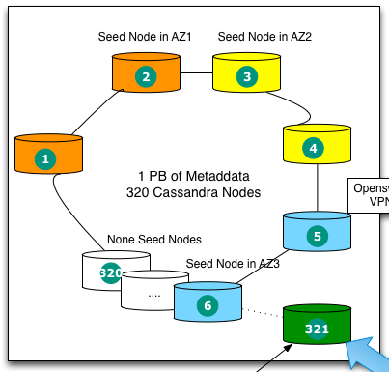
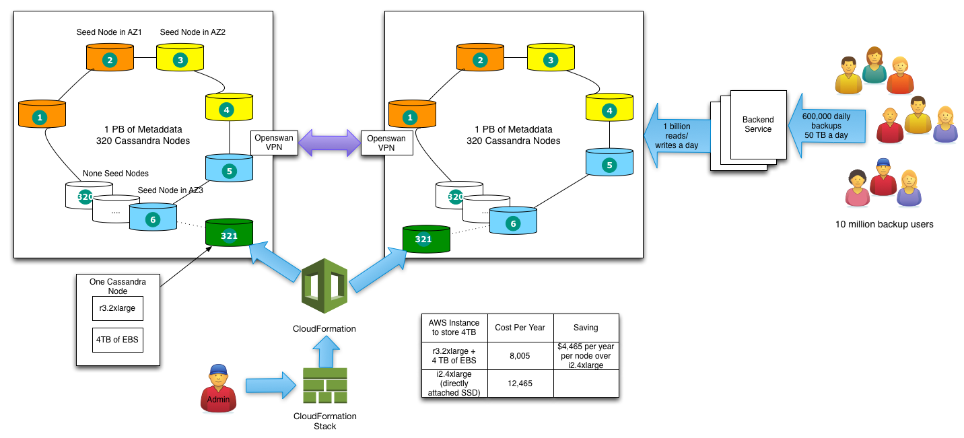
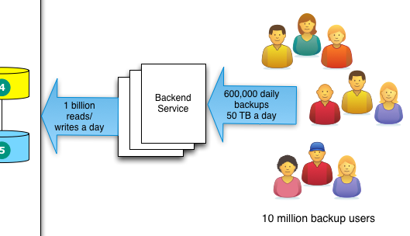
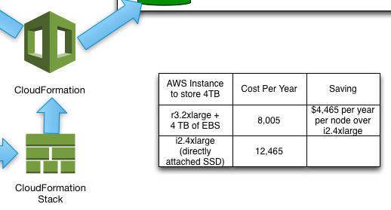
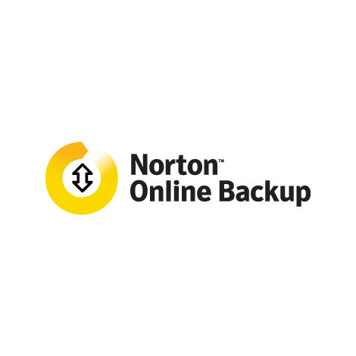
Norton Backup
Notes:
10 million backup users and 600,000 active daily users
50 PB Data in AWS S3 eventually
1 PB of metadata stored in 320 Cassandra nodes
50 TB backup data a day
Over 1 billion reads + writes combined
Use Cloud Formation and Cloud Formation stack to bring up Cassandra nodes. Use two separate CF stacks, one for seed nodes and one for non-seed nodes. Seed nodes should go into their own VPC so one can pre-assign IP addresses for seed nodes. Place nodes in all possible availability zones. Don’t use auto scaling to auto scale Cassandra nodes.
Use r3 + EBS is 50% cheaper than using i2 instances. Plus when i2 crashes, all data is gone. But data on EBS is preserved so one can quickly bring up a new r3 node and remount the original EBS to be back in business again, instead of waiting for hours for the new node to catch up on 4TB of data.
To bring up a new node, just deploy an updated version of CF script.
Use Openswan VPN to replicate between regions

Slide 12

Our Cassandra Results
Performance: 190%
Licensing Cost: 5%
HW Cost: 17%
Operational Cost: 8%
Satisfaction: 200%
Notes:
Performance increase 90%:
- less latency; higher throughput;
- Denormalization; lookup is much faster
- NSP throttle rate increased from 1% to 50% in 3 days and to 100% in two weeks; bottleneck is application, not Cassandra;
- Solving additional issues (users were unable to restore backup); We are able to offer backup to more customers (for default storage) and increase their quota. We are looking at adding more features (Crypto Lock and Ransomware protection), due to the lower cost of cloud solution.
- Combine multi application in one cluster; oracle: patching downtime, resource contention
Licensing Cost: 10M -> 0.5M
HW Cost:
- Supercluster: 384 Processors, 32TB RAM, 432TB raw storage, $5M + M5000 $50K + SAN $300K; $20M -> $1M;
- Cloud price for Vms: r3 2xlarge (8 vCPUs, 61G RAM, 160GB local SSD): $0.66 per hour, $5,786 per year, $17K for three years
Operational expense:
- 10 Oracle DBAs, 1 Cassandra DBA; No SAs, Storage, Network
- deployment automation, easy to maintain,
- No more tablespace full, archive log destination full, replication latency, apply errors, query plan changed, no more war room
- No need to staff three shifts and weekend oncall
Many less Incidents;
Satisfaction:
- data consistency issues; fixing data

Slide 13
Thank you!

