Slide 1
Ben Slater, Instaclustr
Processing 50,000 events per second with Cassandra and Spark

Slide 2

Introduction
Ben Slater, Chief Product Officer, Instaclustr
Cassandra + Spark Managed Service, Support, Consulting
20+ years experience as a developer, architect and dev/dev-ops team lead
DataStax MVP for Apache Cassandra

Slide 3
Processing 50,000 events per second with Cassandra and Spark
1 | Problem background and overall architecture
2 | Implementation process & lessons learned
3 | What’s next?

Slide 4
Problem background
How to efficiently monitor >600 servers all running Cassandra
Need to develop a metric history over time for tuning alerting & automated response systems
Off the shelf systems are available but:
probably don’t give us the flexibility we want to be able to optimize for our environment
we wanted a meaty problem to tackle ourselves to dog-food our own offering and build our internal skills and understanding

Slide 5
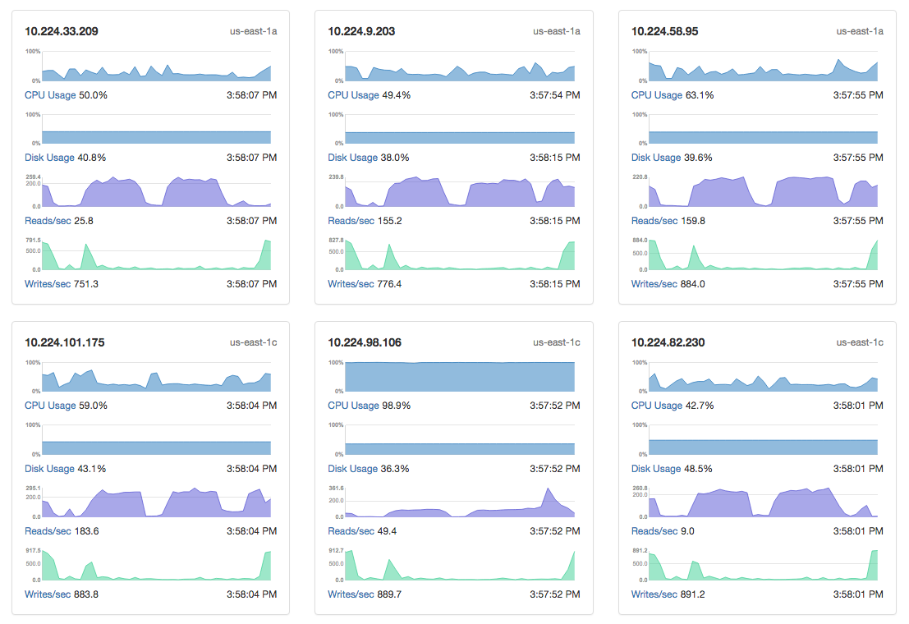
Solution Overview
500 nodes * ~2,000 metrics / 20 secs = 50k metrics/sec
Managed Node (AWS) x many
Console/ API
(x2)
Managed Node (Azure) x many
RabbitMQ
(x2)
Riemann
(x3)
Cassandra + Spark (x15)
Admin Tools
Managed Node (SoftLayer) x many
PagerDuty

Slide 6
Implementation Approach
Writing Data
Rolling Up Data
Presenting Data
~ 9(!) months
(with quite a few detours and distractions)

Slide 7
Writing Data
Worked, Filled Up, Worked, Broke, Kind of Works, Works!
Key lessons:
Aligning Data Model with DTCS
Initial design did not have time value in partition key
Settled on bucketing by 5 mins
Enables DTCS to work
Works really well for extracting data for roll-up
Adds complexity for retrieving data
When running with STCS needed unchecked_compactions=true to avoid build up of TTL’d data
Batching of writes
Found batching of 200 rows per insert to provide optimal throughput and client load
See Adam’s talk from yesterday for all the detail
Controlling data volumes from column family metrics
Limited, rotating set of CFs per check-in
Managing back pressure is important

Slide 8
Rolling Up Data
Works?, Doesn’t Work, Doesn’t Work, Doesn’t Work, Doesn’t Work, Works!
Developing functional solution was easy, getting to acceptable performance was hard (and time consuming) but seemed easy once we’d solved it
Keys to performance?
Align raw data partition bucketing with roll-up timeframe (5 mins)
Use joinWithCassandra table to extract the required data – 2-3x performance improvement over alternate approaches
val RDDJoin = sc.cassandraTable[(String, String)]("instametrics" , "service_per_host") .filter(a => broadcastListEventAll.value.map(r => a._2.matches(r)).foldLeft(false)(_ || _)) .map(a => (a._1, dateBucket, a._2)) .repartitionByCassandraReplica("instametrics", "events_raw_5m", 100) .joinWithCassandraTable("instametrics", "events_raw_5m").cache()
Write limiting (eg cassandra.output.throughput_mb_per_sec) not necessary as writes << reads

Slide 9
Presenting Data
Generally, just worked
Main challenge was dealing with how to find latest data in buckets when not all data is reported in each data set

Slide 10
What’s Next
Decisions to revisit:
Use Spark Streaming for 5 min roll-ups rather than save and extract
Scale-out by adding nodes is working as expected
Continue to add additional metrics to roll-ups as we add functionality
Plan to introduce more complex analytics & feed historic values back to Reimann for use in alerting

Slide 11

Questions?
Further info:
Scaling Riemann: https://www.instaclustr.com/blog/2016/05/03/post-500-nodes-high-availability-scalability-with-riemann/
Riemann Intro: https://www.instaclustr.com/blog/2015/12/14/monitoring-cassandra-and-it-infrastructure-with-riemann/
Instametrics Case Study: https://www.instaclustr.com/project/instametrics/
Multi-DC Spark Benchmarks: https://www.instaclustr.com/blog/2016/04/21/multi-data-center-sparkcassandra-benchmark-round-2/
Top Spark Cassandra Connector Tips: https://www.instaclustr.com/blog/2016/03/31/cassandra-connector-for-spark-5-tips-for-success/
Thanks for attending!

