Slide 1
Anubhav Kale
Running 400+ node Cassandra clusters in Azure

Slide 2
Running 400+ node Cassandra clusters in Azure
Anubhav Kale
Senior Software Engineer – Microsoft Office 365
anubhav.kale@microsoft.com

Slide 3
1 | The big picture
2 | Our stack
3 | Challenges
4 | Solutions
5 | Path forward

Slide 4

Office 365 – Productivity services at scale !
1.6 billion – Sessions / month
59% - Commercial seat growth in FY16 Q2
20.6 million - Consumer Subscribers
>30 Million – iOS and Android devices run Outlook

Slide 5
Why ?
Are users happy with O365?
Are users fully utilizing the services they are paying us for?
How do we proactively find issues ?
Do we understand our users experience over their lifetime?
Linear Scale
Fast Ingestion
Advanced Analytics

Slide 6
How, where, what ?
Cassandra 2.1.13 running on Azure Linux VMs
Apache Kafka as the intermediate queue
Multiple Clusters to serve different teams / scale profiles
Common management stack for all clusters
Home grown internal and external monitoring, recovery
Tooling for On Call Activities, Backups et. al.
Datastax Ops Center does the heavy lifting
Notes:
Compliance requirements a major design decision

Slide 7




Architecture
Zeppelin
Splunk
Admin Portal
Support Tools
Ad Hoc Querying
Serving
O365 servers
Apps/Clients
Commerce systems
Support systems
Spark Streaming
Cassandra Store
Spark Batch Processing
Kafka

Slide 8
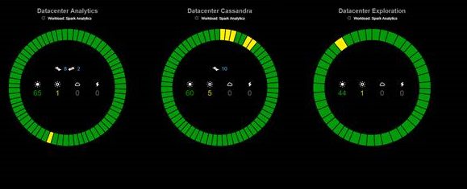
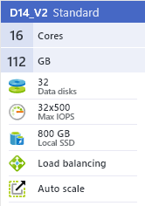
The Cassandra side
10 Clusters - DSE 4.8.5
30 - 400+ nodes (300+ TB)
RF: 5
Virtual nodes
G1 GC
Gossiping-Snitch

Slide 9
Azure Networking
Public IP Addresses
Allow geo-redundant replication over Internet
Not secure
Virtual Networks
No bandwidth limit within a VNET, Allow replication via
High-Performance Gateway – Max 200Mbs.
Express Route – Max 10Gbs
VNET Peering (Public Preview) – No Limit
We use VNETs due to security requirements and dedicated bandwidth guarantees

Slide 10
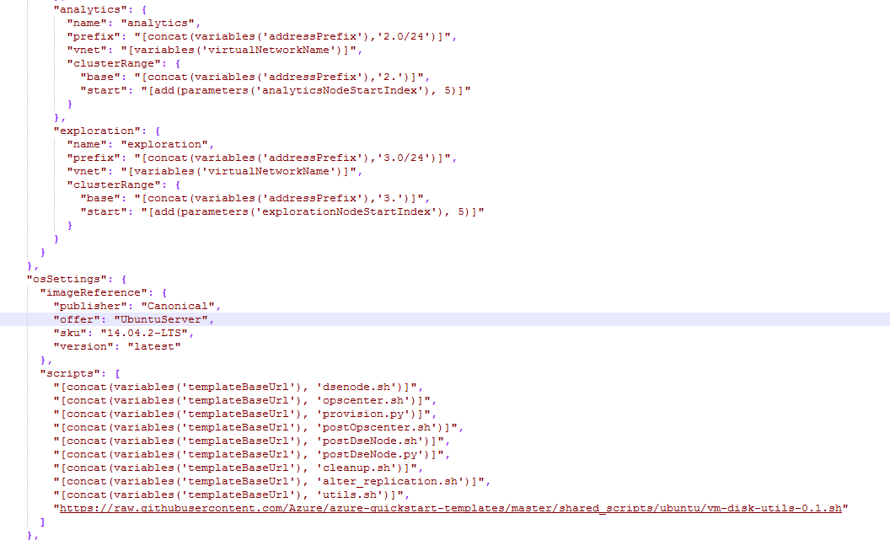
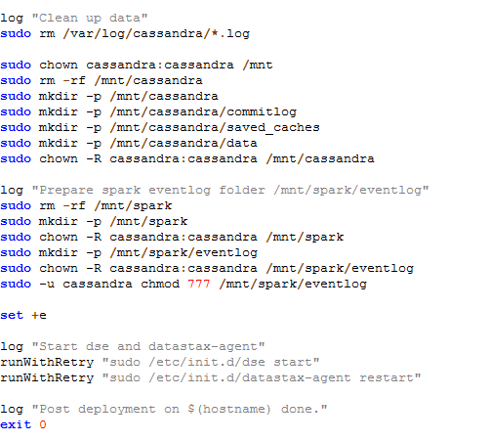
Azure Deployment
ARM Templates with post-deployment scripts

Slide 11
Challenges

Slide 12
SSDs can vanish
SSDs give best latency and IOPs, but they are not persistent.
Why is this a problem?
SSDs are ephemeral. When Azure moves VMs, VMs will lose SSDs !
"A node with address %s already exists, cancelling join. " Use cassandra.replace_address if you want to replace this node."
How to fix it?
. Restart using ‘–Dcassandra.replace_address=<ip address of node>’ in JVM opts
. Don’t forget to remove once the node joins the ring
. We built automation to detect and fix this, running continuously on all nodes

Slide 13
Are you really Rack-aware ?
We use Azure Fault Domains for rack-awareness.
Why is this a problem?
When Azure moves nodes they can change FD.
This invalidates the rack configured in cassandra-rackdc.properties
How to fix it?
. Cassandra won’t let you change DC / Racks of existing node. Must remove and add the node.
. Automation to detect, and change rackdc.properties as needed

Slide 14
Streaming is slow
“nodetool rebuild” or equivalent is often necessary while replacing / adding new nodes.
Why is this a problem?
If the node crashes while streaming, it starts from the beginning
The source node does not transfer SS Table files in parallel
How to fix it?
. Set “nodetool streamthroughput” and “nodetool compactionthroughput” to 0
. sudo sysctl -w net.ipv4.tcp_keepalive_time=60 net.ipv4.tcp_keepalive_probes=3 net.ipv4.tcp_keepalive_intvl=10
. Wait for JIRAs 4663 , 9766 to get fixed in your version of DSE !

Slide 15
Heap dumps are big !!
We use 30GB heaps, so heap dump files tend to be large on our nodes.
Why is this a problem?
A standard Azure OS disk is 30 GB.
The default heap dump dir is /var/lib/cassandra.
We often ran out of OS disk space when Cassandra crashed
How to fix it?
If you are running Datastax Enterprise:
Edit /etc/init.d/dse to add this line at the top: DUMPFILE_DIR=/mnt/dumps
Or, just don’t let Cassandra crash, whichever is easiest.

Slide 16
Memory !
Running Spark and Cassandra on same node poses unique challenges
Why is this a problem?
Bad models / spark code can easily fill up 30 GB heap
Linux Kernel will kill DSE when VM running low on memory
system.log won’t show this. sudo dmesg –T is the way to go !
How to fix it?
. Set -1000 as OOM Score in /proc/<pid>/omm_score_adj file
. Need automation since the pid will change on DSE process restarts

Slide 17
SS Table Compactions
If not tuned correctly, this will melt down clusters !
Why is this a problem?
IO heavy activity
Incorrect compaction strategy parameters is a time bomb !
Makes tmp files requiring double the space until it finishes.
How to fix it?
. Use DTCS only if you can explain what Target.GetBuckets does !
. Use the more stable and easy to reason about thing : STCS
. Pay close attention to PendingTasks, PendingCompactions and “nodetool compactionstats”

Slide 18
Schema Updates
If nodes are down while schema changes are made, badness happens !!
Why is this a problem?
Schema version changes don’t get updated in saved_caches if a node is down. This leads to “couldn’t find cfid=foo exceptions” in logs
Very easy to repro in debugger
Column add / removes are okay, renaming tables not so much !
How to fix it?
. Known problem in community, 3.0 should have a new storage engine
. Don’t rename tables. Create new tables, and migrate data. Yes, it sucks !!

Slide 19
SS Table Corruption
SS Tables can get corrupt! Plan for fault tolerance
Why is this a problem?
Azure node restarts can cause this.
Shows up as apache.cassandra.io.sstable.CorruptSSTableException:
Node won’t start if disk_failure_policy is set to 0
How to fix it?
. “nodetool scrub” doesn’t usually fix such SS Tables.
. sudo find /mnt/cassandra/data -type f -path ./system -prune -o -path ./system_auth -prune -o -cmin -<Number of Minutes> -print | sudo xargs rm.
. Automation to automatically detect, delete bad tables and restart DSE.

Slide 20
Mutation Drops
Even with reasonable tuning, our nodes were showing mutation drops.
LocalMutationRunnable thread wasn’t getting scheduled to run within the configured read and write timeouts.
Contributed below as part of diving deep in code.
JIRA | Description
10866 | Expose dropped mutations metrics per table
10605 | MUTATION and COUNTER MUTATION using same thread pool
10580 | Expose metrics for dropped messages latency

Slide 21
Backup / Restore
With RF = 5 and TBs of data, we need efficient data movement
Explored using a Data Center with RF =1 as “Backup DC”. Failed quickly because “restore” was slow !
Built rsync based solution to snapshot and backup periodically to 1 TB HDDs attached to every node.
Also lets us restore in staged fashion while taking live traffic
https://github.com/anubhavkale/CassandraTools

Slide 22
Takeaways

Slide 23
Don’t underestimate learning curve
Teach, coach, grow, help, assist your fellow team members !
Quiz : https://blogs.msdn.microsoft.com/anubhavk/2016/08/22/the-cassandra-challenge/
Debug multi-node Cassandra locally
You will be surprised often at how things work
How: https://blogs.msdn.microsoft.com/anubhavk/2016/08/25/debugging-multi-node-cassandra-cluster-on-windows/
JIRA and Mailing Lists
Cassandra Devs are fantastic at explaining things deeply
You will find great workarounds there : e.g. CASSANDRA-10371 !

Slide 24
Looking forward

Slide 25
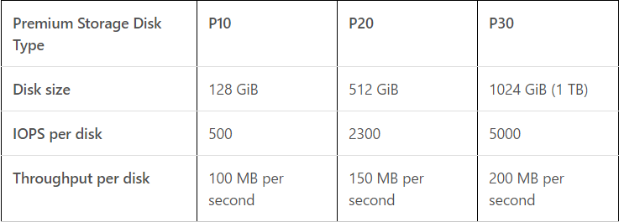
Azure Premium Storage
Network attacked SSD storage with local SSD cache
DS 14 VMs = 550 GB local cache !
Great IOPS and Latency if you RAID disks: Read here and here
We added DS VMs to our existing clusters and did not see any performance degradation. Working through more formal tests.

Slide 26
Questions ?

Slide 27
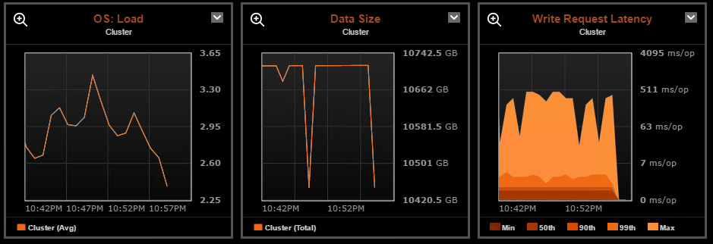
Leverage Ops Center Metrics
Read and Write Latencies
SS Table Counts
Tombstone Counts
OS : CPU, Memory, Disk
Compactions
Blocked Tasks
Aggressively invest in automation
Use Chef or equivalent
Local Monitoring and recovery
Learn concepts deeply
Datastax Enterprise support !

Slide 28
More …
Enable encryption at rest
VNET Peering
Helps with connecting legacy services deployed on old Azure classic stack with new ARM stack
Use Azure HDInsight as Spark compute cluster
DSE Spark version is usually behind the industry latest
Running Spark + Cassandra on same node makes debugging performance issues tricky
Cassandra 3.x
Mostly for bug fixes, and general improvements to repairs

Slide 29
Cleanup !!
By design, Cassandra doesn’t delete data from disk if another node starts owning it.
Why is this a problem?
When adding nodes to a ring, disk space on old nodes won’t be reclaimed automatically !
Disk pressure will bring nodes down
How to fix it?
. “nodetool cleanup”
. Safe to run in parallel on all nodes.
. Be sure to increase concurrent_compactors if needed.

