Slide 1
From Monolith to Microservices with Cassandra, gRPC, and Falcor
Luke Tillman, Technical Evangelist at DataStax

Slide 2
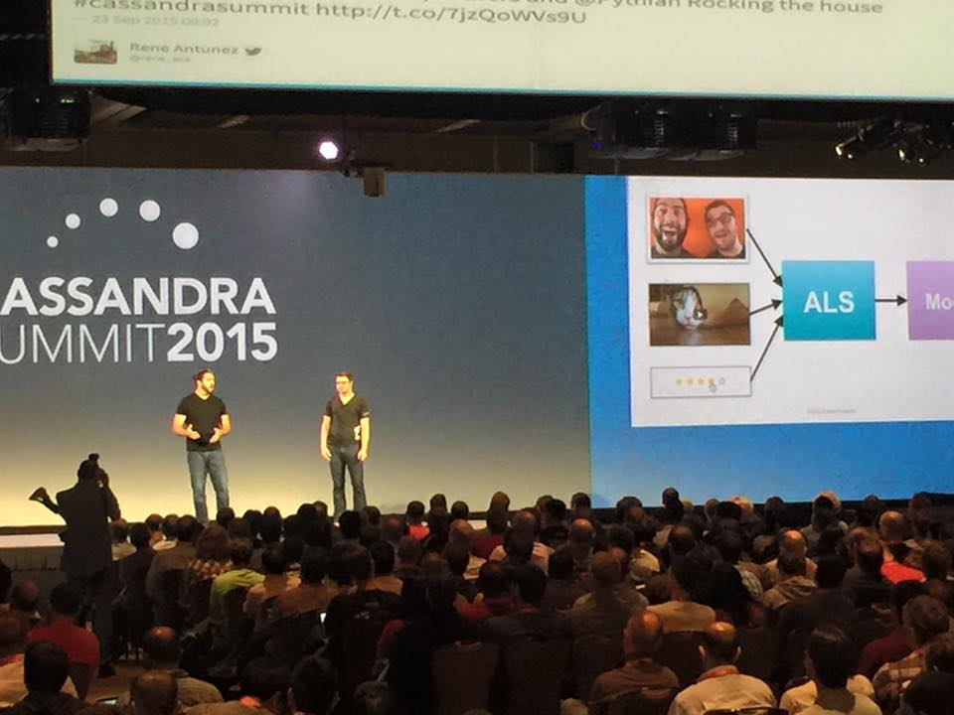
Luke, Technical Evangelist
Currently:
Cassandra
.NET
Node.js
Previously:
Web Applications
RDBMS

Slide 3
A reference application for users looking to learn how to use Cassandra and DataStax Enterprise with their programming language of choice.

Slide 4
KillrVideo was a modular monolith written entirely in C# using events for service collaboration.
The modular monolith is a SOA where all services are in one programming language and can be run in-process together. But it can be difficult to stay disciplined and not blur service boundaries.
Comments
Video Catalog
Search
…

Slide 5
A service publishes events that are interesting things that happen inside of it and other services can subscribe and react to those events.
Let’s figure out what videos to suggest when a user watches it…
I better add that to the search index so users can find it…
Hey, I added a new YouTube video to the catalog!
Suggested Videos
Video Catalog
Search

Slide 6
Fowler’s First Law of Distributed Objects
Don’t.

Slide 7
Mixed technology stacks are a reality for more than just reference applications.
How do we go from a modular monolith in a single programming language to “your programming language of choice”?
Notes:
You might be on stack now, but you're only one acquisition away from being mixed.

Slide 8
Mixed technology stacks are a reality for more than just reference applications.
How do we go from a modular monolith in a single programming language to “your programming language of choice”?
Notes:
You might be on stack now, but you're only one acquisition away from being mixed.

Slide 9
1
1
Define our service contracts in a common format that can be consumed in multiple programming languages.

Slide 10
The ability to generate client and server (stub) code was a requirement.
There are a lot of choices when it comes to selecting an Interface Definition Language, including some other Apache projects like Avro and Thrift.
{…}
Notes:
Codegen should be strongly typed in languages that support it
Usual suspects available

Slide 11
Define your services using Protocol Buffers as the IDL.
service RatingsService {
rpc RateVideo(RateVideoRequest)
returns (RateVideoResponse);
}
message RateVideoRequest {
killrvideo.common.Uuid video_id = 1;
killrvideo.common.Uuid user_id = 2;
int32 rating = 3;
}
message RateVideoResponse { }
Notes:
"RPC" can be scary and kinda got a bad wrap

Slide 12
Pros:
Generate client/server code in 9 languages
Built-in HTTP/2 transport
Protocol Buffers as the wire format
Comes from Google
Cons:
Comes from Google
RIP
READER
2005-2013
Notes:
Reader, Code, IGoogle, Orkut, Wave (now an Apache project)

Slide 13
2
2
Create a standalone web tier that can be reused by service implementations in multiple programming languages.

Slide 14
Wanted a client web app that runs in a browser and works on multiple devices.
The number of frontend JavaScript frameworks out there is mind numbing, but we eventually settled on a setup that makes heavy use of React and Redux.
Notes:
TODO: Frontend framework logos and rage quit?

Slide 15
How should the client fetch data from the gRPC microservices on the backend?
In the browser, we have a JavaScript library for fetching data. On the web server, we have the Falcor Router component that acts an API Gateway to the microservices.
?
Notes:
Call the services directly from the client (non-starter on mobile devices even with HTTP/2 because they either have different IPs or we have some convoluted routing setup)
Put a web server in the middle (we’re gonna need one anyway to serve up static assets for the client)

Slide 16
Falcor
More than just an awesome 80’s Luck Dragon.TM

Slide 17
With Falcor you think of your data as a graph. Clients can request one or more paths in the graph.
GET: /model.json
videosById['12345'][
'name', 'description',
'addedDate'
]
videosById['12345']
.author[
'firstName', 'lastName',
'email'
]
CAT BURRITO
By:
Luke Tillman

Slide 18
{
"videosById": {
"12345": {
"name": "Burrito Cat",
"description": "A cat ...",
"addedDate": "2016-06-29",
"author": {
"$type": "ref",
"value": [ "usersById", "99" ]
}
}
}
}
The Falcor Router on the server matches your paths against a list of routes. Each route has a handler that can then call the appropriate service.

Slide 19
Route handlers return data in JSON Graph format which can reference other parts of the graph. The Router automatically follows references.
"author": {
"$type": "ref",
"value": [ "usersById", "99" ]
}
{
"usersById": {
"99": {
"firstName": "Luke",
"lastName": "Tillman",
"email": "luke@luketillman.com",
}
}
}
Notes:
References are followed before returning the response to the client
Falcor does some pretty aggressive caching of the graph as well, preventing unnecessary roundtrips

Slide 20
Can this architecture and these technologies help us with some of the challenges users have with Cassandra?

Slide 21
1
Users coming from a RDBMS background are often frustrated by the lack of JOIN support in CQL.
SELECT
v.name,
v.description,
v.addedDate,
u.firstName,
u.lastName,
u.email
FROM videos v
JOIN users u
ON v.userId = u.userId
WHERE v.videoId = 12345;
CAT BURRITO
By:
Luke Tillman

Slide 22
1
In a microservices architecture, data that we might have previously used a JOIN to retrieve is probably owned by different services now.
Using references to other parts of the graph in Falcor makes stitching together data from multiple microservices easy.

Slide 23
2
users
users_by_email
Using denormalization is a key part of successful Cassandra data modeling, but maintaining data integrity can seem daunting to new users.
videos_by_date
videos
videos_by_user
videos_by_tag
Notes:
Materialized views in C* 3.0 mitigate some of this, but still have limitations.

Slide 24
2
The concept of data ownership in microservices makes the surface area of impacting operations much smaller.
Having service APIs and events defined in an IDL like Protocol Buffers in gRPC makes it easy to get an immediate conceptual overview of what operations could impact denormalized data.

Slide 25
3
Sizing a cluster, stress testing, and tuning for optimum performance is hard with Cassandra.
Notes:
Choosing disks, disk configuration, JVM settings like GC

Slide 26
3
With a microservices architecture, we ideally have different clusters backing different services.
It's a lot easier to size, test, and tune a cluster for one service's workload than it is to tune a cluster for multiple services' workloads.
Notes:
Different services will have different profiles (i.e. read-heavy, write-heavy, mixed)

Slide 27
https://killrvideo.github.io/
Questions?
@LukeTillman

