Slide 1
The Wrong Way of Using Cassandra
Carlos Rolo - Pythian

Slide 2












Some of our DataStax Enterprise and Apache Cassandra clients:
Pythian is a global IT services company that helps businesses become more competitive by using technology to reach their business goals. We design, implement, and manage systems that directly contribute to revenue and business success. Our services deliver increased agility and business velocity through IT transformation, and high system availability and performance through operational excellence.

Slide 3

Who am I?
Cassandra Consultant for Pythian
I’m all about Distributed Systems
Certified Datastax Architect
Cassandra MVP
Programming since 1997
Cassandra DBA since 2001
Twitter: @cjrolo
LinkedIn: linkedin.com/carlosjuzarterolo
Blog: blog.pythian.com/carlosrolo

Slide 4

Mistake #1 – You don’t need Cassandra
Your model doesn’t fit into Cassandra
Ad-Hoc Queries
Small datasets
Heavy Relational Model
Data needs to be 100% consistent

Slide 5
Fix #1 – Adjust/Improve/Re-think
Don’t use Cassandra!
Or if you really need/want:
Re-work your model
Re-think the way applications work
Tweak queries consistency to fit your needs

Slide 6
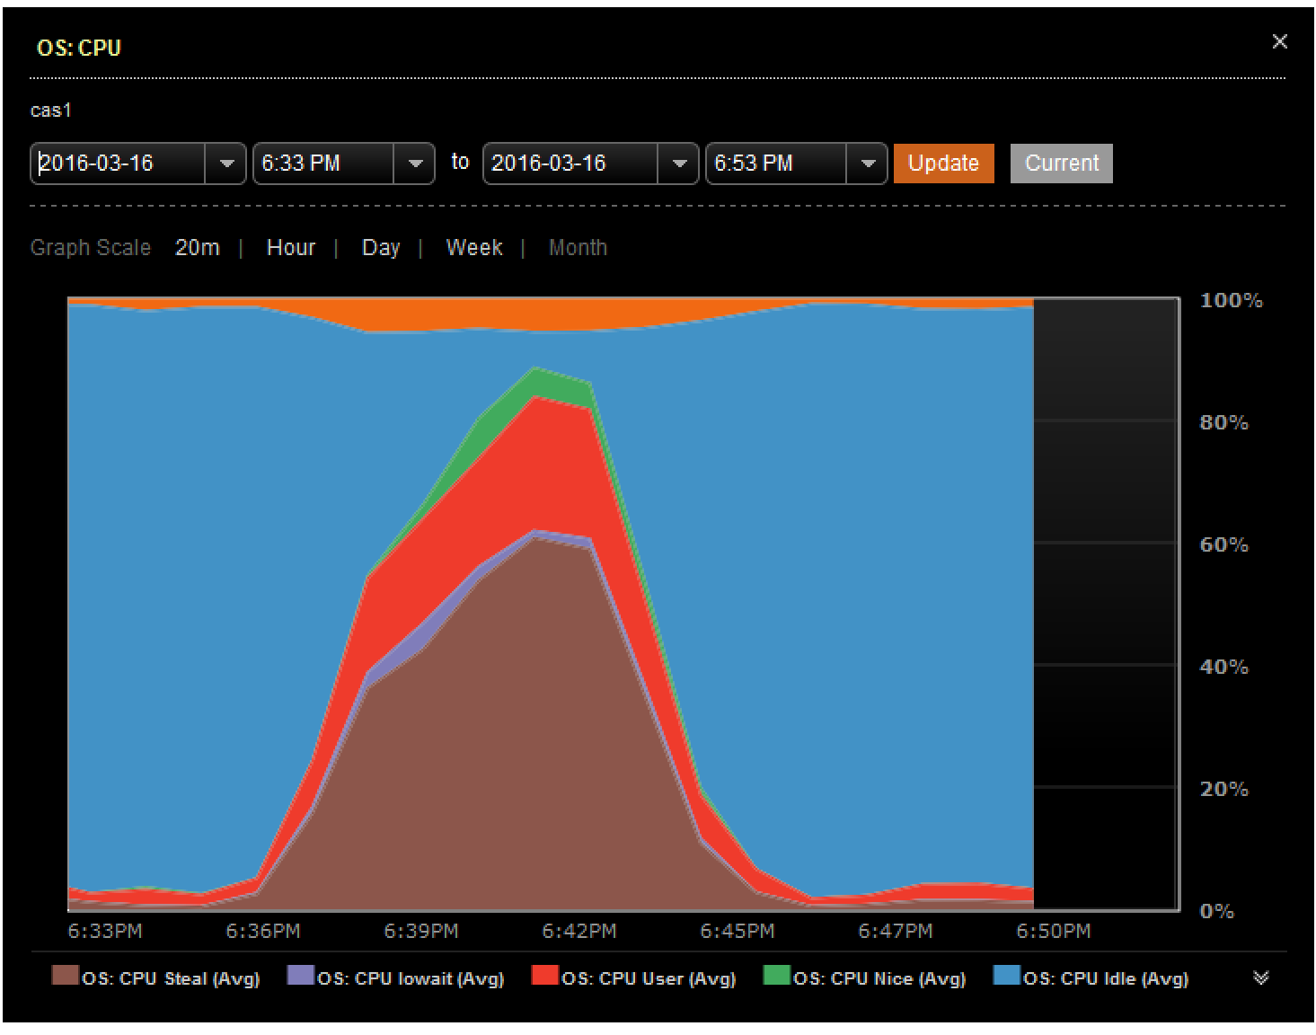
Mistake #2 – You’re using the wrong hardware
“If you’re harddrives have a network plug, then it is wrong”
Not enough CPU/RAM
Low disk space!
Never underestimate compaction
Network…

Slide 7
Fix #2 – Upgrade/Change Hardware
If you’re on Cloud – It’s easy.
Upgrade those VMs
4 Cores 16GB RAM it is good starting point.
Use local storage.
Even if it is spinning disks.
Beware of network capacity
Configure Cassandra accordingly

Slide 8
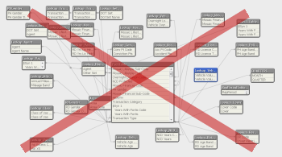
Mistake #3 – Your data model is wrong!
Secundary indexes
Having a lot of secondary indexes per table
Heavy batches
100s of tables
Fat partitions
Massive deletions
Counters

Slide 9
Fix #3 – Change it! (Seriously!)
Understand your read patterns
MV are a good alternative to batches and Secondary Indexes
Tweak batches, might yield great performance improvements
Understand the impact of tombstones and how to deal with it
Counters are a special thing on its own.

Slide 10
Mistake #4 – Replication == Backup
3 Nodes, RF=3 != 3x Data Backup
Things that RF = N (Where N equals # of Nodes) doesn’t fix:
Human error
Application bugs
Deployment problems

Slide 11
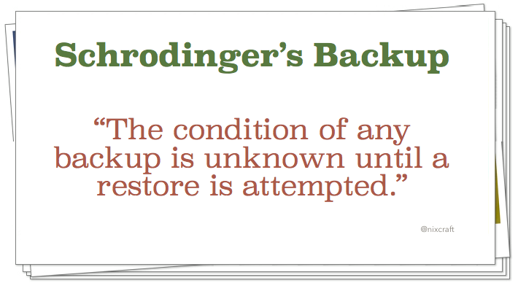
Fix #4 – Enable Backups
Snapshots
Incremental Backups
Volume Snapshot
3rd party solutions
Test your backups!
Backup your schema!

Slide 12
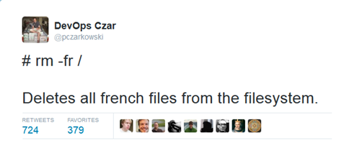
Mistake #5 – You don’t tweak your OS
Your OS is a crucial part of Cassandra!
NTP is not set
Swap is on and swapiness is high
Ulimits not set
Cassandra running as root
Kernel 3.2+

Slide 13
Fix #5 – What you need to do!
Set ulimits accordingly to the docs
Even on package installs check if they are in place
NTP is important. To minimize drift set NTP boxes and sync to those
Public NTP servers might go up to 100ms of drift between them
Use a proper user
Double check permissions!
Disable Swap / set swapiness really low (ex: 10)
Kernel 3.2+ brings pretty good improvements to storage

Slide 14
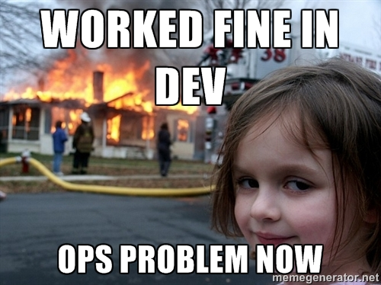
Mistake #6 – “It works fine in Dev”
Single node testing
Dev dataset is not representative of the real data
Load is not representative of the real load
Dev uses different hardware
Dev might be using containers…

Slide 15
Fix #6 – It needs to work with several nodes
Make a proper test environment!
Make test cases
Simulate load
There are tools available!
CCM
Cassandra-stress
DC/OS
Etc…

Slide 16
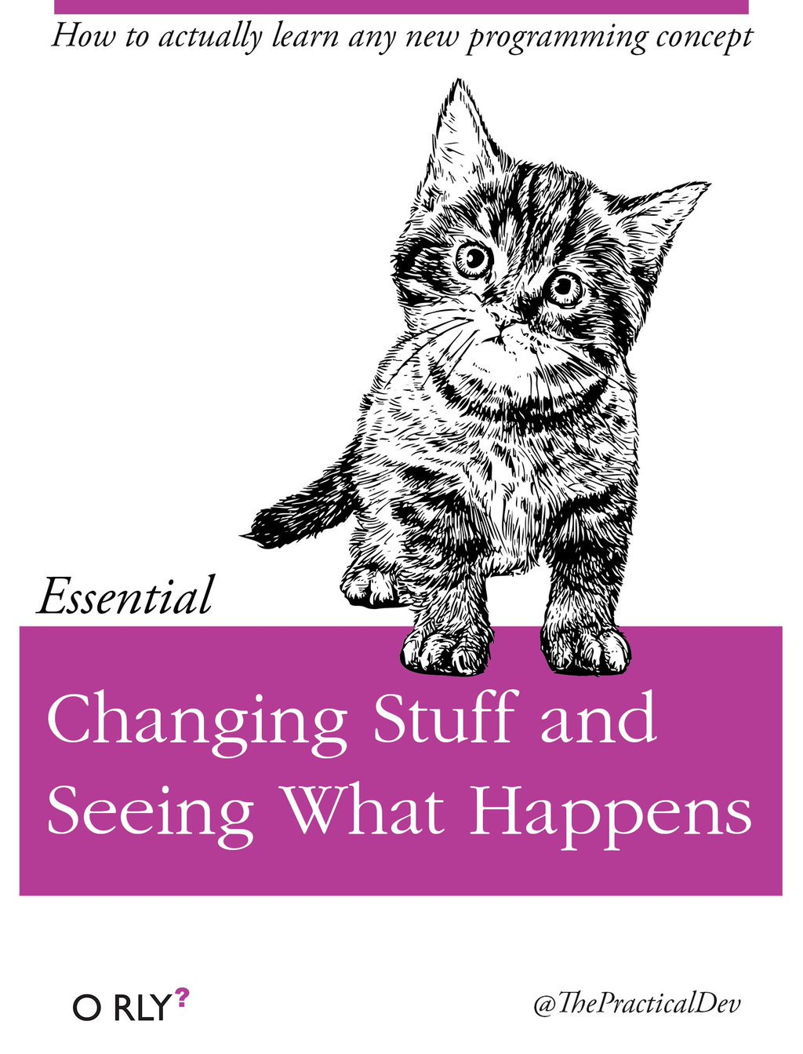
Mistake #7 – pseudo-random configuration changes
Some settings might impact your cluster
Random sized heaps
Compaction settings
Vnode numbers
“random setting that was on internet”

Slide 17
Fix #7 – How to configure correctly
Understand the cause
Nodetool is your friend
Jconsole is a more complicated friend
Jstat is helpfull too
Understand the settings
Nodetool can be used to do changes
Jconsole too
Take advantage of having several nodes

Slide 18
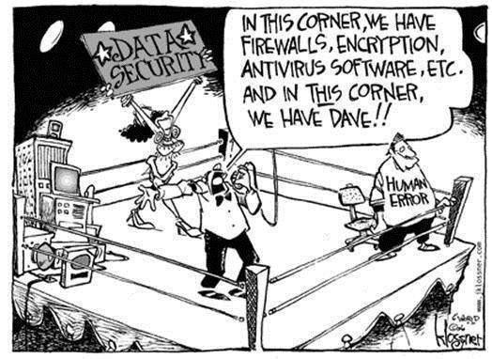
Mistake #8 – Security?
Cassandra does have security features!
Most of the times NONE is enabled
It is possible to remotely:
Truncate tables
Kill nodes
Etc…

Slide 19
Fix #8 – Security 101
Easy
Authentication
Authorization
JMX Credentials
Client – Server SSL
Internode SSL
Use tools to manage SSL
Don’t Forget OS level security!
Firewall
User permissions
Etc…

Slide 20
Mistake #9 – Monitoring?
“Cassandra just died”
Monitoring sometimes is non-existent
When it exists and alerts are not set
And nobody looks into it
Monitoring the wrong metrics.

Slide 21
Fix #9 – Monitoring 101
Lots of options available!
Open-Source
3rd parties
cloud based and self-hosted
Look at the monitoring
Set alerts
Test it!
Learn the Metrics
Above 800 metrics available.
Don’t forget your OS!

Slide 22
Q&A
Thanks for Listening!

