Slide 1
Deploy DSE Clusters with ease using
OpsCenter LifeCycle Manager
Manikandan Srinivasan
Mike Lococo

Slide 2
1 | What is DataStax OpsCenter?
2 | LifeCycle Manager - Introduction
3 | LifeCycle Manager Architecture
4 | REST API
5 | Demo

Slide 3
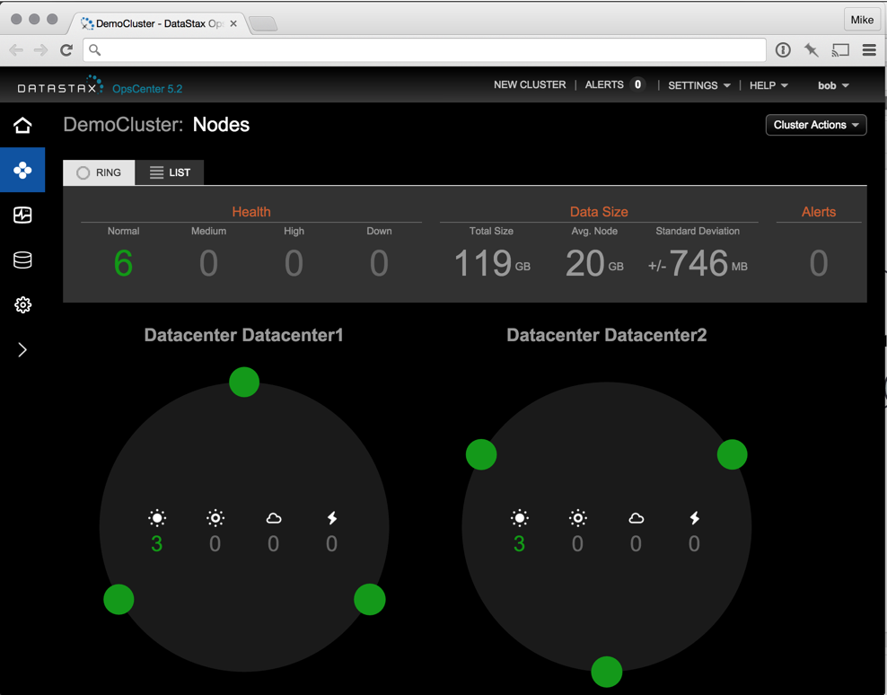
What is DataStax OpsCenter?
Visual Monitoring and Management
Control automatic management services
including transparent repair
Manage and schedule backup and restore
operations
Perform capacity planning with historical
trend analysis and forecasting capabilities
Proactively manage all clusters with threshold
and timing-based alerts
Visually create new clusters with a few
mouse clicks either on premise or in the cloud
Built-in Automatic Failover

Slide 4
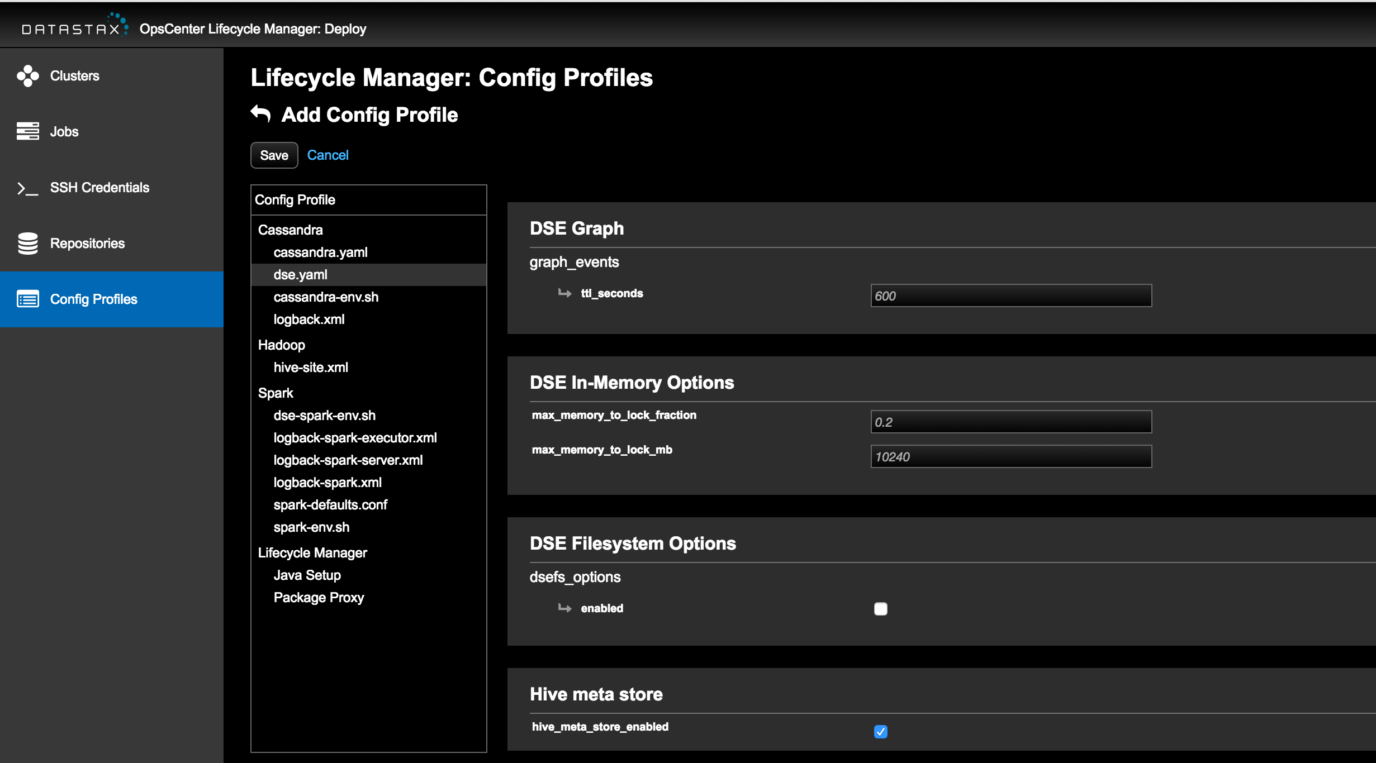
LifeCycle Manager- Introduction
Enterprise-class provisioning
Turnkey Security
Configuration management
“Offline” Deployments
Improved Robustness & Auditability
Improved Usability
Notes:
Offline Deployments via:
Integration with third-party caching http/https proxy.
Custom Java and JCE urls
Custom repositories that mirror DataStax and Linux Distro packages
Improved Usability:
Saves credentials, no more repeated entry.
Enter model/config once. No more repeated entry.

Slide 5

Built for Beginners
Deploy DSE with Confidence
Point and Click Deploy/Configure.
All your DSE configs in one place.
Troubleshoot from the UI.
Auto-generates SSL certificates.

Slide 6

Built for Experts
Deploy DSE with Flexibility
Simple well-documented, and terse API.
Configure every DSE option.
Detailed job-events in one place.
Hack idempotence for advanced workflows.
Cooperates with third-party config management systems.
Notes:
Custom certificate authority is an example of how to hack idempotence for custom-workflows.

Slide 7
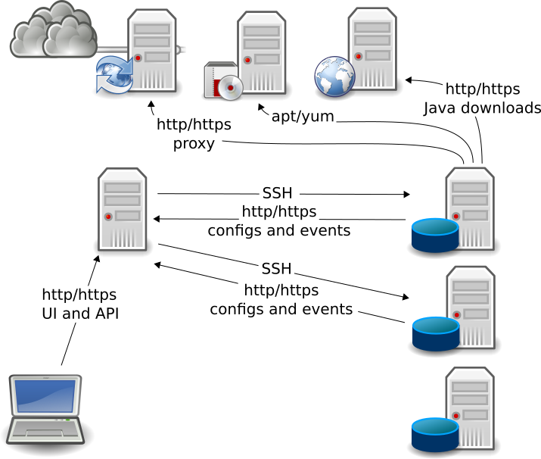
LifeCycle Manager- Architecture
A Proven Approach
Convergent: Does the work that is possible, even in the face of transient errors. Converges toward desired state over multiple runs.
Idempotent: Safe and efficient when run more than once.
Declarative: Model the state you want, LCM figures out how to get there.

Slide 8
LifeCycle Manager- Configuration Profiles
Push Button Config
Comprehensive: Configure every DSE option.
Sparse: Store only your customizations, so you automatically get improved defaults with each DSE upgrade.
Hierarchical: Apply at the cluster, datacenter or node level with smart merging.
Notes:
Don’t apply configuration profiles at the node level unless you REALLY have to.

Slide 9

LifeCycle Manager- REST API
API Driven Custom Workflows
Comprehensive: Everything the UI can do, the API can do. We ride our own airplane.
Documented: With field lists and examples.
Discoverable: The API root lists the possible endpoints. href and related-resources fields make relationships intuitive.

Slide 10
LifeCycle Manager- REST API
$ curl -s http://127.0.0.1:8888/api/v1/lcm/
{"actions-list": {"href": "http://127.0.0.1:8888/api/v1/lcm/actions/"}, "cluster-list": {"href": "http://127.0.0.1:8888/api/v1/lcm/clusters/"}, "config-profile-list": {"href": "http://127.0.0.1:8888/api/v1/lcm/config_profiles/"}, "datacenter-list": {"href": "http://127.0.0.1:8888/api/v1/lcm/datacenters/"}, "definitions": {"href": "http://127.0.0.1:8888/api/v1/lcm/definitions/"}, "job-event-list": {"href": "http://127.0.0.1:8888/api/v1/lcm/job_events/"}, "job-list": {"href": "http://127.0.0.1:8888/api/v1/lcm/jobs/"}, "job-node-list": {"href": "http://127.0.0.1:8888/api/v1/lcm/job_nodes/"}, "machine-credential-list": {"href": "http://127.0.0.1:8888/api/v1/lcm/machine_credentials/"}, "node-list": {"href": "http://127.0.0.1:8888/api/v1/lcm/nodes/"}, "repository-list": {"href": "http://127.0.0.1:8888/api/v1/lcm/repositories/"}}
©2016 DataStax

Slide 11
LifeCycle Manager- REST API
$ curl -s http://localhost:8888/api/v1/lcm/clusters/
{"last" : 1, "per-page" : 50, "previous" : null, "next" : null, "current" : 1, "count": 1, "results": [{"type" : "cluster", "id" : "591ae107-2ef8-4c0f-b603-3b9f2d722d2f", "href" : "http://localhost:8888/api/v1/lcm/clusters/591ae107-2ef8...", "config-profile-id" : "4ff7a9ae-257c-4a6c-bfb0-b47299f39795", "ssh-management-port" : 22, "related-resources" : {"datacenters":"http://localhost:8888/api/v1/lcm/..."},
"more-fields-omitted" : "for brevity"}]}
©2016 DataStax

Slide 12
LifeCycle Manager- REST API
$ curl -s -X POST \ -d '{"name": "test-cluster-01", \ "machine-credential-id": "0f03dff7-1874-4c17-a823-ff79dba6e694", \ "repository-id": "7db37bd2-c23a-4ea6-a415-e9faaeb2060f", \ "config-profile-id": "4ff7a9ae-257c-4a6c-bfb0-b47299f39795"}' \ http://localhost:8888/api/v1/lcm/clusters/
{"datacenter": [], "type": "cluster", "config-profile-id": "4ff7a9ae-257c-4a6c-bfb0-b47299f39795", "repository-id": "7db37bd2-c23a-4ea6-a415-e9faaeb2060f", "machine-credential-id": "0f03dff7-1874-4c17-a823-ff79dba6e694", "name": "test-cluster-01", "comment": null, "id": "108f74ab-0c5c-4bf7-8527-695e3e630e1a", "href": "http://localhost:8888/api/v1/lcm/clusters/108f74ab-0c5c-4bf7-8527-695e3e630e1a", "related-resources": {"datacenters": "http://localhost:8888/api/v1/lcm/clusters/18f.../datacenters/"},
"more-fields-omitted" : "for brevity"}}
©2016 DataStax

Slide 13
DEMO

Slide 14
Thank You!

Slide 15
Appendix
Notes:
OpsCenter 6.0 brings important enhancements to performance, management and monitoring.
We've introduced LifeCycle manager which makes it easy to provision and manage large clusters of machines. You can setup your configurations files on OpsCenter, and it will provision new clusters or push configuration changes to existing nodes. If someone accidently changes the configuration files on one of the machines LifeCycle Manager will notice these changes, and flag them allowing you to automatically correct the issue.
Also, to increase interoperability with your existing management infrastructure we've included support for both SNMP alerting and Graphite dashboards.

