Slide 1
Ben Slater, Instaclustr
Load Testing Cassandra Applications

Slide 2

Introduction
Ben Slater, Chief Product Officer, Instaclustr
Cassandra + Spark Managed Service, Support, Consulting
20+ years experience as a developer, architect and dev/dev-ops team lead
DataStax MVP for Apache Cassandra

Slide 3
Load Testing Cassandra Applications
1 | Load testing background
2 | Cassandra specific considerations
3 | cassandra-stress walkthrough

Slide 4
Why Load Test?
Benchmarking to compare configurations
Prove ability to handle forecast peak application load
Prove application stability under sustained application load
Establish parameters for capacity forecasting models

Slide 5
Planning A Load Test
Need to understand or estimate:
peak minute/10 minute/hour/day in terms of reads/writes per sec (and types of reads/writes)
data demographics
production hardware configuration
Evaluate options for load generation
drive load through application
drive load through custom harness
cassandra-stress
other options
Jmeter w/ Cassandra plug-in
YCSB
Test environment sizing
ideally, full production size
50 or 30% probably acceptable for large environments (assuming good practice data model)

Slide 6
Executing a Load Test
Record everything!
Ensure load client is not a bottleneck
Understand natural variance between tests
Make sure you understand the bottleneck in the system under load

Slide 7
Cassandra-specific considerations
Background operations
compactions
repairs
Data conditions
tombstones
skewed partitions
cache hit rates (including OS cache)
Non/poorly scaling operations
secondary indexes
logged batches
multi-partition queries
UDFs/UDAs ?

Slide 8
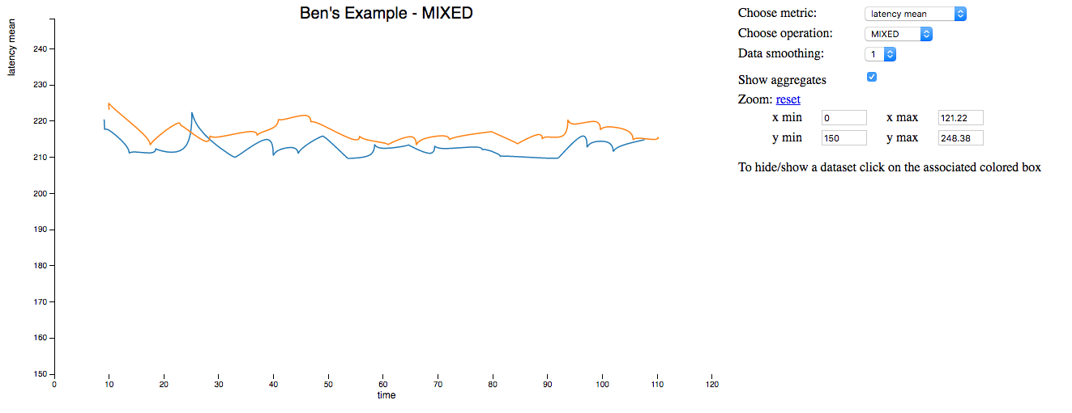
cassandra-stress
Stress tool provide with cassandra
Able to simulate many application scenarios (although still not a perfect substitute for testing via your application)
Supports basic read/write/mixed commands and more sophisticated and custom testing via YAML configuration
Can even graph your results
Currently one table at a time but watch CASSANDRA-8780

Slide 9
cassandra-stress yaml file walkthrough (1)
#
# Keyspace name and create CQL
#
keyspace: stressexample
keyspace_definition: |
CREATE KEYSPACE stressexample WITH replication = {'class': 'NetworkTopologyStrategy', 'AWS_VPC_US_WEST_2': '2'};
#
# Table name and create CQL
#
table: eventsrawtest
table_definition: |
CREATE TABLE eventsrawtest (
host text,
bucket_time text,
service text,
time timestamp,
metric double,
state text,
PRIMARY KEY ((host, bucket_time, service), time)
) WITH CLUSTERING ORDER BY (time DESC)

Slide 10
cassandra-stress yaml file walkthrough (2)
#
# Meta information for generating data
#
columnspec:
- name: host
size: fixed(32) #In chars, no. of chars of UUID
population: uniform(1..600) # About 600 hosts with equal events per host
- name: bucket_time
size: fixed(18)
population: seq(1..288) # 288 potential buckets
- name: service
size: uniform(10..100)
population: gaussian(1000..2000) # 1000 - 2000 metrics per host
- name: time
cluster: fixed(15)

Slide 11
cassandra-stress yaml file walkthrough (3)
#
# Specs for insert queries
#
insert:
partitions: fixed(1) # 1 partition per batch
batchtype: UNLOGGED # use unlogged batches
select: fixed(10)/10 # chance of skipping a row when generating inserts
#
# Read queries to run against the schema
#
queries:
pull-for-rollup:
cql: select * from eventsrawtest where host = ? and service = ? and bucket_time = ?
fields: samerow
get-a-value:
cql: select * from eventsrawtest where host = ? and service = ? and bucket_time = ? and time = ?
fields: multirow

Slide 12
misc cassandra-stress tips
use –rate threads= or throttle= to control level of load generated
when using write, read or mixed commands (simple test) beware that n= (or duration=) impacts default population generation
use sequence distribution for initial base data load

Slide 13

Questions?
Blogs:
Part 1: http://bit.ly/stressblog1
Part 2: http://bit.ly/stressblog2
Part 3: http://bit.ly/stressblog3
(One or two more to come …)
Thanks for attending!
Have a beer with the Instaclustr Tech Team – 7:30PM, The Market Room, Hilton

