Slide 1
Rob Murphy
Adversarial Modeling
Graph, Machine Learning, Text Analytics and Agile DM

Slide 2
1 | Context of Problem
2 | Machine Learning
3 | Graph Theory
4 | Text Analytics
5 | All Together (Agile / agile)

Slide 3
Who am I ?
Rob Murphy, Vanguard Solution Architect, Datastax
rmurphy@datastax.com
Data focused software engineer
3 years with DataStax
11+ years in Computational Science and general science informatics
18+ years designing and building data driven/centric systems
Old school Agile guy
“Data Scientist” at heart

Slide 4
Where does this work come from?
Thesis research
Pre-DataStax work supporting various U.S. Federal Agencies
Work in direct support of DataStax customers
NO SECRET SAUCE SHARED HERE

Slide 5
Problem Space
It is a very very big problem space…

Slide 6
Identity Theft / Synthetic Identities
2014 and 2015 saw high-profile breaches of several retailers where tens of millions of customer records were stolen.
The theft of twenty one million security clearance records discovered in June of 2015 by the U.S. Office of Personnel Management (Office of Personnel Management)
Stolen data are bought, sold and traded actively providing enriched data sources for fraudulent activities.
Everything we do is online providing a de-personalized and highly efficient platform for fraud.
Coordinated and sophisticated networks of people exist to share data, share operational knowledge and actively coordinate efforts to subvert fraud protections in place.
Notes:
Networks are what make synthetic identity fraud so effective

Slide 7
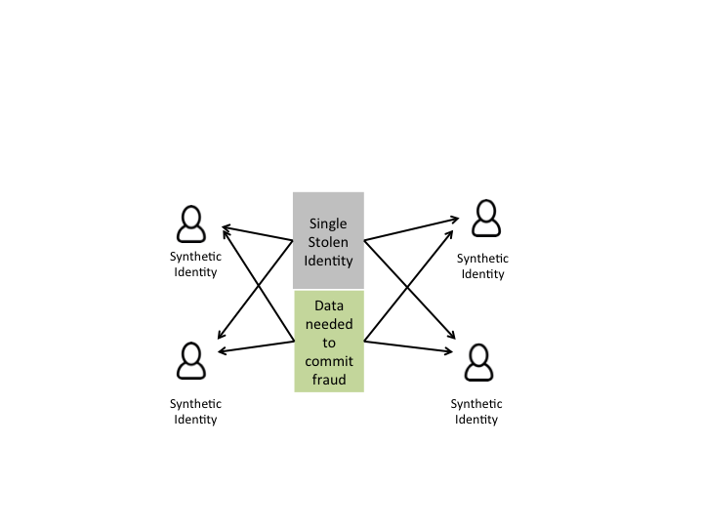
Synthetic Identities
Real identities are modified and/or combined to form multiple synthetic identities
“New” identities are real enough in key properties that they pass review of many business and informatics systems

Slide 8

“Bad Actors”
Can be a first-person problem (they are who they are)
Or, assumed / synthetic identities
Difficult to detect; not all “bad actor” data is in “the system”
Sophisticated actors have very subtle if non-existent predictive attributes
Everyone has patterns

Slide 9
Thinking like an adversary
Dedicated individuals and groups of individuals are actively working to identify, subvert, avoid and exploit any logical, physical or process controls in place.
Weaknesses in physical, system or process controls are shared and exploited en mass
Changes to controls are recognized and behaviors modified
Organizations that want and need to detect and prevent fraud must see some of their customers, stakeholders or applicants as adversaries
Think more like a bank; funds are behind lock and key with more substantial protection as the amount grows
To respond to and engage with adversaries, you have to be agile, capable and approach the work understanding the purpose; to make fraudulent activities challenging to the point they are not worth pursuing (very very big goal)

Slide 10
Assumptions of Adversarial Modeling
Dedicated individuals and groups of individuals are actively working to identify, subvert, avoid and exploit any logical, physical or process controls in place.
Adversarial Modeling as a process must be grounded in data mining, data modeling and software engineering methodologies while embracing change in the most dynamic and natural way possible.
Any process that creates silos around capabilities and communications adds complexity and inefficiency to the fight.
Data mining alone, as a technology ecosystem or focused process, will not be sufficient when engaged with an adversary.
Software engineering as a capability and the related processes and technologies must be part of the larger, adversarial effort.
One technology or tool is incapable of the sensitivity needed to quickly and proactively identify fraudulent patterns; the adversary is committed to exploiting any opportunity and leverage it until is it no longer an option. An ecosystem is needed in this fight.

Slide 11
Machine Learning

Slide 12



Attribute based thinking
Eye makeup
Lighting from below
Eye makeup
RAGE!!!!
Notes:
From “The Enemy Within”
Attributes = features

Slide 13
Supervised Learning, Right?
NO!!!!
Mostly No.
Maybe…
Yes if you are willing to experiment with unsupervised learning derived (“experimental”) labels and dig in.
First lessons learned? Don’t assume anything about the problem, explore the data first then define the technical problem.

Slide 14
Why not supervised learning?
There are more cold or warm-start problems in this space than not.
Data are incorrectly labeled more often than not.
Why? There is always more fraud than you think there is.
Supervised learning algorithms are not accurate when “fraud” and “not fraud” look exactly the same.
Data are many times not labeled at all.

Slide 15
Unsupervised Learning
High-dimension data is the norm
Exploratory Data Analysis is mandatory, you must understand the context and data
Principal Component Analysis is your friend
Clustering is your very best friend
Clusters very often do not map to ‘labels’ (if they exist)
Experimental labels generated through unsupervised learning can be incredibly useful

Slide 16
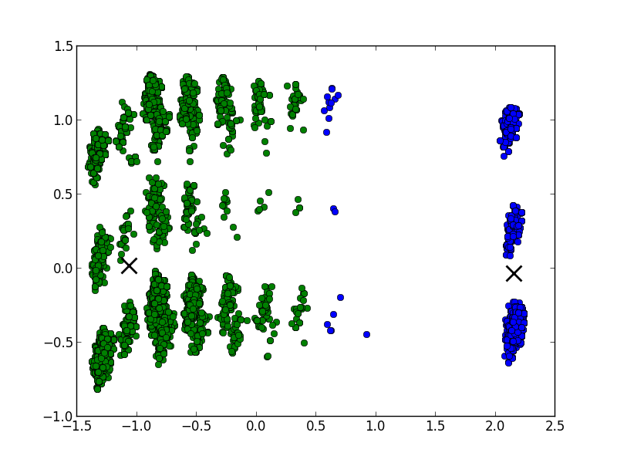
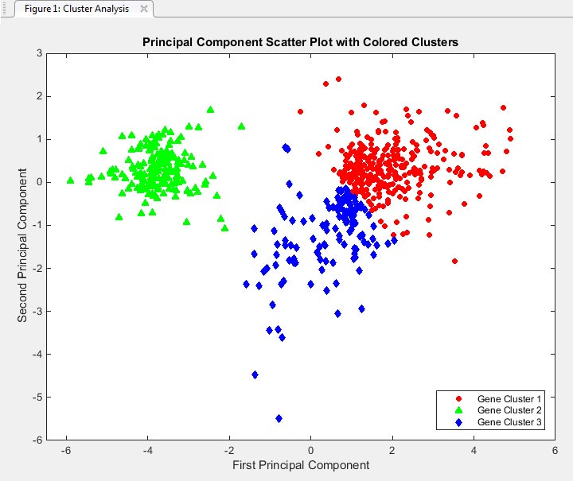
Visualization
Visualization of clusters leverages a powerful computing engine, the human brain
Patterns in data are often only apparent when visualized well

Slide 17
Back to Supervised Learning (sometimes)
Experimental labels facilitate a cycle of effective learning but difficult explain to process bound organizations (government)
Stick to human understandable algorithms for final predictions
Tree-based algorithms
Logistic regression
Naïve Bayes
“Black Box” algorithms are very effective as a guide or ‘b-team’ review
Neural Networks

Slide 18
“Fit” of Machine Learning
Highly effective for mature fraud detection systems / organizations (well labeled data)
Less effective for cold and/or warm-start problems
Require a holistic and dynamic approach to building a ‘ground truth’ of clearly and cleanly labeled data for classification
Absolutely requires a solid data mining approach with supportive business practices to research and validate data mining work.
Very important for detecting non-networked synthetic identities and “bad actors”, worth the effort to invest in a solid data mining process

Slide 19
Graph Theory

Slide 20
G = (V, E)

Slide 21
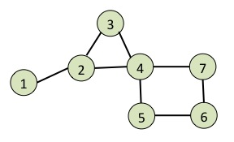
Property Graph
Edge
Person
Event
attends
name = Rob
name = Cassandra Summit
year = 2016
Vertex
https://markorodriguez.com/2011/02/08/property-graph-algorithms/

Slide 22
Networks mean relationships
Coordinated fraud means networks exist
Network detection is possible around key areas where efficiency is needed for financial gain
Key vertex labels, by pattern, are highly predictive
Graph visualization provides engages the human computer in pattern detection
Graph density coefficient (~ degree distribution)
Community detection

Slide 23
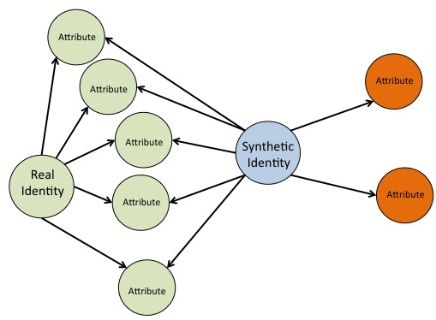
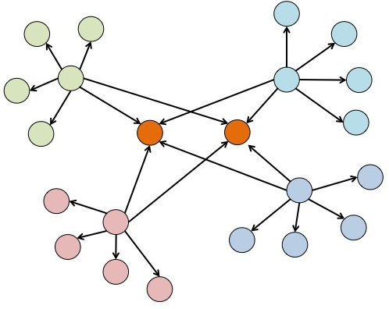

Slide 24
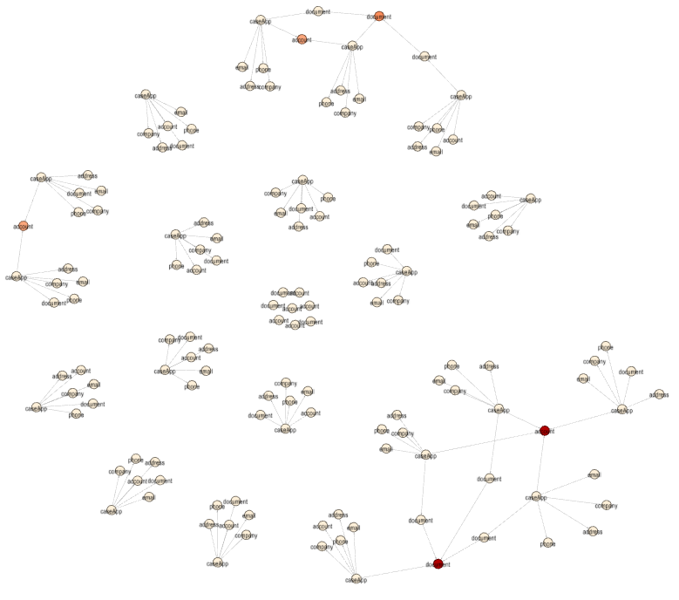
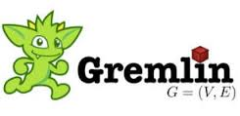
Network Discovery
Networks of fraud / activity are easier to discover.
Easily understood visually and by the “business” subject matter experts.
Various discovery algorithms and patterns.
Not rocket science!!!
g.V("{member_id=0, community_id=374707, ~label=caseApp, group_id=1}").repeat(__.bothE().subgraph('subGraph').inV()).times(50).cap('subGraph').next()

Slide 25
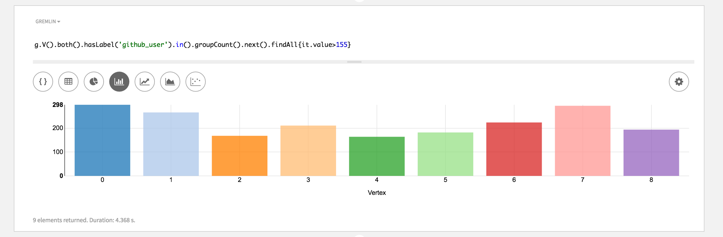
Vertex Degree

Slide 26
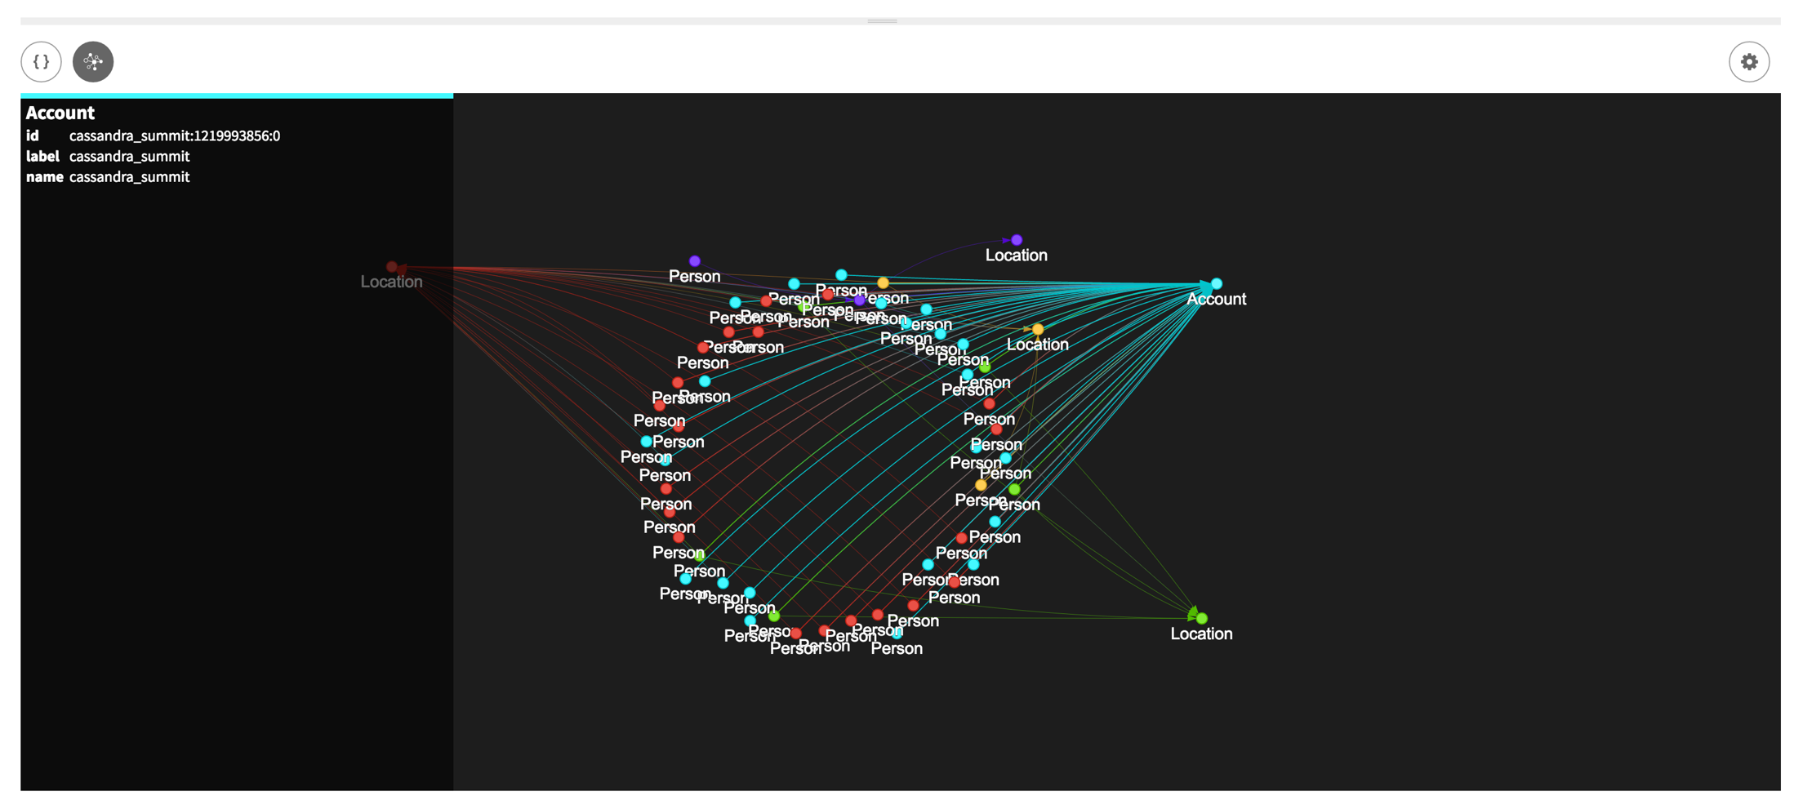

Slide 27
Text Analytics

Slide 28
Text Analytics (a little secret sauce?)
Sentiment Analysis
Classification / Categorization
Topic extraction
Similarity (Search)

Slide 29
Documents, form fields, narratives…
How similar are documents from different identities?
How similar are form fields and narratives?
Are key features/attributes of the identity represented in the text?
Text becomes a “top level” entity for Machine Learning and Graph

Slide 30
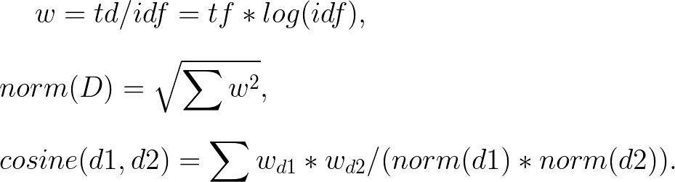
Cosine Similarity
“Math” to determine how similar text is to other text in a corpus
Run-time computation can be expensive if not optimized
Produces similarity score as ideal input to machine learning / graph databases

Slide 31
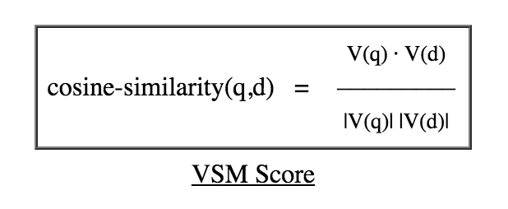
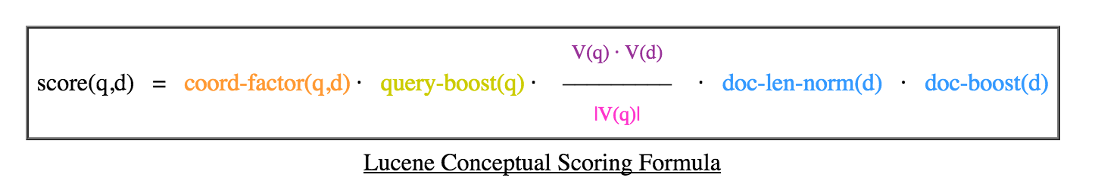
Full-text search
Scalable, distributed and efficient
Cosine similarity as core ‘similarity’ driver
Highly tunable for keywords and other search factors
Useful for run-time retrieval and similarity determination

Slide 32
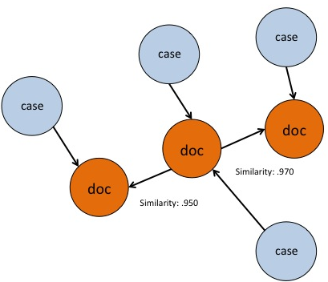
Text + Graph
Document similarity to corpus determined at ingest/runtime
Similarity threshold determined
High similarity score documents / text are ‘linked’ via an edge

Slide 33
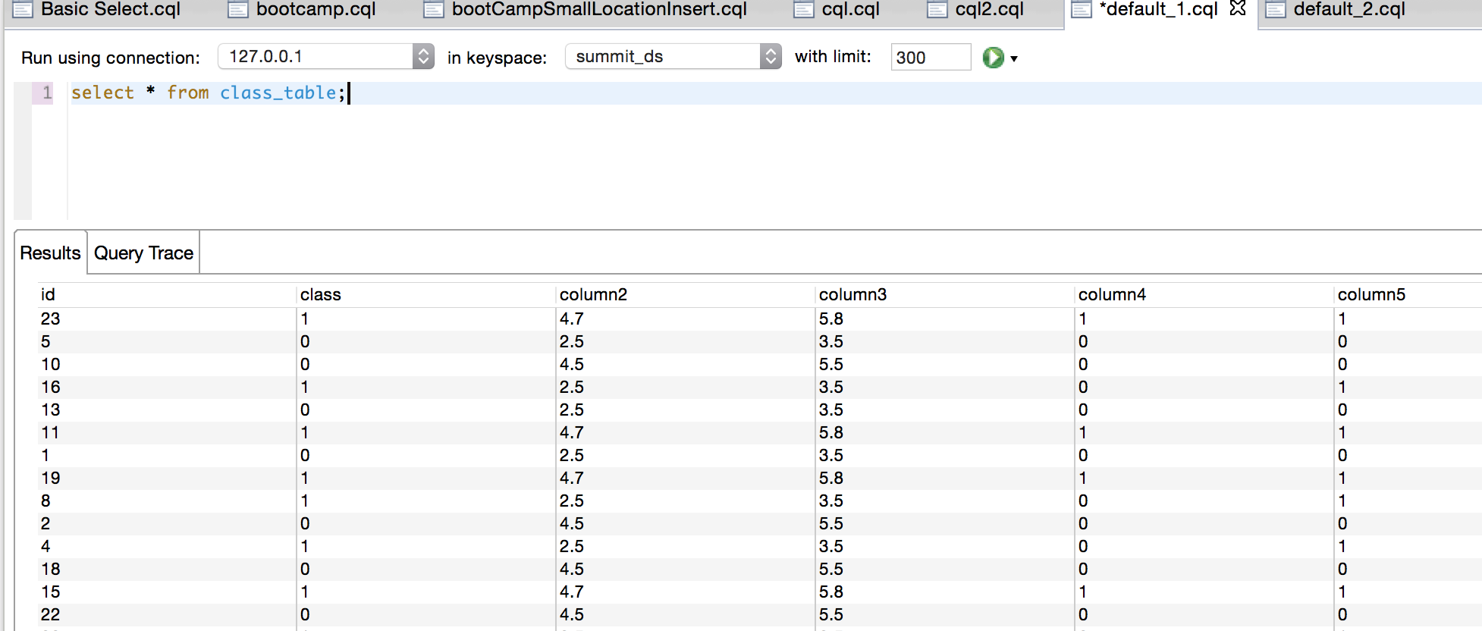
Text + ML
Document similarity to corpus determined at ingest/runtime
Similarity becomes a feature and incorporated into the data mining process

Slide 34
Agile / agile

Slide 35
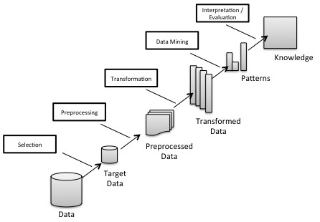
KDD
Knowledge Discovery in Databases
First widely adopted Data Mining Process
Waterfall with some ability to return to previous steps
Better suited to reporting and traditional statistical analysis

Slide 36
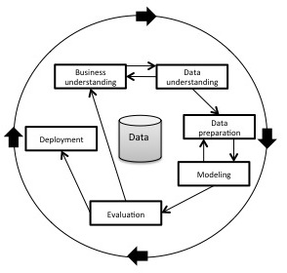
CRISP-DM
Cross Industry Standard Process for Data Mining (CRISP-DM)
Was published in 2000 as the output of a group of private industry practitioners and software engineers from Daimler-Benz, SPSS and NCR
Established as the de-facto process model for data mining (KDNuggets.com, 2014).

Slide 37
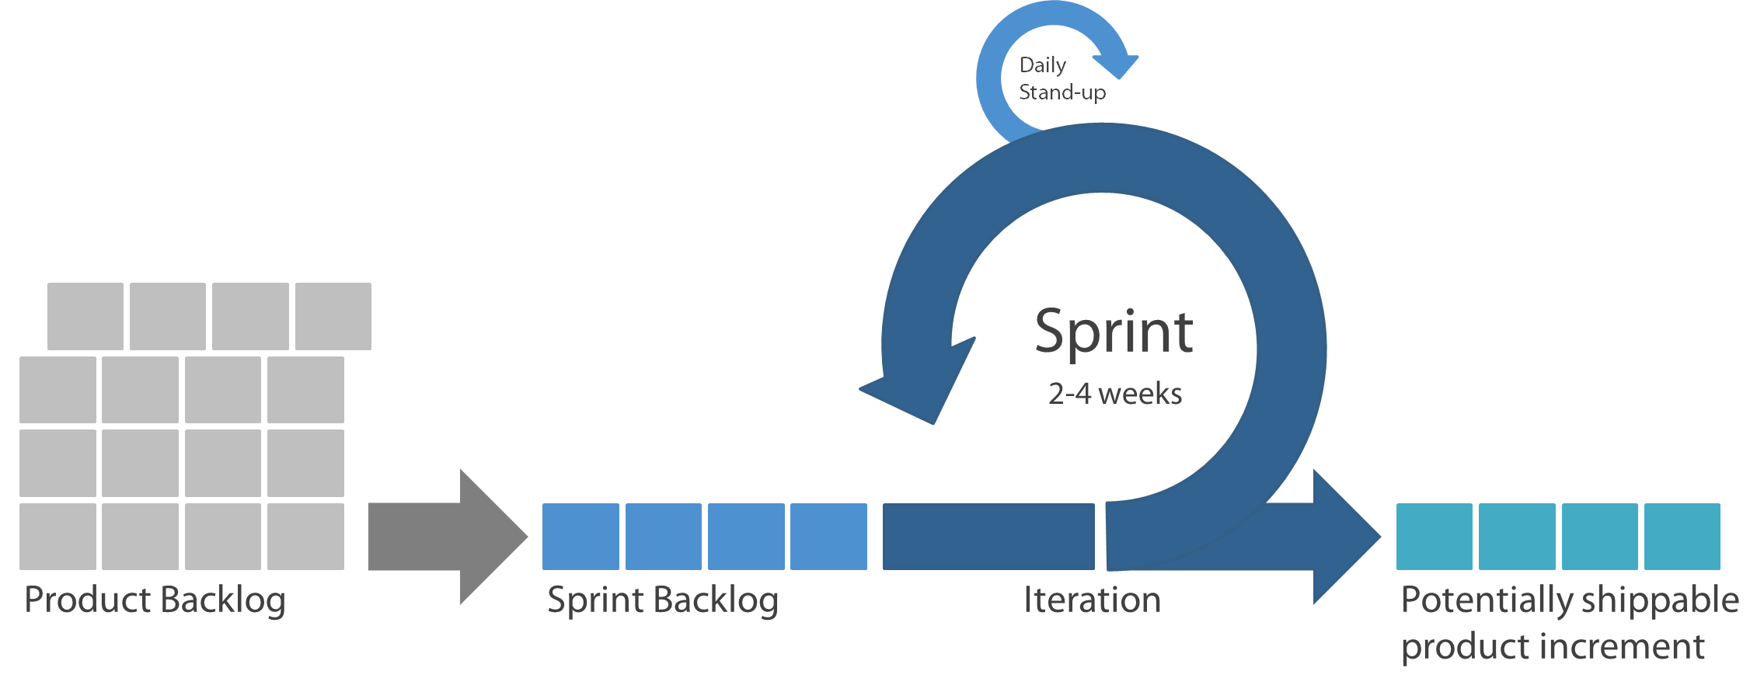
Scrum
“Gateway Drug” for most agile teams
Pervasive adoption
Some haters (have to admit it)
LOTS of tooling
LOST of community knowledge
WORKING PRODUCT BASED

Slide 38
Adversarial Modeling (needs a team!)
Software engineering / application development skills are mandatory
Data science skills are mandatory
Domain knowledge skills are mandatory
No longer the work of skill silos
Cross functional teams bridge the skills gaps between engineering and data focused individuals
Highly effective team-based approach
Adversarial thinking requires rapid response times and agility

Slide 39
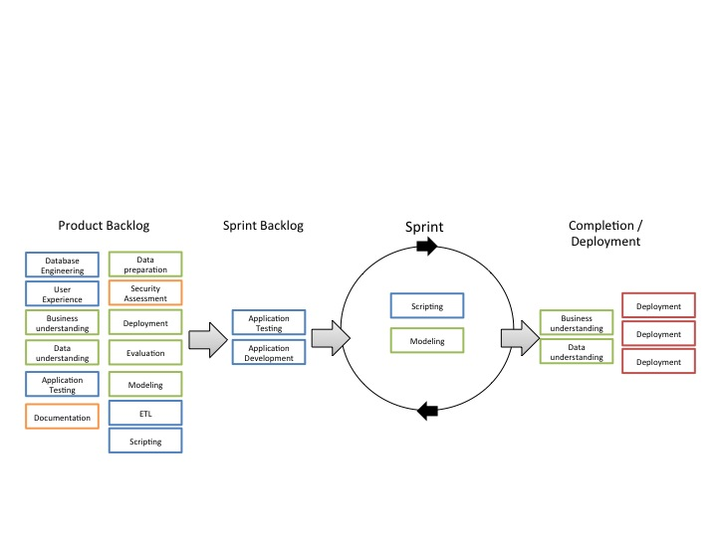
Agile – DM???
Focus on CROSS FUNCTIONAL TEAMS
DEPLOYABLE “Product” ready at the end of every iteration
“Agility” for rapid response to changes in Adversary's behavior
Tool rich environment
Can look like Kanban, XP and others.

Slide 40
A platform approach; ensembles on many levels

Slide 41





Scale, availability, flexibility…
NetworkX
DSE Graph

Slide 42
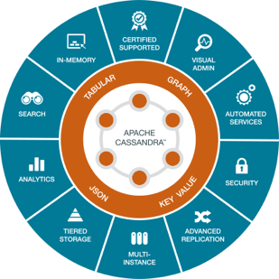
Ensemble of data “models” and tools

Slide 43
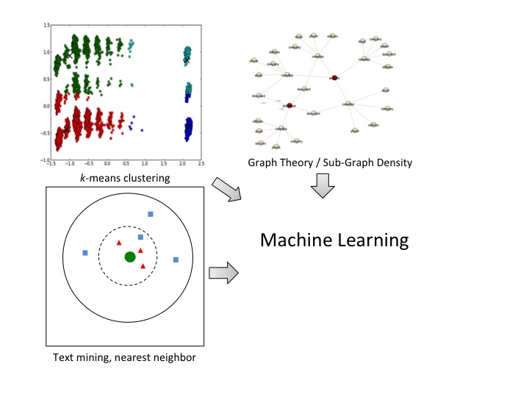
Ensemble of approaches
No single model…
No single approach proved to be wholly effective
Graph and Text stand alone but also greatly enrich Machine Learning
Together, an ensemble of data models, predictive models and approaches proved to be highly effective

Slide 44
Thank you!
Rob Murphy – rmurphy@datastax.com

