Slide 1


Productizing a Cassandra-based solution
Brij Bhushan Ravat
Chief Architect, Voucher Server - Charging System

Slide 2
1 | What is productizing?
2 | A brief on the product – Voucher Server
3 | Technical challenges
4 | O&M challenges
5 | Solution

Slide 3
What is productizing?
Productizing is to take a solution to a level where anyone can:
buy the solution off-the-shelf
install it by himself/herself, and
use it by himself/herself
However, there are also ‘new-age’ solutions which involve upcoming technologies, therefore:
require special skillset to install them, and
skillset for their operations & management is not easily available.

Slide 4

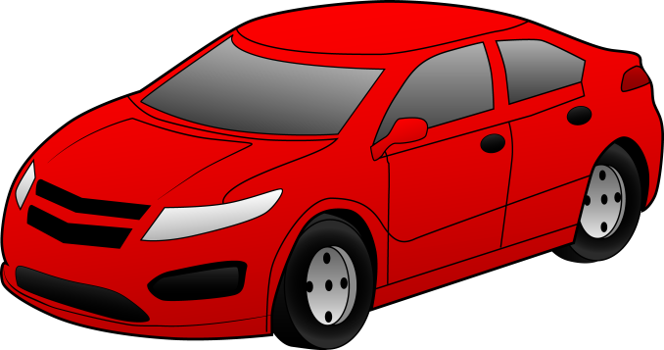


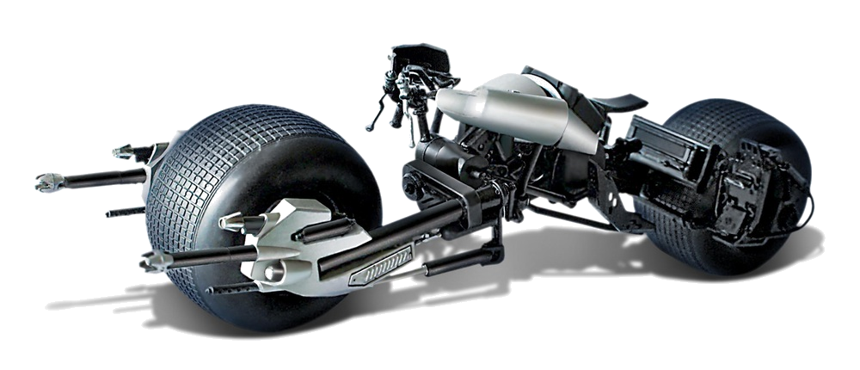

Productizing
Productized
New-Age
(Difficult to productize)
Batpod
Developed in his own facility
Spare-parts & oil not available in market
No external support available
Automobile
Buy from the showroom
Change engine oil yourself
Easy availability of support

Slide 5
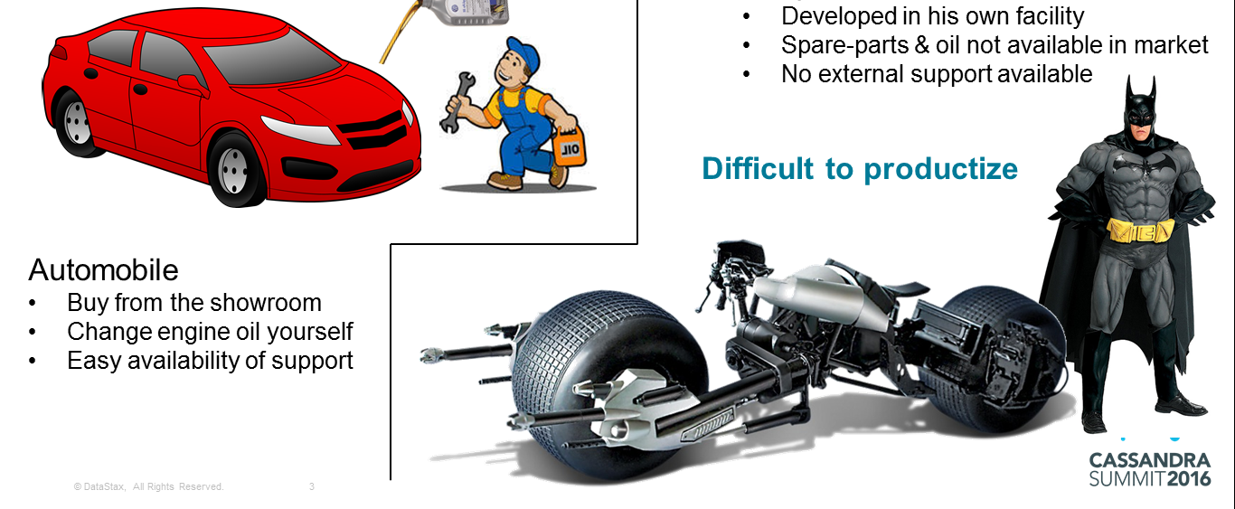
Examples
Productized
New-Age
(Difficult to productize)
Trouble ticketing solution
Multimedia content portal
e-commerce portal
Social media portal
CRM solution
Billing solution
Cassandra is more popular in this segment
Key challenge
Every database requires local O&M expertise (to run a deployment seamlessly)
Skillset for Cassandra administration is not easily available (unlike popular RDBMS)

Slide 6

Typical New-Age Solution
Examples
Social media portal
e-commerce portal
Multimedia content portal
Admin
Admin
Test cluster
Production cluster

Slide 7
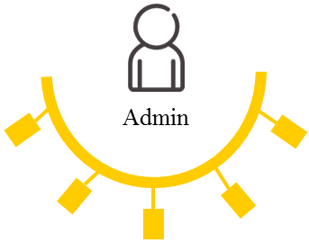
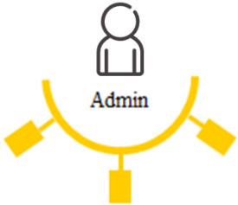
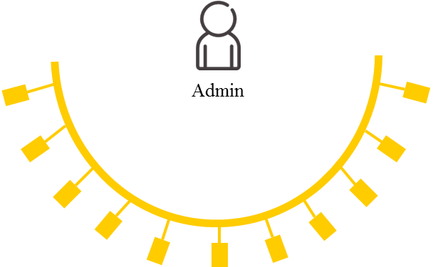
Productizing a New-Age solution
Customer 6
R&D lab
Customer 7
Customer 1
Customer 2
Customer 8
Customer 9
Customer 3
Customer 4
Customer 10
Customer 5
Customer 11

Slide 8
1 | What is productizing?
2 | A brief on the product – Voucher Server
3 | Technical challenges
4 | O&M challenges
5 | Solution

Slide 9

Voucher Server
Voucher Server
Activation Code | Value
42356286 | USD 80
75631975 | USD 50
voucher lookup
(Activation code)
value
Subscribers Account
MSISDN | Balance
1-415-123-8289 | USD 156
1-422-567-6276 | USD 54
topup request
(MSISDN, Activation code)
Prepaid mobile
subscriber

Slide 10





Voucher Server
Operator
1
2
3
4
3
Printed
vouchers
Voucher
codes
Retail Shop
Print Shop
2
voucher state change
voucher generation
voucher loading
voucher purge
top-up request
(MSISDN, Activation code)
Subscribers Account
voucher lookup
Voucher Server
subscribers
(Activation code)
value
…
4
© DataStax, All Rights Reserved.
10

Slide 11
Why Cassandra?
Subscribers Account
Old solution
RDBMS based
Limitation
RDBMS cannot have large clusters
One cluster : 300M vouchers
Therefore
More capacity requires more clusters
But
Latency in routing
Possibility of hot spots
Message Routing
0 - 1
2 - 4
5 - 7
8 - 9
VS
VS
VS
VS
VS
VS
VS
VS
© DataStax, All Rights Reserved.
11
Cluster 1
Cluster 2
Cluster 3
Cluster 4

Slide 12
Why Cassandra?
Subscribers Account
New solution
Cassandra based
Supports large size cluster
Limitation
None
Therefore
One single cluster
And
Easy reconciliation
Easy to scale up & scale down
Message Routing
VS
VS
VS
VS
VS
VS
VS
VS
VS
12
Single Cluster

Slide 13
1 | What is productizing?
2 | A brief on the product – Voucher Server
3 | Technical challenges
4 | O&M challenges
5 | Solution

Slide 14
Quick Recap
We know what is productizing
We have discussed the product – Voucher Server
Now, challenges in productizing the Voucher Server
1. A glimpse of technical challenges
2. Some details on operation & maintenance challenges

Slide 15
Key Technical Challenges
1. Queries based on different columns
Query (K-1)
Query (Col-2)
K-1 | Col-1 | Col-2 | Col-3 | Col-4
A | 10 | X1 | 123 | ab
B | 14 | X2 | 234 | cd
C | 62 | X3 | 345 | ef
Col-2 | Col-1 | K-1 | Col-3 | Col-4
X1 | 10 | A | 123 | ab
X2 | 14 | B | 234 | cd
X3 | 62 | C | 345 | ef
Table 1
Table 2 (Materialized)
Consistency
Performance
Use ‘Cassandra Batches’

Slide 16

Key Technical Challenges
2. Full-table scan (slow)
Node 1
Node 2
Node 3
Node 4
Node 5
Report
Report
Report
Report
Report
Report
Bring all data to one node
Distributed computing
Use

Slide 17
1 | What is productizing?
2 | A brief on the product – Voucher Server
3 | Technical challenges
4 | O&M challenges
5 | Solution

Slide 18


Nodetool repair - Dialog
Why do I need to run repair? Is my data damaged?
No, nothing to worry. It is a cluster & data in nodes go out of sync, due to mutation drops. Just run repair regularly & your data would be ok.
Hmm… Repair is important for sanity of data. I will run it every hour.
No, no. Don’t run it at such a high frequency. It will slow down your system.
Hmm… So, Repair will slow down my system ☹
No. It won’t if you run it at right frequency.
CUSTOMER
DEVELOPER

Slide 19
Nodetool repair
Repair doesn’t have analogy in RDBMS world.
Repair is required periodically, to fix the inconsistencies that build up over a period of time
Typically, repair is run on each node once in a week

Slide 20
Nodetool repair - Challenges
Customer misses out on scheduling periodic repair jobs.
When a repair job fails, it remains unnoticed.
One of the node remains down for a prolonged period
This results in failure of repair in multiple node in the cluster
Lack of awareness about consequences of exceeding ‘gc grace seconds’ in bringing up a failed node.

Slide 21
Sstable compaction - Dialog
Help! Help! Disk utilization of servers has reached 85%
Looks like sstable compaction is not working as expected.
Do you mean to say that it is a product fault?
No, no. Your usage pattern is different from an average customer. That’s why, your compaction needs to be tuned differently.
Ok, I will purge some data to reduce disk utilization.
No. purge will create tombstones which will take more disk space. Purged records free up the disk space only after gc grace period completes.
CUSTOMER
DEVELOPER

Slide 22
Sstable compaction
Cassandra writes data to immutable sstables
Over a period of time, there are several entries corresponding to same record
Size Tiered Compaction Strategy (STCS) compacts sstables of similar size into a single sstable
How many similar sstables & how much similar, are required for compaction – is configurable
4 sstables of similar size

Slide 23
Sstable compaction - Challenges
If customer follows a pattern where nothing is done for a long time & suddenly in one session several millions of transactions are performed, then
this can create very large sstable, which may not find 4 sstables of similar size for a long time.
Customer doesn’t notice increase in disk utilization till it becomes too high to sustain automatic compaction.
With STCS, once disk utilization is 85 – 90% no quick solution is available to recover the disk space.
Only options available are either to bootstrap or to manually run compaction one by one for manually selected set of sstables.

Slide 24
Life cycle management - Dialog
Apr, 2015: Hey! There is a bug in Cassandra 2.0.3. We must upgrade
Ok, lets upgrade to the latest Cassandra 2.1.0
Wait a minute! Cassandra 2.1.0 has a different bug that too affects our product
Ok, then we should upgrade to Cassandra 2.0.14
Jul, 2015: Our product has been released with Cassandra 2.0.14
Great, now our customers can start upgrading.
Aug, 2015: Hey! Cassandra 2.2.0 has been released
DEVELOPER
That’s fast. Our customers haven’t even upgraded to Cassandra 2.0.14 yet, which we released last month.
DEVELOPER

Slide 25
Life cycle Mgmt. - Challenges
It take 3 – 6 months to roll out a new product release in field
If Cassandra releases 2 releases in a span of 6 months,
then Cassandra version of a new product release can go out of support even before its roll-out completes.

Slide 26
1 | What is productizing?
2 | A brief on the product – Voucher Server
3 | Technical challenges
4 | O&M challenges
5 | Solution

Slide 27
Summary of challenges
Key challenge in productizing is lack of knowledge of Cassandra DB administration in the end-user community
Because of that the following challenges become significant
Repair
Compaction
High frequency of releases from Cassandra make it difficult to maintain the pace when there are large number of deployments in the field

Slide 28
Active development
Apart from core functionality & business flows, maintain a continuous focus on new releases and reported issues (in JIRA) for following tasks:
Repair, compaction, Gossip
Token distribution
Handling of tombstones, Hinted handoffs
Build capability to back-port critical fixes of Cassandra
(to handle the situation when you fall behind in version)
Train support team so that they can train the customer and actively work with customers to augment their lack of Cassandra knowledge.

Slide 29

Active Support
CUSTOMER
SUPPORT
DEVELOPER
A strong support team is required:
which trains customers on Cassandra administration tasks and
to whom a customer can reach out whenever it requires to augment its capability to handle Cassandra related queries and issues.

Slide 30
Solution
Customer 6
Customer 7
R&D
Customer 1
Customer 2
Support
Customer 8
Customer 9
Customer 3
Customer 4
Customer 10
Customer 5
Customer 11

