Slide 1
Hecuba2
Cassandra Operations Made Easy
Radovan Zvoncek
zvo@spotify.com
Notes:
Hello! I’m Radovan from Spotify and today I’m going to tell you about how we manage Cassandra clusters at Spotify.

Slide 2
 | Agenda
1 | Two peace stories
2 | Cassandra infrastructure at Spotify
3 | What exactly is Hecuba2?
4 | Wrap up
Notes:
Here’s what I’ll talk about.
I’ll open up with sharing two peace stories. Peace stories are like war stories, but not causing any drama and ending happily.
I’ll be sharing these stories to get into the topic of C* infrastructure at Spotify and, more specifficaly, Hecuba2 and its place in the overall scheme of things.
Finally, in the end I’ll try to draw some conclusions from all this.

Slide 3

About Radovan
Likes pancakes
Notes:
So, to get things moving, a bit about me.
I was here last year, and nothing much has changed since: I still like pancakes. The french ones.

Slide 4

About Radovan
Likes pancakes
Now knows where to get them
Notes:
Now though I know where to get the best ones. They are made by this guy who is an Italian running a creppe place in Linkoping, Sweden.

Slide 5

About Radovan
Likes pancakes
Now knows where to get them
Works at Spotify
Notes:
And I’ve been working at Spotify for 3 years now.

Slide 6
Spotify
Music streaming service
~ 100 million active users
~ 2 billion playlists
Notes:
Spotify is, essentially, a music streaming service.
We have about 100M monthly active users from 59 markets. Throughout the life of Spotify, these users created about 2bn playlists.

Slide 7
Spotify
Music streaming service
~ 100 million active users
~ 2 billion playlists
Happy Apache Cassandra user
~ 100 Cassandra clusters
~ 1000 nodes altogether
Notes:
We’re also quite big and quite happy C* user. We’re currently running something over 100 clusters or 1K nodes altogether.

Slide 8
The Playlist Cluster
The largest cluster we have
2 x 45 nodes
~ 1TB of data on each node
Notes:
The largest cluster we have is (still) the playlist one. It’s the one that holds all the 2bn playlists.
This cluster has nowadays 90 nodes with roughly a TB of data on each.

Slide 9

The Playlist Cluster
The largest cluster we have
2 x 45 nodes
~ 1TB of data on each node
Notes:
However, it was not always this big.
Up until recently, the cluster had only 60 nodes. But the the Discover Weekly happened.
Btw, Discover Weekly is a feature that generates a playlist full of literally ‘unheard of’ (but liked) music for every active user every week.
While the Discover Weekly feature was rolling out the cluster was becoming unhappy and we had to expand it. And we decided to do this by adding 50% more nodes. So no doubling.

Slide 10
The Playlist Cluster
The largest cluster we have
2 x 45 nodes
~ 1TB of data on each node
Had to expand by 50%
Notes:
However, it was not always this big.
Up until recently, the cluster had only 60 nodes. But the the Discover Weekly happened.
Btw, Discover Weekly is a feature that generates a playlist full of literally ‘unheard of’ (but liked) music for every active user every week.
While the Discover Weekly feature was rolling out the cluster was becoming unhappy and we had to expand it. And we decided to do this by adding 50% more nodes. So no doubling.

Slide 11
Peace Story #1: The Playlist Expansion
The previous large cluster expansion went so wrong…
Notes:
We have quite some bad experience with expanding large clusters. You know, the cases when one uninformed decision causes months of work.
Not only because of this experience, but also because the guys running the playlist cluster are very mindful and careful, they came to me and my team asking some very hard questions.

Slide 12
Peace Story #1: The Playlist Expansion
The previous large cluster expansion went so wrong…
How exactly to do the expansion now?
Notes:
They basically wanted to know how exactly to do the expansion in the safest way possible.

Slide 13
Peace Story #1: The Playlist Expansion
The previous large cluster expansion went so wrong…
How exactly to do the expansion now?
What tokens should the new nodes have?
Notes:
This included working out where in the ring should the 30 new nodes be and what should happen to the existing nodes. You probably know this is a lot of token calculation.

Slide 14
Peace Story #1: The Playlist Expansion
The previous large cluster expansion went so wrong…
How exactly to do the expansion now?
What tokens should the new nodes have?
How to bootstrap the nodes?
Notes:
Another question they asked was how exactly to bootstrap the nodes into the cluster. Throwing them all in at once is probably not a good idea.

Slide 15
Peace Story #1: The Playlist Expansion
Turns out, we needed just one command:
hecuba2-cli expand-cluster
dc1-playlistcassandra-a{31..45}.foo.net
Notes:
Well, as it turned out, we could tell them they only needed to do one command.
This command tells Hecuba2 to insert 15 new nodes to the cluster (because we expanded only one DC at first)

Slide 16
Peace Story #1: The Playlist Expansion
Turns out, we needed just one command:
And one peer review
hecuba2-cli expand-cluster
dc1-playlistcassandra-a{31..45}.foo.net
Notes:
After that, they were presented with a peer review showing them all the stuff they are adding. Which we all approved.

Slide 17
Peace Story #1: The Playlist Expansion
Turns out, we needed just one command:
And one peer review
And then a week of waiting
hecuba2-cli expand-cluster
dc1-playlistcassandra-a{31..45}.foo.net
Notes:
And then just wait.
Waiting is pretty useful: one can work on other projects, be in interviews, or do what we did

Slide 18

Peace Story #1: The Playlist Expansion

Slide 19
Peace Story #2: The Slush Incident
Notes:
But back to peace stories.
The second peace story is actually an incident that happened to me.
But before that. Let me explain what slush is (because here in California there’s probably not much of it).

Slide 20

Peace Story #2: The Slush Incident
Notes:
Slush is the snow that fall, and then melts a bit and turns grey.
Now imagine a database like that: it starts with a simple idea of being a simple key-value store for user flags (like fresh snow) but then ends up accumulating a lot of dirt so it turns into slush.
So we have a database like that.

Slide 21
Peace Story #2: The Slush Incident
Got paged with 2 out of 3 nodes being down
Datacenter: dc1
==========
Address Rack Status Load Owns Token
dc1-slush-1.foo.net rac1 Up Normal 797.27 GB 33.33% 0
dc1-slush-2.foo.net rac1 Down Normal 798.58 GB 33.33% 56...
dc1-slush-3.foo.net rac1 Down Normal 797.58 GB 33.33% 11...
Notes:
And this database broke and I got paged because the cluster had 2 out of 3 nodes down (because of reasons).
That’s massively scary.

Slide 22
Peace Story #2: The Slush Incident
Turns out, we needed just two commands
hecuba2-cli replace-nodes
--old-host dc1-slush-2.foo.net
--new-host dc1-slush-4.foo.net
hecuba2-cli replace-nodes
--old-host dc1-slush-3.foo.net
--new-host dc1-slush-5.foo.net
Notes:
However, it turned out to be quite okay.
All I had to do was to issue two commands to replace the machines, and have my buddy review the changes.

Slide 23
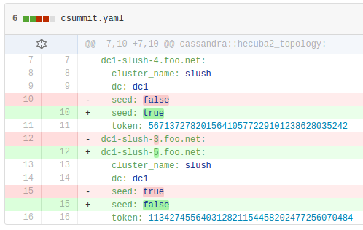
Peace Story #2: The Slush Incident
What gave us two peer reviews, such as:
Notes:
The commands I did yielded some PRs.
Here, for example, you can see one describing how a node got changed.

Slide 24
Peace Story #2: The Slush Incident
After a while, we ended up with
Datacenter: dc1
==========
Address Rack Status Load Owns Token
dc1-slush-1.foo.net rac1 Up Normal 797.27 GB 33.33% 0
dc1-slush-4.foo.net rac1 Up Normal 798.58 GB 33.33% 56...
dc1-slush-5.foo.net rac1 Up Normal 797.58 GB 33.33% 11...
Notes:
Once the PRs got merged, we just waited a bit and cluster got all happy again.
We didn’t have to do anything else beyond merging the PR.

Slide 25
The Peace Stories
Very pleasant experience operating Cassandra @ Spotify
All because our infrastructure
Notes:
As you can see, operating Cassandra is quite a pleasant experience at Spotify.
And this is all due to the infrastructure we’ve built.

Slide 26
 | Agenda
1 | Two peace stories
2 | Cassandra infrastructure at Spotify
3 | What exactly is Hecuba2?
4 | Wrap up
Notes:
So lets have a closer look at what our infrastructure looks like.

Slide 27
Cassandra Infrastructure @ Spotify
Let’s just create a Cassandra cluster like a Spotifier
Notes:
And to do this, let’s just imagine we’re a Spotifier going to create a Cassandra cluster.

Slide 28
Creating C* Cluster Like A Spotifier
Step 1: Get some machines
Notes:
The first thing we need to do is to provision some machines.

Slide 29
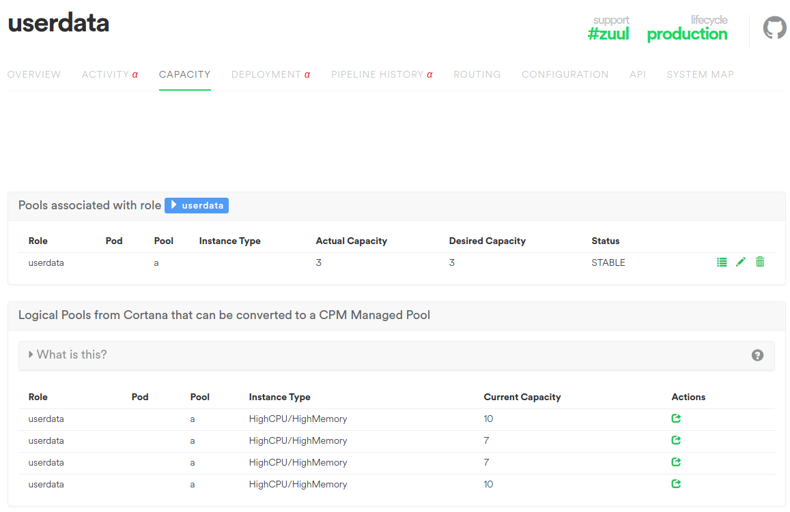
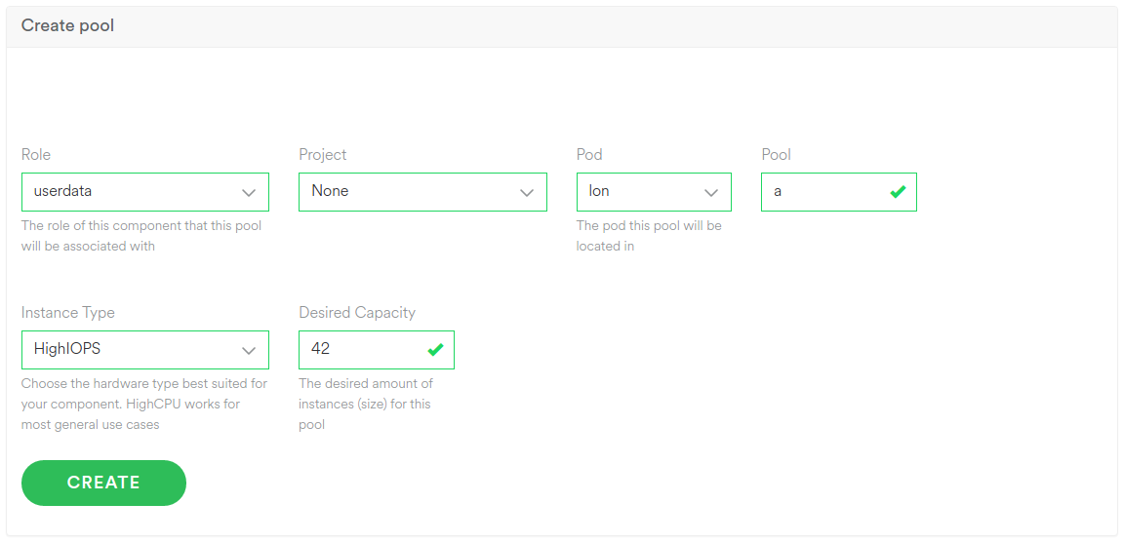
Creating C* Cluster Like A Spotifier
Step 1: Get some machines
Notes:
At spotify, we do this through a system-z
system-z is many things. it looks like a webpage, that has many tabs that allow you to do many things. coolest of which the sysmap one that dynamically draws a map of microservices (even all of them at once).

Slide 30
Creating C* Cluster Like A Spotifier
Step 1: Get some machines
More info about System-Z
Modelling Microservices at Spotify
by Petter Måhlén
https://youtu.be/7XDA044tl8k
Notes:
That’s pretty cool thing actually, and there’s even a talk about it.
But system-z can also help you provision machines. You simply enter some info about the machines you want. This will get passed on to our provisioning system, and your machines will be up in no time.

Slide 31
Creating C* Cluster Like A Spotifier
Step 1: Get some machines
Step 2: Install the operating system
Notes:
With the machines being provisioned, the next step is to install some operating system on them.

Slide 32
Creating C* Cluster Like A Spotifier
Step 1: Get some machines
Step 2: Install the operating system
Notes:
However, that’s exactly what we’re not going to do.

Slide 33
Creating C* Cluster Like A Spotifier
Step 1: Get some machines
Step 2: Setup the cluster
Notes:
Because at Spotify, this happens automagically, and we can just focus on setting up the C* cluster.

Slide 34
Creating C* Cluster Like A Spotifier
Step 1: Get some machines
Step 2: Setup the cluster
hecuba2-cli create-cluster
--cluster-name "My new cluster"
--owner mySquad dc1-userdatacass-{1..3}.foo.net
Notes:
To setup a cluster, all what we do is we issue a create cluster command and pass it some basic information.

Slide 35
Creating C* Cluster Like A Spotifier
Step 1: Get some machines
Step 2: Setup the cluster
Step 3: Check PR
Notes:
Once we merge this PR, a lot of magic will happen.

Slide 36
Creating C* Cluster Like A Spotifier
Step 1: Get some machines
Step 2: Setup the cluster
Step 3: Check PR
Step 4: Wait
Notes:
Our conf. management system will detect that our machines are tagged with the cassandra class. that is why it will install the needed software (JVM, cassandra, and hecuba).
It will also configure cassandra with all the machines.

Slide 37
Creating C* Cluster Like A Spotifier
Step 1: Get some machines
Step 2: Setup the cluster
Step 3: Check PR
Step 4: Wait
This will get picked up by our conf. management system and
Install software
Configure Cassandra
Notes:
Our conf. management system will detect that our machines are tagged with the cassandra class. that is why it will install the needed software (JVM, cassandra, and hecuba).
It will also configure cassandra with all the machines.

Slide 38
Configuring Cassandra
Notes:
Configuring Cassandra is what we are interested in.

Slide 39
Configuring Cassandra
Is (almost) all about putting things into config files
Notes:
Configuring cassandra is almost all about putting values into configuration files.

Slide 40
Configuring Cassandra
Is (almost) all about putting things into config files
Mostly tokens and seeds
Tokens are clunky large strings
V-nodes would help, but...
Notes:
There is a lot of values that can be configured this way, but for our sake, the most important ones are tokens because they are large clunky strings that are very cumbersome to work with.

Slide 41
Configuring Cassandra
Is (almost) all about putting things into config files
Mostly tokens and seeds
Tokens are clunky large strings
V-nodes would help, but...
Also node bootstrap
All nodes joining at once is not desired
Notes:
However, configuring Cassandra is not just about values in configuration files.
This is because it’s not safe to consider a cluster configured while the nodes are not online and in the correct places.
Changing a cluster topology is quite intensive operation which can have very bad impact on SLA.

Slide 42
Configuring Cassandra
Is (almost) all about putting things into config files
Mostly tokens and seeds
Tokens are clunky large strings
V-nodes would help, but...
Also node bootstrap
All nodes joining at once is not desired
Both are handled by Hecuba2
Notes:
Luckily for us, who are common Spotifiers and not Cassandra experts, both of these tricky and dangerous operations are managed by hecuba.

Slide 43
 | Agenda
1 | Two peace stories
2 | Cassandra infrastructure at Spotify
3 | What exactly is Hecuba2?
4 | Wrap up
Notes:
So, what exactly is this hecuba thing.

Slide 44
What Exactly is Hecuba2
Hecuba2
Client
Library
Cassandra Node
Hecuba
YAML
File
Hecuba2
jmx-proxy
Hecuba2
jmx-proxy
Hecuba2
Agent
Hecuba2
Agent
Hecuba2
SeedProvider
Hecuba2
Seed
Provider
C*
Process
Notes:
Hecuba is bunch of things.
First, there are some things present on the cassandra node.
Then there is some YAML file and some client library.

Slide 45
Hecuba YAML File
Represents the truth about the cluster
Notes:
The best place to start making sense of this all is the Hecuba YAML file because it’s simple and it’s the truth.

Slide 46
Hecuba YAML File
dc1-mytestcass-1.foo.net:
cluster_name: mytestcass
dc: dc1
seed: true
token: 0
dc1-mytestcass-2.foo.net:
cluster_name: mytestcass
dc: dc1
seed: false
token: 56713727820156410577229101238628035242
Notes:
The hecuba yaml file describes the desired topology of the cluster.
It’s a simple YAML map/dict, keyed by hostnames, and valued with cluster name and DC the host belongs to, whether the host is a seed or not, and what token the host occupies in its cluster.

Slide 47
Hecuba2 Client Library
Manipulates the Hecuba YAML file
Notes:
The second hecuba component is the client library.
This is a piece of software that produces the YAML file.
It has a lot of smartness in it.

Slide 48
Hecuba2 Client Library
Manipulates the Hecuba YAML file
Does this in a smart way
Notes:
The second hecuba component is the client library.
This is a piece of software that produces the YAML file.
It has a lot of smartness in it.

Slide 49
Hecuba2 Client Library
Manipulates the Hecuba YAML file
Does this in a smart way
Doubling the cluster
Double the size
New node
Existing node stayed in place
Notes:
For example, it can double the cluster.
As you’ve seen in the intro, it only needs to know the new hosts and figures everything else (ish).
Then it inserts the new hosts exactly in the way that the old hosts don’t need to move, and the ring stays balanced.

Slide 50
Hecuba2 Client Library
Manipulates the Hecuba YAML file
Does this in a smart way
Doubling the cluster
Expand by 50%
Add 2 nodes
New node
Existing node stayed in place
Existing node moved
Notes:
Since doubling is trivial, let me show you expanding by 50%.
In this case, the client library will change the topology in such way that the minimal number of old nodes has to move.
So, when moving 4->6 nodes, 2 old stay at their places, 2 old nodes move and 2 new nodes enter the ring.

Slide 51
Hecuba2 Server-Side Components
Cassandra Node
Hecuba2
jmx-proxy
Hecuba2
Agent
Hecuba2
Seed
Provider
C*
Process
Notes:
The last hecuba component, the server-side components,

Slide 52
Hecuba2 Server-Side Components
Again, three things:
hecuba2-agent
State machine managing the C* process
Notes:
it’s actually a set of another three things.
The largest is the hecuba2-agent which is a pure state machine responsible for manipulating the cassandra process.

Slide 53
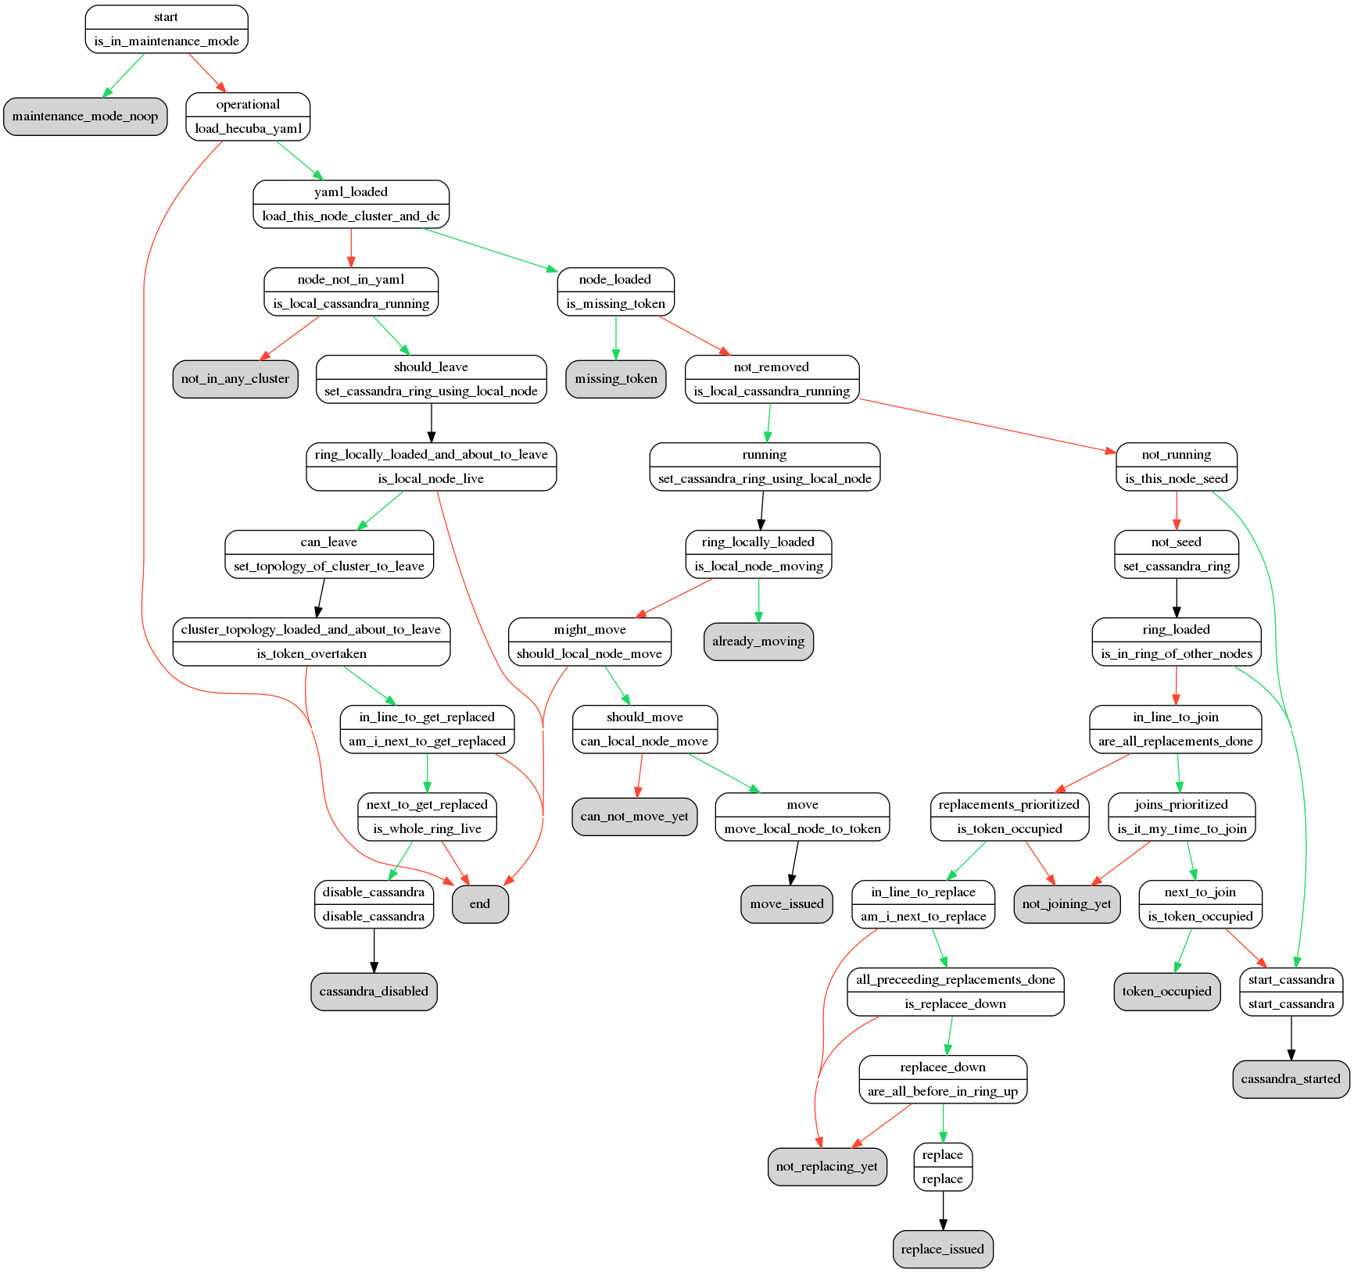
hecuba2-agent
Notes:
When I said the hecuba2-agent is a state machine, I wasn’t kidding.
We’ve implemented it so purely that it can even can draw itself. This is how it looks like.
What you see here is a decision making process regarding what state should the cassandra be in the agent performs once executed.

Slide 54
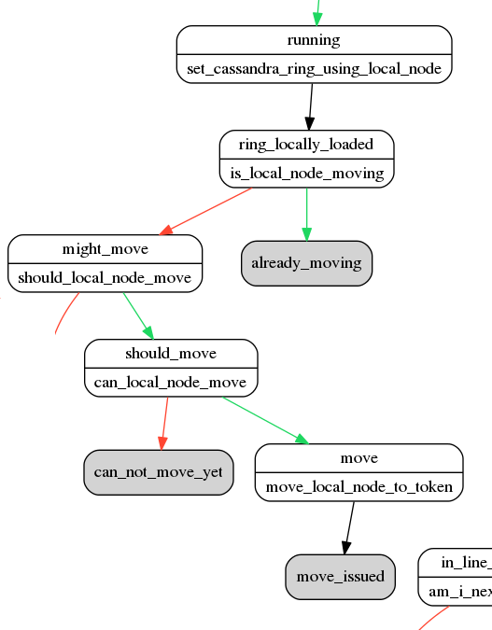
hecuba2-agent
Notes:
Zooming a bit it, you can see some of the stuff going on.
If C* is locally running, the agent checks if the node is should or can be moving.
If C* is not locally running, the agent checks if the node should just start as a seed, or wait for some other nodes to join first, or maybe replace some other node.
Mention deadlock prevention

Slide 55
Hecuba2 Server-Side Components
Again, three things:
hecuba2-agent
State machine managing the C* process
hecuba2-jmxproxy
nodetool with JSON output
Notes:
Then there is the hecuba2-jmxproxy which you can think of as a nodetool with JSON output.

Slide 56
Hecuba2 Server-Side Components
Again, three things:
hecuba2-agent
State machine managing the C* process
hecuba2-jmxproxy
nodetool with JSON output
hecuba2-seedprovider
Picks seeds from Hecuba YAML
Notes:
Finally, there is a hecuba2-seed provider which picks seeds based on the hecuba YAML file.

Slide 57
How Does It All Work Together
Notes:
So, at this point you’re probably pretty confused about all the bits and pieces.
So let me go through all of them once more and show you how they all interact with each other.

Slide 58
How Does It All Work Together
Hecuba2
Client
Library
Notes:
To start with, we have the hecuba client library.

Slide 59
How Does It All Work Together
Hecuba2
Client
Library
Creates
Hecuba
YAML
File
Not in scope
Hecuba2
Notes:
This one creates the hecuba yaml file

Slide 60
How Does It All Work Together
Hecuba2
Client
Library
Text Editor
Creates
Hecuba
YAML
File
Alternative
Not in scope
Hecuba2
Notes:
however, because it’s just a yaml file, there are other ways of crafting it. like manually in the text editor (yuck).
what’s important is the fact how exactly the file is created is not hecuba’s problem.

Slide 61
How Does It All Work Together
Hecuba2
Client
Library
Text Editor
Cassandra Node
Hecuba
YAML
File
Creates
Hecuba
YAML
File
Distribution
Hecuba2
jmx-proxy
Hecuba2
Agent
Alternative
Hecuba2
Seed
Provider
C*
Process
Not in scope
Hecuba2
Notes:
the same way, distributing the yaml file to the actual cassandra nodes is none of hecuba’s concern. neither is installing C* itself for that matter.

Slide 62
How Does It All Work Together
Hecuba2
Client
Library
Text Editor
Cassandra Node
Hecuba
YAML
File
Creates
Hecuba
YAML
File
Distribution
Hecuba2
jmx-proxy
Hecuba2
Agent
Manual
Puppet
Alternative
Hecuba2
Seed
Provider
C*
Process
Not in scope
Hecuba2
Notes:
As far as the distribution is concerned, it can be done in any way.
We could manually copy the files, or have a conf. management system do it for us.

Slide 63
How Does It All Work Together
Hecuba2
Client
Library
Text Editor
Cassandra Node
Hecuba
YAML
File
Cron
Creates
executes
Hecuba
YAML
File
Distribution
Hecuba2
jmx-proxy
Hecuba2
Agent
Manual
Puppet
Alternative
Hecuba2
Seed
Provider
C*
Process
Not in scope
Hecuba2
Notes:
hecuba’s entry point on a C* machine is the agent. The agent is a one-pass state machine that it needs to be executed somehow.
In our case, we use cron to run it every minute.

Slide 64
How Does It All Work Together
Hecuba2
Client
Library
Text Editor
Cassandra Node
Hecuba
YAML
File
Cron
Creates
reads
executes
Hecuba
YAML
File
Distribution
Hecuba2
jmx-proxy
Hecuba2
Agent
Manual
calls
Puppet
Alternative
Hecuba2
Seed
Provider
C*
Process
Not in scope
Hecuba2
Notes:
what the agent does once started is to check the hecuba yaml file and potentially do a jmx-proxy call to discover the rest of the ring.

Slide 65
How Does It All Work Together
Hecuba2
Client
Library
Text Editor
Cassandra Node
Hecuba
YAML
File
Cron
Creates
reads
executes
Hecuba
YAML
File
Distribution
Hecuba2
jmx-proxy
Hecuba2
Agent
Manual
calls
Puppet
manages
Alternative
Hecuba2
Seed
Provider
C*
Process
Not in scope
Hecuba2
Notes:
the agent then uses the information to do something with cassandra (start, stop, or move).

Slide 66
How Does It All Work Together
Hecuba2
Client
Library
Text Editor
Cassandra Node
Hecuba
YAML
File
Cron
Creates
reads
executes
Hecuba
YAML
File
Distribution
Hecuba2
jmx-proxy
Hecuba2
jmx-proxy
Hecuba2
Agent
Hecuba2
Agent
Manual
calls
Puppet
manages
Hecuba2
SeedProvider
Alternative
Hecuba2
Seed
Provider
C*
Process
calls
Not in scope
Hecuba2
Notes:
In case of starting up, the C* process will load the hecuba2 agent (previously installed by the conf. management)

Slide 67
How Does It All Work Together
Hecuba2
Client
Library
Text Editor
Cassandra Node
Hecuba
YAML
File
Cron
Creates
reads
executes
Hecuba
YAML
File
Distribution
Hecuba2
jmx-proxy
Hecuba2
jmx-proxy
Hecuba2
Agent
Hecuba2
Agent
Manual
reads
calls
Puppet
manages
Hecuba2
SeedProvider
Alternative
Hecuba2
Seed
Provider
C*
Process
calls
Not in scope
Hecuba2
Notes:
and the seed provider will in turn read the information about seeds from the hecuba yaml file.
and that’s about it.

Slide 68
To Recap
Hecuba2 manages cluster topologies
create-cluster
expand-cluster
replace-node
Many things are out of scope
Missing features:
parallelism @ hecuba2-agent
cluster shrinking
Notes:
So to recap,
Hecuba2 is a tool to manage cassandra clusters (on the topology level)
There are many things that are out of scope (like provisioning the machines, installing software, backups, etc) that will never become part of hecuba.
There are also a few things that are just missing. these include cluster shrinkage (a thing we just don’t do at spotify) and certain parallelism at the agent (for now, only one topo change can be happening at a given time).

Slide 69
 | Agenda
1 | Two peace stories
2 | Cassandra infrastructure at Spotify
3 | What exactly is Hecuba2?
4 | Wrap up
Notes:
So, to wrap up

Slide 70
Our Experience So Far
It’s been in use for a year
It hasn’t let us down yet
But it has surprised us by being more robust than we thought
State machine testable, visualisable, and easily extensible
Peer review for changes
Notes:
Our experience with hecuba2 has been extremely positive so far.
We’ve been using it for more than a year to manage all of our clusters.
During this time, we’ve not hit a single bug. We’ve even been surprised about how reliable the thing is.
This is probably due to proper testing we’ve done on the agent, as well as on the client lib.
And another thing we just can’t get enough of is the peer review possibility when changing cluster topologies.

Slide 71
FAQ
Why is it called Hecuba2?
Does it support v-nodes?
Does it support Cassandra version X?
Can I use it on Y?
Is it FOSS?
Notes:
Now, let me try something and do a short FAQ session.
It’s called Hecuba 2 because (Netflix) Priam was Cassandra’s father, Hecuba her mother and we’ve already built and discontinued the first Hecuba.
We don’t use vnodes at Spotify and we have no clue what would happen if you’d use them with hecuba.
Because so many things are not in scope, it supports any cassandra version given that it doesn’t break the signature of the 2-3 MBeans jmxproxy uses
Again, for the limited scope, and java and python, you could probably run hecuba on anything.
And we’re working on FOSS.

Slide 72
Actual Q
Notes:
Now, if there are any actual questions, I’d be more than happy to answer.

Slide 73
Thank You!
bases-ext@spotify.com
zvo@spotify.com
Eventually https://github.com/spotify/hecuba2
Notes:
And we’re out of time, so thank you for listening and feel free to find me sometime after.

