Slide 1
Christopher Bradford
Replication and consistency in Cassandra... What does it all mean?

Slide 2
Who is this guy?

Slide 3

Christopher Bradford
Solutions Architect with DataStax
Built the world’s smallest C* cluster
Twitter: @bradfordcp
GitHub: bradfordcp
Notes:
I have contributed to multiple open source projects around distributed computing

Slide 4
Introduction
Notes:
Today we are talking about Consistency & Replication. We want to dive into how are these key components are implemented in Cassandra and what do they mean to Developers and Operations?

Slide 5
CAP Theorem
Consistency
Pick 2 of the 3
Availability
Partition Tolerance
Notes:
We’ll start with the CAP theorem. The CAP theorem says that it is impossible for a distributed system to provide guarantees around the following areas.
Autumn of 1998

Slide 6
CAP Theorem
Consistency
Consistency
Every read receives the most recent write or an error
Availability
Partition Tolerance
Notes:
Consistency - Every read receives the most recent write or an error

Slide 7
CAP Theorem
Consistency
Availability
Every request receives a response
Availability
Partition Tolerance
Notes:
Availability - Every request receives a response
Note the data returned is not guaranteed to be the most recent

Slide 8
CAP Theorem
Consistency
Partition Tolerance
The system continues to operate despite arbitrary partitioning
Availability
Partition Tolerance
Notes:
Wikipedia says “due to network failures”, given my week it is due to disk controller errors.
Partition Tolerance – the system continues despite arbitrary partitioning

Slide 9
CAP Theorem Evolved
The modern CAP goal should be to maximize combinations of consistency and availability that make sense for the specific application. Such an approach incorporates plans for operation during a partition and for recovery afterward, thus helping designers think about CAP beyond its historically perceived limitations.
- Eric Brewer
C
A
P
Notes:
Eric Brewer, creator of the CAP theorem, argues that the pick 2 statement was a bit misleading. Really system designers need to choose where to be flexible in the case of a partition.
Some systems prefer availability while Cassandra focuses on consistency.

Slide 10
CAP Theorem
Consistency
Cassandra’s View
AP – Availability & Partition tolerance above all else.
Availability
Partition Tolerance
Notes:
Consistency may be flexible to meet the needs of the application!

Slide 11
Replication
Availability & Partition Tolerance
Notes:
How are availability and partition tolerance achieved? Through replication

Slide 12
Replication
Replica
Write
Coordinator
Client
Replica
Replica
Notes:
Let’s look at how replication affects availability and partition tolerance. Assume in this environment we have a replication factor of 3. This means every piece of data written to our cluster is stored 3 times.
The client issues a write to a node in the cluster. This node is known as the coordinator for the duration of this request.
The coordinator hashes the PARTITION KEY portion of the PRIMARY KEY and uses a REPLICATION STRATEGY to determine where the replicas live and forwards the request to those nodes.

Slide 13
Replication
Replica
Write
Coordinator
Client
+1 Hint
Replica
Replica
Notes:
When one of the replicas is down the coordinator still writes to the other two replicas. This satisfies the availability portion of the CAP Theorem
A hint is then stored on the coordinator. Should the replica that was down come back up within a certain time period (default 3 hours) the hint will be replayed against that host. This helps get the node back in sync with the rest of the cluster. This satisfies the partition tolerant portion of the CAP theorem

Slide 14
Replication
Replica
Read
Coordinator
Client
Replica
Replica
Notes:
Reads behave in a similar manner (although without the need for a hint).
The coordinator is aware that one of the replicas is down and responds with data from the two replicas that are still available.

Slide 15
Configuring Replication
Replication is defined at the keyspace level.
CREATE KEYSPACE cassandra_summit
WITH REPLICATION = {
‘class’: ‘SimpleStrategy’,
‘replication_factor’: 3
};
Strategy
Parameters
Notes:
Replication is defined at the keyspace level. The number of replicas and placement strategy are supplied during keyspace creation.
The replication strategy is specified with the class parameter. Other parameters may also be required, but they are tied to the strategy being used.

Slide 16
Replication Strategies
1 | Simple Strategy
2 | Network Topology Strategy
Notes:
Cassandra ships with a few replication strategies. Let’s look at those now.

Slide 17
Simple Strategy
Replica
Request
Coordinator
Client
Replica
Class: SimpleStrategy
Parameters:
replication_factor
Replica
Notes:
The Simple Strategy is just that, Simple. The replicas for a particular piece of data circle the ring in order.

Slide 18
Simple Strategy
Request
Coordinator
Client
Replica
Replica
Replica
Notes:
If the token hashes differently then it may look like this.
WARNING: Be very careful with SimpleStrategy in multi-DC environment. Depending on the consistency level and load balancing policy writes may throw exceptions as hosts are not necessarily routable.

Slide 19
Network Topology Strategy
Request
Coordinator
Client
Replica
Class: NetworkTopologyStrategy
Parameters:
dc_name: replication_factor
Replica
Replica
Notes:
Network Topology Strategy layers additional logic into the replica selection process. It utilizes topology information to place replicas in a manner which ensures an even higher level of reliability.
In our first example let’s assume every node is in the same DC and physical rack. The replica selection process looks similar to the SimpleStrategy, there is nothing too intense here.
Note you must use an appropriate Snitch. The snitch defines how topology information is shared in the cluster. The GossipingPropertyFileSnitch uses the cassandra-rackdc.properties file to share topology info with peers where the SimpleSnitch has hardcoded values ☹

Slide 20
Network Topology Strategy
Rack 1
Request
Replica
Replica
Client
Coordinator
Replica
Rack 2
Notes:
In this example we have two racks, the aptly named rack 1 and rack 2. Now the network topology strategy will try and protect against an entire rack failure by placing replicas on different racks. In fact it won’t even attempt to write to another node in the same rack until all other rack options have been exhausted.

Slide 21
Network Topology Strategy
Rack 1
Request
Replica
Replica
Coordinator
Rack 2
Client
Replica
Tools:
nodetool status ks
nodetool getendpoints ks table val
Rack 3
Notes:
In this example we have two racks added a third rack. Now one replica will be placed on each of the racks. This will lead to an imbalance in the cluster. The singular node in rack 1 will contain 100% of the data in the cluster.

Slide 22
Consistency
Balancing performance and correctness
Notes:
Remember how we discussed how the CAP theorem has evolved over time. It’s clear in Cassandra that this is at the heart. Consistency can be tuned on a per-query level to enhance performance or ensure consistency.

Slide 23
Tunable Consistency
Notes:
We call this tunable consistency. Consistency can even be tuned depending on cluster health to ensure application availability. Let’s look at some of these levels.

Slide 24
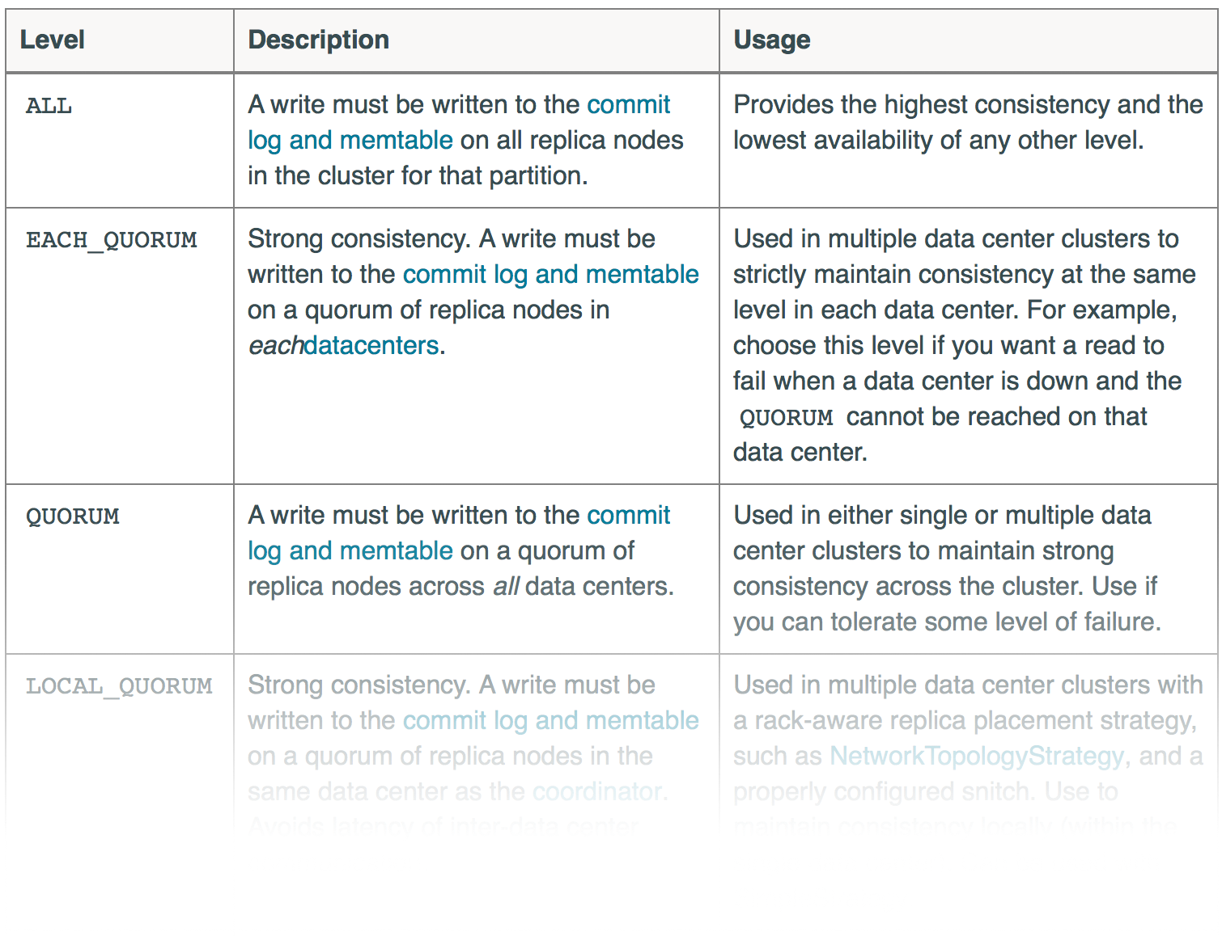
Consistency Levels
Notes:
The consistency level is used to determine the number of replicas that must respond for any given query. Some levels are unique to the type of query being performed (read vs write). Others span datacenters and are not expected to be extremely performant.

Slide 25
Consistent Reads
Replica
ALL
QUORUM
LOCAL_QUORUM
ONE
LOCAL_ONE
SERIAL
Replica
Replica
Notes:
Discuss advantages of each, speed, correctness, failure tolerance.

Slide 26
Consistent Writes
Replica
ALL
QUORUM
LOCAL_QUORUM
ONE
LOCAL_ONE
ANY
Replica
Replica
Notes:
Discuss advantages of each, speed, correctness, failure tolerance. Note that even though we may return after one replica acknowledged the write we still attempt the write on other replicas. Bring up immediate consistency.

Slide 27
Consistency Failures
Replica
What happens when the desired consistency level cannot be achieved?
Replica
Replica
Notes:
An exception is thrown! At this point you can alert the user to a potential issue or try the request with a different consistency level. This process may be automated with a RetryPolicy.
This is a big win for your application as you can stay available for users while alerting them that there may be a slight delay on changes.

Slide 28
Failure Recovery
Replica
Staying Consistent
In the event of a failure how do replicas get the latest data?
Replica
Replica
Notes:
Cassandra has a number of anti-entropy processes to ensure nodes respond with the latest information.
We were first introduced to this earlier with hinted handoffs.
Should hints expire a manual repair of the node will synchronize it with its neighbors.
There is also a read repair system in place. This takes the data returned by multiple replicas, compares them, and returns the latest value. A write is also issued which fixes any replicas that are out of date.
This was taken a step further by Netflix with the Cassandra tickler. This process performs a read at the ALL consistency level across every primary key value forcing replicas to be brought in sync.

Slide 29
Conclusion
Notes:
Replication
Controls where copies live
Set on the keyspace level
Are imperative both during a and p situations
Consistency
Dictates trade-offs between performance and correctness
Achieves synchronization of replicas
Consistency levels
Both are core building blocks of Cassandra. Understand their usage and don’t be afraid to jump in the code. The classes that make this up are fairly simple and easy to reason about.

Slide 30
Questions?

