Slide 1


Migration from Thrift to CQL
Brij Bhushan Ravat
Chief Architect, Voucher Server - Charging System

Slide 2


To be continued …
“I didn't come here to tell you how this is going to end.
I came here to tell you how it's going to begin.”

Slide 3
1 | Why Thrift-to-CQL
2 | Impact on data model
3 | Approaches
4 | Comparison
5 | Summary

Slide 4


Context
When everyone thought there is no alternative to RDBMS, one started his journey with Cassandra
Thrift is deprecated and
CQL is the new interface
He interfaced the application with Cassandra using Thrift interface

Slide 5
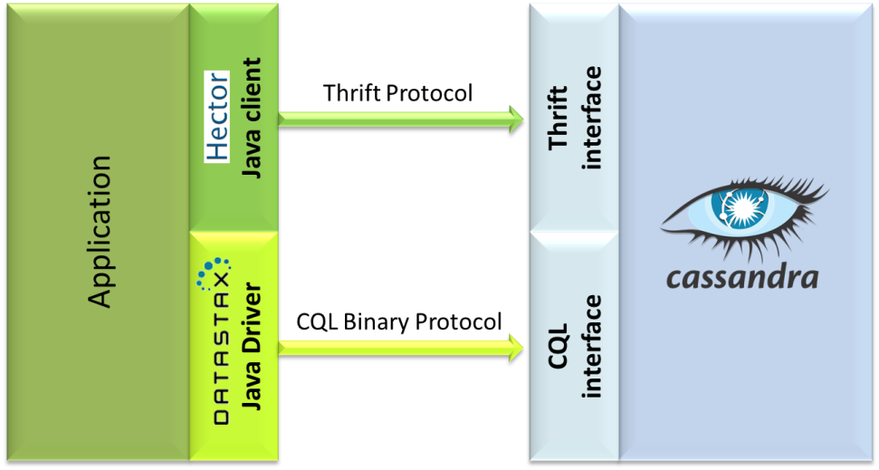
Thrift & CQL
CQL interface was introduced in Cassandra in Nov, 2012.
Since then Cassandra can be interfaced, using Thrift as well as CQL interface

Slide 6
Thrift & CQL
Development of Thrift interface has been officially frozen from last 2 years
Thrift’s support will be completely removed in Cassandra 4.0
Therefore, moving from Thrift to CQL is not just a choice. It is mandatory:
in order to leverage new capabilities of Cassandra, and
if you want your application to be ready for Cassandra 4.0
Moreover:
With Cassandra 3.0 onwards, performance of CQL is much better than that of Thrift, and
CQL is easier to use because it is similar to SQL

Slide 7
Few Points to ponder
Moving from Thrift to CQL changes all touch points of an application with Cassandra
This implies that the application may have to redesign its framework for those operations that directly work on data
For example:
Atomicity of multiple updates
Isolation of a transaction

Slide 8
1 | Why Thrift-to-CQL
2 | Impact on data model
3 | Approaches
4 | Comparison
5 | Summary

Slide 9
Impact on data model
Unlike Thrift, CQL depends more on column_metadata
Therefore, if your table has both fixed & dynamic columns then CQL will be able to read only fixed columns

Slide 10
Cassandra table
create column family hotels
with key_validation_class = UTF8Type
and comparator = UTF8Type
and column_metadata = [
{column_name: Name, validation_class: UTF8Type},
{column_name: City, validation_class: UTF8Type},
{column_name: State, validation_class: UTF8Type},
{column_name: Zip, validation_class: IntegerType},
{column_name: Phone, validation_class: UTF8Type}
]

Slide 11
Cassandra table
Actual format

Slide 12
Dynamic column
column_metadata = [
column_name: Name, column_name: City, column_name: State, column_name: Zip, column_name: Phone
]
If table has dynamic column along with fixed columns
CQL will fail to read the dynamic column(s)
Because unlike Thrift, CQL depends more on metadata

Slide 13
1 | Why Thrift-to-CQL
2 | Impact on data model
3 | Approaches
4 | Comparison
5 | Summary

Slide 14
Approaches (for Moving to CQL)
Add collections to the schema
Make the table schema-less
(If you have both fixed & dynamic columns)

Slide 15
Add collections to the schema
Replace multiple dynamic columns with one (or more) collections, like map

Slide 16
Make the table schema-less
Drop the entire column_metadata
This will make it possible to read all the columns of the table (because now all the columns are dynamic).
In absence of column_metadata, CQL will make use of an internal column called ‘column1’
column1 has listing of all the column names in the table
update column family hotels
with key_validation_class = UTF8Type
and comparator = UTF8Type
and column_metadata=[]

Slide 17
Schema-less table: advantage
Usually, an application performs multiple operations on a table, like
Adding new data records
Seek a data record & update it
Update data records in bulk (based on a criteria)
Just read the data records & generate a report
Good news
APIs that work with Thrift interface, will continue working even without the metadata
This gives flexibility in development to migrate functionalities from Thrift to CQL one-by-one.

Slide 18
Schema-less table: Advantage
Add new hotel
Update hotel record
Add a rating to hotel
Report Generation
Hector APIs
CQL APIs
Hector APIs
CQL APIs
Hector APIs
CQL APIs
Hector APIs
CQL APIs
Cassandra
Thrift interface
CQL interface

Slide 19
1 | Why Thrift-to-CQL
2 | Impact on data model
3 | Approaches
4 | Comparison
5 | Summary

Slide 20
Comparison
Schema with collections
Schema-less
Requires data migration
Once schema is changed, all functions will require migration in one-go
No need for data migration
Application functions can be migrated in multiple phases
Wait !
Don’t jump to schema-less. The decision won’t be that easy.
There is one more dimension to be evaluated. --------> Performance

Slide 21
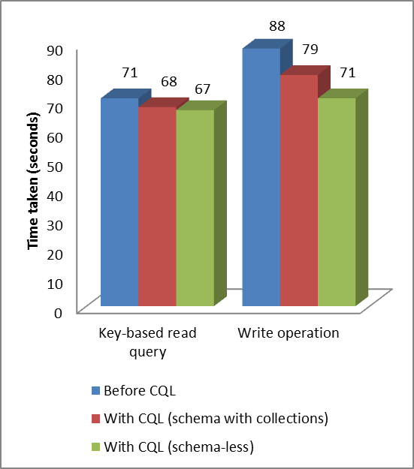
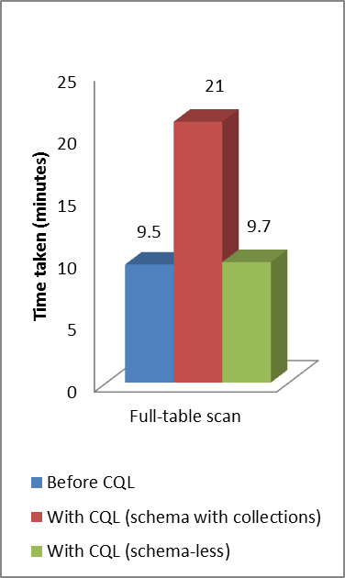
Performance Comparison
Cassandra: 2.0.14
Data size: 1 million records
Data size: 50 million rec.
By moving to CQL
Marginal improvement in performance, in key-based read queries and write operations
But there is a major performance drop in full-table scan scenario, with ‘Schema with collections’

Slide 22
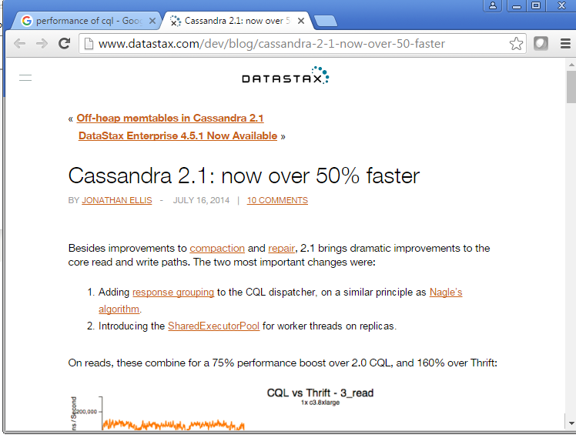

Slide 23

“I didn't come here to tell you how this is going to end.
I came here to tell you how it's going to begin.”
So, when you move to CQL from Thrift and you are on Cassandra v 2.0.x, you don’t get significant performance benefit.
Performance benefit will come when you upgrade Cassandra

Slide 24
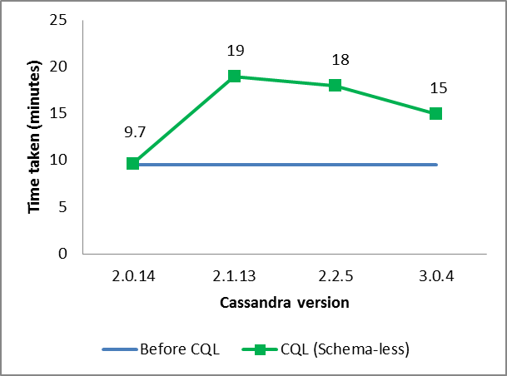
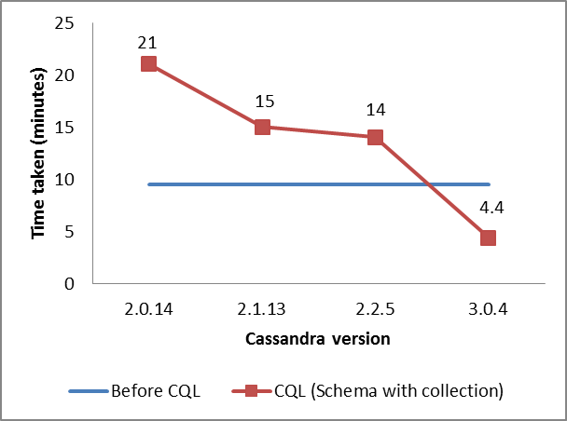
Performance across versions
Scenario: Full-table scan
Data size: 50 million records
Spark version: 1.2
Schema-less
Schema-with-collection
At v 2.0.14, Schema-less gives same performance
but v 2.1 onwards, performance drops
At v 2.0.14, Schema-with-collection give almost half performance
but v 2.1 onwards, its performance is always better than schema-less

Slide 25
1 | Why Thrift-to-CQL
2 | Impact on data model
3 | Approaches
4 | Comparison
5 | Summary

Slide 26
Summary
Moving from Thrift to CQL is important for lifecycle management of a solution
CQL gives a challenge when both fixed as well as dynamic columns are present
There are two approaches for moving to CQL
Schema-less
Doesn’t require data migration. Hence, data remains compatible with Thrift APIs
Better performance with Cassandra v 2.0.14
Schema with collections
Requires data migration. Hence, data is no longer compatible with Thrift APIs
Better performance with Cassandra v 2.1.13 & higher
Performance of CQL (schema with collection) improves with Cassandra version upgrade & becomes significantly high after upgrade to Cassandra 3.x

