Slide 1
Improving Tombstone Compactions in Apache Cassandra
Jim Witschey
Philip Thompson

Slide 2
What are Tombstones

Slide 3
C* Read/Write Path
Write
Memtable
commit log
SSTable

Slide 4
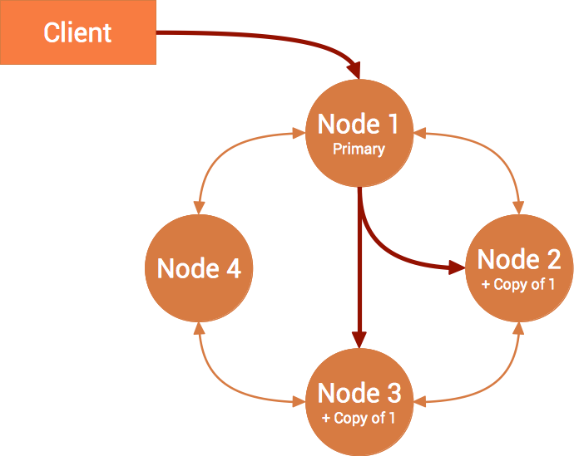
C* Read/Write Path

Slide 5
Tombstones
How do we handle deletes?

Slide 6
Tombstones
Deletion artifact to handle consistency issues

Slide 7
Tombstones
Safe to purge after gc_grace_seconds

Slide 8
Why Tombstones are Terrible

Slide 9
Tombstones are Terrible for Queries
Tombstones returned not transparent to dev/client
OOMs possible

Slide 10
Tombstones are Terrible for Operators (You!)
Zombie Data from Repair, or lost disks, or restored nodes, or lots of stupid reasons
Must repair within gc grace!
No disk space!

Slide 11
What is CASSANDRA-7019
“Improve Tombstone Compactions”

Slide 12
Pre CASSANDRA-7019
Single sstable Tombstone purges based on % tombstones
Major compactions
This has limitations

Slide 13
CASSANDRA-7272
Major LCS Compaction

Slide 14
CASSANDRA-7019
What was our goal?

Slide 15
CASSANDRA-7019
A new algorithm for tombstone compactions

Slide 16
nodetool garbagecollect
Trigger a tombstone purging compaction

Slide 17
What great new things can we do now?

Slide 18
Disk space vs. Perf
Cassandra-stress with the new CASSANDRA-7019 options
50% Inserts
33% Reads
3% partition deletes
6% row deletes
6% cell deletes

Slide 19
Disk space vs Perf
None:
ROW:
CELL:

Slide 20
Using nodetool garbagecollect
Use it as-needed during non-peak load!
Reclaim all your disk space, while not upsetting your users!

