Slide 1
CMPLXSYS 530
Computer Modeling of Complex Systems
Networks I
3/8/17

Slide 2
Agenda for Today
ABM and Networks
What is being represented?
Classes of network dynamics
Terminology
Overview of basic network terms and concepts
Network Metrics
Overview of metrics characterizing network structure
Working with Networks in ABM
NetLogo
Python: NetworkX

Slide 3
ABM and Networks
Networks in ABM
In contrast to either perfectly mixed and regular grid topologies, networks provide a way of getting at the role of non-homogeneous interaction structures in emergent processes
Consequently, understanding of networks often proves to be important in computational model of complex systems

Slide 4
ABM and Networks
What is being represented in a network?
Networks are an extraordinarily flexible means of representing the relationships/interactions between entities within a system
As with ABM more generally, networks can handle a wide range of conceptual concreteness – from empirically driven to highly abstracted

Slide 5
ABM and Networks
What is being represented in a network?
Examples:
Links between webpages
Family trees
Food webs among species
Friendships
Diplomatic relationships btwn countries
Gene regulatory networks
Boolean networks
CAUTION!!!
Just because you can think of a network representation of a system does not make it a meaningful representation of that system

Slide 6
ABM and Networks
Dynamics on networks
models with fixed topologies wherein the processes of interest occur over the network structure
Dynamics of networks
models concerned with the mechanisms that generate certain topologies, network features, or characteristics
Adaptive networks
models looking at the interplay of the two

Slide 7
Network Terms and Types - Overview
Basic Terms
Network, Graph

Slide 8
Network Terms and Types - Overview
Basic Terms
Network, Graph
Node, Vertex, Actor

Slide 9
Network Terms and Types - Overview
Basic Terms
Network, Graph
Node, Vertex, Actor
Tie, Edge, Link

Slide 10
Network Terms and Types - Overview
Basic Terms
Walk
List of edges sequentially connected to form a continuous route
Path
Walk that doesn’t visit any node twice
Cycle
Walk that starts and ends at same node

Slide 11
Network Terms and Types - Overview
Basic Terms
Subgraph
Part of the graph
Connected Graph
Graph in which every node is “reachable” from every other
Connected Component
Subgraph that is connected w/in itself but not the rest of the graph

Slide 12
Network Terms and Types - Overview
Complete Graph
All pairs of nodes are connected

Slide 13
Network Terms and Types - Overview
Regular Graph
All nodes have the same degree

Slide 14
Network Terms and Types - Overview
Bipartite (n-partite) Graph
Graph whose nodes can be divided into n groups such that no edges connect w/in a group

Slide 15
Network Terms and Types - Overview
Tree and Forests
A tree is a graph with no cycles; forest is a graph containing multiple trees

Slide 16
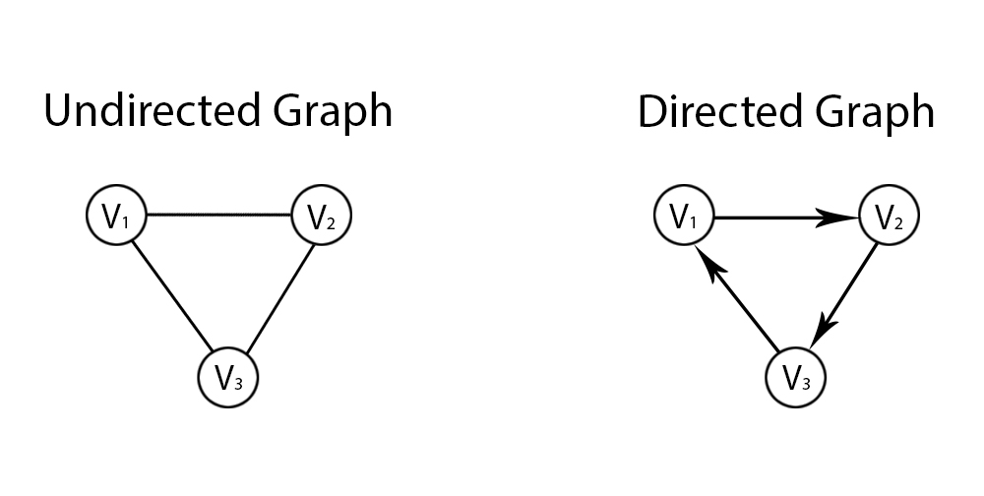
Network Terms and Types - Overview
Undirected: symmetrical relationships [e(1, 2) = e(2,1)]
Directed: asymmetrical relationships [e(1, 2) =/= e(2,1)]

Slide 17
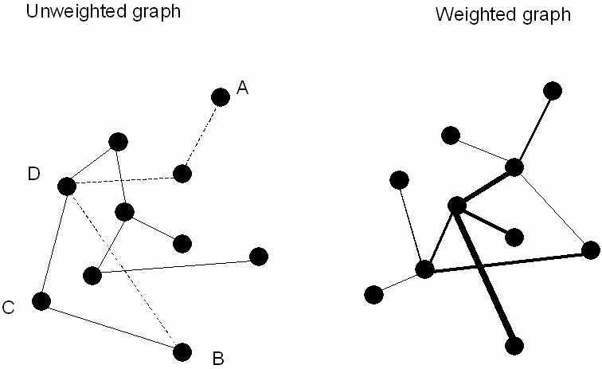
Network Terms and Types - Overview
Unweighted: Edges are binary [0,1]
Directed: Edges have weight values attached to them

Slide 18
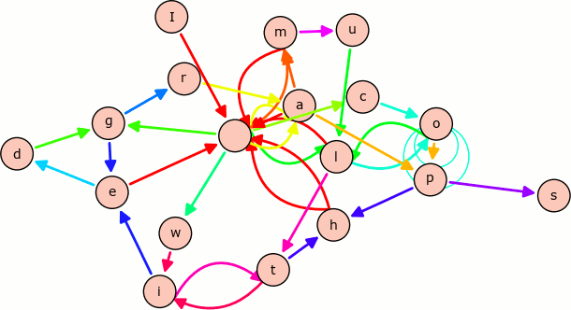
Network Terms and Types - Overview
Multiple Edge Graphs
Graph containing multiple edge types (i.e. multiple edge sets)

Slide 19
Network Terms and Types - Overview
Adjacency Matrix vs. Adjacency List

Slide 20
Network Metrics
Network Measures
There are variety of measures, of varying levels of complexity, that are used to characterize networks at both the “micro” (i.e. node and edge) and “macro” (i.e. network) levels

Slide 21
Network Metrics
Size
Number of nodes and edges in a network
Density
Portion of all realized edges relative to possible edges
n = number of nodes
m = number of edges
D = 2m/n(n-1) [for undirected]

Slide 22
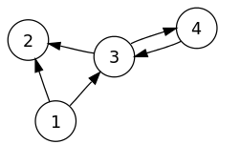
Network Metrics
Degree
Number of edges connected to a node [Ex: deg(5) = 2]
Average Degree
Average degree of nodes in network
In/Out Degree
In a directed graph, number of edges coming into or out of a node

Slide 23
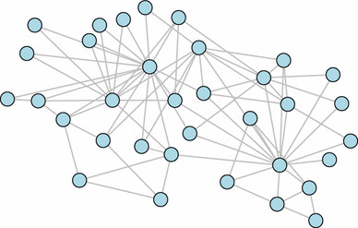
Network Metrics
Degree Distribution
Distribution of node degrees in a network [probability distribution indicating probability of a node having degree k ]

Slide 24
Network Metrics
Average (Characteristic) Path Length
Average of the shortest path lengths between all pairs of nodes in the network
Eccentricity
For each node, shortest path to the node farthest away from it in the network
Network Diameter
Maximum eccentricity value in the network

Slide 25
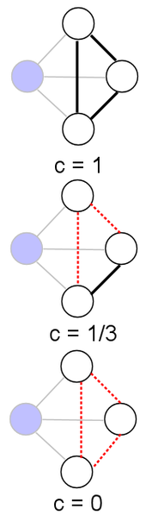
Network Metrics
Clustering Coefficient
For a node, proportion of realized ties between neighbors as compared to possible ties between neighbors
Average Clustering Coefficient
Average of all individual node clustering coefficients; gets at “clumpiness” or “cliquishness” of a network
Also related to the notion of network transitivity

Slide 26
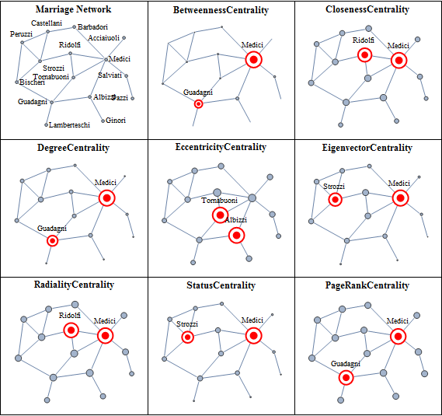
Network Metrics
Centrality Measures
Way of getting at how “important” a node is in a network
Many different approaches to assessing this…
Centrality of Florentine Families
(from Wolfram Mathematica)

Slide 27
Networks in ABM
Dynamics on Networks
Investigating how introduction of different interactional topologies between agents impacts emergent outcomes
Think: network characteristics as independent variables
Dynamics of Networks
Investigating how individual rules constitute emergent network structures
Think: network characteristics as dependent variables
Adaptive Networks
Individual rules interact dynamically with topology of interaction
Think: recursive, evolving interplay between the two

Slide 28
Networks in ABM
Agents as Nodes
Almost always, your agents will be your nodes.
Will consequently need ways to specify node attributes in order to capture agent attributes and be able to iterate through the node set to apply agent methods.
Interaction Structure as Ties
Agents’ interaction partners for a turn will be drawn (usually) from their network neighbors. Will need a way of identifying and storing this set of neighbors.
Additionally, if different partnerships will have different qualities (e.g. type of relationship, weight, etc.) will need to be able to specify tie attributes

Slide 29
Networks in ABM
NetLogo
Nodes → Turtles
Node attributes are “turtles-own” variables
Node sets are the agentsets of turtles
Ties → Links
Links treated as their own agents in NetLogo
Identified by the “who” id of the turtles they connect
Default is undirected, but can be directed
Tie attributes handled through “links-own”
Neighbor set is identified via “[turtle] link-neighbors”
Further flexibility available via the NetLogo Network Extension

Slide 30
Networks in ABM
Python (NetworkX package)
Graph
The entire graph is stored as a NetworkX Graph object
Nodes → Keys in “dictionary of dictionaries” called <Graph object>.node
Node attributes are kept in that node’s associated dictionary
Example: {“Node1”: { “attribute1”: attribute1 value}}
Edges → Each node acts as the key in another “dictionary of dictionaries of dictionaries” called <Graph object>.edge
Each node acts as a key for a dictionary containing each of its neighbors
Specifying a node and then neighbor allows access to edge attributes
Default is undirected graph that populates edge symmetrically (can use “DiGraph” for a directed one)
Example: {“Node1” : { “Node3” : {“weight”: .5}, “Node8”: {“dislike”: .2}}… “Node8”: {“Node1”: {“dislike: 2}}}

Slide 31
Networks in ABM
Practice with NetworkX with “Intro_to_NetworkX” notebook
(OR just work on your model!!!)

