Slide 1
CMPLXSYS 530
Computer Modeling of Complex Systems
Networks II: Dynamics of Networks
3/15/17

Slide 2
Agenda for Today
Networks’ Greatest Hits
Random graphs
Erdos-Renyi construction
Small-World
Watts-Strogatz algorithm
Scale-Free
Preferential attachment
NetLogo Implementations

Slide 3
Networks’ Greatest Hits
Under the much more general heading of “networks,” there are 3 that prove particularly important in complex systems:
Random
Small-World
Scale Free
An overview of the these also offers a great opportunity to look at the dynamics of networks

Slide 4
Random Graphs
Random graphs are networks in which the edges between nodes are (through some process) randomly generated
Usually conceptualized as a baseline or “null” model to compare against other graphs of comparable size that have more bias or order in their construction

Slide 5
Random Graphs
Generating Random Graphs
Frequently used approach to generating random graphs are two Erdos-Renyi models:
G(n,m) where n = number of nodes, m = number of edges
G(n,p) where n = number of nodes, p = probability of an edge existing between any two nodes

Slide 6
Random Graphs
Generating Random Graphs
G(n, m):
Randomly choose from all possible graphs possessing n and m
G(n, p):
For each node pair in a node set, create an edge with probability p

Slide 7
Random Graph Generation: NetworkX examples
G(n,m)
.gnm_random_graph(10,20)
G(n,m)
.gnp_random_graph(10, .10)
Random Degree Sequence
.random_degree_sequence_graph([deg distribution list])
Random Regular Degree
.gnp_random_graph(3, 10)

Slide 8
Random Graphs
Randomizing Graphs
Can also think about creating random graphs via randomization of existing networks (good for generating a null to compare against)
w/conservation of number of nodes and edges only
w/conservation of degree distribution
w/conservation of expected degree
Double-edge swap

Slide 9
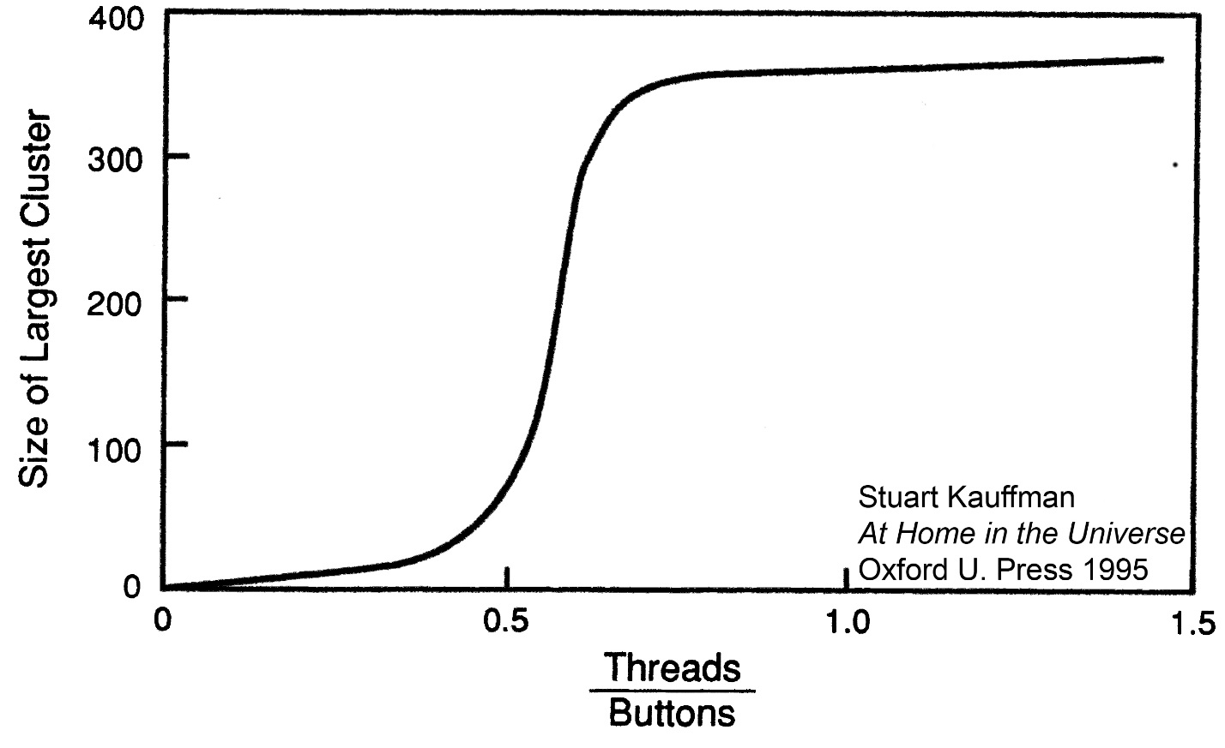
Random Graphs
Emergent Properties
Demonstrate phase transitions in macro-level network properties at critical values of network density (relevant to models of percolation and network robustness)

Slide 10
Beyond Random Graphs
In many respects, modeling random networks is easy due to the high degree of independence assumed in tie formation processes
How plausible is this assumption in real world contexts?

Slide 11
Small Worlds
One of the most prominent models to explore the interplay of order/bias and randomness in network topologies are those developed to get at the “Small World” problem
Empirical puzzle initially motivated by Milgram’s “Small World” studies but ultimately found to have a stunningly wide arena of application

Slide 12
Small Worlds
Strogatz and Watts Small World Model
Goal to capture four features:
Small, densely connected groups w/overlaps between groups
Connections can be created and dropped [dynamics]
Not all connections happen with the same probability [“structure”]
Allow for the existence of some “random” connections – that is connections not entirely determined by one’s existing network [“agency”]

Slide 13
Small Worlds
The β-model algorithm:
Start with a completely ordered network (“periodic” network)
Visit the first node in the network
With a probability = β, “rewire” that node by erasing one of its ties to a neighbor and creating a new tie to a random node
Repeat for every node in the network

Slide 14
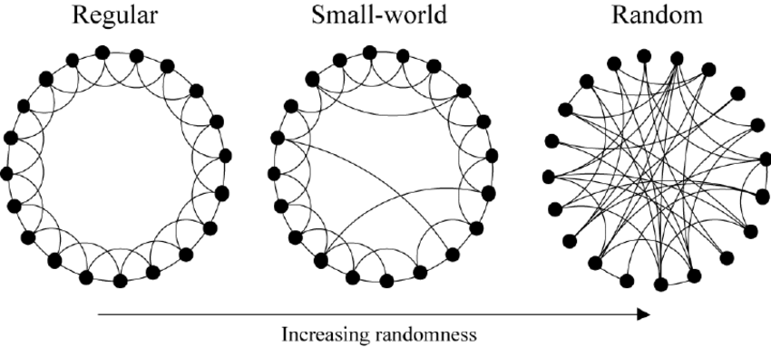
Small Worlds

Slide 15
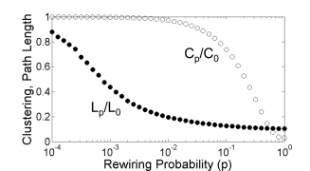
Small Worlds

Slide 16
Small Worlds
The β-model:
On average, first 5 rewirings reduces path length by 50%
Need 50 more rewirings, on average, to get it down by another 50%
Clustering coefficient decreases way more slowly – leads to another “sweet spot” for these networks

Slide 17
Scale Free
Small World network models are exceptionally good at getting at certain types of empirically observed “order” in networks, but not others.
Specifically, neither Small World nor Random Graph models are able to describe observed topologies which involve a very long-tail degree distribution

Slide 18
Scale Free
Degree Distribution described via:

Slide 19
Scale Free
“Scale Free” refers to the extremity of values in these distributions
Given the presence of nodes with both very few and very many connections, no innate “scale” to the network

Slide 20
Scale Free
Barabasi and Albert
Identified power law characteristic of scale free networks and proposed a model of how they are generated
Key insights:
Do not start with a fixed number of nodes. Instead, start with a small system and gradually add nodes to system
For a new node (B) added to the system, make the probability of connecting to an existing node (A) positively depend on the number of existing connections that node (A) already has

Slide 21
Scale Free
Algorithmically, can conceive of this as process of preferential attachment:
Begin with a network of m₀ initial nodes and an arbitrary topology (constrained s.t. each node has degree of at least 1)
For all subsequent nodes added, connect to existing node i with probability:

Slide 22
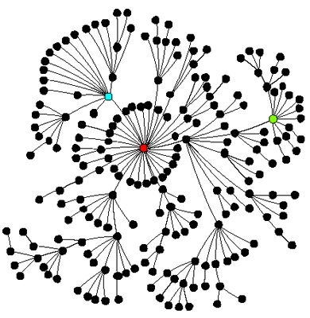
Scale Free
Network Properties:
Gives rise to a characteristic “spoke and hub” structure with a few central nodes of very high degree and many nodes on the peripheral with very low (~ 1) degree
Network model of a cumulative advantage process that is strongly biased toward early nodes
Robust to random “attacks” but quite vulnerable to targeted

Slide 23
NetLogo Implementations
NetLogo Models
Giant Component
Small Worlds
Preferential Attachment
FYI:
All these graph construction algorithms available in NetworkX

