Slide 1

Global Education
Lyn Detwiler &
Luci Barnett

Slide 2
Variables
Countries and Areas
Latitude
Longitude
OOSR_PrePrimary_Age_Male
OOSR_PrePrimary_Age_Female
OOSR_Lower_Secondary_Age_Male
OOSR_Lower_Secondary_Age_Female
OOSR_Upper_Secondary_Age_Male
OOSR_Upper_Secondary_Age_Female
Completion_Rate_Primary_Male
Completion_Rate_Primary_Female
Completion_Rate_Lower_Secondary_Male
Completion_Rate_Lower_Secondary_Female:
Completion_Rate_Upper_Secondary_Male
Completion_Rate_Upper_Secondary_Female
Grade_2_3_Proficiency_Reading
Grade_2_3_Proficiency_Math
Primary_End_Proficiency_Reading
Primary_End_Proficiency_Math
Lower_Secondary_End_Proficiency_Reading
Lower_Secondary_End_Proficiency_Math
Youth_15_24_Literacy_Rate_Male
Youth_15_24_Literacy_Rate_Female
Birth_Rate
Gross_Primary_Enrollment
Gross_Secondary_Enrollment
Unemployment_Rate
Continents
Youth_15_24_Literacy_Rate_Avg
Developed_Country

Slide 3
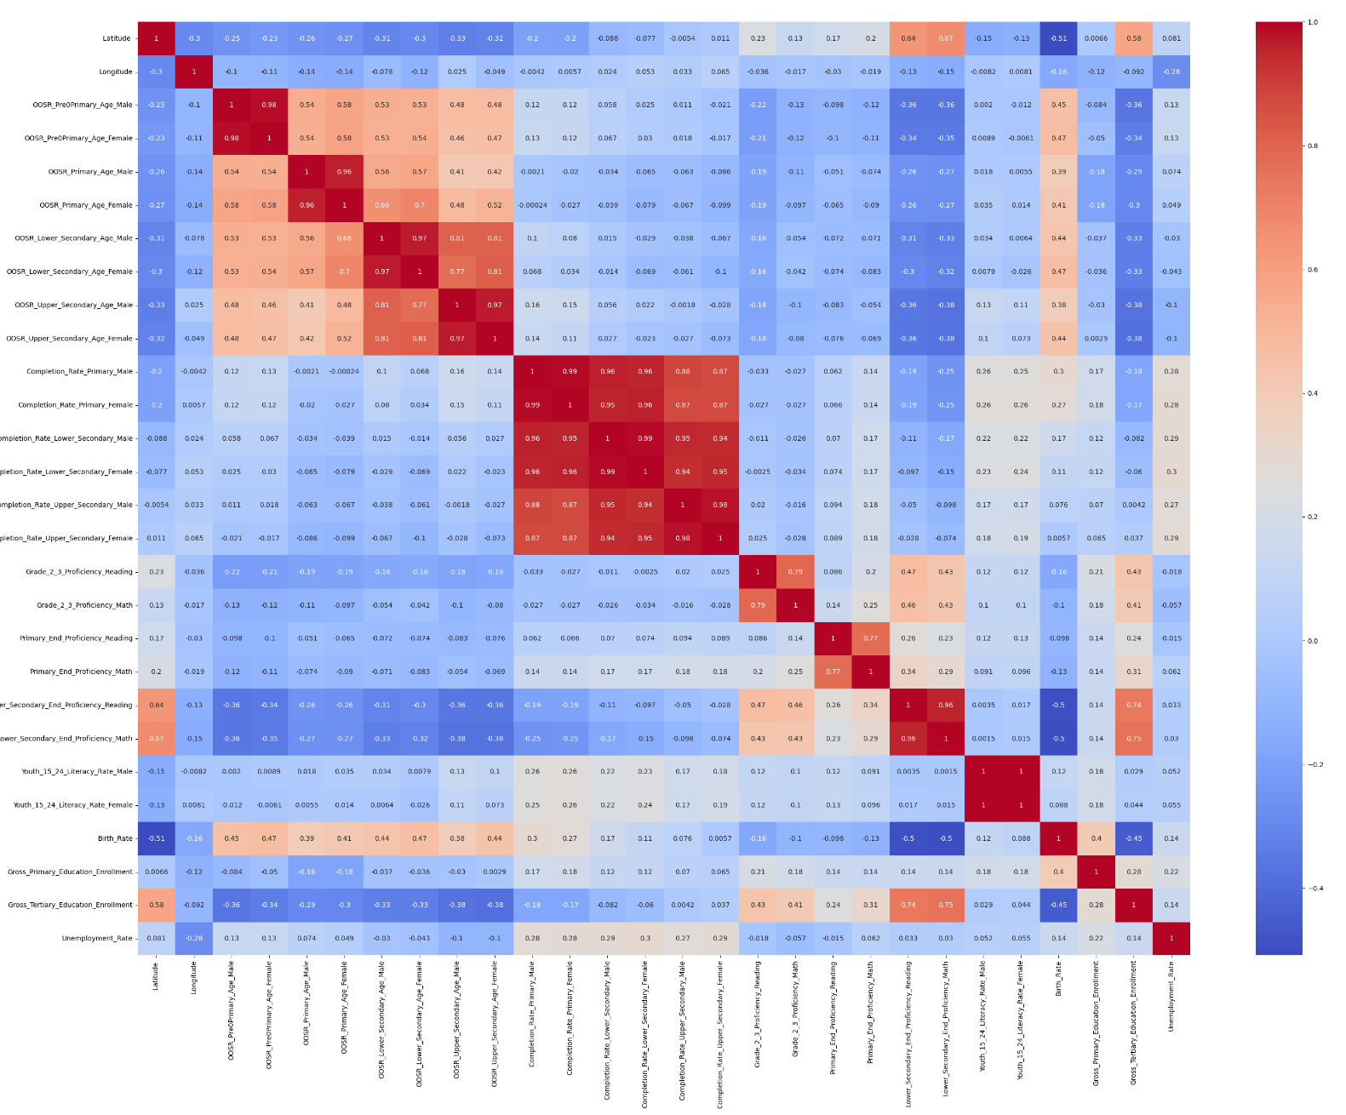
EDA
Lots of positive correlations between out of school rates & completion rates
Likely there won’t be good regressions out of this dataset alone

Slide 4
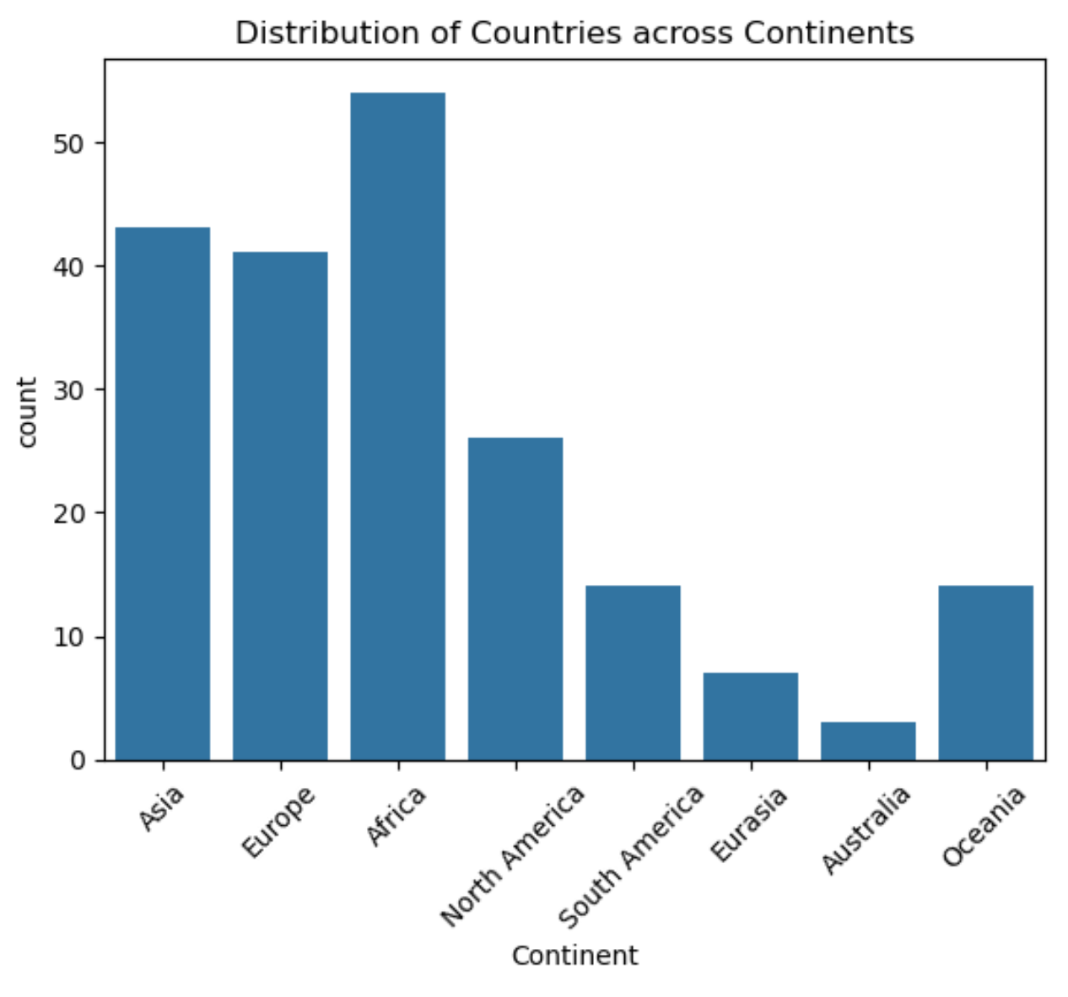
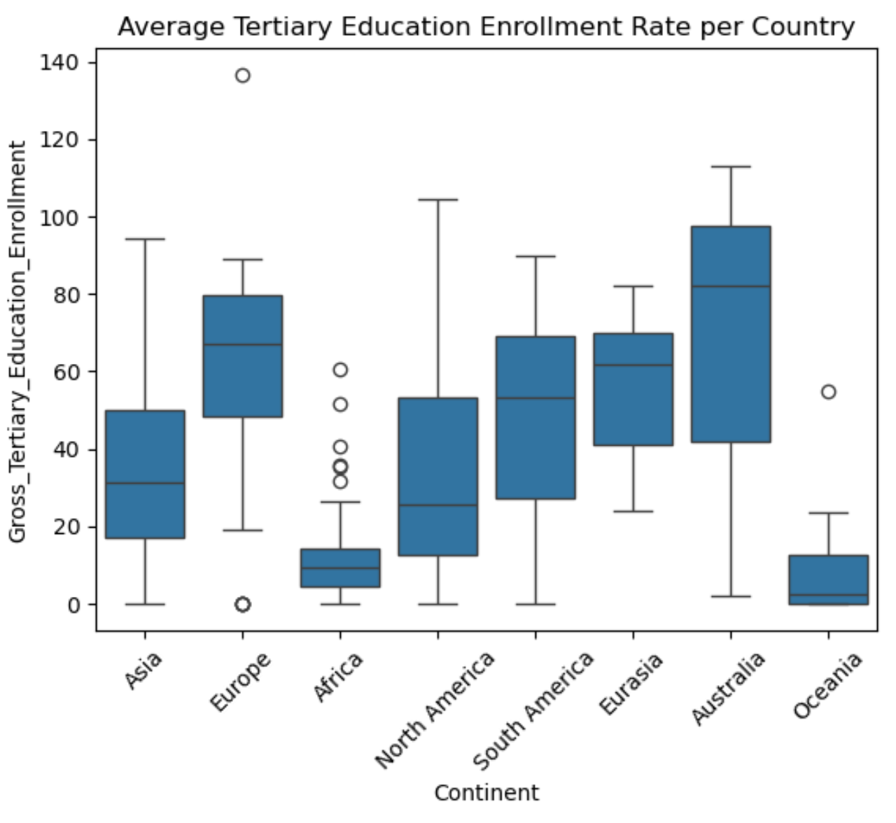

Slide 5
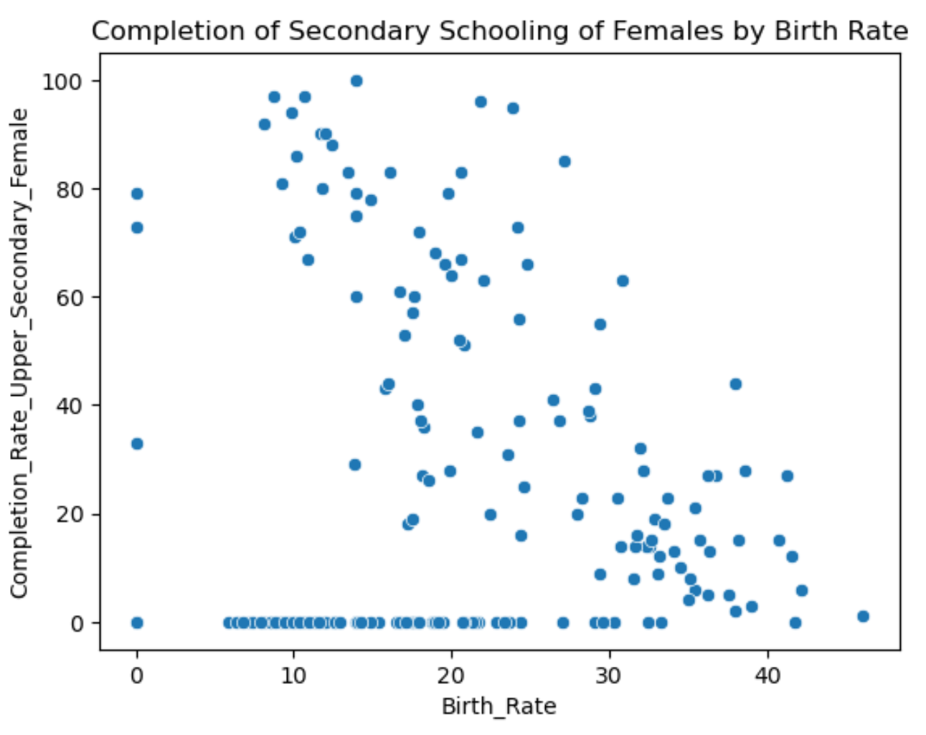
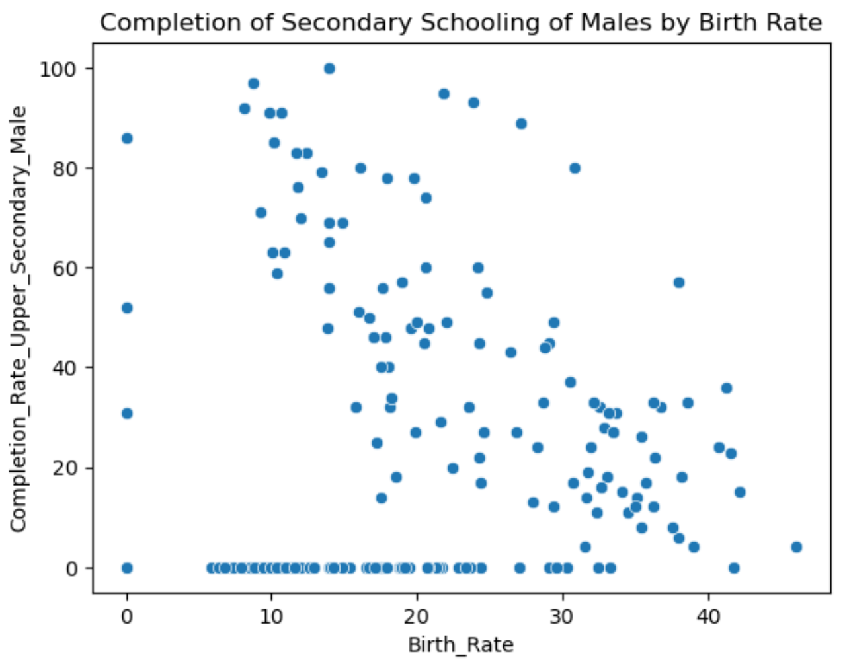

Slide 6
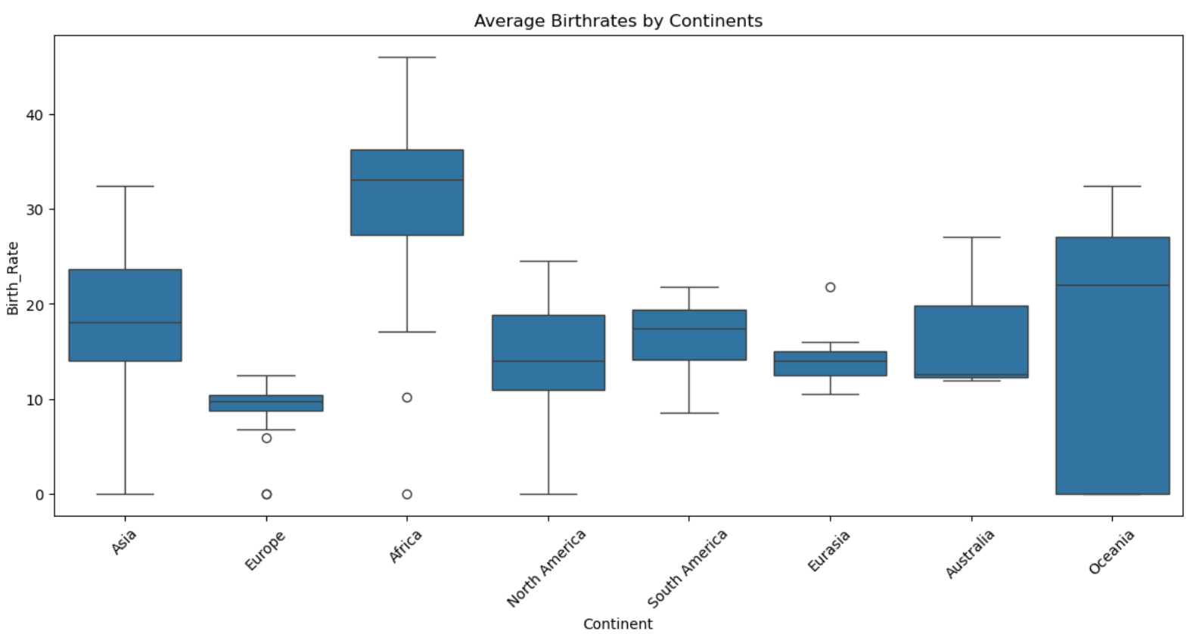

Slide 7

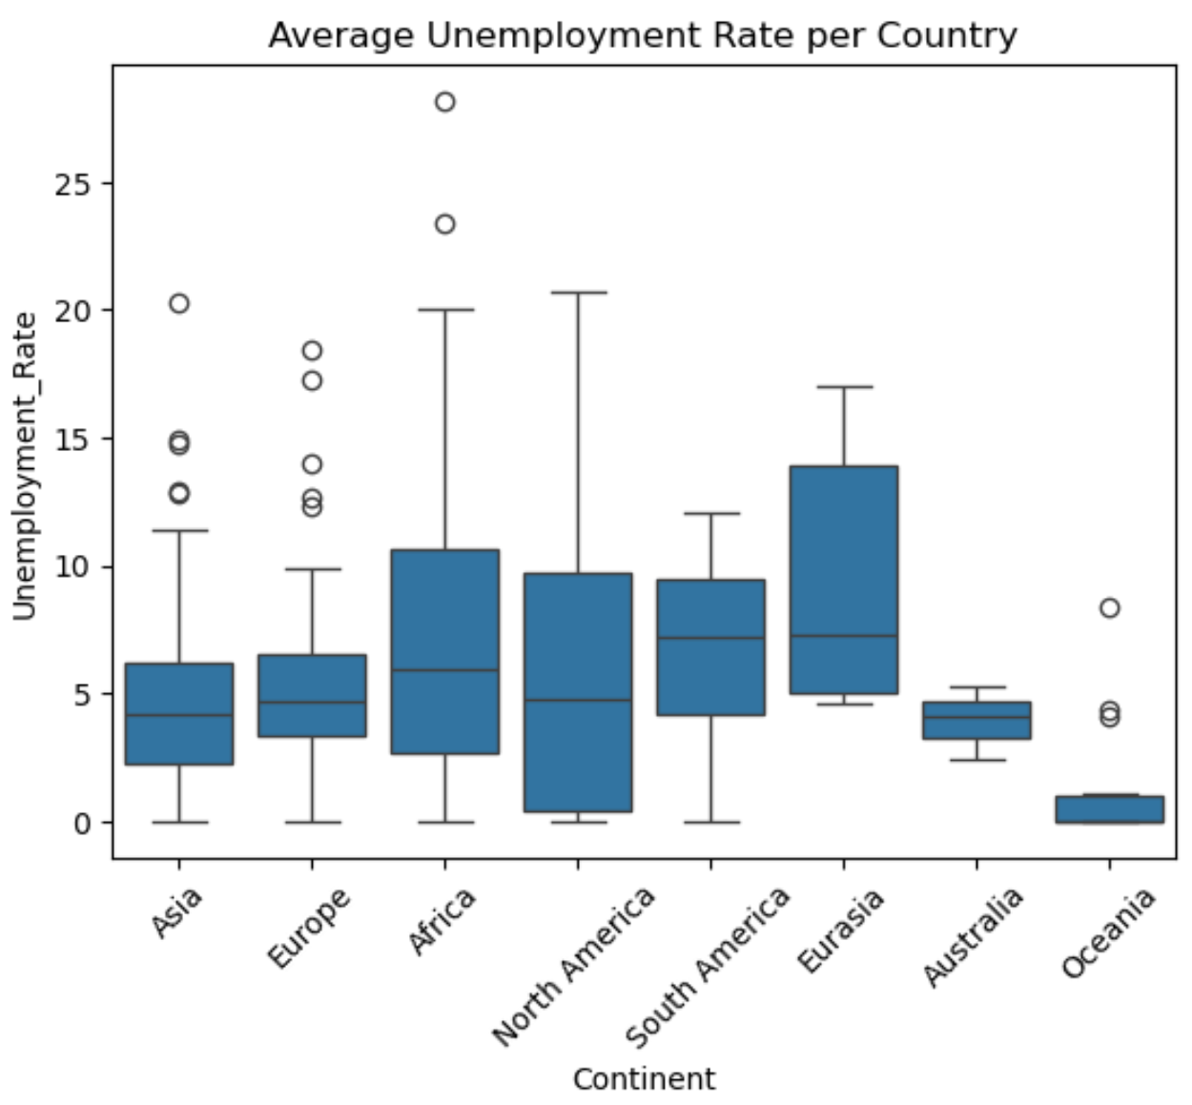

Slide 8
Linear Regression
Is there a linear relationship between at the primary education proficiency in math and reading and education?
Independent variables:
Primary_End_Proficiency_Reading
Primary_End_Proficiency_Math
Dependent variables:
Unemployment_Rate

Slide 9
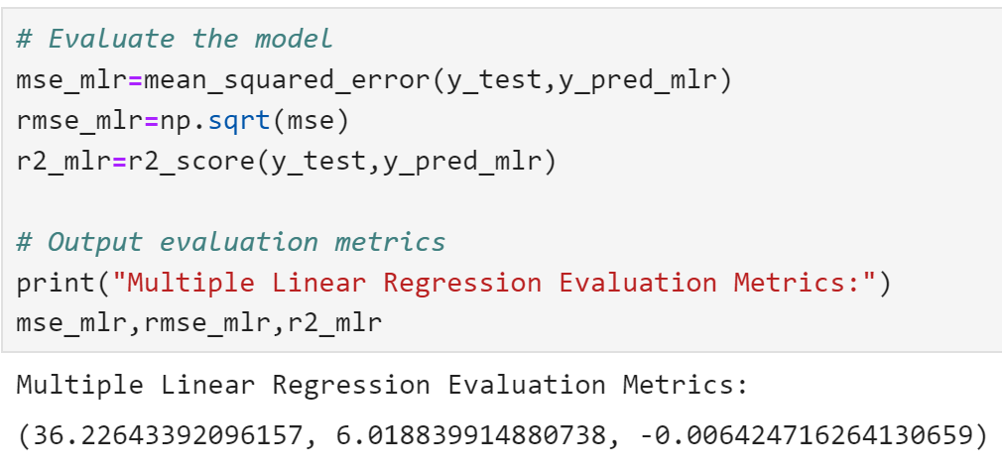
Linear Regression
MSE: 36.23
RMSE: 6.02
R2: -0.00624
This model is a horrible fit
There is no linear relationship between primary end proficiency of math and reading to the unemployment rate.

Slide 10
Logistic Regression
Two new variables were created:
Youth_15_24_Literacy_Rate_Avg
Taken by summing Youth_15_24_Literacy_Rate_Maleand female and dividing by two
Developed_Country
Taken by benchmark of a population needing around 95% to be literate to be developed – used new variable
Can we classify if a person is from a developed country based on the continent, birth rate, and primary and tertiary enrollment?

Slide 11
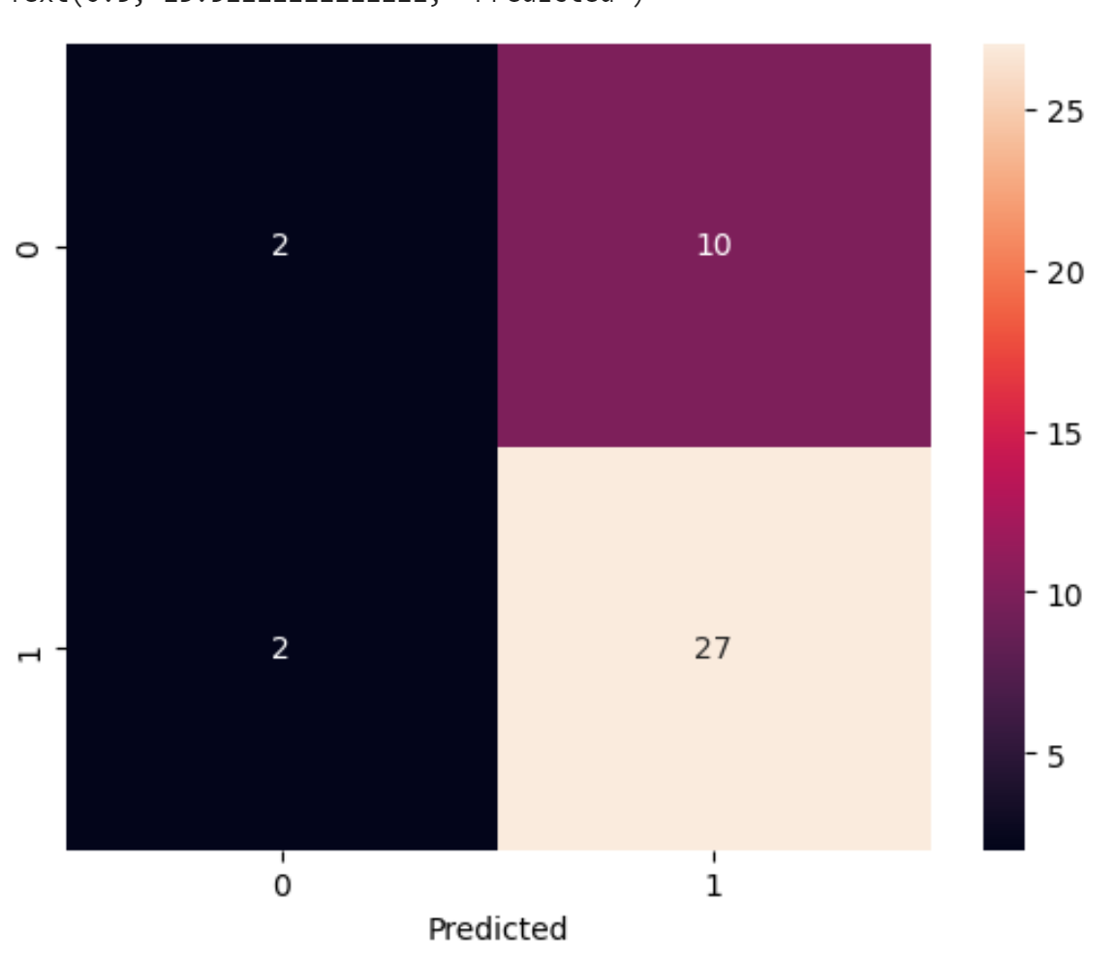
Logistic Regression
The confusion matrix shows us that this is also not going to be great.
Likely this is a problem with the data as it has many 0’s for entry and not enough data to work with
But let see what happens

Slide 12
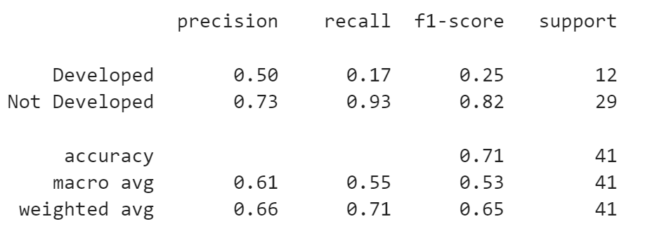
Logistic Regression cont
It would not have enough data to work with.
Enough to tell if a country is not developed, but not enough for developed.
Only way to fix this to fill the gaps in data that show up as ‘0’

Slide 13
Why did the models turn out so poor?
The dataset was not reliable
Likely the data was farmed and had no real relevancy or failed to come from trusted sources
The data also had a great amount of 0’s for entries. This did not show up when doing .isnull() but still skewed and impacted the data.
The variables were all highly correlated and had multicollinearity issues which would make the model not robust

