Slide 1
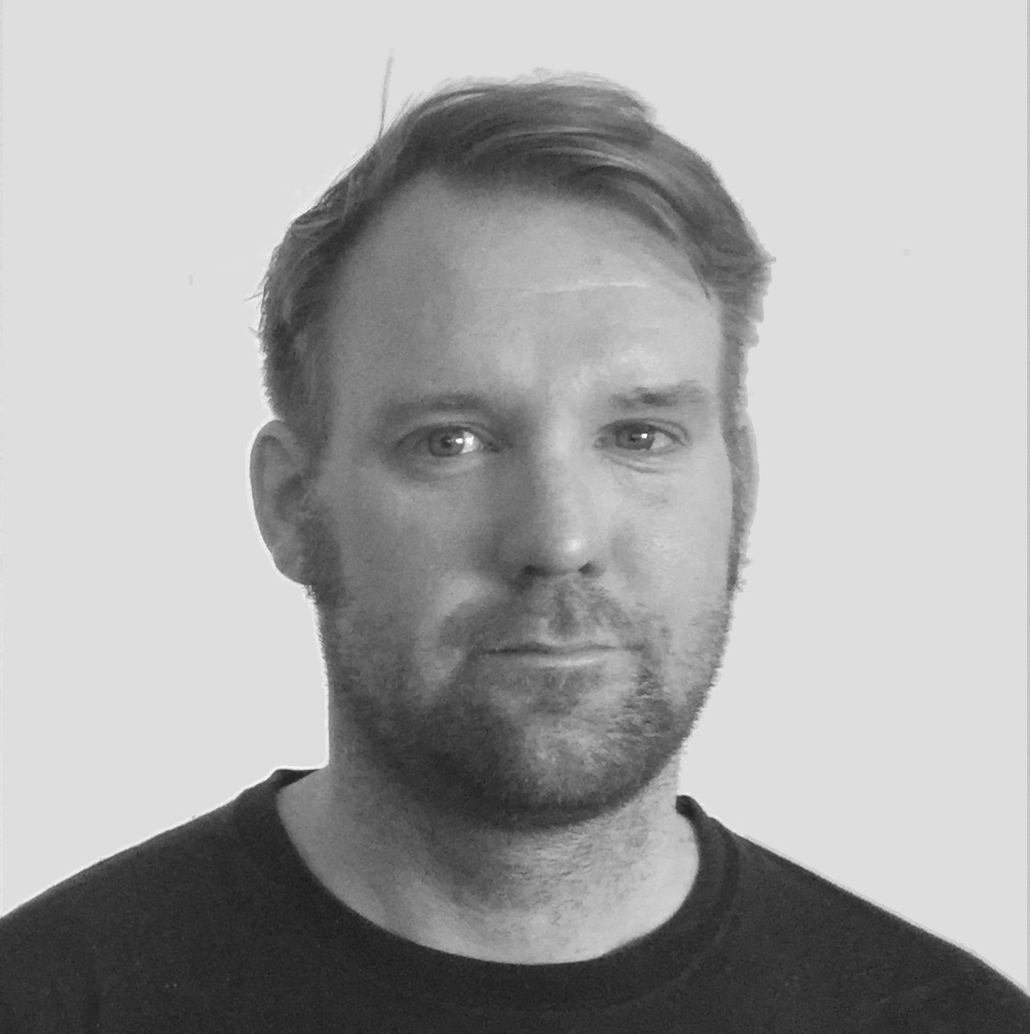
Becoming a Power User
Reindert-Jan Ekker
@codesensei www.codesensei.nl

Slide 2
Wildcards
Redirection and pipes
Running commands as a superuser
Customization
Overview

Slide 3
Pipes
# Use output from one command as input for another
# Use less to read output from ls
ls | less
# Find occurrences of 1978, then count the lines
grep 1978 oscars.csv | wc -l

Slide 4
Wildcards
# Move all files to another place
mv * another_place/
# List only files ending with pdf
ls *pdf

Slide 5
Run a Command as a Superuser
# Note: still need permission to use sudo
sudo nano /etc/hosts

Slide 6
Bash
.profile read on login
.bashrc read for interactive shells
Other files: see manpage
Zsh
.zshenv read always
.zshrc read for interactive shells
Other files: see documentation
Check out https://ohmyz.sh
Saving Customization

Slide 7
Use .-rc file for interactive shells
aliases
running commands
Use .profile/.zshenv for variables
like $PATH, $EDITOR
Saving Customization

