Slide 1
Table of Contents
What & Why React?
How React works?
Things in React
Getting started with React
Debugger and Test Utilities

Slide 2
What & Why React?
React is a JavaScript library for creating user interfaces by Facebook and Instagram. Many people choose to think of React as the V in MVC.
We built React to solve one problem: building large applications with data that changes over time.
React will automatically manage all UI updates when your underlying data change. When the data changes, React conceptually hits the "refresh" button, and knows to only update the changed parts.
React supports most popular browsers, including Internet Explorer 9 and above.

Slide 3
How React works?
React is all about building reusable components.
Components make code reuse, testing, and separation of concerns easy.
React components are just like functions that take in props & state.

Slide 4
How React works? (cont.)
React uses a concept called the virtual DOM, it never talks to the DOM directly. React maintains a fast in-memory representation of the DOM. render() methods actually return a description of the DOM, and React can compare this description with the in-memory representation to compute the fastest way to update the browser.
When a change happened, two things take place. First, React runs a “diffing” algorithm, which identifies what has changed. The second step is reconciliation, where it updates the DOM with the results of diff.

Slide 5
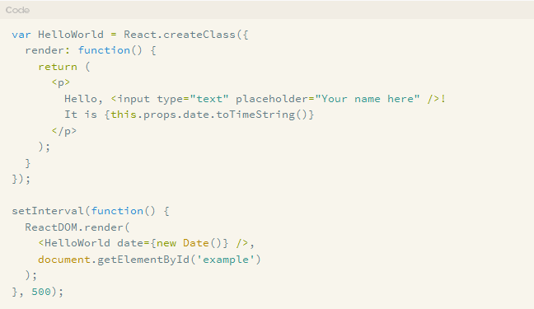
How React works? (cont.)

Slide 6
Things in React - JSX
JSX is a preprocessor step that adds XML syntax to JavaScript. You can definitely use React without JSX but JSX makes React a lot more elegant
Just like XML, JSX tags have a tagname,attributes, and children. If an attribute value is enclosed in quotes, the value is a string. Otherwise, wrap the value in braces and the value is the enclosed JavaScript expression.

Slide 7
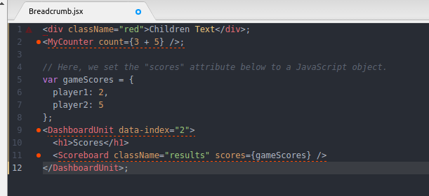
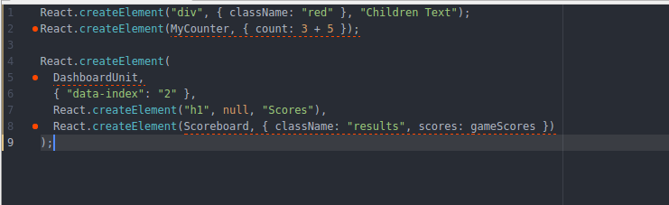
Things in React - JSX
JSX
Without JSX

Slide 8
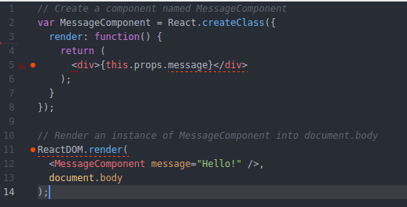
Things in React - Component

Slide 9
Things in React – Component (cont)
Create a new component class using React.createClass. Components have one requirement; they must implement render, a function that tells the component what to... render.

Slide 10
Things in React - Props vs State
The key difference between props and state is that state is internal and controlled by the component itself while props are external and controlled by whatever renders the component.

Slide 11
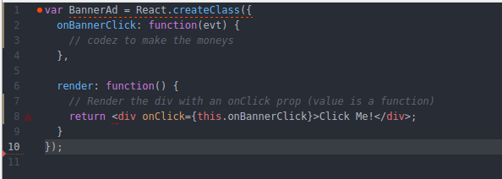
Things in React - Events
Some popular events: onClick onChange onBlur
Full supported event list in https://facebook.github.io/react/docs/events.html
To bind an event:

Slide 12
Things in React - Component Specifications
render use to render component.
getInitialState invoked once before the component is mounted. The return value will be used as the initial value of this.state.
getDefaultProps invoked once and cached when the class is created. Values in the mapping will be set on this.props if that prop is not specified by the parent component

Slide 13
Things in React - Component Specifications (cont)
propTypes the propTypes object allows you to validate props being passed to your components.
mixins the mixins array allows you to use mixins to share behavior among multiple components
statics the statics object allows you to define static methods that can be called on the component class
displayName The displayName string is used in debugging messages

Slide 14
Things in React – Lifecycle “mounting”
componentWillMount
componentDidMount

Slide 15
Things in React – Lifecycle “updating”
componentWillReceiveProps
shouldComponentUpdate
componentWillUpdate
componentDidUpdate

Slide 16
Things in React – Lifecycle “unmounting”
componentWillUnmount

Slide 17
Getting started with React
JSX Transformer library / In-browser JSX Transform
Precompiled JSX
The in-browser JSX transformer is fairly large and results in extraneous computation client-side, it is not recommended for production use. Instead, you'll probably want to precompile your JSX into JavaScript.
IDE: Sublime Text 3 + JSX Integrations babel: Snippets, syntax highlighting and optimized color schemes.

Slide 18
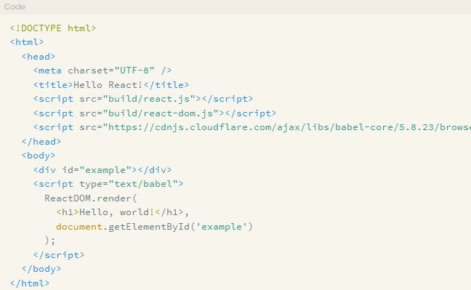
Getting started with React - JSX Transformer library
The starter kit
  includes React and some simple example apps http://facebook.github.io/react/downloads/react-0.14.8.zip

Slide 19
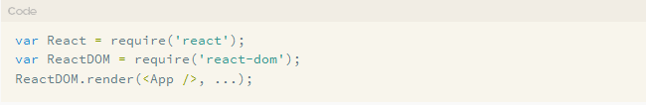
Getting started with React - JSX Transformer library
Install Node from https://nodejs.org/en/download/
Setting up npm: npm init -> to create package.json
React from npm
  React, ReactDOM npm install --save react react-dom
  Browserify npm install -g browserify

Slide 20
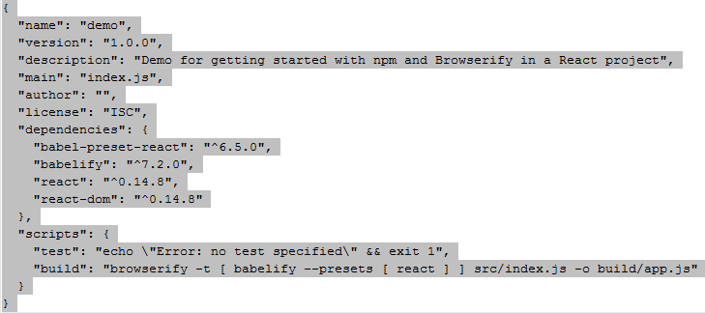
Getting started with React - Precompiled JSX
Babelify package, which allows browserify to use babel to compile JSX code npm install --save babelify babel-preset-react
Bundle and compile the code Package.json
npm run build

Slide 21

Q&A
THANK YOU!

