Slide 1


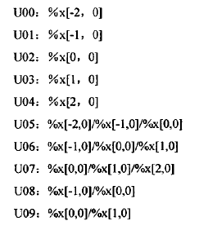
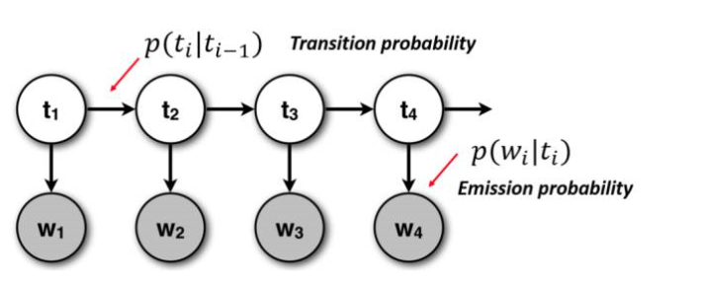















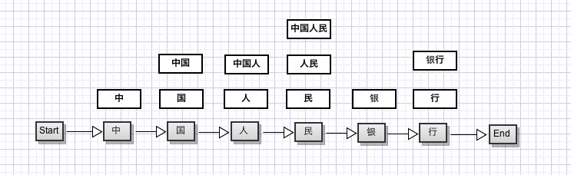

Machine Learning Algorithms
for Chinese Word Segmentation
\
Wendy Liu Department of Computer Science, Furman University, Greenville, SC
Introduction
Also, it’s not good at dealing with ambiguities, such as a character that can go with either the previous character or the latter character to form a word. Sometimes, one word has more than one meanings. Machines using dictionary dependent algorithms cannot distinguish between multiple meanings. Thus, we need better algorithms.
In this algorithm, you first assign a label to
each of the characters when reading the
inputs. For example, a common label system
is “BMES” stands for beginning, middle, end
and single-character word. In this example,
we have (on the right):
Then you must choose a template to assist the probability of each different segmentation. There are many different templates, this is only one of the easiest. Suppose we are reading the 3rd character “ ”. X[0, 0] would be “ ”, X[-2, 0] would be “ ”, X[-1, 0] would be “ ” and so on. “U00” of the template would be the probability of the single character word “ ”, “U05” would be the probability of the trigram “ ” and so on.
In languages like Chinese, there is no word boundary markers like spaces in English. If you want to split a Chinese sentence by words, you must know the semantic meanings, and sometimes you also need some help from the context. Therefore, it’s very difficult for machines to parse Chinese writings automatically and extract information from them. But, this technique is very important for refining search engine results, filtering email by categories by contents, and censoring webpage content in Chinese and other similar languages.
Currently there are three types of algorithms for Chinese word segmentation. The first uses a neural network and expert system to train artificial intelligence to parse Chinese like humans do. It may be the best way to parse Chinese, but, as far as I know, current technology doesn’t allow us to do this.
Hidden Markov Model (HMM)
The third type of algorithm is a machine learning algorithm. Algorithms in this category requires a large amount of known correct segmentation data to train the machines and then machines can segment new articles by probabilities of the appearance of the words. Hidden Markov Model (HMM) is a general algorithm for Chinese word segmentation. It is based on Bayesian model and Viterbi algorithm and its structure it’s like a linked list.
One assumption in HMM is that each state is only related to the previous state. That’s not always the case in language! For example, this phrase can be “older student” or “college student” based on different segmentation.
You often need some context to determine which one it actually is. And, actually, once the second character in this phrase is consumed, it changes the probability of the following segments. However, HMM doesn’t respond to this change.
Conclusion
Dictionary-dependent algorithms
As mentioned above, there are three types of algorithms for automated Chinese word segmentation. My demonstration displayed dictionary-dependent and machine learning algorithms. I hope one day, we will be able to talk about the methods that AI would employ to parse Chinese words.
The second type of algorithm is dictionary-dependent. For example, forward procedure.
In the example below, we first cut the sentence in half. Then we ask whether the current sequence of characters is a legitimate word in our dictionary. If not, then chop down the last character. The operations we perform on the second half of this sentence would be the following:
However, this algorithm depends too much on the dictionary, it must be constantly updated for like- borrowed words. It’s difficult to parse things like names (for example, the word “Furman” in the the sentence above) that are not in the dictionary.
References
older/student college/student
easily modifiable
C. Wang, J. Chen and X. Wu. 2010. Dictionary Chinese word segmentation research a method combined with CRFs. 5th International Conference on Computer Sciences and Convergence Information Technology. 962 p.
D. Liu, W. Fang, H. Zhou and Y. Li. 2009. Bigram Chinese word segmentation by Viterbi algorithm. 2009. Sixth International Conference on Fuzzy Systems and Knowledge Discovery. 364 p.
Hubert Hin-Cheung Law and Chorkin Chan. 1996. Ergodic multigram HMM integrating word segmentation and class tagging for Chinese language modeling. 1996 IEEE International Conference on Acoustics, Speech, & Signal Processing. 196 p.
“Furman University has a bell tower.”
Conditional Random Field (CRF)
easily modifiable
Conditional Random Field is a better algorithm that does consider the probability of the following segments when the consumption of a character changes. In the example, the first character can be a word alone, meaning “in the middle”; it can be combined with the second character, meaning China; adding the third character to it, it means “Chinese” referring to people.
Special Thanks
Special thanks to Dr. J. Thomas Allen from Computer Science Department, Furman University.

