Slide 1


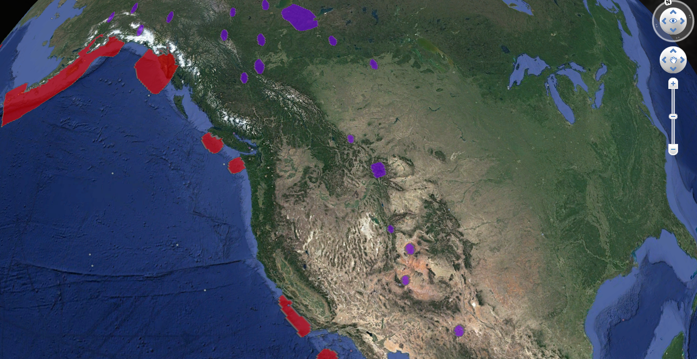
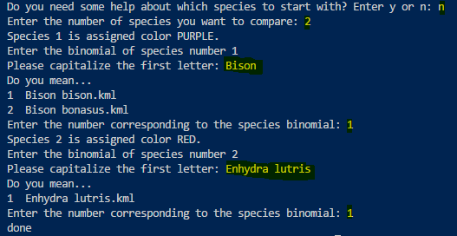

Visualization of the geographical distribution of endangered wildlife species on Google Earth
Wendy Liu
Furman University
Introduction
It was necessary to write 13 functions in Python for this project. First, the large KML file was split into 5305 XML code sections in different text files. Then a combine function was created to generate functioning KML files with desired geodata of one species to be displayed on Google Earth. Later, an updated version of this function was coded in order to display the geographical distribution of several species at the same time for comparison. Moreover, an updated split function was created to shrink the size of the final KML files by leaving only five decimal places of precision for representing longitudes and latitudes. The reason why I chose
this level of precision was that it measures positions on the earth to within 1 meter, which is sufficiently precise for this project. Finally, a help function was created to provide the user with a list of 1175 genera to start with, since the binomial name of each species consists of genus and species.
Management of wildlife geographic data has been a difficult task for researchers. Existing public searchable databases of wildlife habitats were lacking. For example, Biodiversity Information Serving Our Nation provided a US map view that displays the geographical distribution of a target species by state (BISON 2018). If a species is present in a state, the whole state was highlighted. This type of output is imprecise given that the natural environment of wildlife habitats may not be simply represented by whole states. Another example of existing wildlife habitat database is Map Of Life (MOL 2018). However, the searching time of each entry is too long, and the search is impossible on mobile devices like the Safari browser on iPhones. The main objective of this study is to create a method to generate functioning keyhole markup language (KML) files, a file type that aims at displaying geographic data on Earth browsers like Google Earth.
Conclusion
My research was done in the hope that my method of organizing the data would make it easier to pinpoint the relation between wildlife and their geographic distribution, and, hopefully, the proposed method of KML file generation would contribute to future studies in the conservation of biodiversity and preservation of the ecological environment where the wildlife resides.
Literature Cited
Biodiversity Information Serving Our Nation - explore & download North American species occurrence data & map [Internet]: USGS; c2018 [cited 2018 2/17]. Available from: https://bison.usgs.gov .
Map Of Life [Internet]; c2018 [cited 02/17/2018]. Available from: https://mol.org/ .
Research data source:
The IUCN Red List of Threatened Species - Red List Spatial Data [Internet]; c2017 [cited 02/17/2018]. Available from: www.iucnredlist.org/technical-documents/spatial-data .
Figure 1. The screen shot of the habitat distribution of bison (Bison bison) and sea otters (Enhydra lutris) on Google Earth Pro. Bison habitats are represented in purple and red for sea otters.
Methods & Results
The data source of this project is the data set of Terrestrial Mammals from the International Union for Conservation Nature (IUCN) Red List. Shapefiles are a popular geospatial vector data format, and the website provides an original set. Geographic information system (GIS) software called ArcGIS Map was used to convert the shapefiles into a KMZ file, and then decompressed into a 1.6-gigabyte KML file.
Acknowledgments
Figure 2. The screen shot of the user interface. What the user typed in was highlighted in yellow. For searching the target species, you can either enter the whole binomial name of that species or enter the beginning few letters of the binomial name of that species. When the functioning KML file is successfully created, the program prints “done”.
Instructor: Dr. Chris A. Healy, Computer Science, Furman University.
I would also like to thank Dr. John E. Quinn from Biology Department, Furman University for giving me some insights in data gathering and the usage of ArcGIS Map.

