Slide 1
Retail Rental Price vs Venues of San Diego, CA
Qing Lin
Coursera Capstone Final Project
July 2020

Slide 2
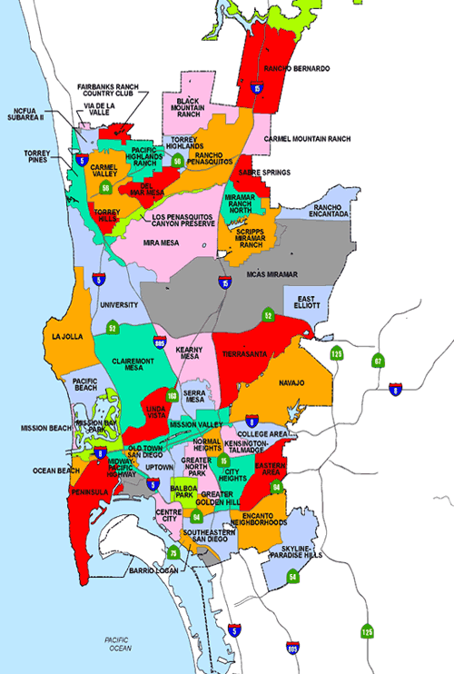
Introduction-Background
San Diego, California
The eighth-largest city in the US
The second-largest city in California
Estimated population of 1.4 million as of July 2019
More than 120 neighborhoods
Retail space prices vary among neighborhoods

Slide 3

Introduction-Business Problem
An investor is looking for a place to open a milk tea shop and is considering two important factors:
Average rental cost
The prospective clientele
This project is focus on checking the most common venues of neighborhoods and their average rent

Slide 4
Data
Average Rent in San Diego, CA by Neighborhood from https://www.rentcafe.com/average-rent-market-trends/us/ca/san-diego/, the data was updated February 2020
use Nominatim Geocoding service to get the coordinates of the neighborhoods
use Foursquare API to get the most popular venues of the given neighborhoods.

Slide 5
Methodology
Python Folium library is used for geospatial visualization
Foursquare API is used to get the up-to-date location data. I set the limit as 100 venues and the radius 600 meters for each neighborhood from the given latitude and longitude information
Use One-hot encoding to convert the categorical data to numerical data
K-means clustering
Elbow method is used to get the optimal k value

Slide 6
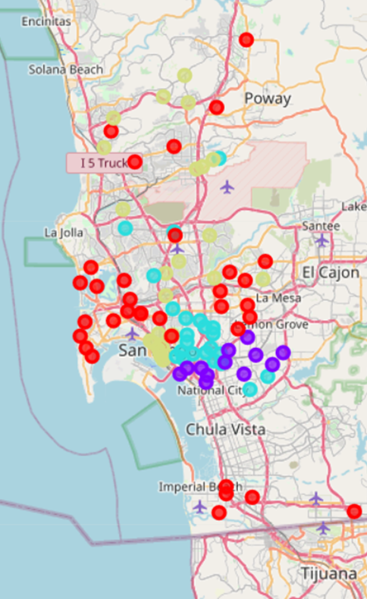
Results-Clusters on the map
Cluster0 - red
Cluster1 -purple
Cluster2 -lighb blue
Cluster3 - yellow

Slide 7
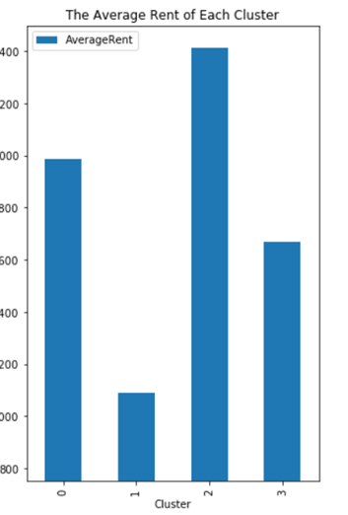
Results-Average Rent
Cluster Labels | AverageRent ($)
0 | 1987.088
1 | 1088.636
2 | 2413.846
3 | 1667.208

Slide 8
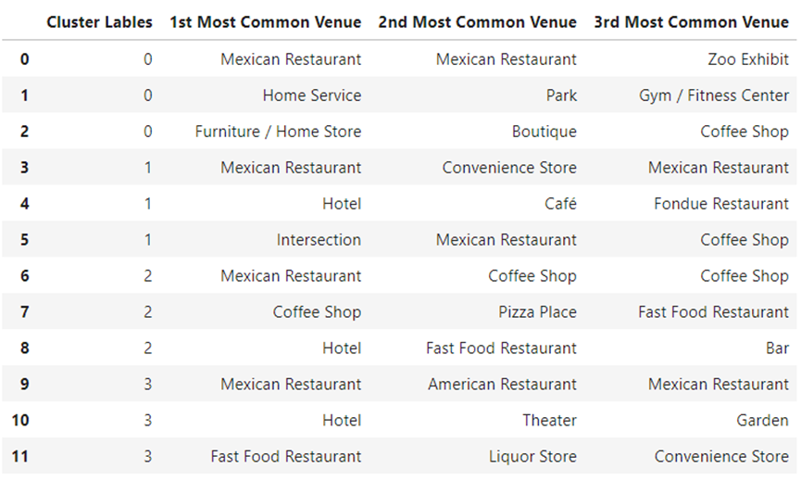
Results-Most Common Venues
The top 3 venues in ‘1st Most Common Venues’, ‘2nd Most Common Venues’, ‘3rd Most Common Venues’ of all clusters

Slide 9
Discussion
The first three most common venues in Cluster 1 and Cluster 2 almost are restaurant, coffee shop or bar, which means that people like to go those neighborhoods for food and drink. But compared with other clusters, Cluster 1 has fewer common venues. So, Cluster 2 may have more visitors.
Cluster 1 has the lowest average rent, while Cluster 2 has the highest. So, Cluster 2 may be more prosperous in business

Slide 10
Conclusion
Based on my current available data and result, I would like to suggest the investor to choose Cluster 2 as his target area.
In my view, the clustering result does not partition the neighborhoods very well, because the most common venues show similarity to each other. I may try to add more data or use other algorithms to find a good suggestion in real life

