Slide 1
Retail Rental Price vs Venues of San Diego, CA
Qing Lin
Coursera Capstone Final Project
July 2020

Slide 2
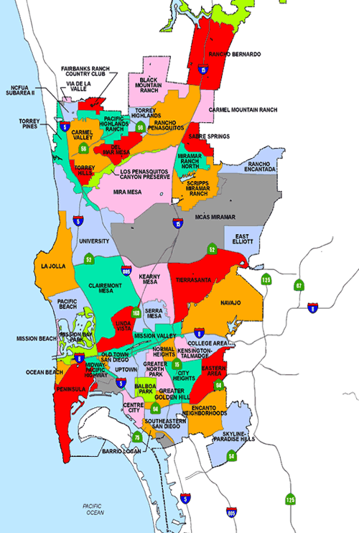
Introduction-Background
San Diego, California
The eighth-largest city in the US
The second-largest city in California
Estimated population of 1.4 million as of July 2019
More than 120 neighborhoods
Retail space prices vary among neighborhoods

Slide 3
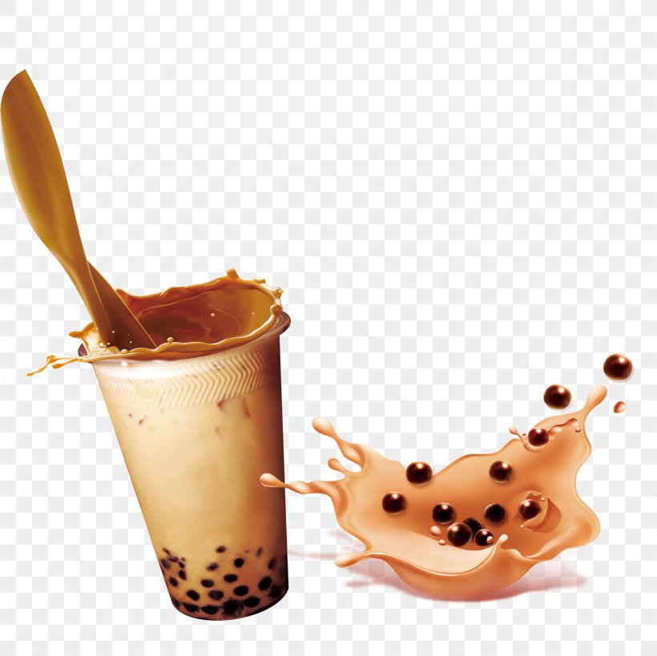
Introduction-Business Problem
An investor is looking for a place to open a milk tea shop and is considering two important factors:
Average rental cost
The prospective clientele
This project is focus on checking the venues categories of neighborhoods and their average rent

Slide 4
Data
Average Rent in San Diego, CA by Neighborhood from https://www.rentcafe.com/average-rent-market-trends/us/ca/san-diego/, the data was updated February 2020
use Nominatim Geocoding service to get the coordinates of the neighborhoods
use Foursquare API to get the venues categories of the given neighborhoods.

Slide 5
Methodology
Python Folium library is used for geospatial visualization
Foursquare API is used to get the up-to-date location data
K-means clustering

Slide 6
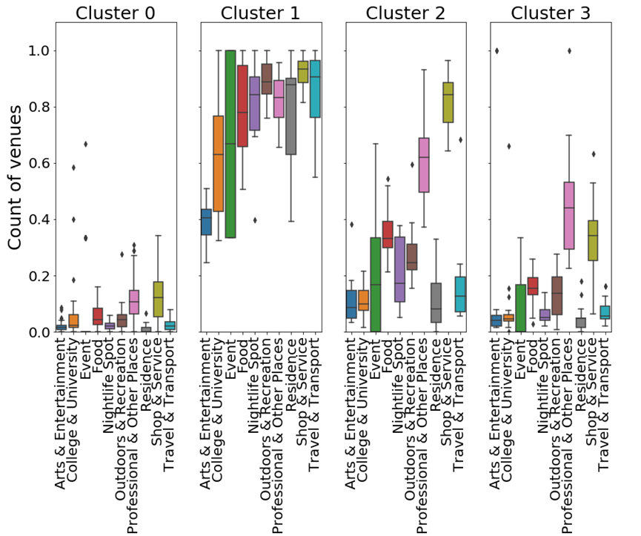
Results-Frequencies of categories
Cluster1 has the highest frequency of Food category

Slide 7
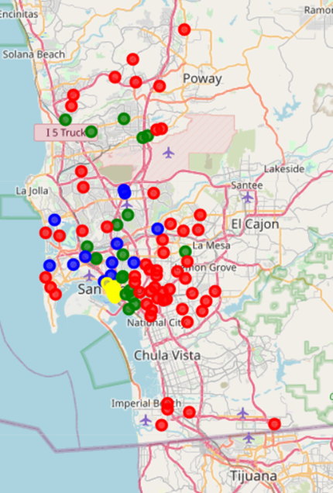
Results-Clusters on the map
Cluster0 - red
Cluster1 - yellow
Cluster2 - blue
Cluster3 - green

Slide 8
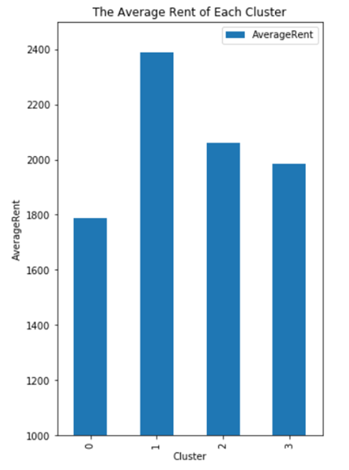
Results-Average Rent

Slide 9
Discussion
Based on the boxplot of frequencies of categories, we can tell that Cluster1 has the highest frequency of Food category, while Cluster 2 is second cluster has high frequency of food category.
Cluster1 also has the highest rental cost, and then Cluster2

Slide 10
Conclusion
Considering the prospective customers, neighborhoods in Cluster1 are the best choice for opening a milk tea shop. But the investor also needs to think about the rental cost. If the cost is over his/her budget, Cluster2 is still a good option

