Slide 1
Course Information
Logic Design Lab.
Fall 2019
Prof. Sungjoo Yoo
(yeonbin@snu.ac.kr)
TA. Hyunsu Kim
(gustnxodjs@gmail.com)
TA. Hyunyoung Jung
(gusdud1500@gmail.com)

Slide 2
Notification
For the report
No sample form Put today’s results and homework altogether and make it as one file pdf Submit your report on eTL assignment
Lab computer account Use designated lab account on lab class
Contact
Check your e-mail address on eTL
Feel free to contact TA
About lectures, labs, schedule, etc.

Slide 3
Contents
Combinational logic practice
Lab 1 review
Tactile switches
LEDs
Pull-up & pull-down resistors
Practice: Half-adder implementation
Homework

Slide 4
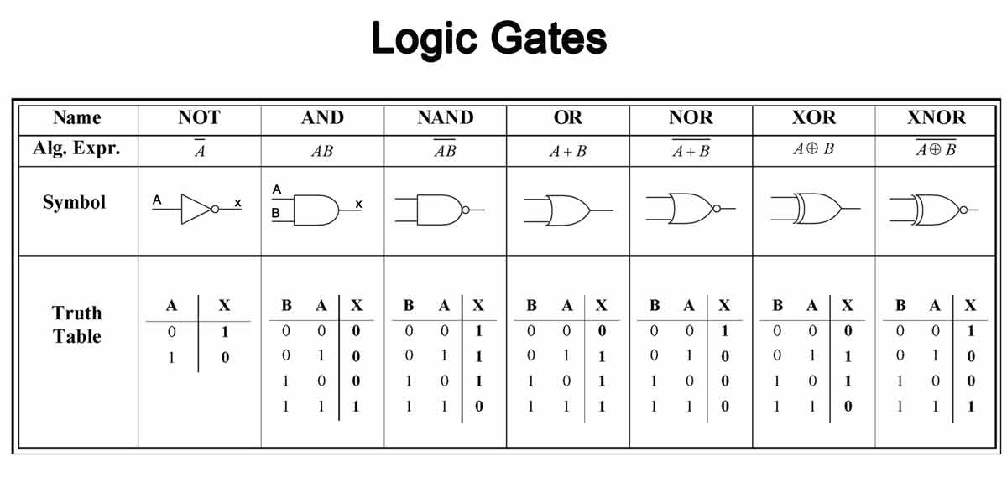
Lab 1 review

Slide 5
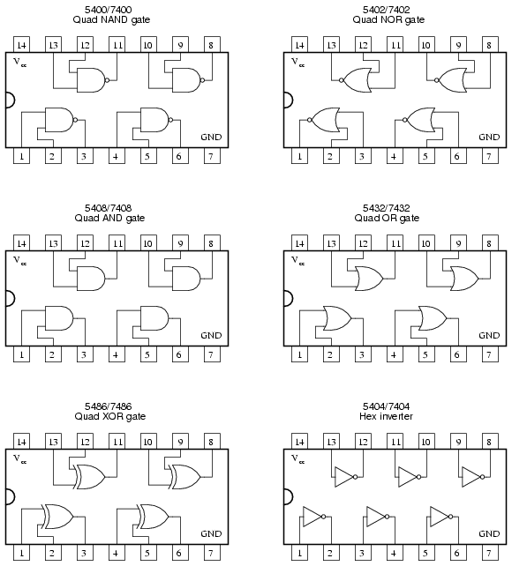
Lab 1 review
Logic Gates on IC chip

Slide 6
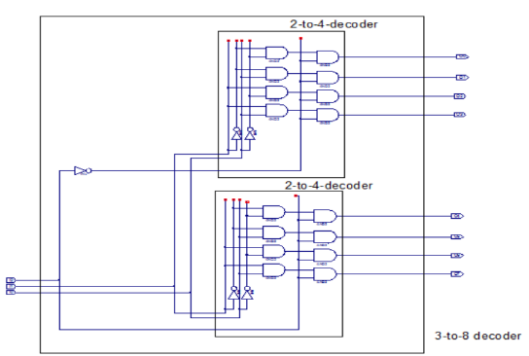
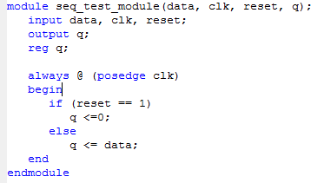
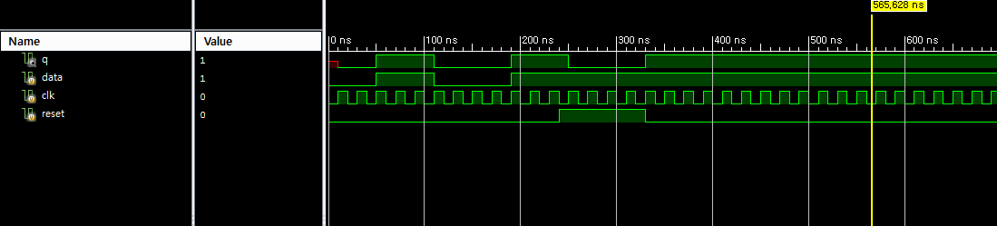
Lab 1 review
Computer Simulation
Schematic Design
Hardware Description Language
Prototyping

Slide 7
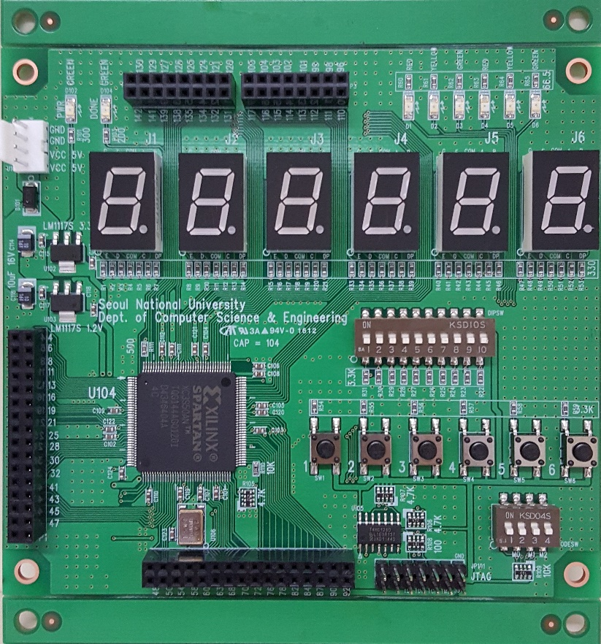
Lab 1 review
Prototyping
You can build your own board of your logic design with logic gates and electronic parts.
This is SNU’s logic design evaluation circuit board.
You will make a computer with this for the term project.
Evaluation Circuit Board

Slide 8
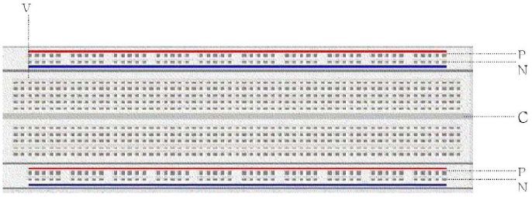
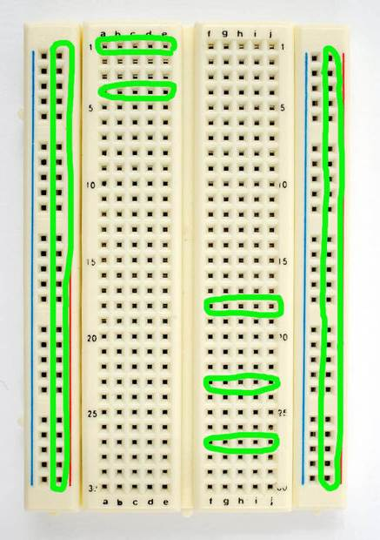
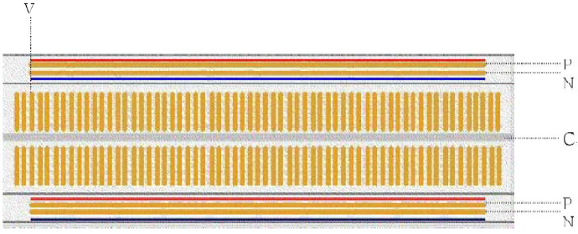
Lab 1 review
Bread board
Internal wiring of Bread board
You can construct testing the circuit using the bread board, before soldering or wrapping.

Slide 9
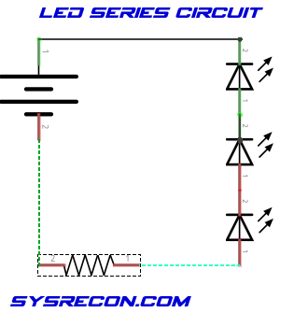
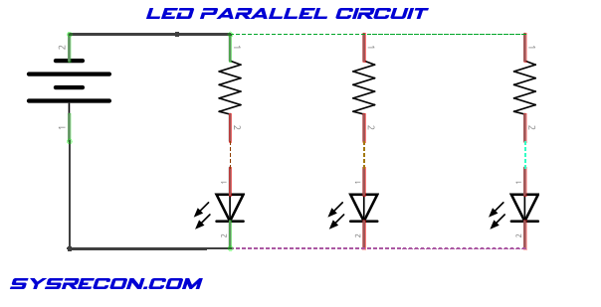
Lab 1 review

Slide 10
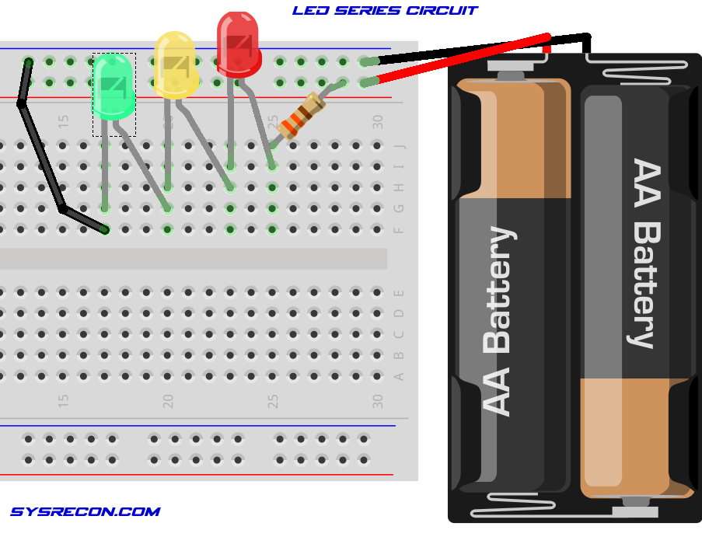
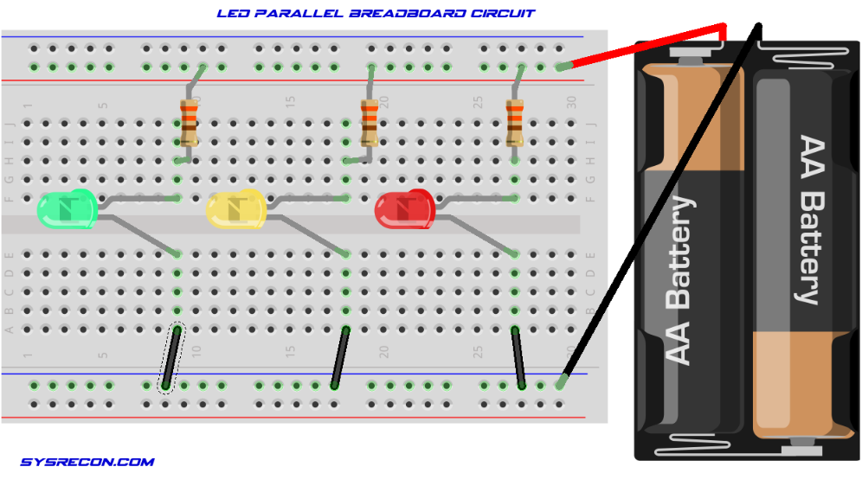
Lab 1 review

Slide 11
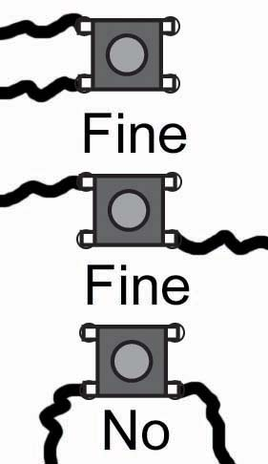
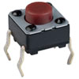
Combinational Logic Practice
Tactile switches
①
④
④
①
③
②
②
③
Tactile Switch
Circuit Diagram
Usage

Slide 12
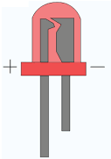
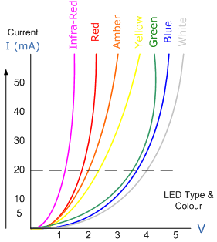
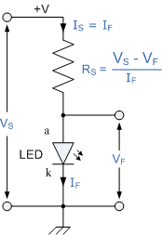
Combinational Logic Practice
LEDs
LEDs emit colored light when passed through by forward current
To protect LED from excessive current flow, using an appropriate resistor(around 3~400Ω) is necessary

Slide 13
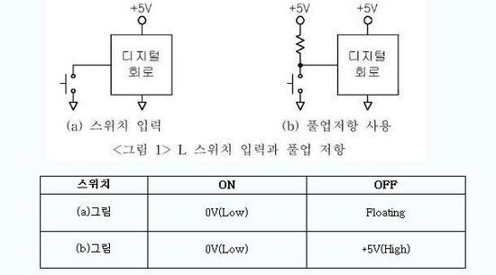
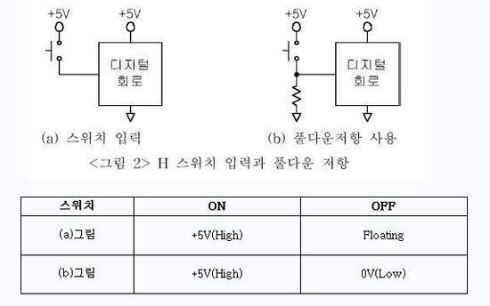
Combinational Logic Practice
Pull-up & pull-down resistors
Digital Circuit
Digital Circuit
Digital Circuit
Digital Circuit
(a) Switch Only
(b) Pull-up resistor
(a) Switch Only
(b) Pull-down resistor
<Pic 1> L switch & Pull-up resistor
<Pic 2> H switch & Pull-down resistor
switch
switch
Pull-up Resistor
Pull-down Resistor

Slide 14
Combinational Logic Practice
Pull-up & pull-down resistors
Digital Circuit
Digital Circuit
Digital Circuit
Digital Circuit
(a) Switch Only
(b) Pull-up resistor
(a) Switch Only
(b) Pull-down resistor
<Pic 1> L switch & Pull-up resistor
<Pic 2> H switch & Pull-down resistor
switch
switch
Pull-up Resistor
Pull-down Resistor
Switch on
Switch off

Slide 15
Combinational Logic Practice
Pull-up & pull-down resistors
Digital Circuit
Digital Circuit
Digital Circuit
Digital Circuit
(a) Switch Only
(b) Pull-up resistor
(a) Switch Only
(b) Pull-down resistor
<Pic 1> L switch & Pull-up resistor
<Pic 2> H switch & Pull-down resistor
switch
switch
Pull-up Resistor
Pull-down Resistor
Switch on
Switch off

Slide 16
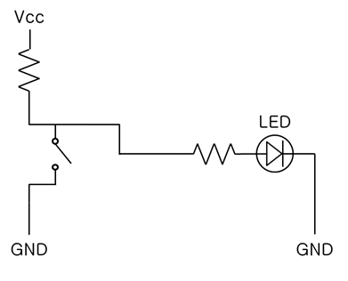
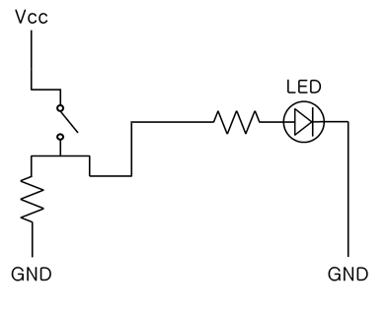
Combinational Logic Practice
Pull-up & pull-down resistors
Pull-Up Resistor
Pull-Down Resistor

Slide 17
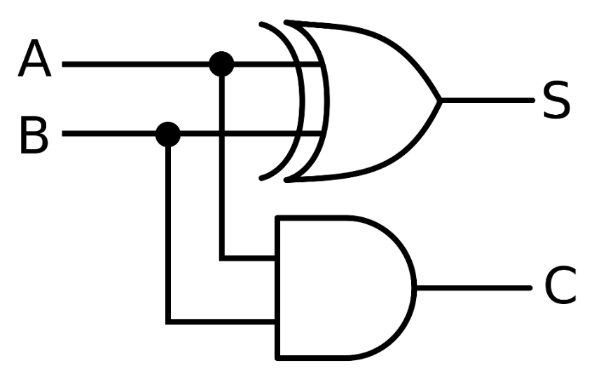
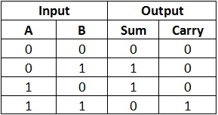
Combinational Logic Practice
Practice: Half-adder implementation
Let’s implement half-adder on breadboard.

Slide 18
Homework
1. Draw a circuit schematic for the below formula using ONLY NOR
gates and NOT gates. You can draw it by hand or using any of a
computer program.
- Y = A(B+CD)
2. Y = AB + ABC + A’B + AB’C
Make a truth table
Minimize # of gates
Draw a circuit schematic

Slide 19
Homework
3.
Implement simple combinational logic circuits 1-1 and 1-2 using
breadboard. (Take pictures to prove it’s working)
3-1. Implement a full adder using 2-input NAND gates only
3-2. Implement LM1 & RM1 using NOR gates only
4-bit input, 2-bit LM1 output, 2-bit RM1 output
LM1 (RM1) outputs position of leftmost (rightmost) 1 in input
E.g. LM1(1010) = 00, RM1(1010) = 10
LM1(0100) = 01, RM1(0100) = 01
LM1(0000) = XX, RM1(0000) = XX (don’t care)
Position (2-bit) :
00
01
10
11
Input (4-bit) :

Slide 20
Homework
Write a report
Either in Korean or in English
Must include the result and discussion of the practice
# of pages doesn’t matter
Due : 23 Sep., 7:00 pm (Before class, on eTL)

