Slide 1
Lab. 04
Logic Design Lab.
Fall 2019
Prof. Sungjoo Yoo
(yeonbin@snu.ac.kr)
TA. Hyunsu Kim
(gustnxodjs@gmail.com)
TA. Hyunyoung Jung
(gusdud1500@gmail.com)

Slide 2
Contents
Verilog
Lab
Implement a Decoder in Verilog
Implement a 3-to-8 Decoder using a 2-to-4 Decoder
Homework

Slide 3
Verilog

Slide 4
Overview
Hardware description languages (HDLs)
Types of programming
Gate-level design
Behavioral design / Register-transfer level design
Verilog Basics
Verilog Notations
Verilog Operators
Verilog Keywords & Constructs

Slide 5
Overview
Hardware description languages (HDLs)
Types of programming
Gate-level design
Behavioral design / Register-transfer level design
Verilog Basics
Verilog Notations
Verilog Operators
Verilog Keywords & Constructs

Slide 6
Hardware description languages (HDLs)
Different kinds of HDLs
Abel (circa 1983) - developed by Data-I/O
ISP (circa 1977) - research project at CMU
Verilog (circa 1985) - developed by Gateway (absorbed by Cadence)
VHDL (circa 1987) - DoD sponsored standard
Advantages of HDLs
IEEE standard
Common
Flexible – Delay modeling, Matrices …
Describe hardware at varying levels of abstraction
( = Describe hardware to other people briefly )

Slide 7
Overview
Hardware description languages (HDLs)
Types of programming
Gate-level design
Behavioral design / Register-transfer level design
Verilog Basics
Verilog Notations
Verilog Operators
Verilog Keywords & Constructs

Slide 8
Types of programming
Describe hardware at varying levels of abstraction
Gate-level design
Textual replacement for schematic
Hierarchical composition of logic gates
Register-transfer level design
Specify dataflow between hardware registers
(Synthesizable) Behavioral design
Describe what module does, not how
Synthesis generates circuit for module

Slide 9
Overview
Hardware description languages (HDLs)
Types of programming
Gate-level design
Behavioral design / Register-transfer level design
Verilog Basics
Verilog Notations
Verilog Operators
Verilog Keywords & Constructs

Slide 10
Verilog Notations
Verilog is:
Case sensitive(event-driven)
Based on the programming language C
Comments
Single Line
// [end of line]
Multiple Line
/*
…………
…………
*/
List element separator: ,
Statement terminator: ;

Slide 11
Verilog Notations
Binary Values for Constants and Variables
0
1
X,x - Unknown
Z,z – High impedance state (open circuit)
Constants
n’b[integer]: 1’b1 = 1, 8’b1 = 000000001, 4’b0101 = 0101, 8’bxxxx = 0000xxxx
n’h[integer]: 8’hA9 = 10101001, 16’hf1= 0000000011110001
Identifier Examples
Scalar: A,C,RUN,stop,m,n
Vector: sel[0:2], f[0:5], ACC[31:0], SUM[15:0],
sum[15:0]

Slide 12
Overview
Hardware description languages (HDLs)
Types of programming
Gate-level design
Behavioral design / Register-transfer level design
Verilog Basics
Verilog Notations
Verilog Operators
Verilog Keywords & Constructs

Slide 13
Verilog Operators
Bitwise Operators
~ NOT
& AND
| OR
^ XOR
^~ or ~^ XNOR
Example:
input[3:0] A, B;
output[3:0] Z ;
assign Z = A | ~B; // Z = A + B’

Slide 14
Verilog Operators
Logical & Relational Operators
!, &&, | |, = =, !=, >=, <=, >, <, etc.
Arithmetic Operators
+, -, etc.
Concatenation & Replication Operators
{identifier_1, identifier_2, …}
{n{identifier}}
Examples: {REG_IN[6:0],Serial_in}, {8 {1’b0}}

Slide 15
Overview
Hardware description languages (HDLs)
Types of programming
Gate-level design
Behavioral design / Register-transfer level design
Verilog Basics
Verilog Notations
Verilog Operators
Verilog Keywords & Constructs

Slide 16
Verilog Keywords & Constructs
module – fundamental building block for Verilog designs
Used to construct design hierarchy
Cannot be nested
endmodule – ends a module – not a statement
=> no “;”
Module Declaration
module module_name (module_port, module_port, …);
Example: module full_adder (A, B, c_in,
c_out, S);
…
endmodule

Slide 17
Verilog Keywords & Constructs
Input Declaration
Scalar
input list of input identifiers;
Example: input A, B, c_in;
Vector
input[range] list of input identifiers;
Example: input[15:0] A, B, data;
Output Declaration
Scalar Example: output c_out, OV, MINUS;
Vector Example: output[7:0] ACC, REG_IN, data_out;
Wire Declaration
Scalar Example: wire t1, t2;
Vector Example: wire[7:0] t1, t2;

Slide 18
Verilog Keywords & Constructs
wire and reg
Values must be retained over time
Register type: reg
The reg in contrast to wire stores values between executions of the process
We can set values on reg, but cannot on wire

Slide 19
Verilog Keywords & Constructs
Primitive Gates
buf, not, and, or, nand, nor, xor, xnor
Syntax:
gate_operator instance_identifier (output, input_1, input_2, …)
Example:
or O1 (t1, A, B)
O2 (t2, B, C, D);
// t1=A+B, t2=B+C+D
and A1 (OUT, t1, t2);
// OUT = t1•t2 (OUT = (A+B)•(B+C+D))

Slide 20
Verilog Keywords & Constructs
Process
The body of a process consists of procedural statement to make desired outputs from inputs as like a common programming
Processes are running in parallel
initial – executes only once beginning at t = 0
Only works on simulation – cannot be synthesized!
Syntax: initial Statement; initial begin Statement; Statement; … end
always – executes at t = 0 and repeatedly thereafter following repeat conditions.
Syntax: always Repeat condition Statement; always Repeat condition begin Statement; Statement; … end

Slide 21
Verilog Keywords & Constructs
Timing Control Statement (for repeat conditions)
The body of the process consists of procedural assignments
Blocking assignments
Example: C = A + B;
Execute sequentially as in a programming language
Non-blocking assignments
Example: C <= A + B;
Evaluate right-hand sides, but do not make any assignment until all right-hand sides evaluated. Execute concurrently unless delays are specified.
Type | Syntax | Description
Delay Control | #10 | Delay 10 unit time
Event Control | @(a) | Wait until signal ‘a’ is changed
 | @(posedge a) @(negedge a) | Wait until signal ‘a’ is changed to ‘1’ Wait until signal ‘a’ is changed to ‘0’
Level Control | wait (a==0) | Wait until signal ‘a’ is equal to ‘0’

Slide 22
Verilog Keywords & Constructs
Examples:
Always @(*)
begin
B = A;
C = B;
end
Suppose initially A = 0, B = 1, and C = 2
After execution, B = 0 and C = 0
Always @(*)
begin
B <= A;
C <= B;
end
Suppose initially A = 0, B = 1, and C = 2
After execution, B = 0 and C = 1

Slide 23
Verilog Keywords & Constructs
Conditional constructs
The if-else
If (condition)
begin procedural statements end
{else if (condition)
begin procedural statements end}
else
begin procedural statements end
The case
case expression
{case expression : statements}
endcase;

Slide 24
Lab

Slide 25
Today
Design a 74x139(dual 2-to-4 decoder) in Verilog
Practice all designing methods for half 74x139 each and simulate them
Gate-level
Behavioral / RTL
Implement a 74x139 and simulate it
Prepare simulations for all possible input combinations

Slide 26
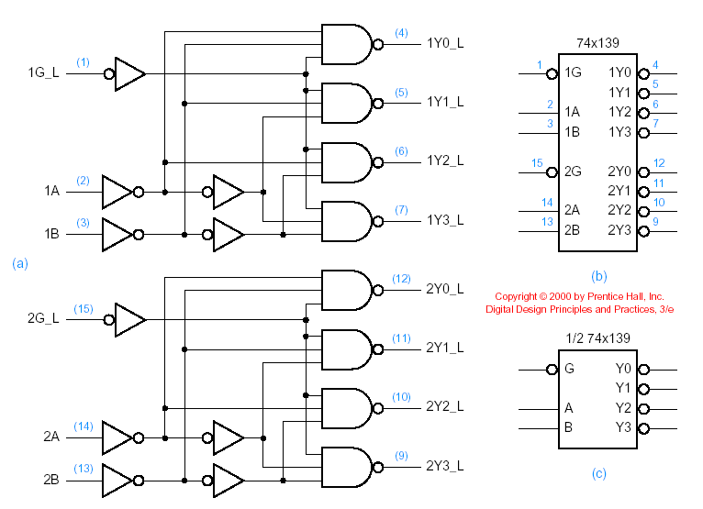
Designing 74x139(Dual 2-to-4 decoder)
Schematic design of a 74x139
G
U6
U1
U7
A_i
U8
A_L
U3
U5
U2
B_L
B_i
U9
U4

Slide 27
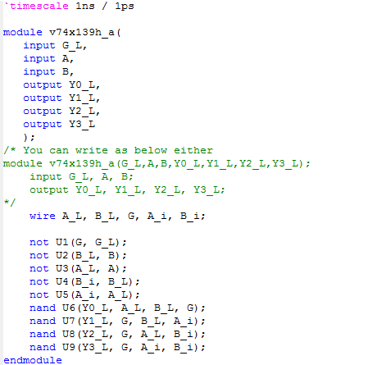
Designing 74x139(Dual 2-to-4 decoder)
Gate level design (Half 74x139)
Circuit function can be described with gate primitives

Slide 28
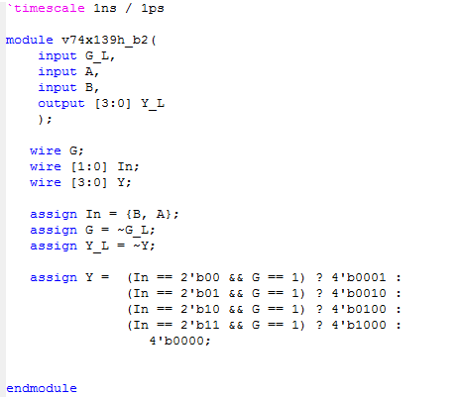
Designing 74x139(Dual 2-to-4 decoder)
RTL design (Half 74x139)
Circuit function can be described by assign(assign/always) statements and the conditional operator with binary combinations as in a truth table

Slide 29
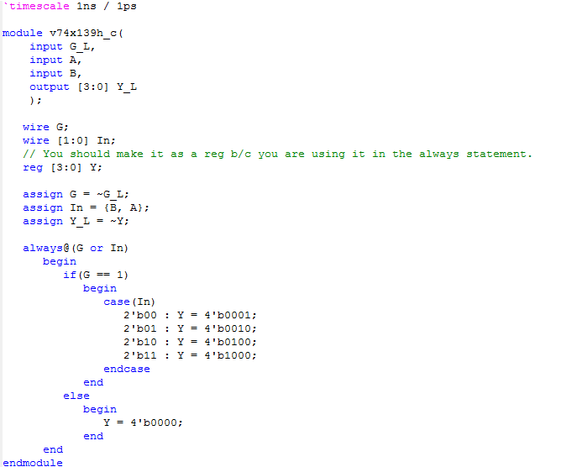
Designing 74x139(Dual 2-to-4 decoder)
Behavioral design (Half 74x139)
Circuit function can be described by assign(assign/always) statements and the conditional operator with binary combinations as in a truth table

Slide 30
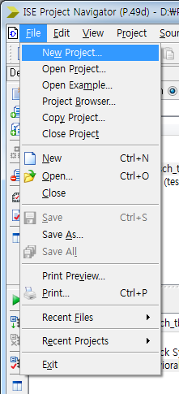
Create a new Verilog project

Slide 31
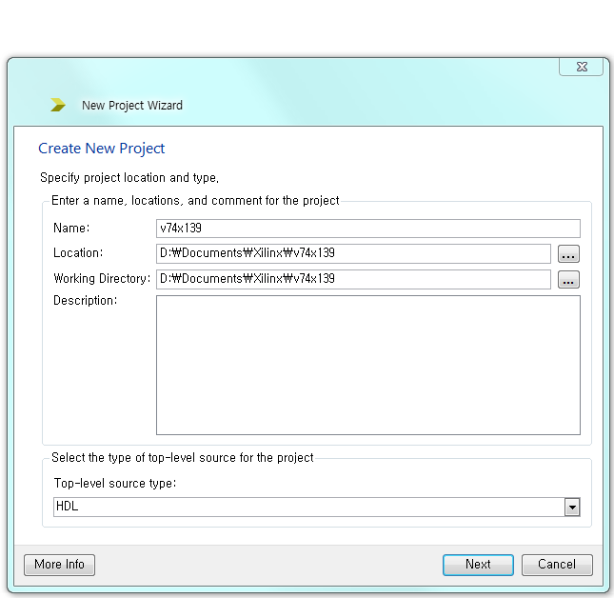
Set the project name, location, type

Slide 32
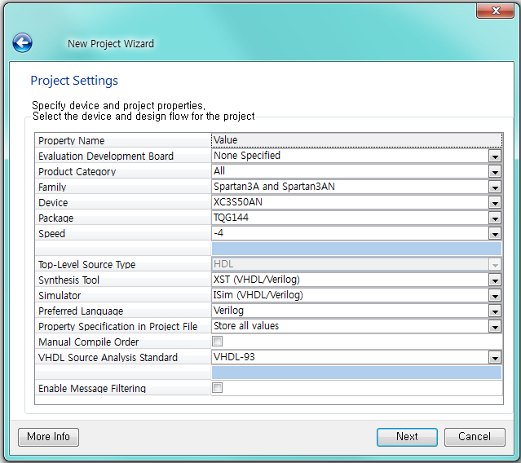
Set the project name, location, type

Slide 33
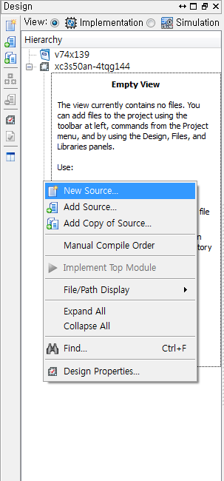
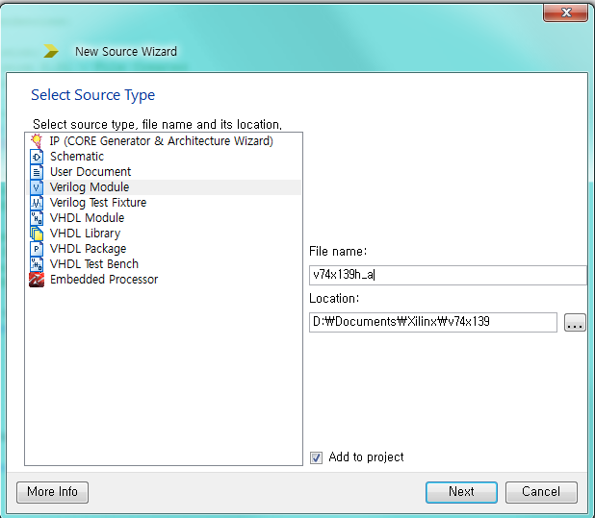
Create a new Verilog source

Slide 34
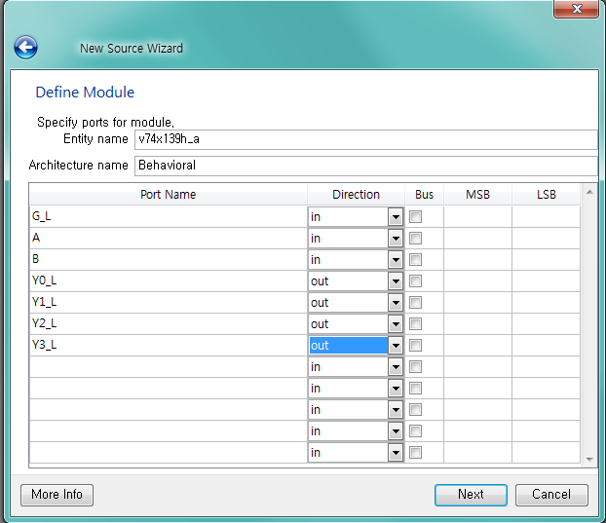
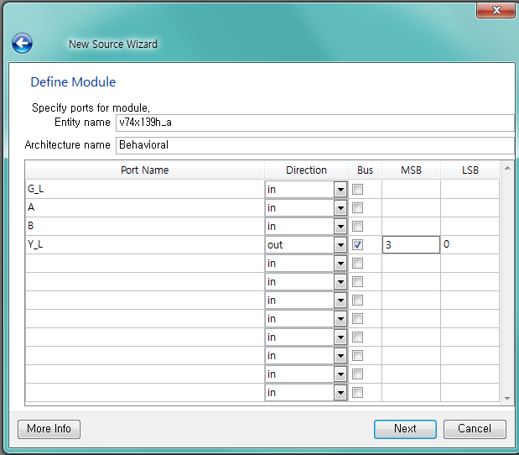
Create a new Verilog source
or

Slide 35
Write your own Verilog codes

Slide 36
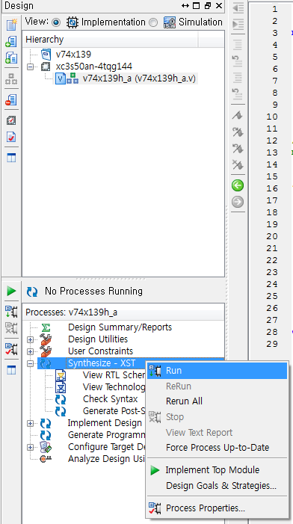
Compile and check errors

Slide 37
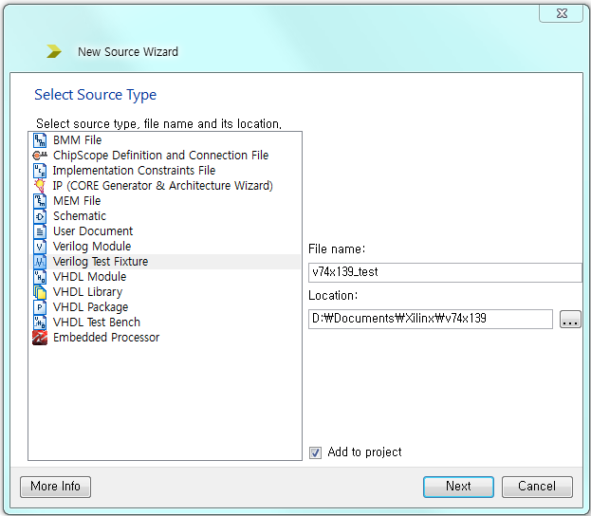
Create a Verilog test bench

Slide 38
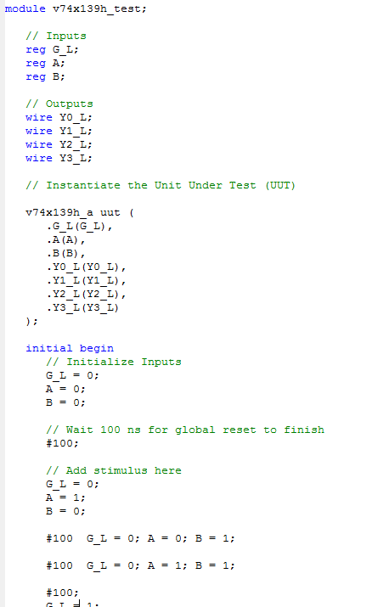
Write a Verilog test bench codes

Slide 39
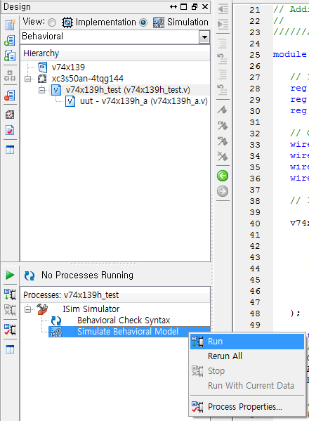
Simulate it

Slide 40
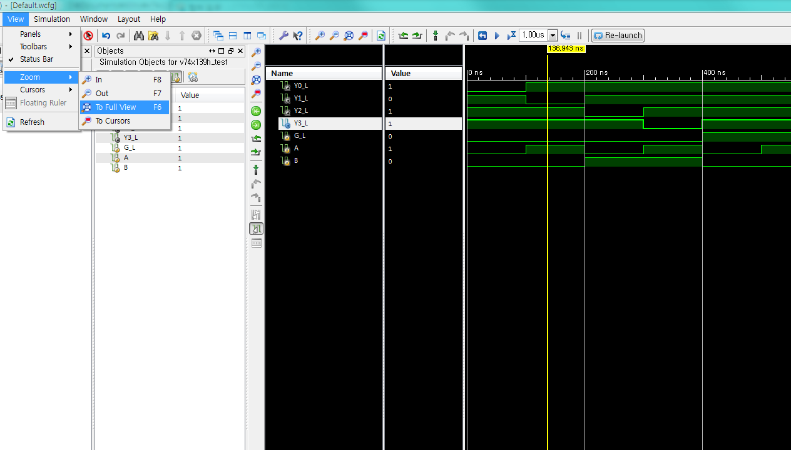
Simulation result

Slide 41
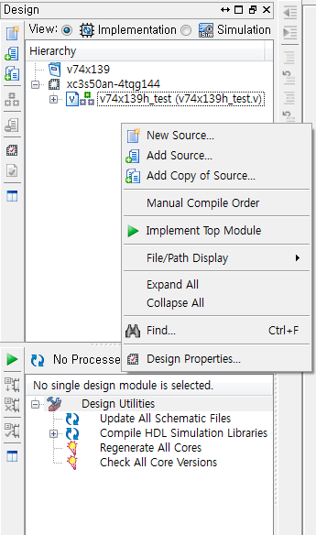
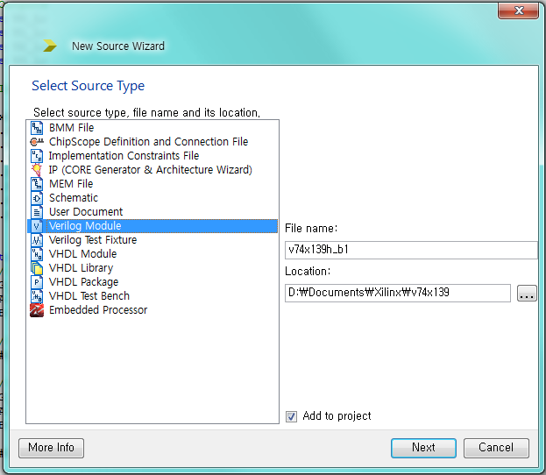
Create a new Verilog source

Slide 42
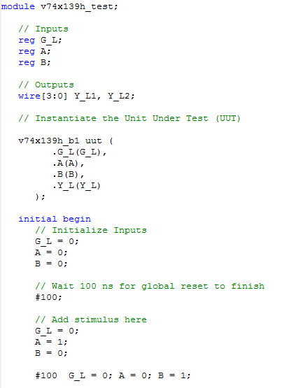
Re-write a Verilog test bench codes

Slide 43
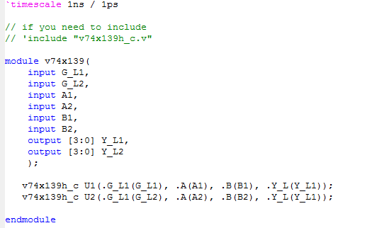
Designing 74x139(Dual 2-to-4 decoder)
Hierarchical Design (2 × ½ 74x139)
You make higher level module with the modules you already made
Y_L2

Slide 44
Homework

Slide 45
Homework
Implement 3-to-8 decoder and simulate it
You have to re-use your 2-to-4 decoder implemented in lab
Implement 4-to-1 MUX and simulate it
Implement in gate and rtl/behavior level
Discuss two methods(Pros & Cons, etc.)
Implement 16-to-1 MUX and simulate it
You have to re-use your 4-to-1 MUX implemented above
Given a four-input Boolean function
F(A,B,C,D) = Σ m(0,2,4,5,8,10,12,13,14,15),
implement the function using a 16-to-1 MUX
You have to re-use YOUR 16-to-1 MUX implemented above

Slide 46
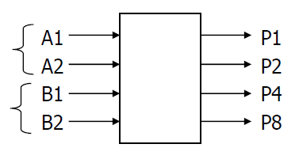
Homework(Cont’d)
5. Design a 2x2-bit multiplier.
Implement in Verilog and simulate it
(TIP) This is a 2x2-bit multiplier that generates 4 bit output (whose MSB is
P8 and LSB is P1). Note that A2 and B2 are MSBs.

Slide 47
Report
Write a report
# of pages doesn’t matter
Include codes and simulation result
The file size should not exceed 15MB
Due : 7 Oct. (Before class begin at 7:00pm)

Slide 48
Appendix

Slide 49
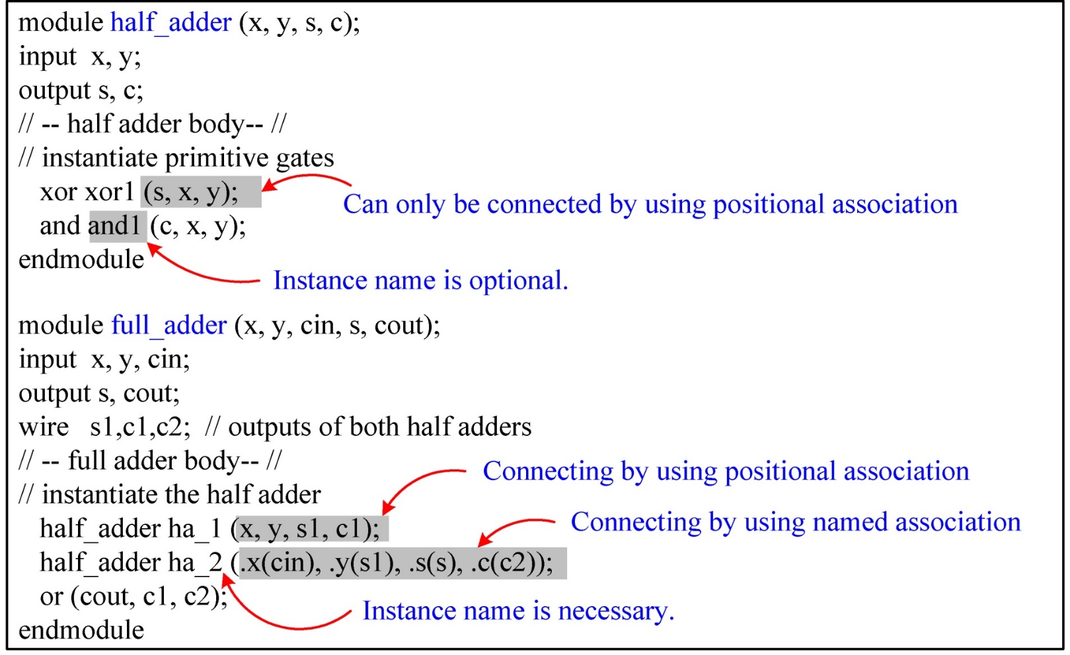
An Example: Port Connection

