Slide 1
Lab. 08
Logic Design Lab.
Fall 2019
Prof. Sungjoo Yoo
(yeonbin@snu.ac.kr)
TA. Hyunsu Kim
(gustnxodjs@gmail.com)
TA. Hyunyoung Jung
(gusdud1500@gmail.com)

Slide 2
Overview
FSM: Moore & Mealy Machine
Verilog FSM Implementation Example
Lab
Homework

Slide 3
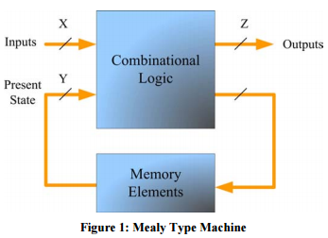
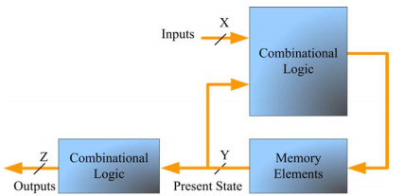
FSM: Moore & Mealy Machine
Definition of Moore & Mealy Machine
Moore machine
Outputs are computed via a function of current state only
Output delayed by one clock period
Mealy machine
Outputs are computed via a function of current state and input values

Slide 4
FSM: Moore & Mealy Machine
State Transition Diagram
0, 1: input
a, b: output
s0, s1: state
output depends
only on prior state
output depends
both on prior state AND input
0
0/a
s0
a
s1
b
s0
s1
1
1/b
Moore machine
Mealy Machine

Slide 5
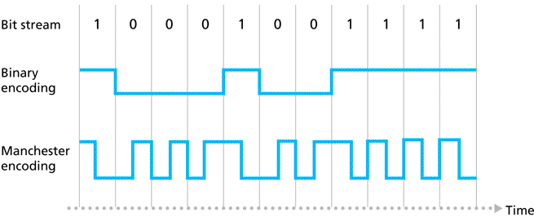
Verilog FSM Implementation Example
Manchester Encoding
0:
1:

Slide 6
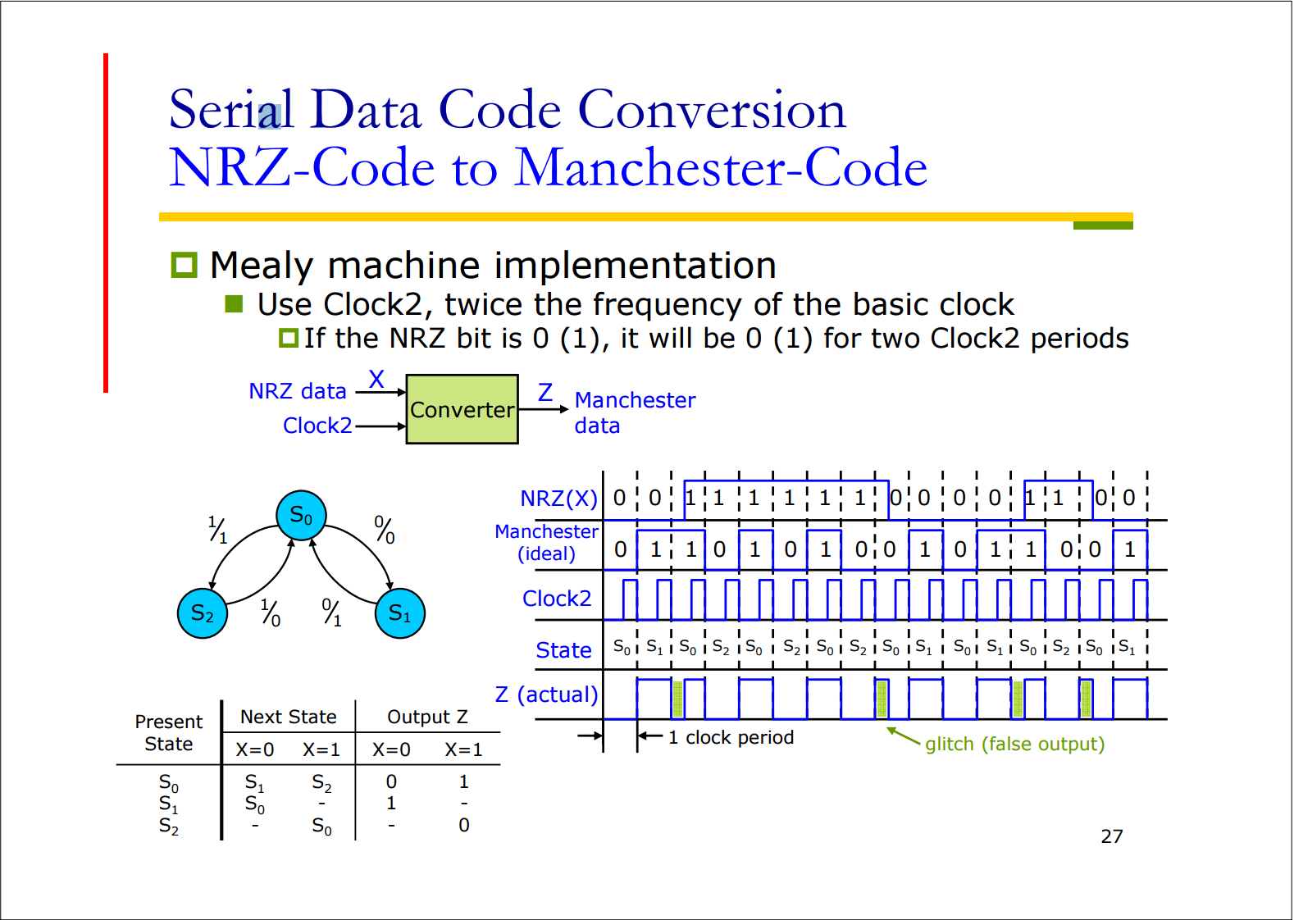
0 1 1 1 0 0 1 0

Slide 7
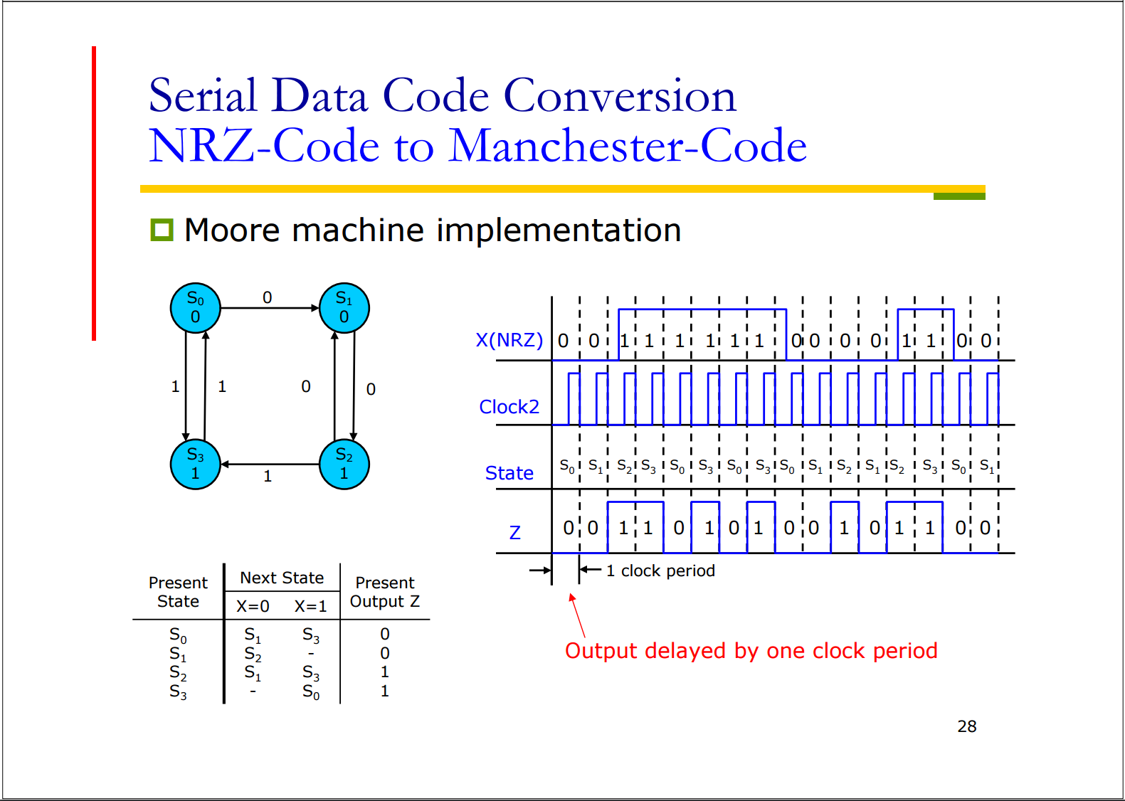

Slide 8
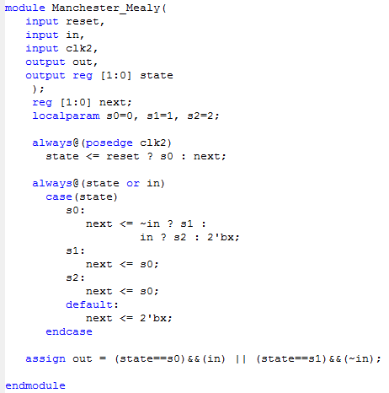
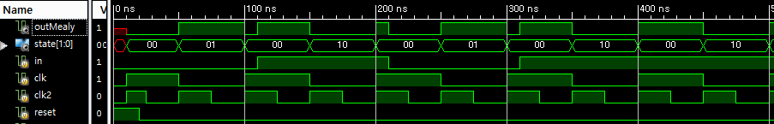
Verilog FSM Implementation Example
Mealy machine
reset
1/1
0/0
S2
S0
S1
1/0
0/1
glitch
Output change is NOT synchronous with state change; output can change during one state

Slide 9
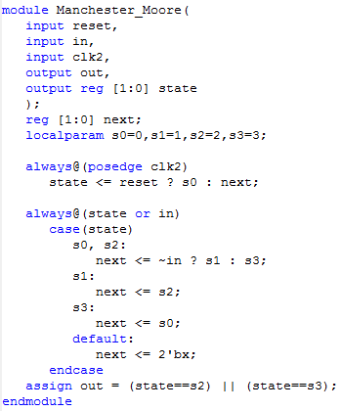
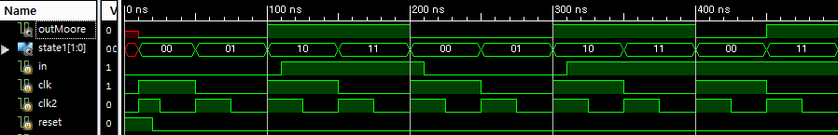
Verilog FSM Implementation Example
Moore machine
reset
S0
0
S1
0
0
1
1
0
0
S3
1
S2
1
1
Output change is synchronous with state change; output doesn’t change during one state
Same as synchronous Mealy

Slide 10
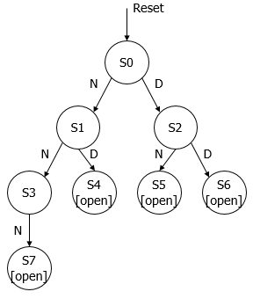
Today
Implement the vending machine described in Lecture07_FSM slide p19-p31 in Verilog
Show your simulation results
Implement it as a Mealy machine and Moore machine
Discuss the difference of two types of implementation
Difference between Mealy and Moore style
State transition diagram
<Moore>

Slide 11
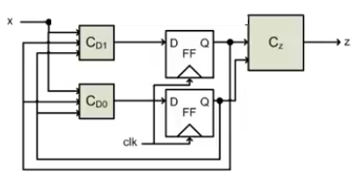
Homework
Implement and simulate ‘010’ string recognizer in Schematic using Xilinx ISE
1 bit input, 1 bit output
For all other string that isn’t ‘010’, the output must be ‘0’
Use D F/Fs to represent states (FSM method)
Test with input ‘0100101001101011’ to verify your circuit
(TIP) Follow the steps below
Draw a state transition diagram and a state transition table
Specify D F/F inputs and one 1-bit output
Draw a circuit block diagram with combinational logic blocks and D F/F like below:
output
…
…
Present_state
Next_state
11

Slide 12
Homework
2-1. Implement your string recognizer in Verilog
2-2. Try to test your string recognizer on the Logic Design Board
If possible, test with input ‘0100101001101011’ to verify your implementation
If not, discuss the problems and possible solutions
Ex) What is the problem, how to fix the problem, etc.
You may get full score if you can discuss (or fix) the problem properly, although your design does not work on the FPGA Board!
3. Write a report
Submit as one pdf file (# of pages doesn’t matter)
The file should contain simulation, verilog code or schematic and explanations.
Due : 11 Nov. (Before class begins at 7:00pm)
12

